Slide 1
Operators and
Branching

Slide 2
Operators
Operator | Syntax | Action
Assignment | x = y | Store y in x.
Walrus | x := y | Store y in x and return y.
Addition | x + y | Returns the sum of x and y.
Subtraction | x - y | Returns difference of x and y.
Multiplication | x * y | Returns x times y.
Division with remainder | x / y | Returns x over y as float.
Division without remainder | x // y | Returns x over y as integer without remainder.
Exponential | x ** y | Returns x to the power of y.

Slide 3
Operators
Operator | Syntax | Action
Modulo | x % y | Returns the remainder of x over y.
Operation in-place | x □= y | Store the result of any operation □on x and y in x.
Smaller than | x < y | Returns True if x is smaller than y.
Bigger than | x > y | Returns True if x is bigger than y.
Smaller or equal | x <= y | Returns True if x is smaller or equal y.
Bigger or equal | x >= y | Returns True if x is bigger or equal y.
Equality | x == y | Returns True if x is equal y.
Unequality | x != y | Returns True if x is unequal y.
.
.
.

Slide 4
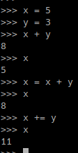
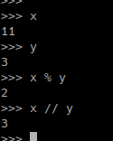
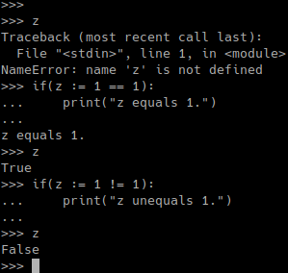
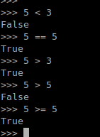
Operators

Slide 5
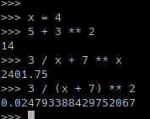
Math

Slide 6
Branching
if condition:
code …
else:
code …

Slide 7
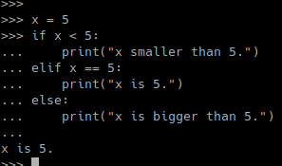
if statements
if first_condition:
code
elif second_condition:
alternative
…
else:
final_alternative
first_condotion and second_comdition
first_condition or second_condition
not condition

Slide 8
Exercise 3: Inconvenient Calculator
Programm a calculater that takes in user input.
Determine with if-clauses which operation the user wants to perform.
Print the result to the screen.
Don’t implement to much operations. We have more stuff planned today.

