Slide 1
Iteration and Loops

Slide 2
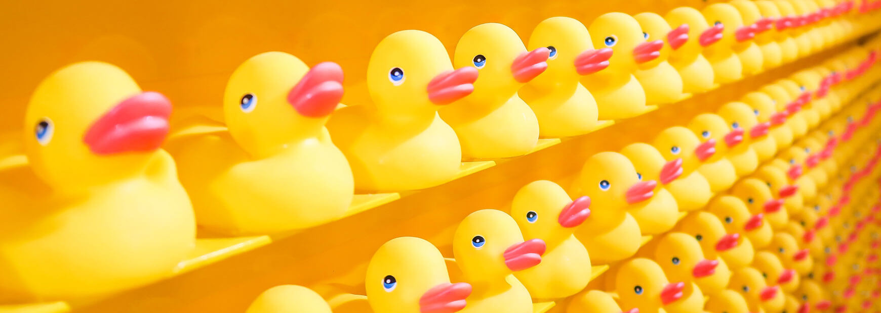
Why iterate?
Notes:
Why iterate?
- Reuse code
- Process arrays of data

Slide 3
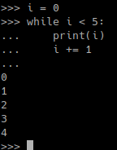
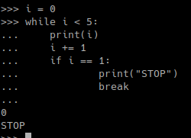
While-loops
while CONDITION:
code to loop over

Slide 4
Exercise 4: Number Guessing
Write a program that makes the user guess an integer number.
The user should have multiple attemps on guessing the number.

Slide 5
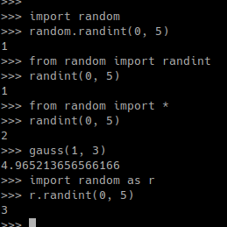
Importing Modules
if __name__ == “__main__”:
your programm …
module.py
your_program.py

Slide 6

Iteration
for-loops
List & Generator Comprehension
Map & Filter
Aggregation
iterable_obj
iterable_obj
iterable_obj
.
.
.
.
.
.
.
.
.

Slide 7
Iterables
Arrays, Dictionaries, Sets, Tupels
File Objects
Generators
…

Slide 8
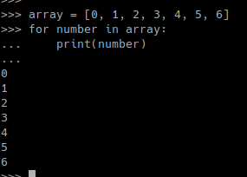
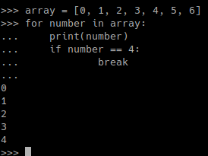
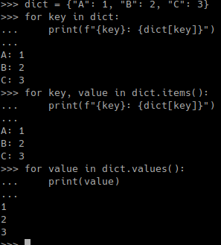
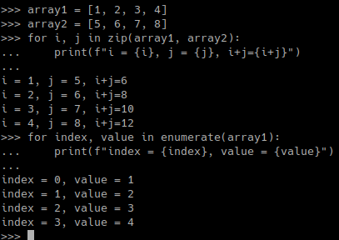
for-loops

Slide 9
tqdm
https://tqdm.github.io/

Slide 10


List Comprehension
new_list = []
for i in old_list:
if filter(i):
new_list.append(expressions(i))
[ expression for item in list if conditional ]
=
for item in list:
if conditional:
expression

Slide 11
Dictionary Comprehension
{ key:value for key, value in dictionary.items() }
{ key:value for key, value in zip(key_array, value_array) }
{ element:element for element in array }
=
new_dict1 = {}
for key, value in dictionary.items():
new_dict1[key] = value
new_dict2 = {}
for key, value in zip(key_array, value_array):
new_dict2[key] = value
new_dict2 = {}
for element in array:
new_dict3[element] = element

Slide 12
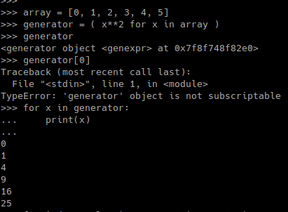
Generator Comprehension
( expression for item in list if conditional )
“A”
“A”
“B”
“B”
“C”
“D”

Slide 13
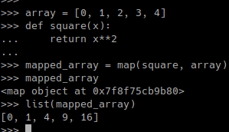
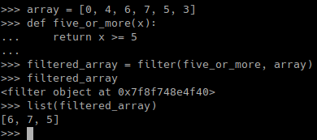
Map & Filter
map(function, iterables)
filter(function, iterables)

Slide 14
Aggregation
iterable
Function | Return Value
len(iterable) | length of iterable
sum(iterable) | sum of all elements
min(iterable) | smallest value
max(iterable) | biggest value
all(iterable) | True if all elements True
any(iterable) | True if at least one element is True
Single Value

Slide 15
Exercise 5: FizzBuzz
Write a programm that prints all integers between 0 and 100.
If the integer is divisible by 3 print “Fizz” instead.
If the integer is divisible by 5 print “Buzz” instead.
If the integer is both print “FizzBuzz” instead.
Feel free to add more phrases and divisors.

