Slide 1
Reading and Writing Files
with Pathlib

Slide 2
Create Paths
from pathlib import Path
relative_path = Path(“folder/file.txt”)
# On Linux
absolute_path = Path(“/folder/subfolder/file.txt”)
# On Windows
absolute_path = Path(r”C:\User\folder\file.txt”)
absolute_path = Path(“/User/folder/file.txt”)
home = Path.home()
workingDir = Path.cwd()
some_path = home / “folder/subfolder” / “file.txt”

Slide 3
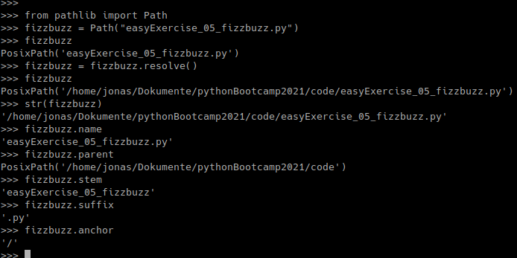
Extract Information

Slide 4
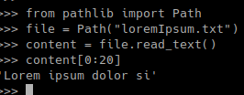
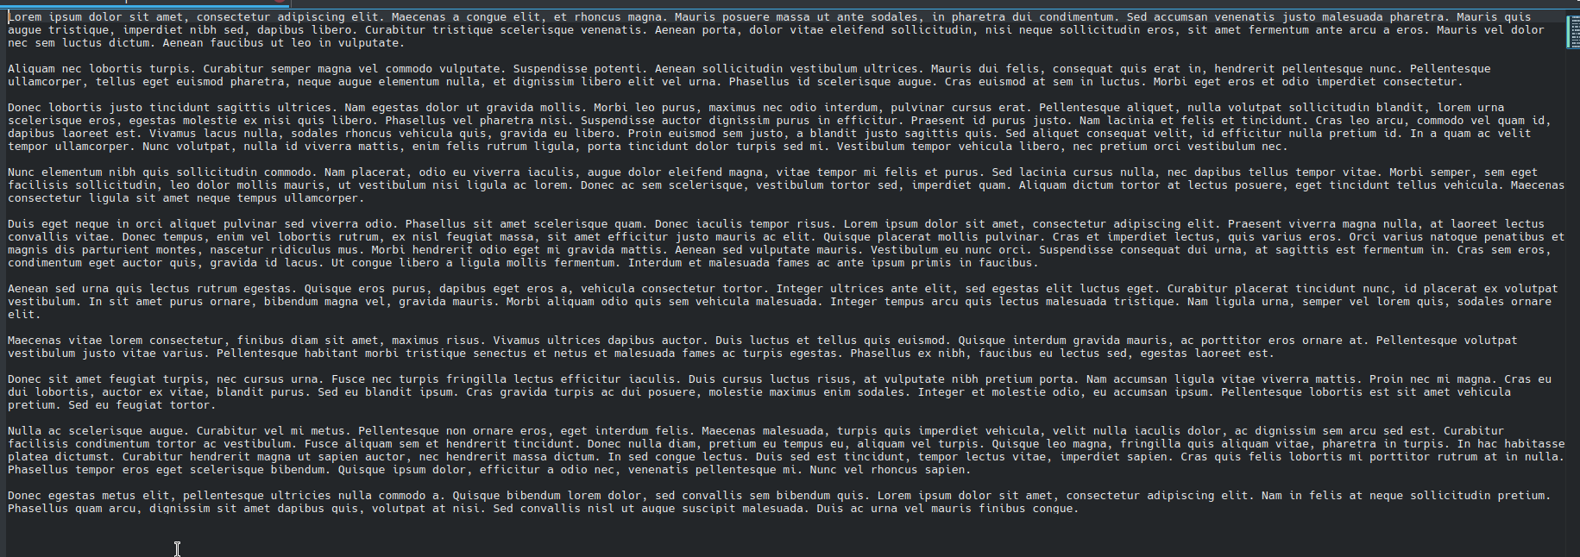
Reading Files
loremIpsum.txt

Slide 5






Writing Files
newFile.txt
newFile.txt
newFile.txt

Slide 6
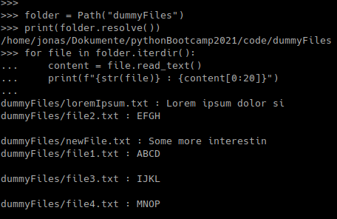
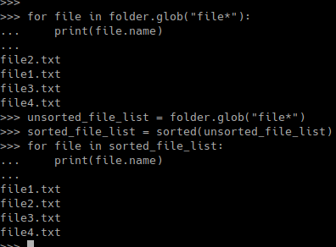
Handling Mutliple Files

Slide 7

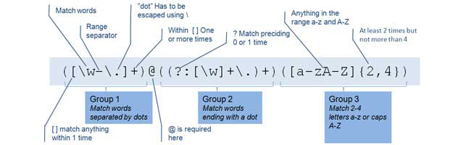

Regex / Regular Expressions
import re
re.findall(pattern, string)

Slide 8
Exercise 6: Reading Files
You should have a folder with a bunch of files named alphabet and numbers.
Read the content of the files and print the content of the files in the right order to the screen.
Your result should be the alphabet and the numbers from 0 to 9.

Slide 9
And more …
Move, delete, copy files.
Create, delete, move directories.
Do anything you can do with files and directories.

Slide 10
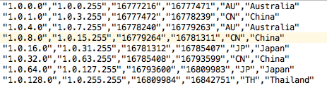
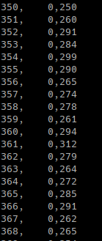
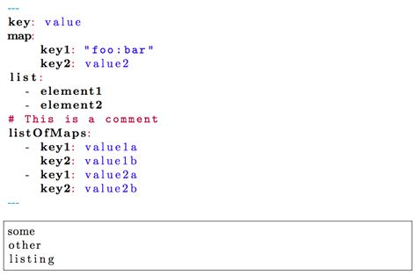
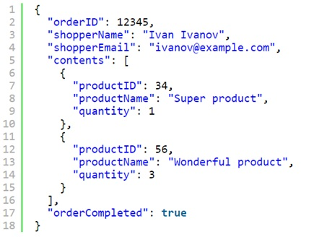
File Types
CSV
TXT
YAML
import csv
JSON
import yaml
import json

Slide 11
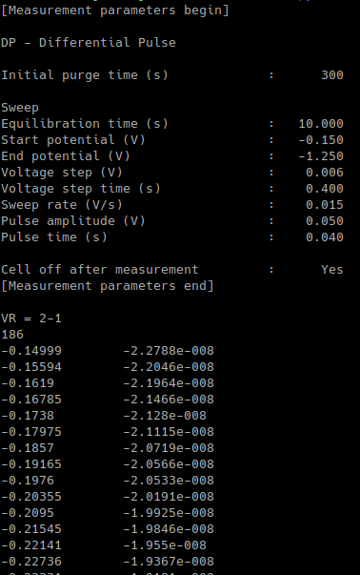
Parsing Text
content
content
content
content
…
…
…
…
content = content[21:]
content = content.splitlines()
content = content.split(“ “)

Slide 12
Parsing Text
content
column1
column2
…
…
…
content = content.split(“ “)
convert German number notation to English notation with string.replace(“,”, “.”)
“2,34”.replace(“,”, “.”) → “2.34”
convert string to numbers with float()
column1 = [row[0] for row in content]
column2 = [row[1] for row in content]

Slide 13
Exercise 7: Parsing Files
You should have a file named measuredData.txt.
Read the file and convert the data in it into an array.
Print the resulting array to the screen.

