Slide 1
Functions

Slide 2
What’s a function?
Function Definition
“””
Your interesting program
“””
a = 5
b = 10
aa = square(a)
bb = square(b)
print(f”{aa}, {bb}”)
Parameter List
Function Name
def square(number):
square = number**2
return square
Function Call
Return Value
Function Call
Important: Variables Defined in the function can only be used inside of the function they are declared in.

Slide 3
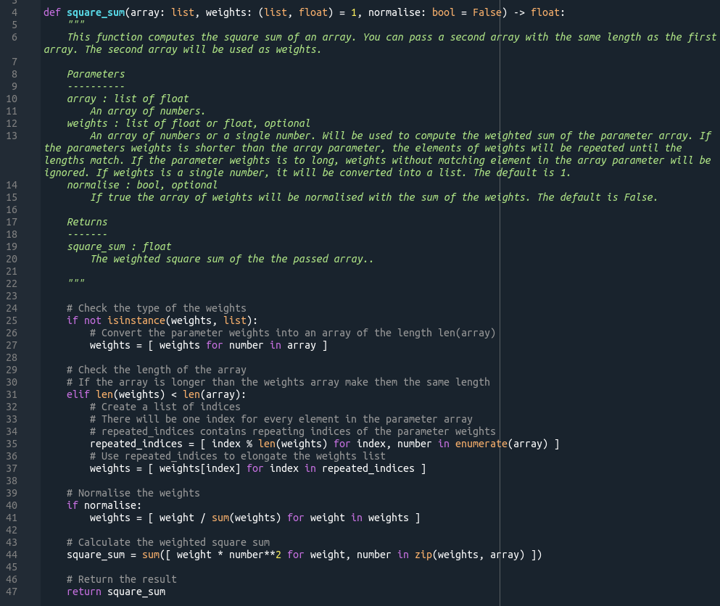
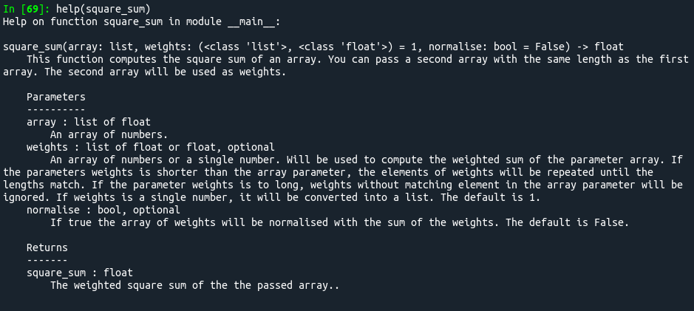
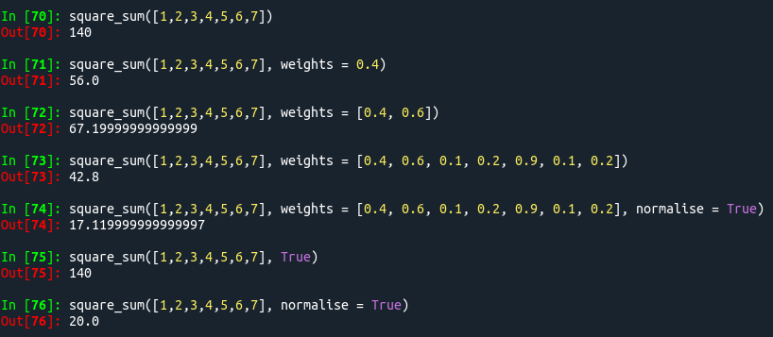
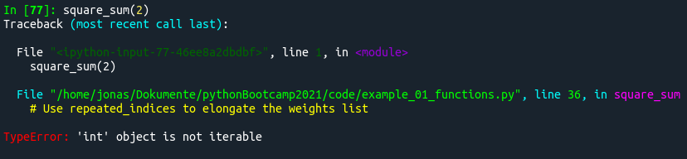
Advanced Functions

Slide 4
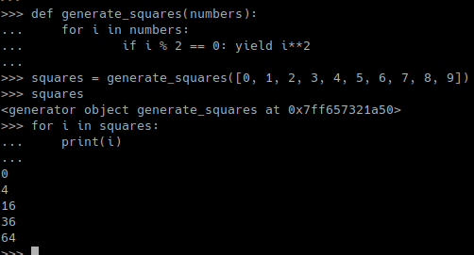
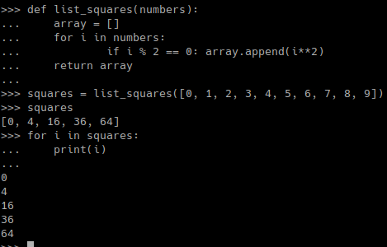
Yielding Generators

Slide 5
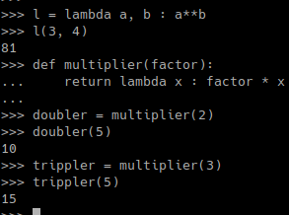
Lambda Functions
lambda parameter : expression

Slide 6
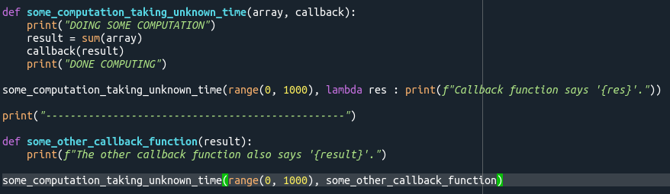
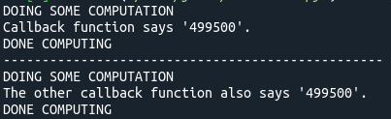
Callback Functions

Slide 7
Exercise 8: Parsing Files
Convert the script from exercise 7 into a function parsing files.
The function takes the path to the file as parameter.
The return value is the parsed data.
Keep in mind: The headers of the files are different.

