Slide 1
Objects

Slide 2
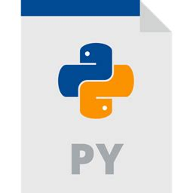

Why (not) Objects?
Object
+ Encapsulate data
+ Reusable
+ Organise Data with their functions
- More complexity
- Data not free available

Slide 3
Structure of Objects
Person
person1
person2
surname
“Mustermann”
“Mustermann”
Attributes
name
“Marie”
“Max”
age
22
20
Constructor
__init__()
__init__()
__init__()
greetYou()
greetYou()
greetYou()
Methods
setSurname()
setSurname()
setSurname()
getAge()
getAge()
getAge()
getFullName()
getFullName()
getFullName()

Slide 4
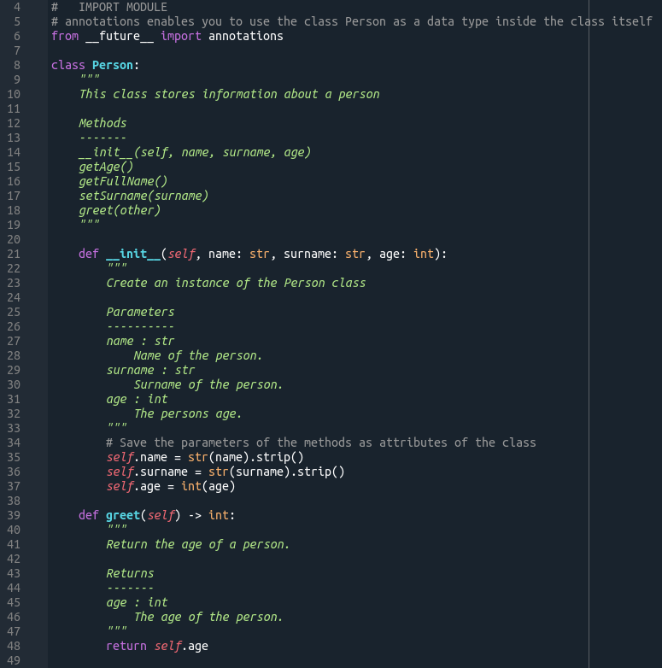
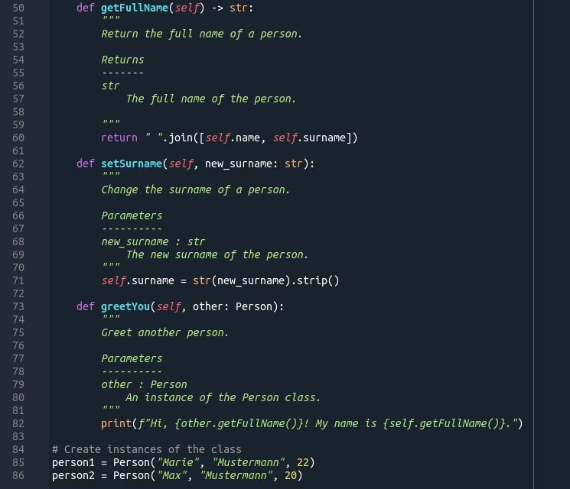
Declaring Objects/Instances

Slide 5
Inheritance
Person
Student
surname
surname
name
name
age
age
major
__init__()
__init__()
greetYou()
greetYou()
setSurname()
setSurname()
getAge()
getAge()
getFullName()
getFullName()

Slide 6
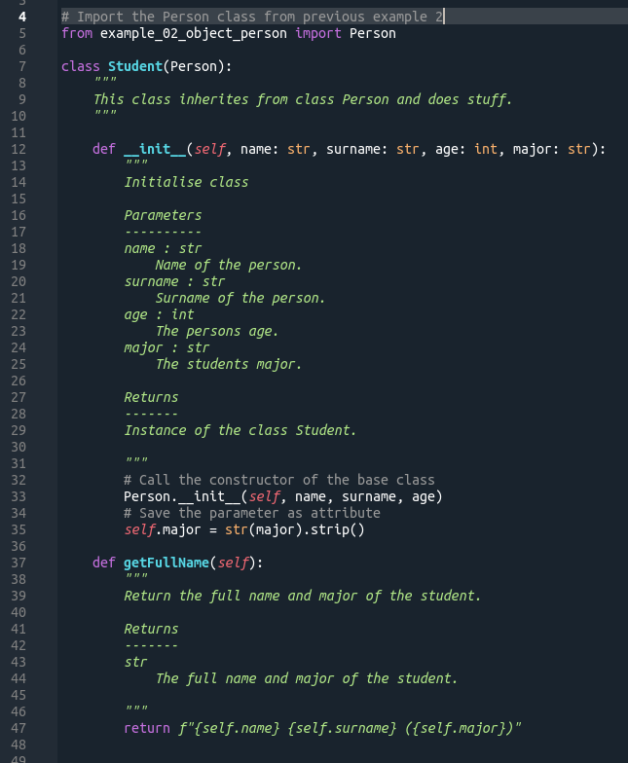
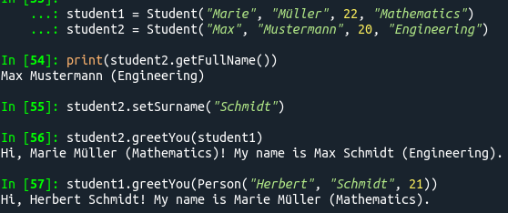
Inheritance

Slide 7
Exercise 9: Objects
Create a class with some attributes and methods.
Create a second class inheriting from the first class.
Feel free to come up with some classes on your on or get some inspiration from my earlier examples.

