Slide 1
Exceptions

Slide 2
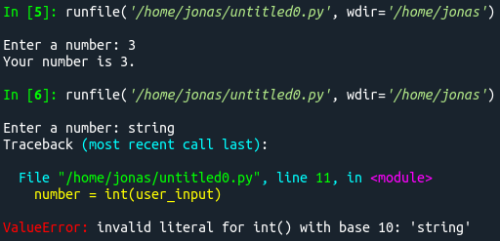

What are Exceptions?
Exceptions will end your program!

Slide 3

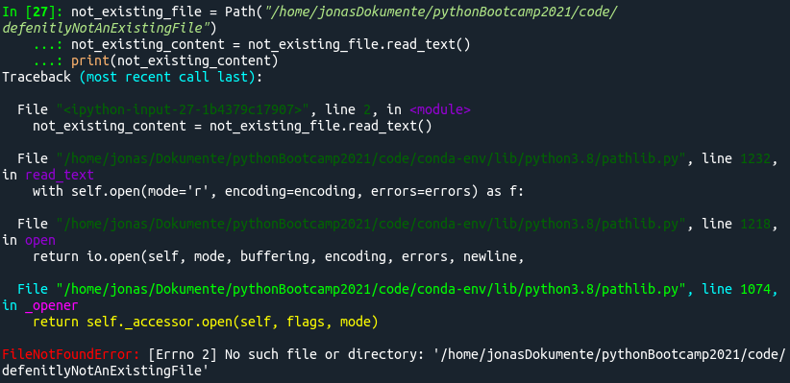
Why should I care?

Slide 4







Vocabular
Python Raises Exceptions
The rest of the world Throws Errors

Slide 5
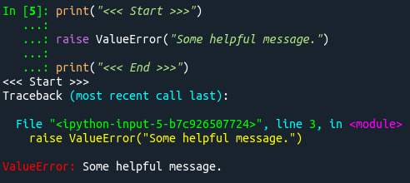
Raising Exceptions
Built-in Exceptions
NameError | NotImplementedError
AttributeError | SystemExit
ImportError | TypeError
ModuleNotFoundError | ValueError
IndexError | ZeroDivisionError
KeyError | FileNotFoundError
KeyboardInterrupt | FileExistsError
Base Exceptions:
Exception
ArithmeticError
LookupError
BufferError
https://docs.python.org/3/library/exceptions.html

Slide 6
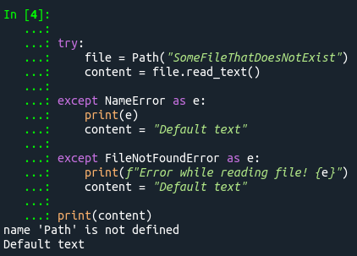
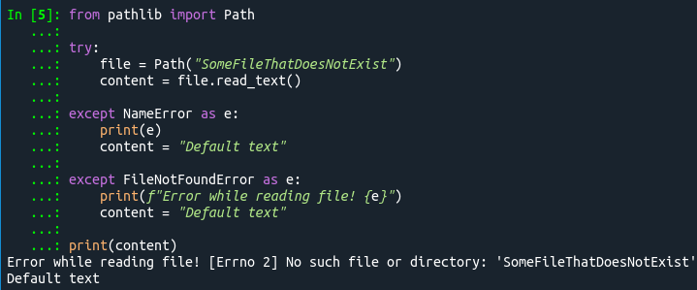
Catching Exceptions

Slide 7
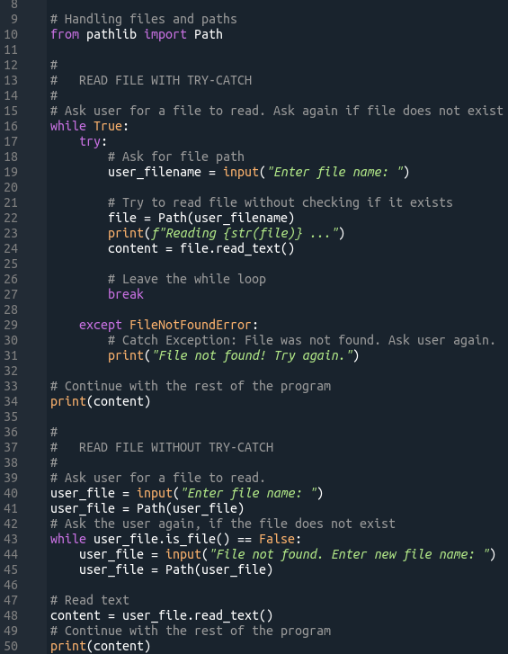
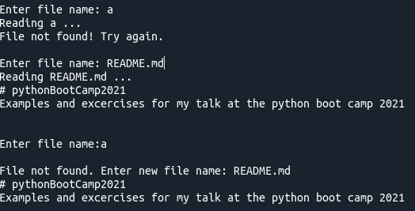
Handling Exceptions

Slide 8
Exercise 9: New Hello, You!
Rewrite the “Hello, You!” program.
Ask the user for its name and age.
Make sure that the age is an integer.
Print a personalised greeting.

