Slide 1
Creating Plots with
Matplotlib

Slide 2
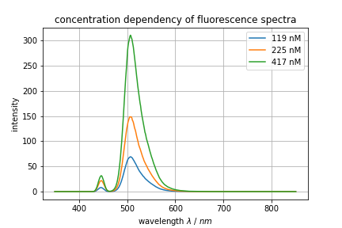



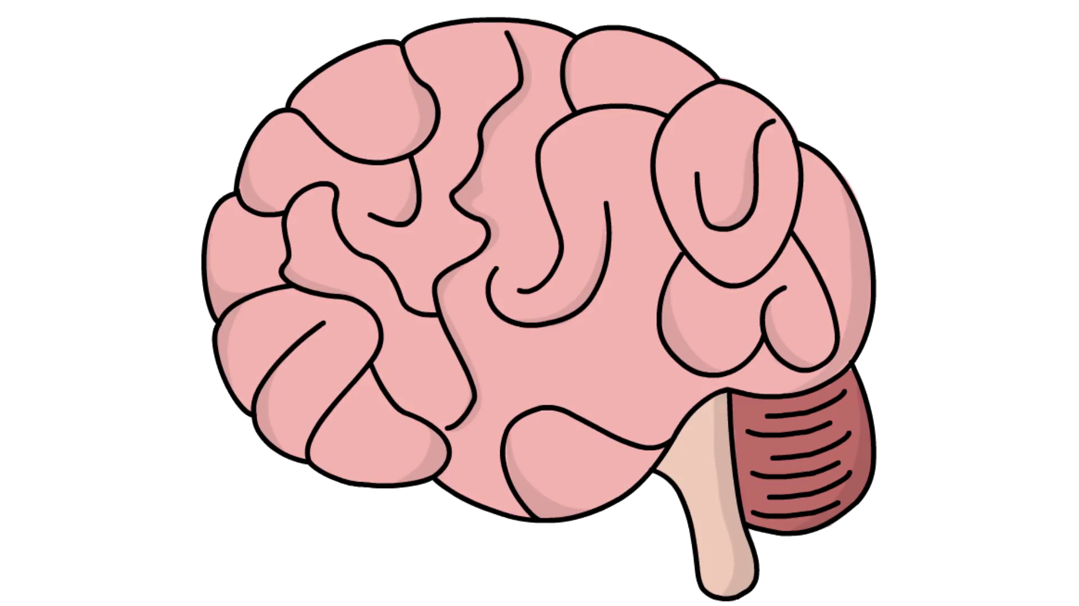
Common Workflow

Slide 3
Pyplot
# Import pyplot
from matplotlib import pyplot as plt
# Create a plot
plt.plot(x_values, y_values, …)
# Save the plot to file
plt.savefig(“path/to/image.png”)
Tutorials and Advanced Techniques:
https://matplotlib.org/stable/tutorials/index.html
Examples and Possibilities:
https://matplotlib.org/stable/gallery/index.html

Slide 4
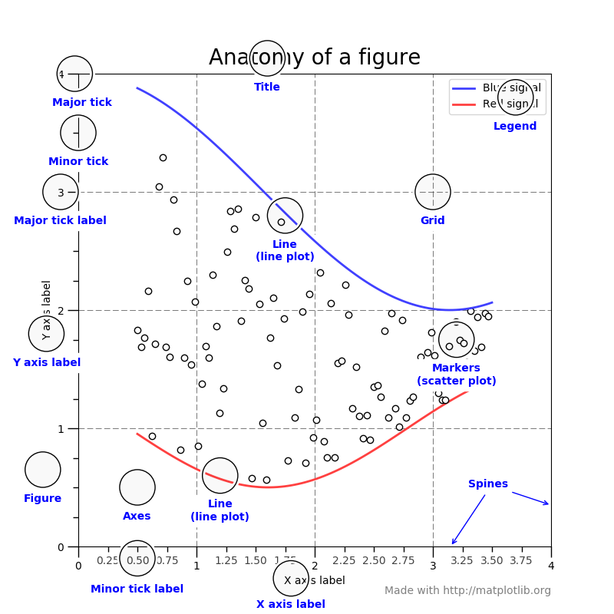
Google The Right Things

Slide 5
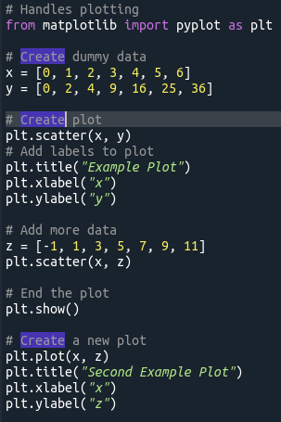
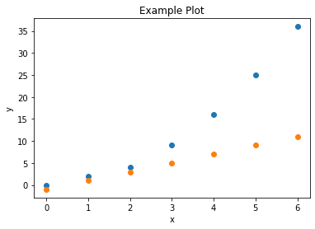
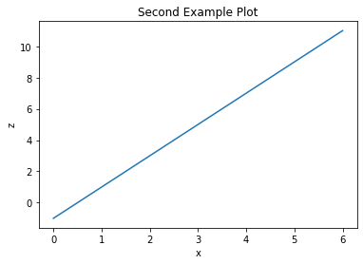
Plotting Data

Slide 6
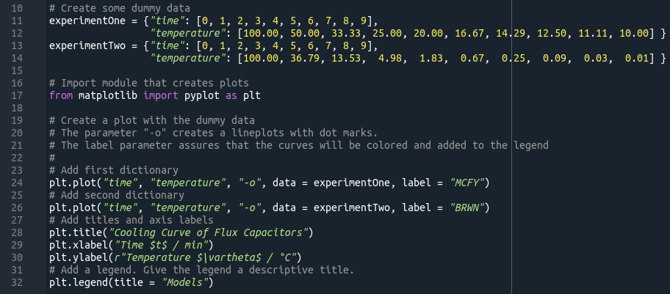
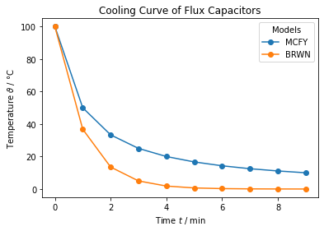
Adding a Legend

Slide 7
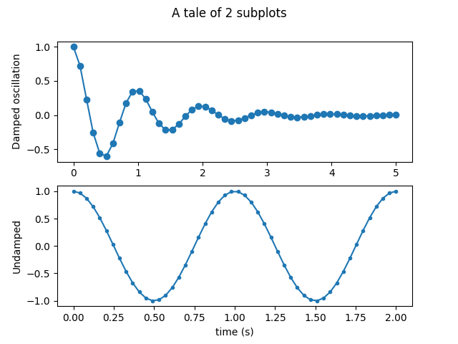
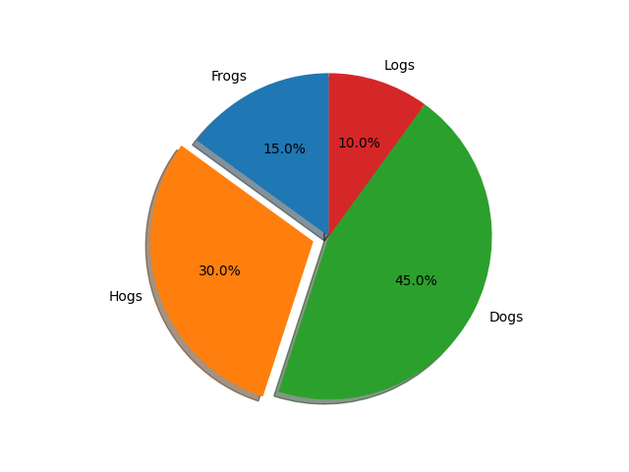
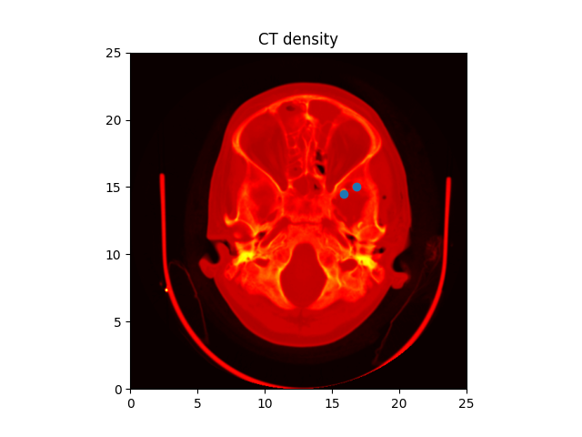
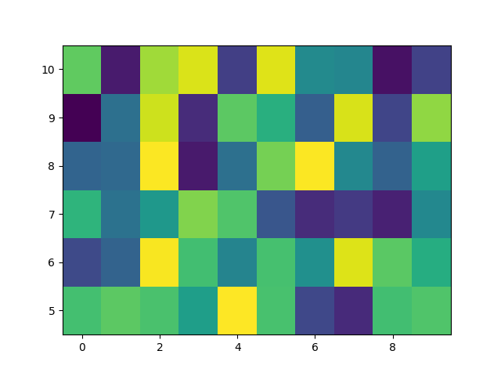
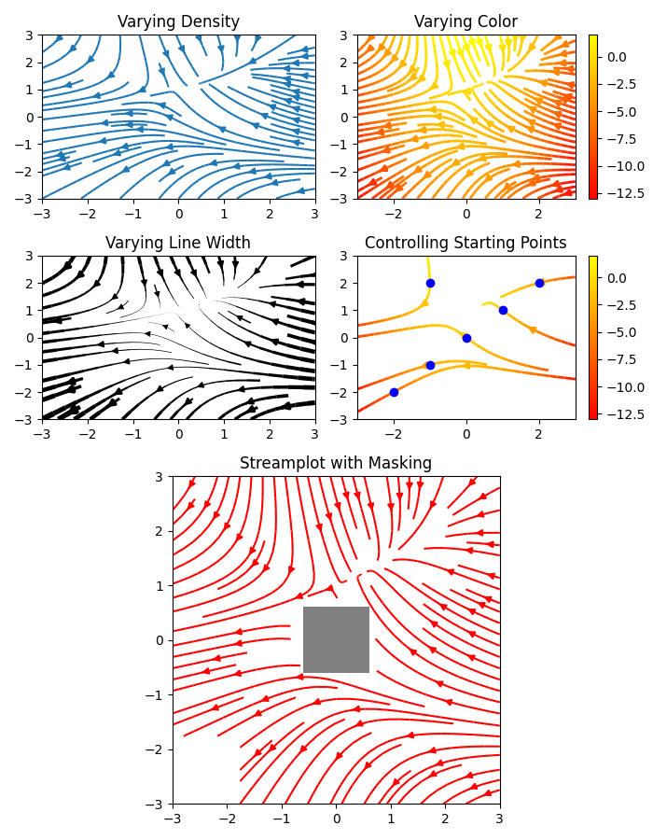
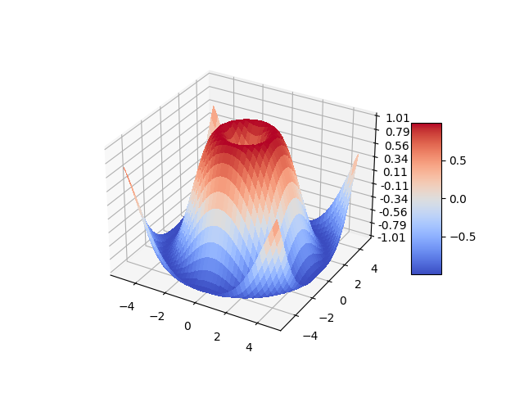
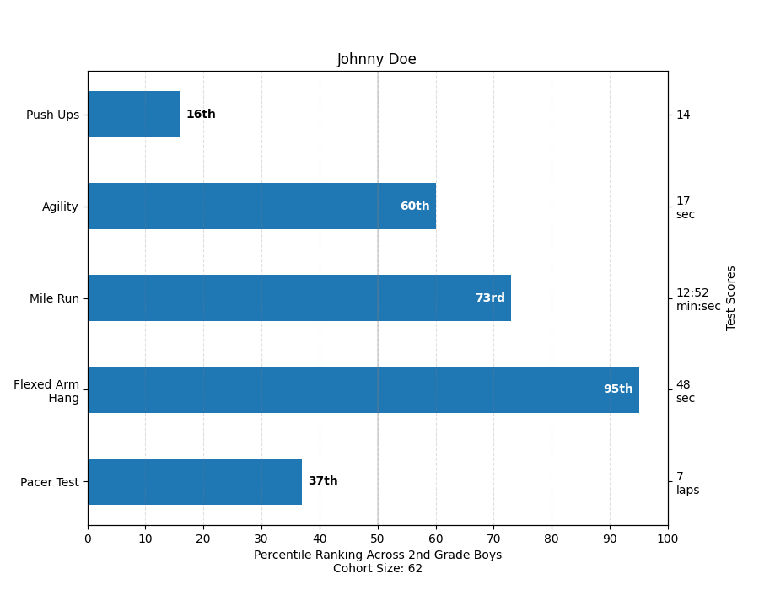
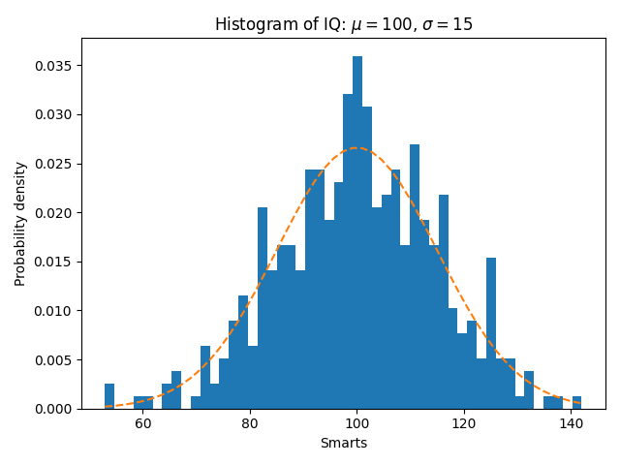
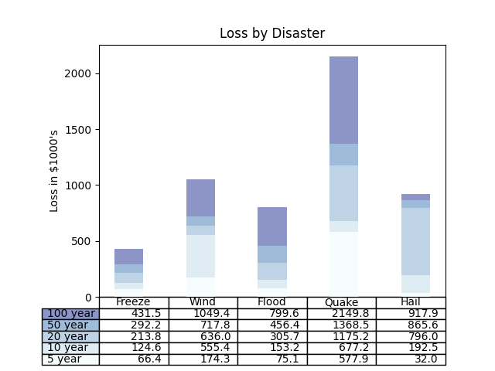
Further Possibility
and more on matplotlib.org

Slide 8
Exercise 11: Creating Plots
Create your first plot
It doesn’t matte what your plotting.
Try to change the axis labels and the title.
Add a legend.

