Slide 1
Computing Regressions

Slide 2

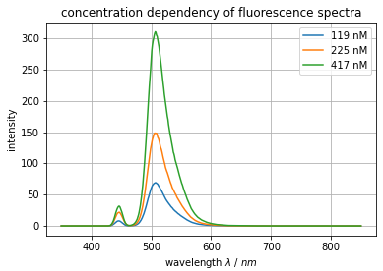
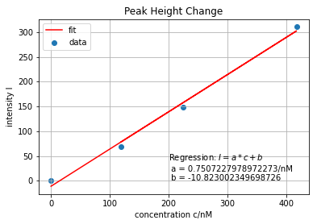


Common Workflow

Slide 3
Linear Regression
# Import scikit-learn
from sklearn.linear_model import LinearRegression
# Create a linear regression model
linearModel = LinearRegression()
# Fit testing data
linearFit = linearModel.fit(xvalues, yvalues)
# Extract the fitting parameters
coefficient = linearFit.coef_
intercept = linearFit.intercept_
Machine Learning Module
https://sklearn.org/

Slide 4
Formating Training Data for Linear Regression
xvalues = [ [x₀],
[x₁],
…
[x_{n}] ]
xvalues.reshape(-1,1)
xvalues = [x₀, x₁, …, x_{n}]
yvalues = [ y₀, y₁, …, y_{n} ]

Slide 5
Formating Training Data for Multiple Linear Regression
xvalues = [ [x₀₀, x₀₁, …, x_{0m}],
[x₁₀, x₁₁, …, x_{1m}],
…
[x_{n0}, x_{n1}, …, x_{nm}] ]
xvalues = [ [x₀₀, x₁₀, …, x_{m0}],
[x₀₁, x₁₁, …, x_{m1}],
…
[x_{0n}, x_{1n}, …, x_{mn}] ]
xvalues.T
yvalues = [ y₀, y₁, …, y_{n} ]

Slide 6
Extracting Fitting Parameters
# Fit testing data
linearFit = LinearRegressions().fit(xvalues, yvalues)
# Extracting fitting parameter
linearFit.intercept_ # → b₀
linearFit.coef_ # → [ b₁, b₂, …, b_{n} ]
# Predict new data
newY = [ linearFit.coef_[0] * x + linearFit.intercept_ for x in newX ]
newY = linearFit.predict(newX)

Slide 7
Exponential Regression
# Import modules
from scipy.optimize import curve_fit
import numpy as np
# Define a regression formula
model = lambda x, A, b : A * np.exp(b*x)
# Fit testing data
fit = curve_fit( f = model,
xdata = xvalues,
ydata = yvalues,
p0 = [initial_A, intial_b] )
# Extract fitting parameters
parameters = fit[0] # → [ A, b ]

Slide 8
Exerise 12: Regression
Do a linear regression on some data of your choice.
Try a second kind of regression if you want
(e.g. polynominal, exponential, …).
Create a plot with the training data
and your regression models.

