Slide 1
PYTHON 101 – Recap

Slide 2
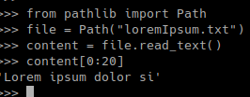
Reading Files
from pathlib import Path
relative_path = Path(“folder/file.txt”)
# On Linux
absolute_path = Path(“/folder/subfolder/file.txt”)
# On Windows
absolute_path = Path(r”C:\User\folder\file.txt”)
absolute_path = Path(“/User/folder/file.txt”)
home = Path.home()
workingDir = Path.cwd()
some_path = home / “folder/subfolder” / “file.txt”

Slide 3
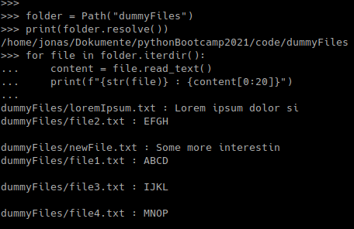
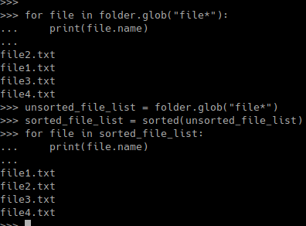
Reading Multiple Files

Slide 4
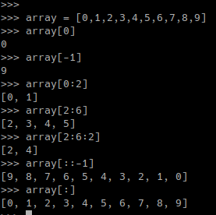



Parsing Files
Ready to use parsers
Slicing
Regex
import re
re.findall(pattern, string)
…
array[start:end:step]

Slide 5
Regressions
# Import scikit-learn
from sklearn.linear_model import LinearRegression
# Create a linear regression model
linearModel = LinearRegression()
# Fit testing data
linearFit = linearModel.fit(xvalues, yvalues)
# Extract the fitting parameters
coefficient = linearFit.coef_
intercept = linearFit.intercept_
# Import modules
from scipy.optimize import curve_fit
import numpy as np
# Define a regression formula
model = lambda x, A, b : A * np.exp(b*x)
# Fit testing data
fit = curve_fit( f = model,
xdata = xvalues,
ydata = yvalues,
p0 = [initial_A, intial_b] )
# Extract fitting parameters
parameters = fit[0] # → [ A, b ]
xvalues = [x₀, …, x_{n}]
xvalues.reshape(-1,1)
xvalues = [ [x₀],
…
[x_{n}] ]

Slide 6
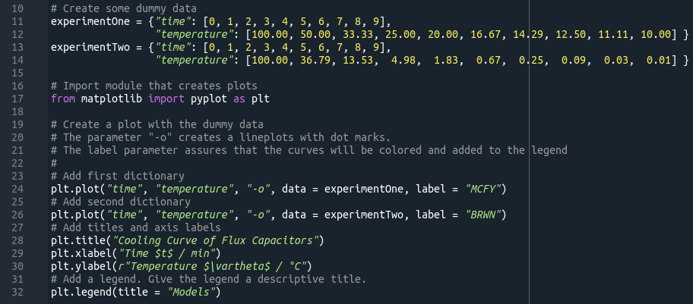
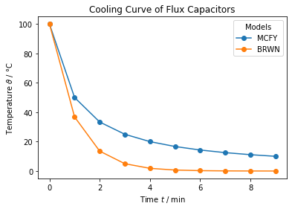
Plotting

Slide 7






Writing Files
newFile.txt
newFile.txt
newFile.txt

Slide 8
Writing Files
Create a string with a table
from tabulate import tabulate
table = tabulate(2D_array_with_data, headers = 1D_array_column_names)
Path(“table.txt”).write_text(table)
Ready to use parsers
…

