Slide 1
Complex Exercises

Slide 2
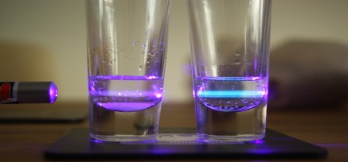
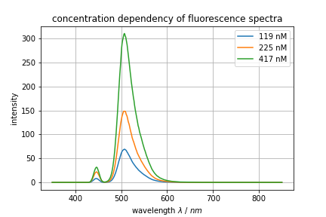

Complex Exercise 1:
Fluorescence

Slide 3
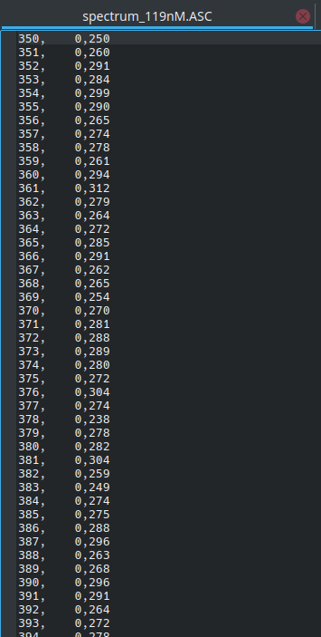
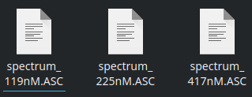
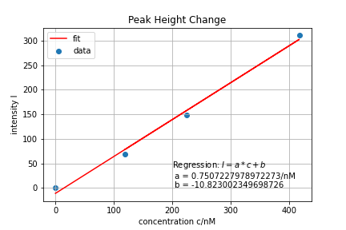
Complex Exercise 1:
Fluorescence
German
Notation

Slide 4

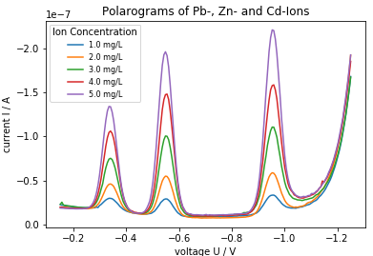
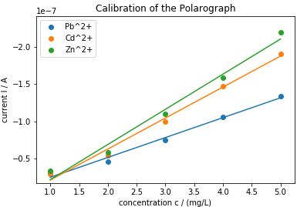
Complex Exercise 2:
DPP

Slide 5
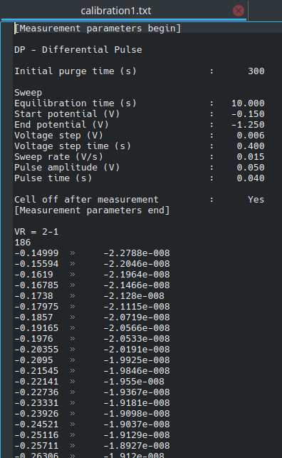
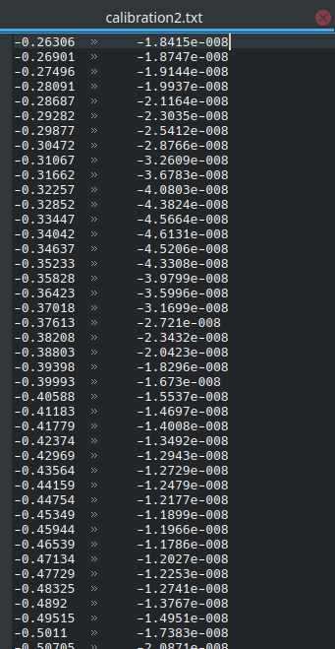
Complex Exercise 2:
DPP
Sample | Maximum
Lead (Pb²⁺) | - 0.340 V
Cadmium (Cd²⁺) | - 0.555 V
Zinc (Zn²⁺) | - 0.959 V

Slide 6
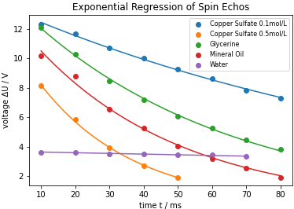

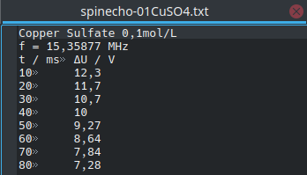

Complex Exercise 3:
NMR

