Slide 1
Some Stuff You Might Look Up Some Day.

Slide 2
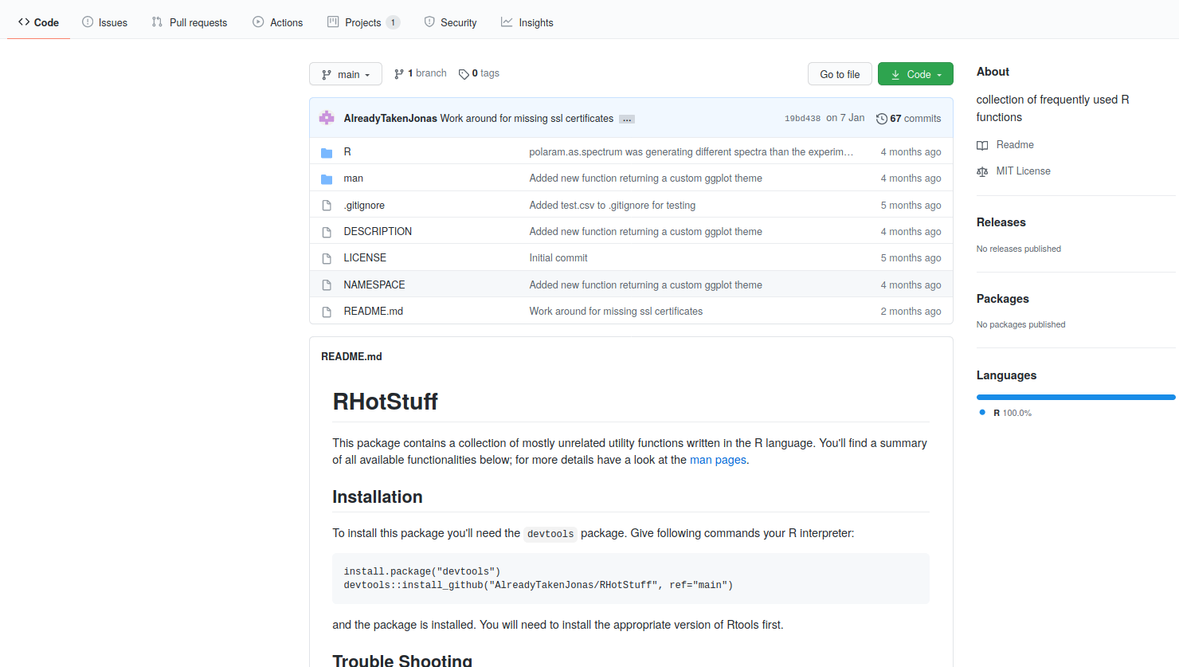
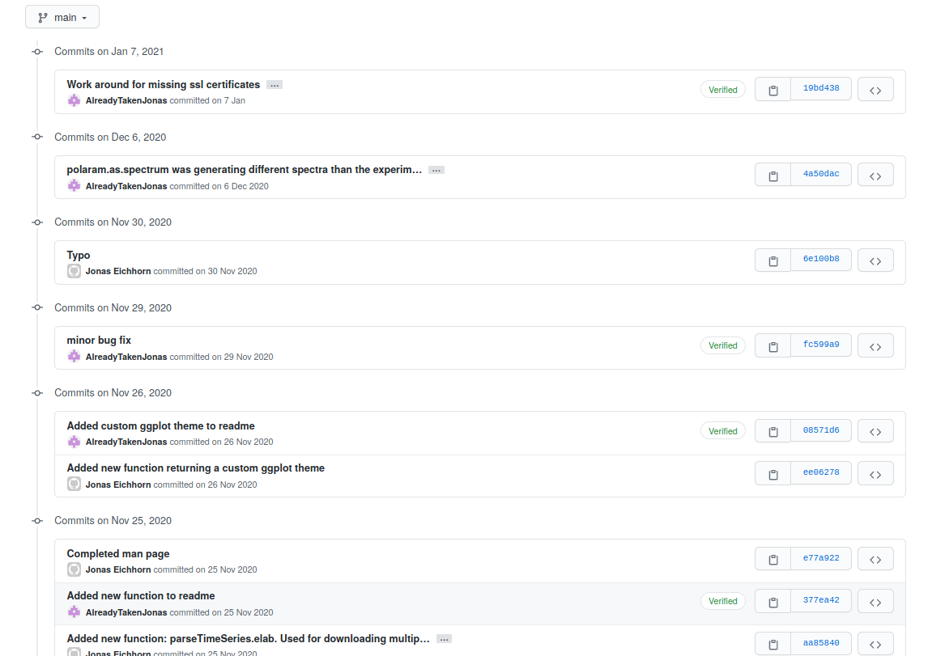
Git / Github

Slide 3
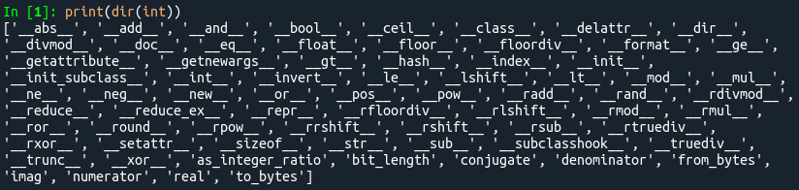
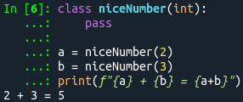
Everything is an object
a + b → a.__add__(b)
abs(a) → a.__abs__()

Slide 4
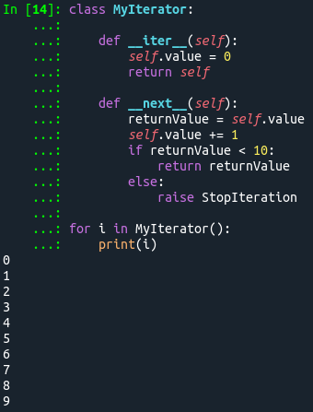
Iterables are Objects

Slide 5

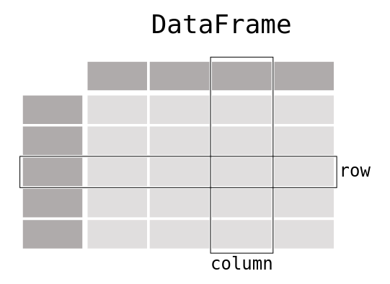
Data Manipulation

Slide 6
Topics for Bigger Projects
Testing your code with the unittest module.
Monitor your programm with the logging module.
Create a commandline interface (CLI) with the argparse module.
Create a graphical user interface (GUI).

