Slide 1


SMART INDIA HACKATHON 2026
TITLE PAGE
Problem Statement ID - SIH26077
Problem Statement Title - AI-Driven Hyper-Local Early Warning System for Severe Weather Nowcasting
Theme - Disaster Management
PS Category - Software
Team ID - (as registered on portal)
Team Name - SCAPEGOATS

Slide 2

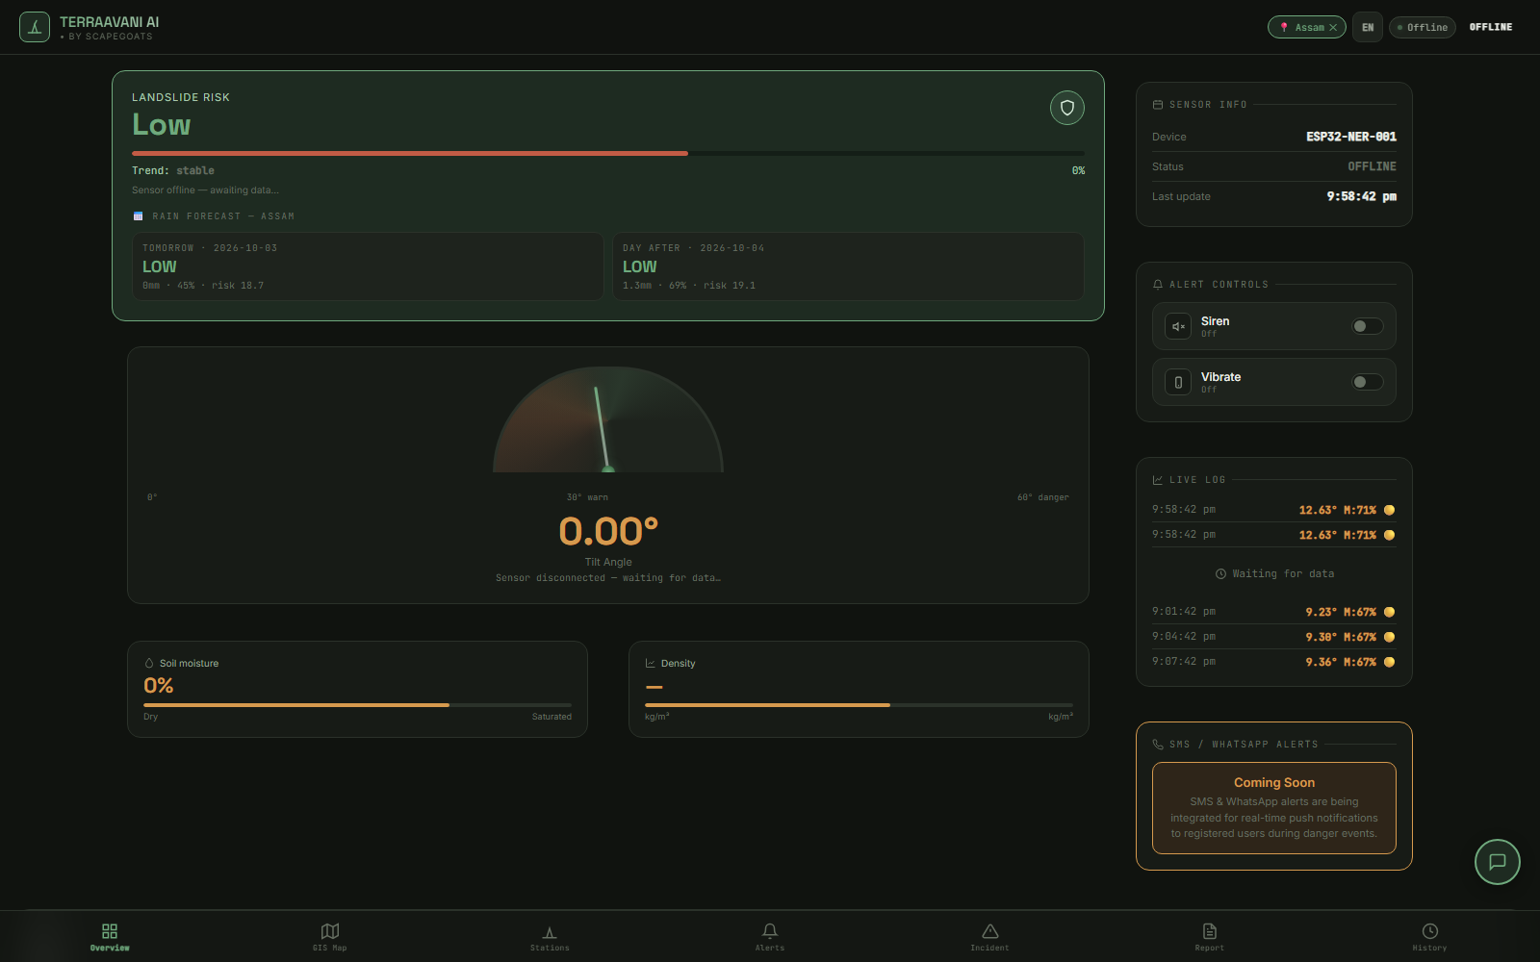
IDEA TITLE
MeghSentinel - AI-Driven Hyper-Local Early Warning System for Severe Weather Nowcasting
• Problem: a cloudburst hits with almost no warning - today's weather models are too slow and too broad to see it coming for one district
• What we built: one AI model that reads satellite images and weather data and tells a district how likely a cloudburst or flash flood is, 2 to 6 hours before it happens
• How you get the warning: a live risk map that opens on any phone, plus SMS alerts to the districts in danger
PROBLEM TODAY | WITH MEGHSENTINEL
Storms intensify within a few hours | One AI model warns 2 to 6 hours before impact
Weather models are too slow and too broad to see a cloudburst | Reads satellite images directly - no waiting for model runs
Too few ground stations, so warnings go untrusted | District-wise risk map, checked against our own field sensors

Slide 3
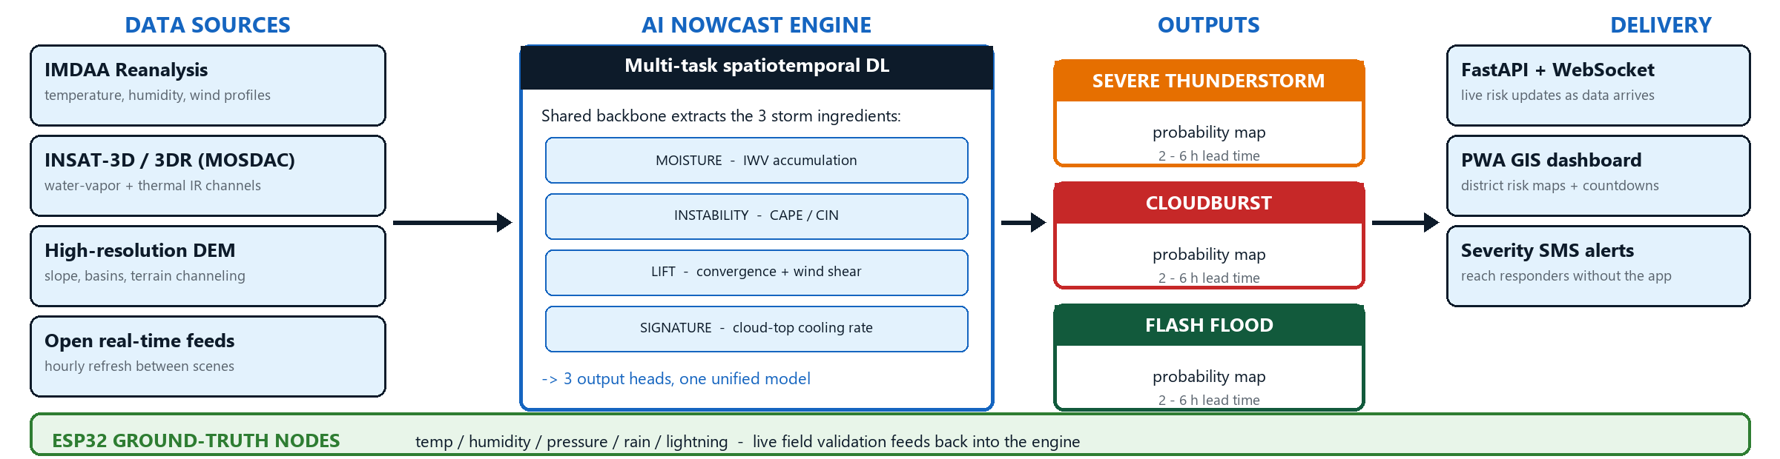
TECHNICAL APPROACH
• Inputs - free government data: IMDAA weather grids, INSAT-3D satellite images (MOSDAC) and a terrain map
• How it works - it learns from past storms: when moisture, heat and wind line up and cloud tops cool quickly, a cloudburst is on the way
• What you get - a district-wise risk map on a live dashboard plus SMS alerts, 2 to 6 hours before the rain
• Proof - our own field sensors (rain, pressure, lightning) record what really happened, so every alert can be checked

Slide 4
FEASIBILITY AND VIABILITY
• Most of the system already exists - our team built and runs the dashboard, the server and the SMS alerts; only the prediction model is new
• All the data is free - IMDAA and MOSDAC just need a free account, and the terrain maps need no key
• Plan - idea in October, data and model training in November, a working end-to-end demo in December
ASPECT | STATUS | EVIDENCE
Data | Confirmed | Open data from MOSDAC and IMDAA, DEM needs no key
Server | Reused | The backend service is already live and running
Website | Reused | The web app installs and shows live sites
Alerts | Reused | SMS alerts already fire at set thresholds
New work | Scoped | Prediction model, map layer and node firmware

Slide 5
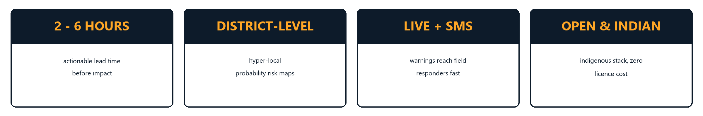
IMPACT AND BENEFITS
• 2 to 6 extra hours before a cloudburst - enough time to move people out, not just count the damage
• Warnings name the district, not the whole state, so rescue teams go where the danger actually is
• Any district can run it on free data, with no expensive licence, and it can be extended to other disasters
• A public dashboard keeps people informed while the storm is still building, not after it has hit

Slide 6
RESEARCH AND REFERENCES
• Data sources: IMDAA Reanalysis (IITM + NCEP/NCAR) | INSAT-3D/3DR via MOSDAC (mosdac.gov.in) | GPM IMERG (gpm.nasa.gov) | Copernicus DEM | Open-Meteo (open-meteo.com)
• Method references: Ravuri et al., 'Skilful precipitation nowcasting using deep generative models', Nature (2021) | Zhang et al., 'NowcastNet', Science (2023)
• Problem statement: SIH26077, Ministry of Earth Sciences (MoES) / India Meteorological Department
• Our platform: the live monitoring dashboard and the field sensor nodes shown on slides 2-3

