Slide 1

CS SCHOOL

Slide 2
CPython VM
Virtual Stack Machine - stack-based
2. Operand Stack

Slide 3
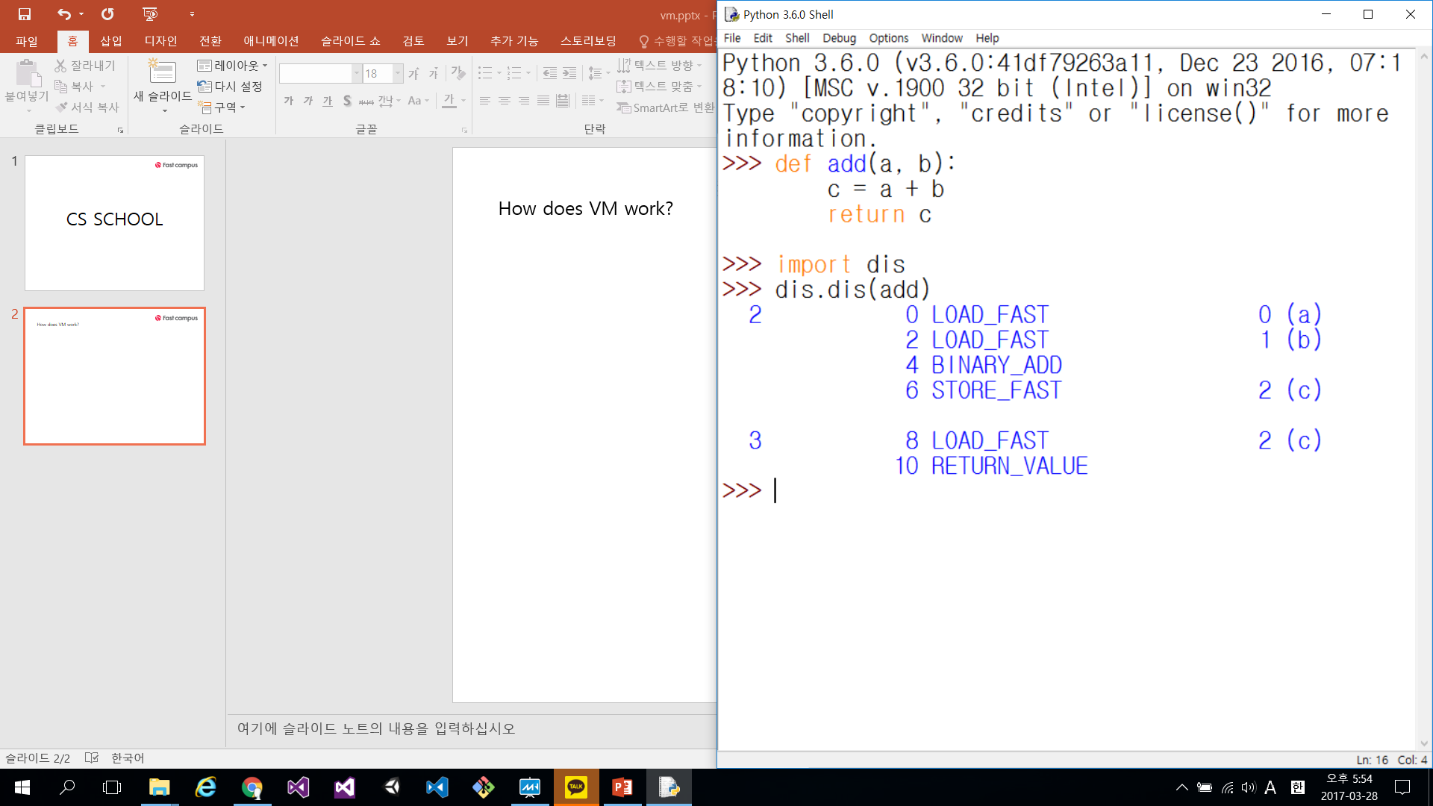
How does VM work?
disassembling

Slide 4
How does VM work?
Operand stack
a

Slide 5
How does VM work?
Operand stack
b
a

Slide 6
How does VM work?
Operand stack
a + b

Slide 7
How does VM work?
Private heap
c = a + b

Slide 8
How does VM work?
Operand stack
c

Slide 9
How does VM work?
returns c

