Slide 1
SQL

Slide 2
Technologies Involved in Project
Architecture
Web server
Web pages, JS files, and data
Database server (if necessary)
Data
Web server
Team web space URL:
http://teams.up.ist.psu.edu/ist402sp17/section2/Team01/....
Each team member can access the folder and files under it.
Be careful when you modify a document.

Slide 3
Database Server
SQL Server
Help manage data and respond dynamic queries
Why is Python insufficient?
Python is good if you know what data users may need
Database server is better if user info and needs are more dynamic and unpredicatable.
Team database
IST402SP1700201 – IST402SP1700210

Slide 4
Revisit to Relational Database and SQL

Slide 5
Relational Model
A relational database includes tables that are connected through keys (primary key ➔ foreign key).
Table: a set of unique records (rows) with multiple attributes (columns)
Each table is an entity
Primary key: the attribute(s) used to identify a record in a table.
Foreign key: the attribute(s) in a table used as the primary key in another table
Primary-foreign key pair defines a relationship between two entities.

Slide 6
Example
MC 2 entities and relationships
Data sets we have
Car-assignments
Credit card spending records
Shopper card spending records
GPS records
What entities do we have here?
Their relationships?

Slide 7
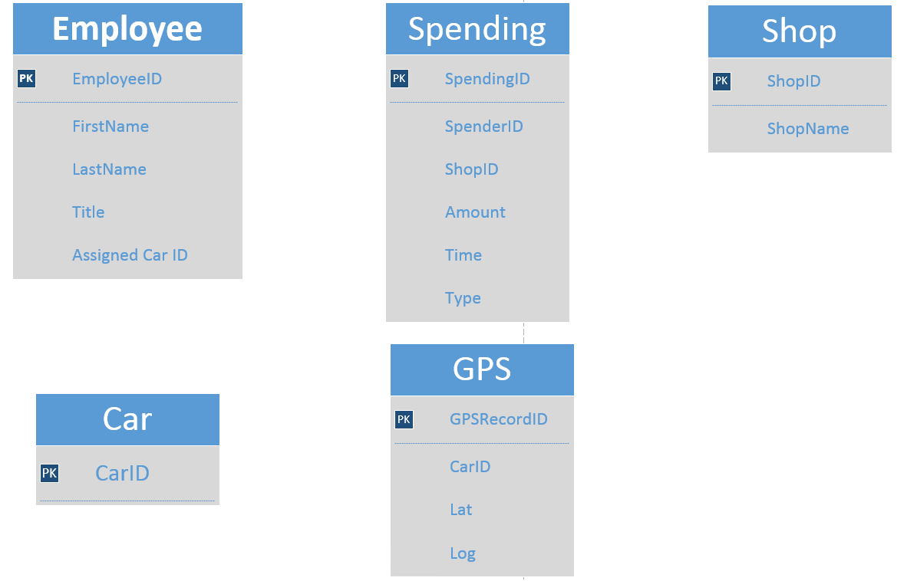

employee
shop
spending
GPS
car

Slide 8
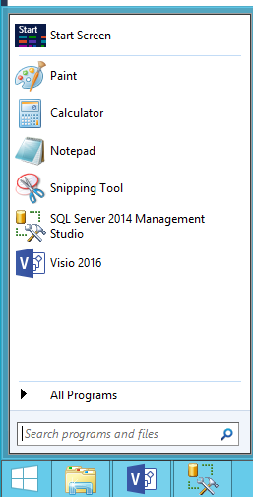
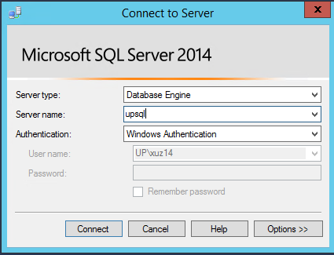
Import Data into Database
Start SQL Server 2014 Management Studio
Log on the Database Server upsql

Slide 9
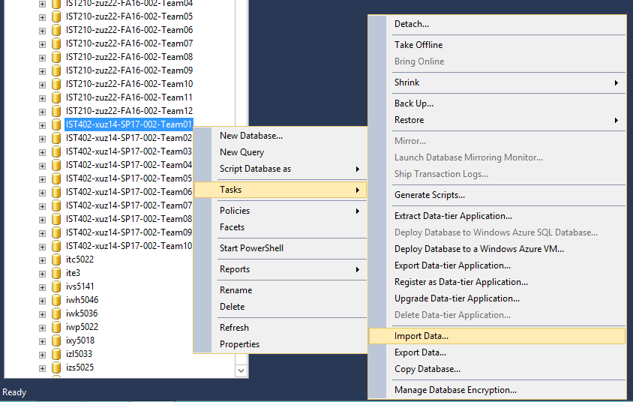
Locate your database and right-click to find the Import-Data tool

Slide 10
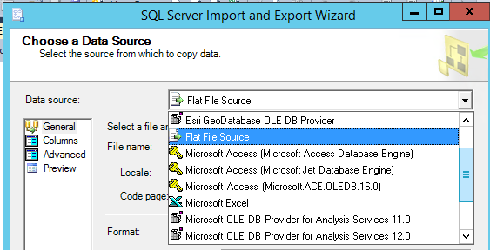
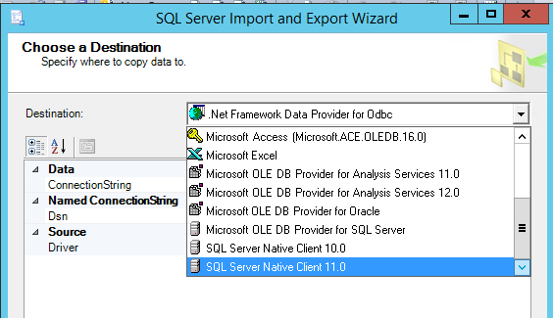
Follow the Import and Export Wizard
Choose “Flat File Source” as the type of data source,
and “SQL Server Native Client 11.0” as the type of your Destination

Slide 11
Exercise: Import the cc_data.csv into your database
Use your personal database.
Copy the source file to your desktop and import the copied file.

Slide 12
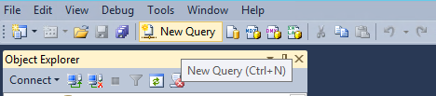
SQL
Structured Query Language

Slide 13
Basic Form of SQL
Select attribute1, attributes2, …
From table
Where condition
Get all spending records before 1/10/2014
Select *
From table_name
Where timestamp < '2011-01-01 0:0:0.0'

Slide 14
SQL Match Criteria
The WHERE clause match criteria may include
Equals “=“
Not Equals “<>”
Greater than “>”
Less than “<“
Greater than or Equal to “>=“
Less than or Equal to “<=“
Multiple matching criteria may be specified using
AND
Representing an intersection of the data sets
OR
Representing a union of the data sets

Slide 15
Save Query Result
Select attri, … into Table_name

Slide 16
Count function
Get the number of records
Select count(*)
From table
Where condition
For subgroup count
Group by aggregation_condition

Slide 17
SQL: Wildcard Searches
LIKE
Multiple character wildcard character is a percent sign (%)
Single character wildcard character is an underscore (_)
Select *
FROM emp
WHERE Display LIKE ‘f%';

Slide 18
SQL: Sorting the Results
ORDER BY
SELECT LastName, FirstName, Count(*) as ShoppingTimes
FROM cc_data
GROUP BY LastName, FirstName
ORDER BY ShoppingTimes

Slide 19
Find the amount of Spending

Slide 20
Join Example: Combine More Tables
SELECT attribut1, …
FROM Table1, Tabe2
WHERE Table1.JoinAttr = Table2.JoinAttr

Slide 21
Find out Whether a Person Driving a Car when Shopping

Slide 22
Select FirstName, LastName, ShopIDreceiver.Display
From employee, spending as sp, GPS as gp
Where employeeID = spenderID and
assigneCardID = CarID and
sp.time = gp.time

