Slide 1





HOME
WHY CHOSE US
OUR SERVICES
COBRISSA We a leader in collection services. We are based on profesional and ethic work.
Professionalism
Experience
Get to know us
HOME
Av. Reforma 8-60 zona 9
Guatemala, Guatemala
Tel. 502 638700
info@cobrissa.com
Copyright © 2023 Cobrissa
All Rights reserved

Slide 2

HOME
WHY CHOSE US
OUR SERVICES
Professionalism Our agents are hired based on customer service experience, values and trained on a regular basis. Making sure to mainteing a high standard of service and knowledge
Experience We have over 10 years of experience in the industry. Our agents have a customer service and financial backgrounds that allows to provide the best service.
HOME
Av. Reforma 8-60 zona 9
Guatemala, Guatemala
Tel. 502 638700
info@cobrissa.com
Copyright © 2023 Cobrissa
All Rights reserved

Slide 3
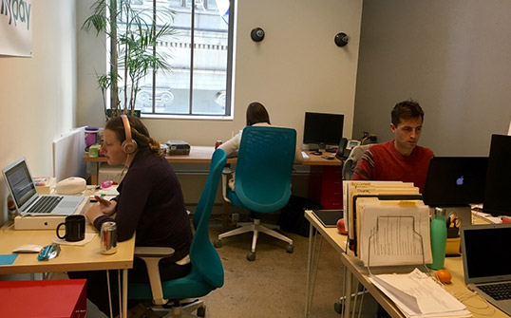
HOME
WHY CHOSE US
OUR SERVICES
Preventive Collection
Administrative Charge
Digital Financial services
Services
HOME
Av. Reforma 8-60 zona 9
Guatemala, Guatemala
Tel. 502 638700
info@cobrissa.com
Copyright © 2023 Cobrissa
All Rights reserved

