Slide 1

A/B Testing Mobile Game Project
Alejandro Alemany

Slide 2


Table of contents
1
2
3
4
About Cookie Cats
Problem and Solution
Data Analysis
And modeling
Recommendation
A game by Tactile Entertainment
Increasing retention
Finding the relationship
Strategy after the analysis

Slide 3


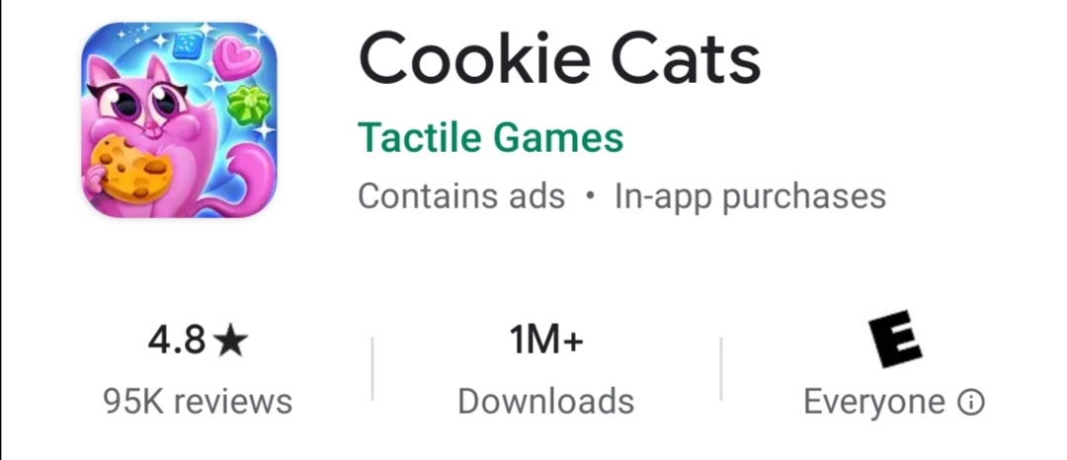
Cookie Cats overview

Slide 4
Problems and Solutions
Retention
First gate
Hypothesis
It’s very low
First gate is at level 30
Moving the gate from level 30 to 40 will increase retention.
Approach
Results
A/B Testing
Decision will be taken based on results

Slide 5
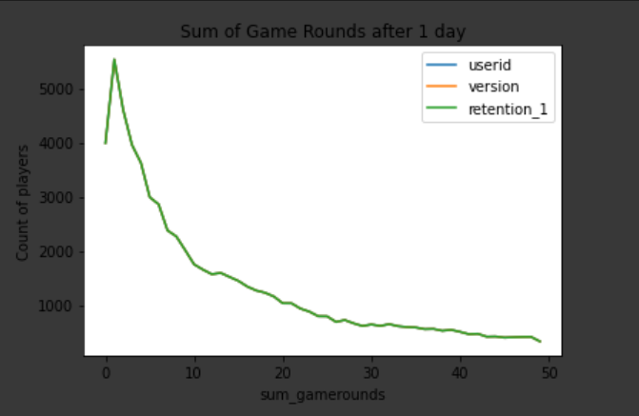
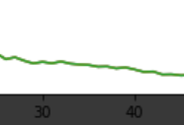
How much do people play?
Skills
25%
25%
60%

Slide 6
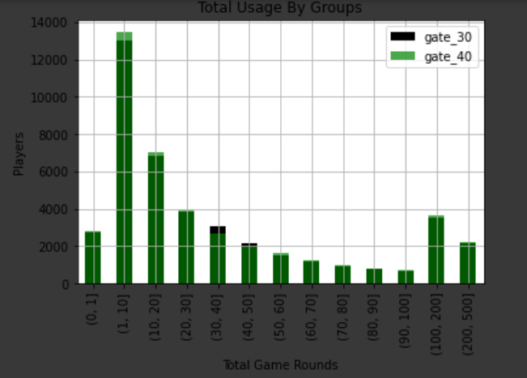

Distribution of rounds
Retention percentage at gate 30: 44.82%
Retention percentage at gate 40: 44.2%
Retention difference: 0.62%
2015 2019
Mention the company
Describe your job here

Slide 7
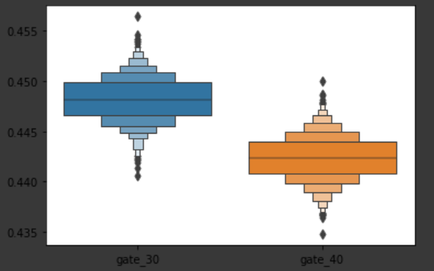
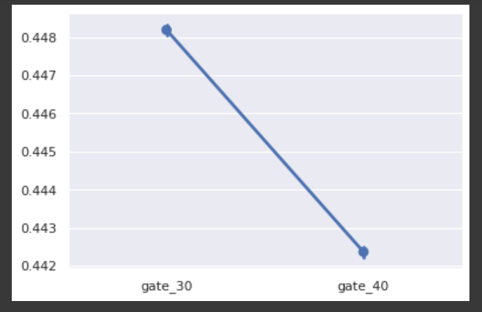
How significant is the difference in retention

Slide 8
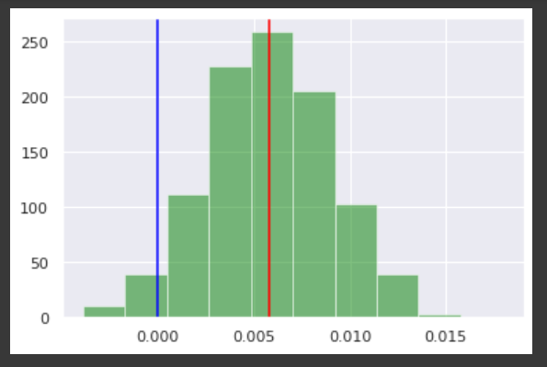
There is not enough statistical evidence to find a relationship between the game’s version and one day retention.
Probability that retention is higher at gate 30: 96.8%

Slide 9
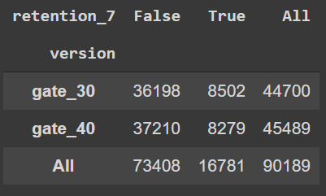
The history is different after 7 days
There is enough statistical evidence to find a relationship between retention and the game’s version.
Retention percentage at gate 30: 19.02%
Retention percentage at gate 40: 18.2%
Retention difference: 0.8%

Slide 10
Recommendation:
1. It was expected that moving the first gate from 30 to level 40 will increase retention.
Nevertheless, the analysis shows that it is not the case.
2. Graphs showed that people started to lose interest in the game after 20 rounds. People who reach level 30, and are forced to stop, have a more significant motivation to come
back later or make a purchase to continue playing.
3.
However, by the time a user reaches level 40, interest might have decrease.

Slide 11
About my work
A/B testing Project
Github: github.com/AlrxKali

