Slide 1
Cyclistic’s Trip Data:
How do annual members and casual riders use Cyclistic bikes differently?
Google Data Analysis Case Study
Published By:
Alireza Mohebbi
May 4, 2025

Slide 2
Cyclistic’s Trip Data:
How do annual members and casual riders use Cyclistic bikes differently?
Summary
Casual riders use Cyclistic bikes more frequently on Sundays–Wednesdays and less on Thursdays–Saturdays, while annual members ride consistently throughout the week. Classic bikes dominate among both groups, and casual riders take significantly longer trips. Seasonal trends show casual ridership peaking in warmer months, while members maintain steady usage year-round.

Slide 3
Cyclistic’s Trip Data:
How do annual members and casual riders use Cyclistic bikes differently?
Key Insights Addressed
How do casual riders' weekday and weekend usage patterns compare to those of annual members?
Which type of bike is most favored by both casual and annual members?
Do casual riders exhibit different trip durations compared to annual members?
What impact does seasonality have on ridership trends?

Slide 4
How do casual riders' weekday and weekend usage patterns compare to those of annual members?
Casual riders exhibit lower engagement from Sunday to Wednesday, averaging 155K–179K trips daily, indicating reduced usage during early weekdays. However, their ridership significantly increases from Thursday to Saturday, peaking at 306K rides on Friday, suggesting a stronger preference for late-week and weekend cycling.
Annual members, also experience fluctuations throughout the week. Their highest ridership occurs on Tuesday (426K rides), whereas Friday and Saturday mark the lowest engagement (325K–285K rides), indicating variations in their riding behavior.

Slide 5
How do casual riders' weekday and weekend usage patterns compare to those of annual members?
Casual riders may rely more on leisure trips, leading to higher engagement later in the week when work schedules loosen. Meanwhile, annual members might exhibit peak usage on Tuesdays due to work commutes but experience a decline on Fridays and Saturdays, possibly influenced by alternative weekend transportation options.

Slide 6
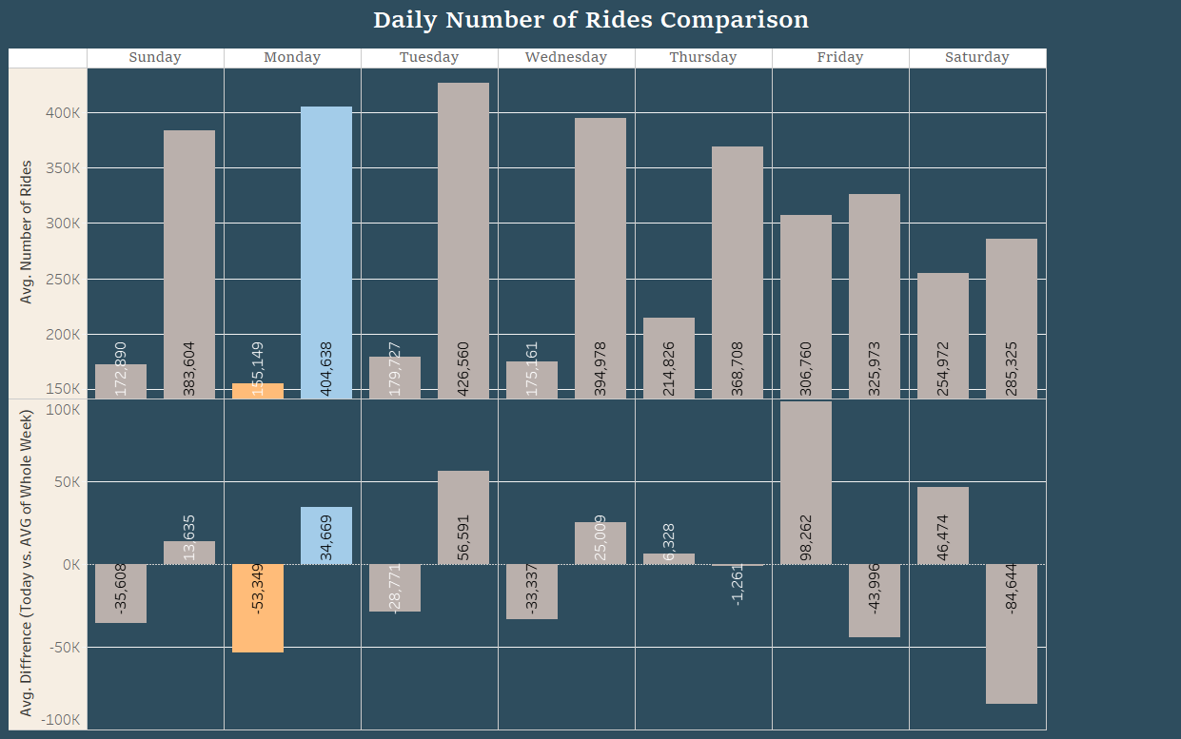
How do casual riders' weekday and weekend usage patterns compare to those of annual members?
Casual Riders:
Lowest engagement: Sunday–Wednesday (~155K-179K rides/day)
Increase in activity: Thursday–Saturday (~215K–307K rides/day)
Annual Members:
Ridership fluctuates between 369K–427K rides daily.
Peaks on Tuesdays, declines on Fridays and Saturdays.
Click on the chart to see the full dashboard.

Slide 7
How do casual riders' weekday and weekend usage patterns compare to those of annual members?
Implications
Casual riders’ stronger engagement from Thursday to Saturday presents an opportunity for targeted promotions during peak demand periods to encourage membership conversions.
Annual members' fluctuating ridership patterns suggest a need for adaptive service enhancements rather than assuming consistent engagement.
Marketing strategies should align with casual riders’ late-week surge, promoting habit-forming membership benefits to maximize retention.

Slide 8
Which type of bike is most favored by both casual and annual members?
Both casual riders and annual members overwhelmingly favor classic bikes over electric bikes and scooters. This preference is evident across all days of the week, with classic bikes consistently dominating the ride totals for both user segments.

Slide 9
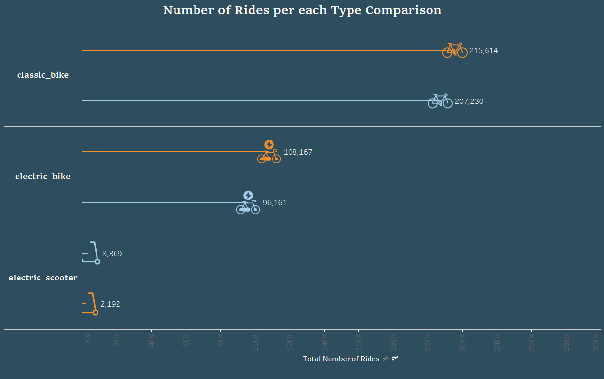
Which type of bike is most favored by both casual and annual members?
Electric Bikes:
Casual riders: ~53K rides/day
Annual members: ~96K rides/day
Example (Friday): Casual – 108,167 rides, Members – 96,161 rides
Classic Bikes:
Casual riders: ~138K rides/day
Annual members: ~312K rides/day
Example (Friday): Casual – 215,614 rides, Members – 207,230 rides
Click on the chart to see the full dashboard.

Slide 10
Which type of bike is most favored by both casual and annual members?
Electric Scooters:
Casual riders: ~3K rides/day
Annual members: ~2K rides/day
Example (Friday): Casual – 3,369 rides, Members – 2,192 rides
Electric Bikes:
Casual riders: ~53K rides/day
Annual members: ~96K rides/day
Example (Friday): Casual – 108,167 rides, Members – 96,161 rides
Classic Bikes:
Casual riders: ~138K rides/day
Annual members: ~312K rides/day
Example (Friday): Casual – 215,614 rides, Members – 207,230 rides
Click on the chart to see the full dashboard.

Slide 11
Which type of bike is most favored by both casual and annual members?
Electric Scooters:
Casual riders: ~3K rides/day
Annual members: ~2K rides/day
Example (Friday): Casual – 3,369 rides, Members – 2,192 rides
Electric Bikes:
Casual riders: ~53K rides/day
Annual members: ~96K rides/day
Example (Friday): Casual – 108,167 rides, Members – 96,161 rides
Click on the chart to see the full dashboard.

Slide 12
Which type of bike is most favored by both casual and annual members?
Implications
Marketing efforts should focus on classic-bike promotions, as they cater to the broadest user base.
Electric bikes have moderate adoption, suggesting potential for incentives to drive increased usage.
Electric scooters have minimal engagement, indicating limited appeal or accessibility within the Cyclistic service model.

Slide 13
Do casual riders exhibit different trip durations compared to annual members?
Casual riders consistently take longer trips across all vehicle types compared to annual members. On average, their ride durations are nearly twice as long as those of members. This trend suggests that casual riders may use Cyclistic services for leisure or extended travel, whereas annual members likely integrate bike usage into their daily routines.

Slide 14
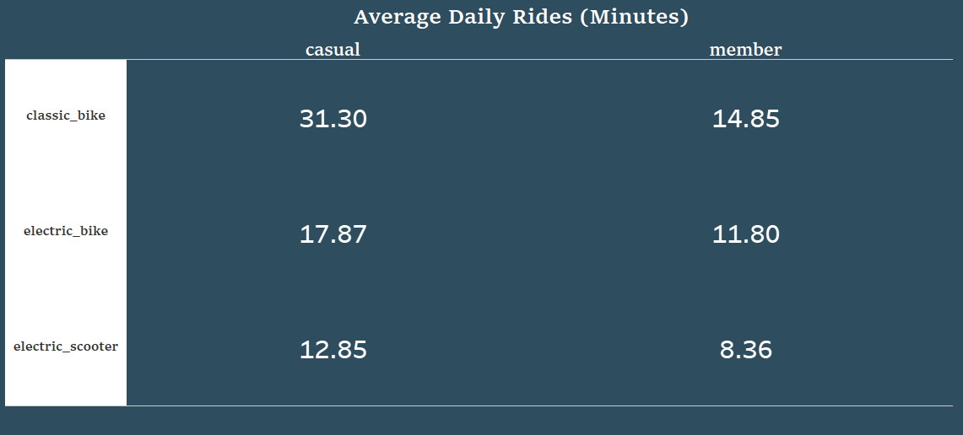
Do casual riders exhibit different trip durations compared to annual members?
Classic Bikes:
Casual riders: 28.2 min (weekly avg.)
Annual members: 13.4 min (weekly avg.)
Example (Friday): 31.3 min (casual) vs. 14.85 min (members)
Electric Bikes:
Casual riders: 17.9 min (weekly avg.)
Annual members: 11.8 min (weekly avg.)
Average daily rides on Friday.
Click on the chart to see the full dashboard.

Slide 15
Do casual riders exhibit different trip durations compared to annual members?
Classic Bikes:
Casual riders: 28.2 min (weekly avg.)
Annual members: 13.4 min (weekly avg.)
Example (Friday): 31.3 min (casual) vs. 14.85 min (members)
Electric Scooters:
Casual riders: 12.9 min (weekly avg.)
Annual members: 8.4 min (weekly avg.)
Electric Bikes:
Casual riders: 17.9 min (weekly avg.)
Annual members: 11.8 min (weekly avg.)
Average daily rides on Friday.
Click on the chart to see the full dashboard.

Slide 16
Do casual riders exhibit different trip durations compared to annual members?
Electric Scooters:
Casual riders: 12.9 min (weekly avg.)
Annual members: 8.4 min (weekly avg.)
Electric Bikes:
Casual riders: 17.9 min (weekly avg.)
Annual members: 11.8 min (weekly avg.)
Average daily rides on Friday.
Click on the chart to see the full dashboard.

Slide 17
Do casual riders exhibit different trip durations compared to annual members?
Implications
Casual riders engage in longer trips, signaling potential interest in membership benefits that offer cost savings for extended usage.
Marketing strategies should emphasize trip-duration savings, encouraging casual users to convert into annual members for more cost-effective travel options.
Annual members demonstrate shorter, more consistent ride durations, reinforcing their habitual use of the service for routine transportation.

Slide 18
What impact does seasonality have on ridership trends?
Seasonality significantly affects casual ridership, while annual members display more stable engagement year-round. Casual riders show peak demand in the warmer months (May–September), with ridership exceeding 250K monthly trips during this period. In contrast, their engagement drops notably in colder months (November–February), where trips decline to <180K per month.
Annual members maintain consistent usage patterns, averaging 115K–222K rides per month, with slight reductions during the winter months. Their habitual usage contrasts with the more seasonally dependent behavior of casual riders.

Slide 19
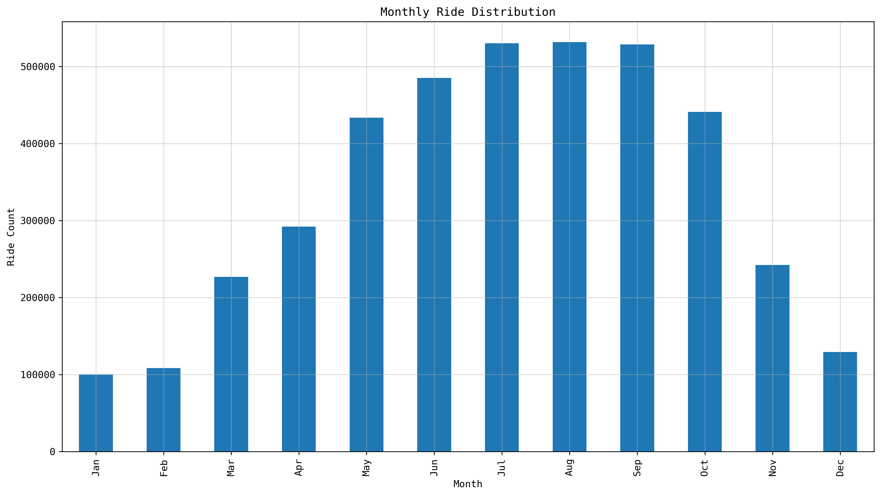
What impact does seasonality have on ridership trends?
Seasonal Trends in Cyclistic Ridership: Peaks and Declines Across the Year
This visualization highlights the fluctuation in monthly ride counts, showcasing peak ridership during the warmer months (June–September) and a noticeable drop in the colder months (November–February). The trend underscores the seasonal impact on casual riders while annual members maintain more stable engagement year-round.

Slide 20
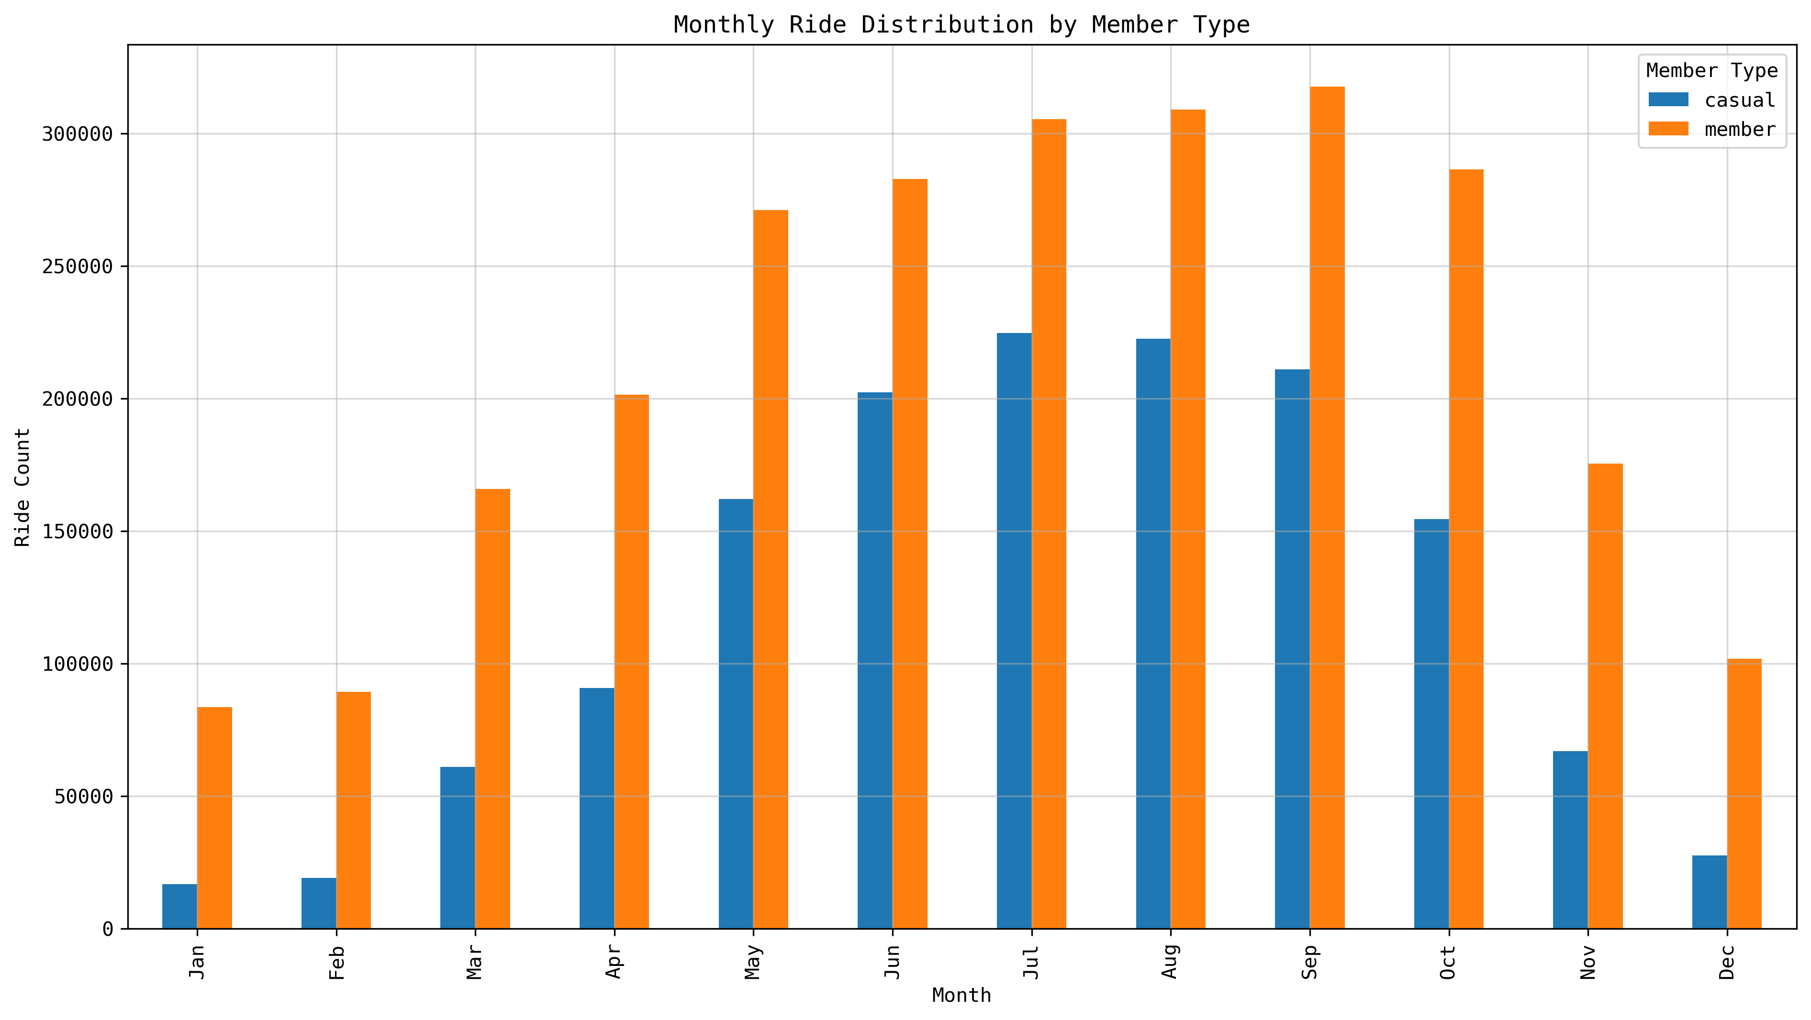
What impact does seasonality have on ridership trends?
Peak Casual Ridership: May–September (~250K+ trips/month)
Lowest Casual Ridership: November–February (~167K–101K trips/month)
Annual Members’ Steady Usage: Monthly rides range from 115K–222K, remaining more predictable than casual usage

Slide 21
What impact does seasonality have on ridership trends?
Implications
Casual riders exhibit seasonal variability, making summer and early fall ideal opportunities for membership conversion campaigns.
Winter reductions in casual trips suggest a need for retention strategies, such as discounted cold-weather memberships or bundled services.
Annual members provide consistent revenue streams, reinforcing the value of converting casual riders into long-term subscribers.

Slide 22

Conclusion
This analysis of Cyclistic ridership patterns reveals significant behavioral differences between casual riders and annual members, offering valuable insights for targeted marketing strategies. Casual riders exhibit clear seasonal and weekly variations, with peak demand during warmer months and early weekdays, while annual members maintain steady usage year-round. Classic bikes remain the preferred mode of transport across both groups, and casual riders consistently take longer trips, highlighting their engagement potential.

Slide 23
Conclusion
This analysis of Cyclistic ridership patterns reveals significant behavioral differences between casual riders and annual members, offering valuable insights for targeted marketing strategies. Casual riders exhibit clear seasonal and weekly variations, with peak demand during warmer months and early weekdays, while annual members maintain steady usage year-round. Classic bikes remain the preferred mode of transport across both groups, and casual riders consistently take longer trips, highlighting their engagement potential.

Slide 24
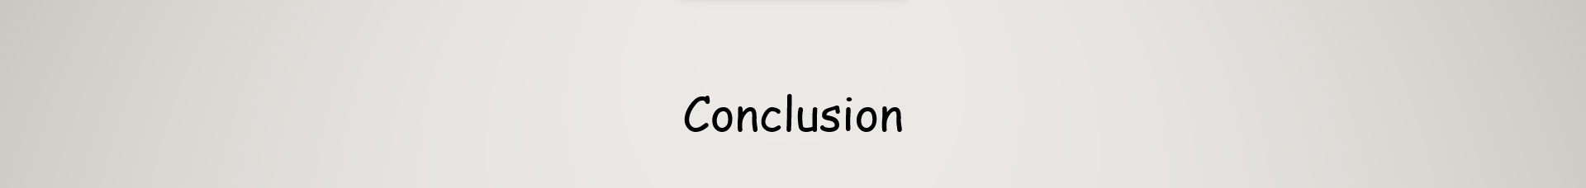
Conclusion
This analysis of Cyclistic ridership patterns reveals significant behavioral differences between casual riders and annual members, offering valuable insights for targeted marketing strategies. Casual riders exhibit clear seasonal and weekly variations, with peak demand during warmer months and early weekdays, while annual members maintain steady usage year-round. Classic bikes remain the preferred mode of transport across both groups, and casual riders consistently take longer trips, highlighting their engagement potential.
To maximize membership conversions, Cyclistic should focus on weekend and seasonal promotions, emphasizing cost-saving benefits for longer trips. Encouraging casual riders to adopt annual memberships through tailored incentives will enhance retention and stabilize ridership throughout the year. By leveraging these findings, Cyclistic can refine its marketing strategies and optimize services to drive long-term growth and customer loyalty.

Slide 25
This analysis of Cyclistic ridership patterns reveals significant behavioral differences between casual riders and annual members, offering valuable insights for targeted marketing strategies. Casual riders exhibit clear seasonal and weekly variations, with peak demand during warmer months and early weekdays, while annual members maintain steady usage year-round. Classic bikes remain the preferred mode of transport across both groups, and casual riders consistently take longer trips, highlighting their engagement potential.
Conclusion
To maximize membership conversions, Cyclistic should focus on weekend and seasonal promotions, emphasizing cost-saving benefits for longer trips. Encouraging casual riders to adopt annual memberships through tailored incentives will enhance retention and stabilize ridership throughout the year. By leveraging these findings, Cyclistic can refine its marketing strategies and optimize services to drive long-term growth and customer loyalty.
How to reach me

Slide 26
Conclusion
To maximize membership conversions, Cyclistic should focus on weekend and seasonal promotions, emphasizing cost-saving benefits for longer trips. Encouraging casual riders to adopt annual memberships through tailored incentives will enhance retention and stabilize ridership throughout the year. By leveraging these findings, Cyclistic can refine its marketing strategies and optimize services to drive long-term growth and customer loyalty.
How to reach me

Slide 27







Conclusion
To maximize membership conversions, Cyclistic should focus on weekend and seasonal promotions, emphasizing cost-saving benefits for longer trips. Encouraging casual riders to adopt annual memberships through tailored incentives will enhance retention and stabilize ridership throughout the year. By leveraging these findings, Cyclistic can refine its marketing strategies and optimize services to drive long-term growth and customer loyalty.
How to reach me
Click on desired platform to connect …

Slide 28
How to reach me
Click on desired platform to connect …

