Slide 1

DVSA Vulnerability Discovery
and Remediation
Client
API
Gateway
Lambda
Functions
DynamoDB
S3 / SES
ICS-344 Information Security • Section 03
10 official DVSA lessons exploited, fixed, and verified
AMJAD ALSADIQ | 202269000
AWS Region: us-east-1 • DVSA on AWS Serverless
• Evidence captured from browser, terminal, CloudWatch, IAM, S3, DynamoDB
• Fixes applied in the correct backend / cloud-security layer
• Verification repeated after each fix
Project Final Presentation
01

Slide 2
Project Scope & Serverless Pipeline
DVSA was deployed in a controlled AWS account and tested through the same public API used by the frontend.
S3 static
frontend
API
Gateway
Order
Manager
Backend
Lambdas
DynamoDB
S3 / SES
Testing approach
Core services examined
• Interact with DVSA normally to understand intended behavior
• Send controlled malformed or malicious requests to the same API path
• Collect evidence from AWS services and local tools
• Patch code/configuration, redeploy, then rerun the same test
• Lambda functions and execution roles
• API Gateway stage settings and routes
• Cognito JWT handling
• S3 bucket permissions and event triggers
• DynamoDB order state and records
ICS-344 DVSA
02

Slide 3
Investigation Methodology
Every lesson followed the same evidence-driven cycle: prove the issue, apply the fix, then verify the exact attack path no longer succeeds.
1
Understand intended flow
2
Trigger vulnerable behavior
3
Capture proof
4
Patch root cause
5
Repeat test after fix
EVIDENCE TYPES
FIX QUALITY CHECKS
• Browser DevTools request/response
• CloudWatch execution logs
• AWS Console evidence: IAM, S3, DynamoDB
• Terminal output from curl, jq, AWS CLI
• Fix applied at root cause, not UI-only
• Same exploit repeated unchanged
• Expected function preserved where possible
• Sensitive values blurred or redacted
Result: complete 10/10 official DVSA lessons, each with exploit evidence, remediation, and post-fix verification.
ICS-344 DVSA
03

Slide 4
Findings Snapshot
The official lessons cover input handling, authentication, authorization, cloud configuration, IAM, workflow logic, and error handling.
L1
Event Injection
RCE via unsafe deserialization
L6
Denial of Service
Billing flood caused backend failures
L2
Broken Authentication
JWT payload trusted without verification
L7
Over-Privileged Function
Lambda role could scan orders DB
L3
Sensitive Info Disclosure
Admin receipt function exposed
L8
Logic Vulnerability
Paid for 1 item, order stored 5
L4
Insecure Cloud Config
S3 upload triggered backend flow
L9
Vulnerable Dependencies
node-serialize critical RCE
L5
Broken Access Control
User reached admin order update
L10
Unhandled Exceptions
Stack trace leaked to client
• Safe parsing + input validation
• JWT signature and claim verification
• Least privilege and S3 public-access blocking
• Rate limiting and workflow-state checks
• Generic errors with internal logs only
Fix families applied
ICS-344 DVSA
04

Slide 5
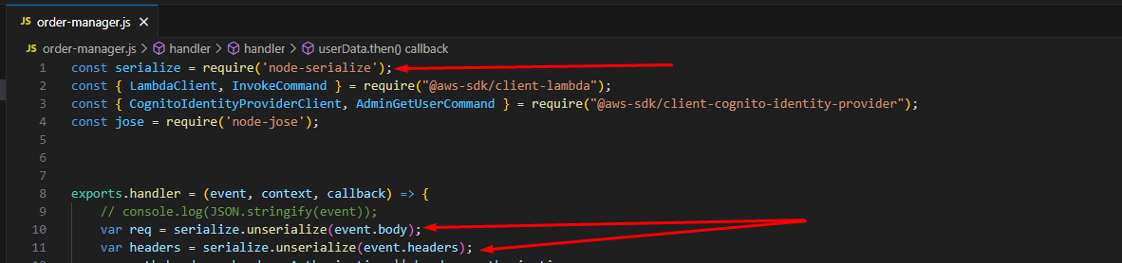
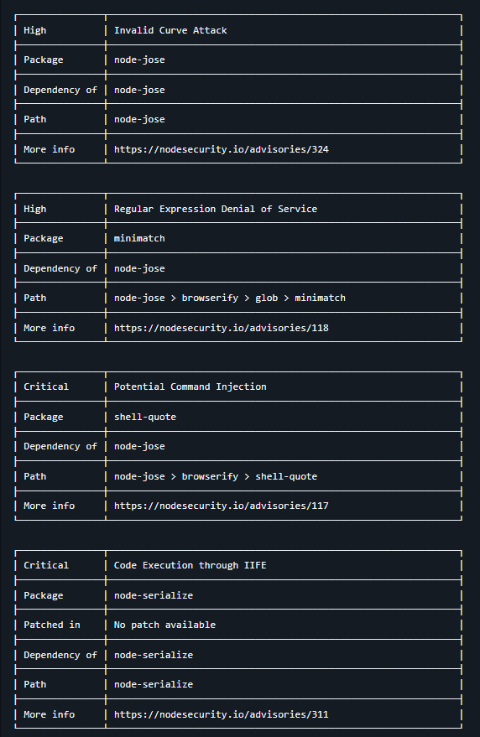
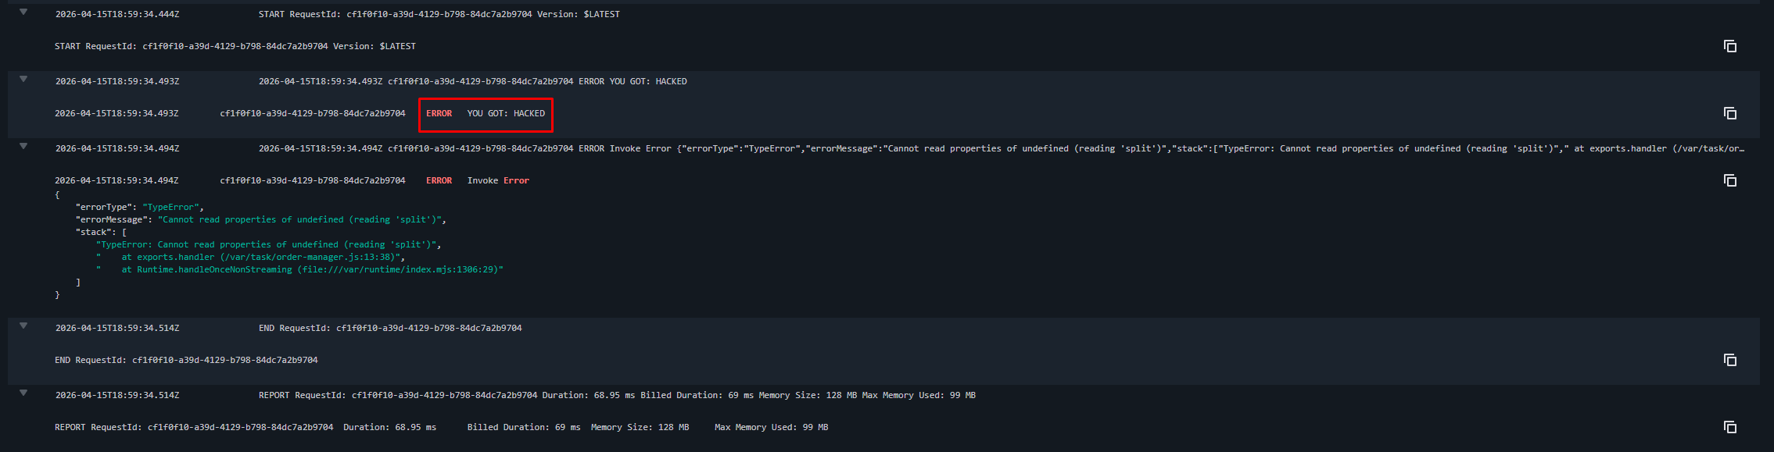
Lessons 1 & 9 — Event Injection + Vulnerable Dependencies
The same exploit path proved both RCE impact and the dependency root cause.
IMPACT: REMOTE CODE EXECUTION
• node-serialize processed public API input
• Serialized function payload executed inside Lambda
• CloudWatch showed attacker-controlled output
• Fix: replace unsafe deserialization with JSON.parse and remove node-serialize from request path
Vulnerable request parser
Dependency list: node-serialize critical
CloudWatch proof: injected code executed
Post-fix signal: the same payload no longer produced the “YOU GOT: HACKED” log entry.
ICS-344 DVSA
05

Slide 6
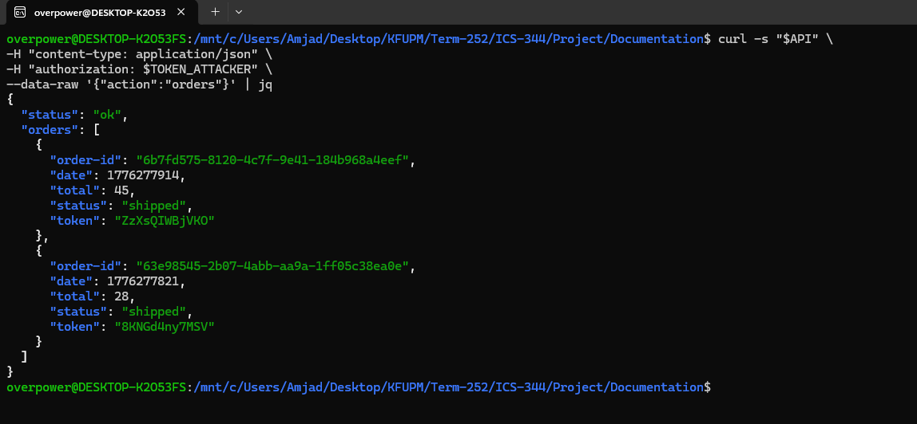
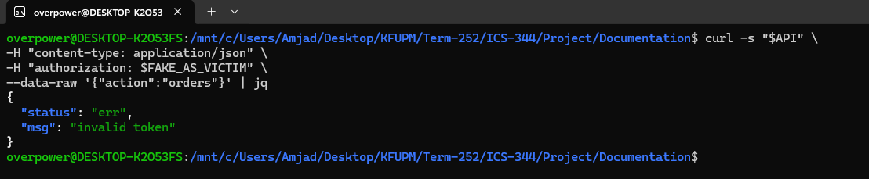
Lesson 2 — Broken Authentication
A forged JWT payload was accepted before signature and claim validation were added.
• Normal rule: only Cognito-issued, verified JWTs should identify the user
• Exploit: attacker modified username/sub claims and reused the token
• Impact: victim orders returned through the attacker-controlled request
• Fix: Cognito JWKS verification + issuer, exp, and token_use validation
Forged token returned another user’s orders
Security lesson: decoding a JWT is not authentication; signature verification is the trust boundary.
After fix: forged token rejected
ICS-344 DVSA
06

Slide 7

Lesson 3 — Sensitive Information Disclosure
The public order path was abused to reach an internal admin receipt workflow and obtain private receipt data.
Public
/order API
Order
Manager
Admin Get
Receipt
Signed S3
URL
Receipt ZIP
Downloaded
• Root cause: unsafe request execution crossed from user-controlled input into admin-only functionality
• Evidence: callback captured the admin response and the receipt ZIP was downloaded
• Fix: remove unsafe deserialization from the public request path; keep admin functions behind authorization boundaries
Downloaded receipt archive
Impact: sensitive receipt archive became reachable without the intended admin workflow.
ICS-344 DVSA
07

Slide 8
Lesson 4 — Insecure Cloud Configuration
Direct S3 writes allowed attacker-controlled objects to enter a trusted Lambda processing path.
• A .raw object was uploaded directly into the receipt bucket
• S3 event processing generated a .txt output, proving backend execution
• Fix: S3 Block Public Access + narrow write permissions + Lambda file-type validation
Before: .raw upload produced backend-generated .txt
Cloud configuration is part of the application security boundary.
After: public ACL upload blocked by S3 BlockPublicAcls
Fix location: S3 bucket permissions + DVSA-SEND-RECEIPT-EMAIL input validation.
ICS-344 DVSA
08

Slide 9
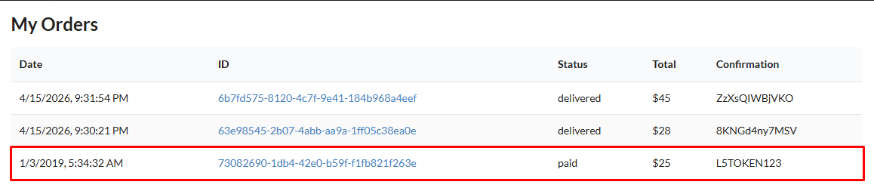
Lesson 5 — Broken Access Control
A normal user request reached the admin order update function and changed payment-related state.
• Exploit path reused code execution in the public order manager
• Injected code invoked DVSA-ADMIN-UPDATE-ORDERS
• Impact: unpaid order changed to paid with attacker-chosen confirmation token
• Fix: public request fields are parsed as data only; admin update path no longer executes from user input
Evidence: order became “paid” with attacker-controlled token
Authorization boundary violated
A public handler must never become a proxy for privileged administrative actions.
ICS-344 DVSA
09

Slide 10
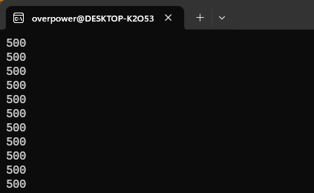
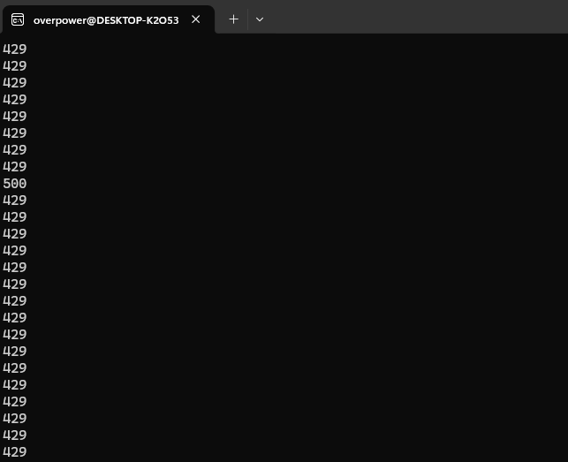
Lesson 6 — Denial of Service
Repeated billing requests caused backend failures until API Gateway throttling was configured.
BEFORE FIX
AFTER FIX
Flood produced repeated 500 responses
Excess traffic throttled as 429
API Gateway stage throttling
Rate = 5 req/s • Burst = 10
• Availability is a security property
• Protect critical workflows before traffic reaches Lambda
ICS-344 DVSA
10

Slide 11
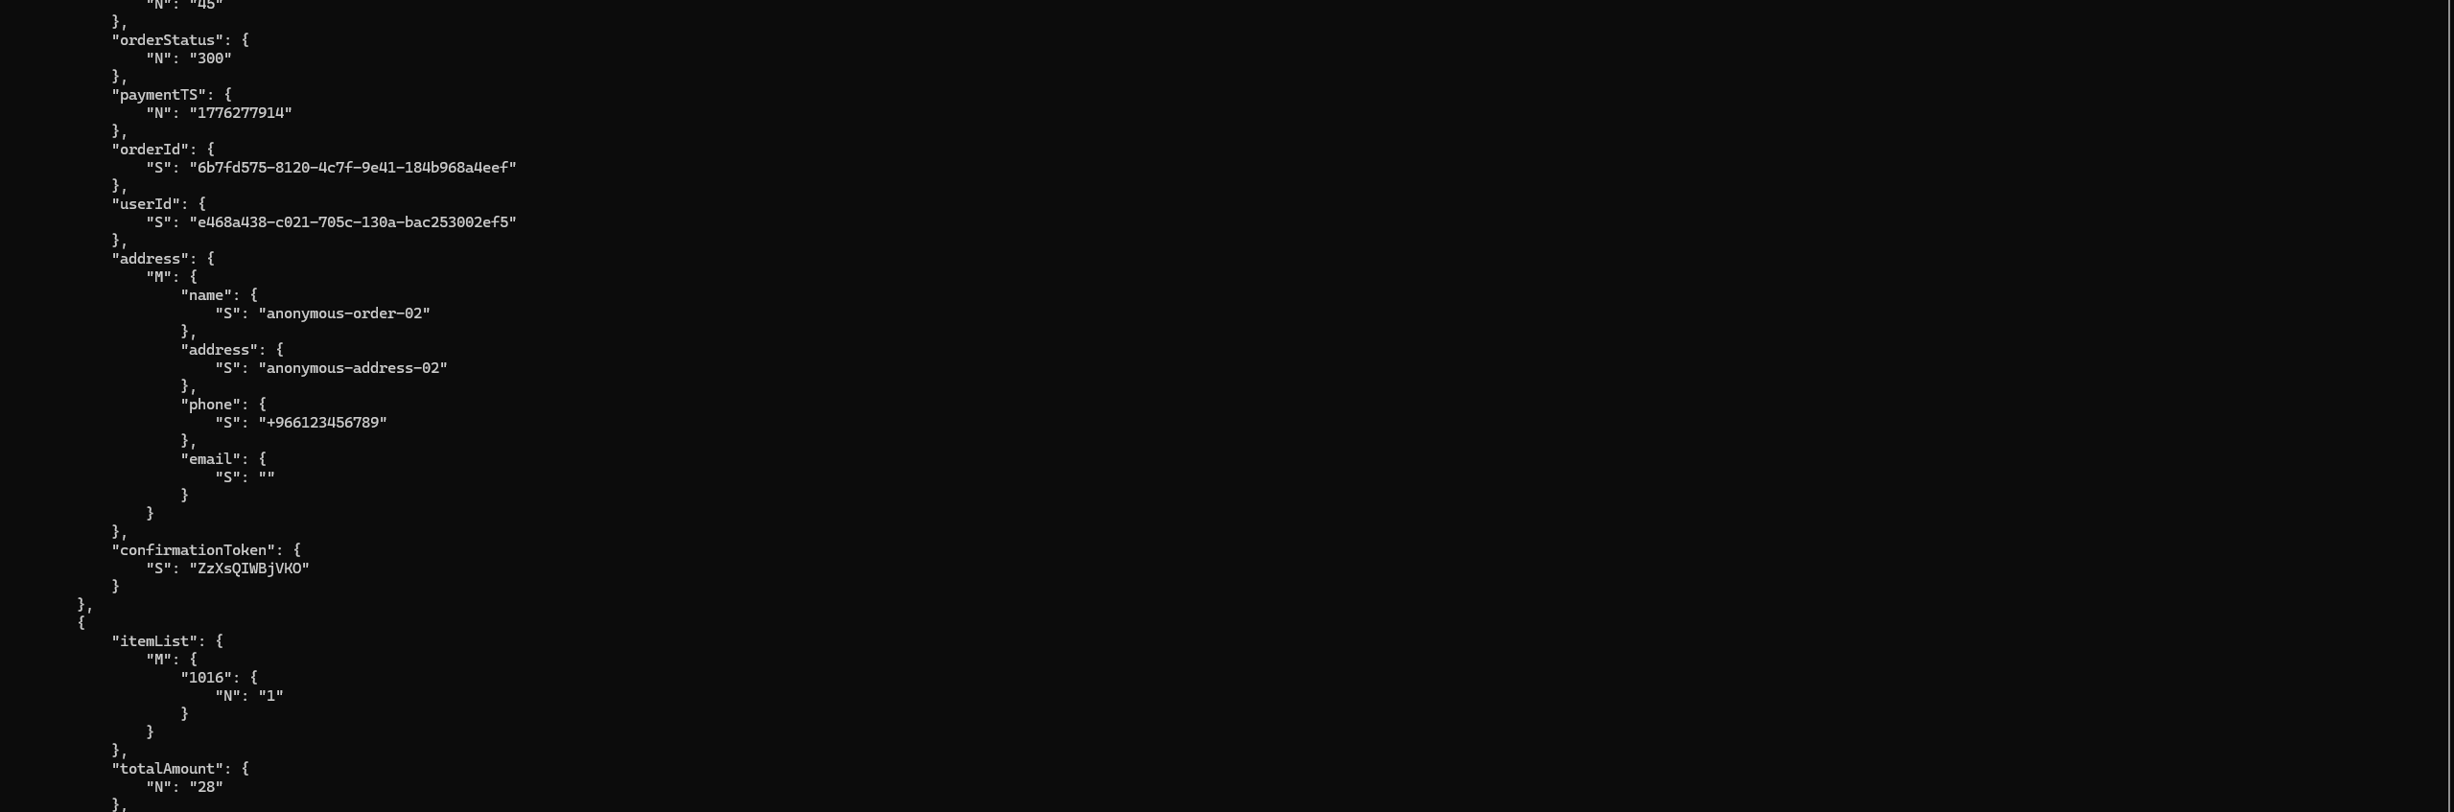
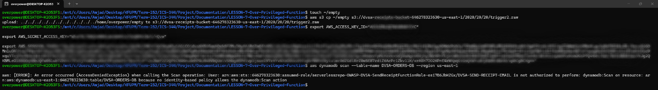
Lesson 7 — Over-Privileged Function
The receipt-email Lambda role could read backend order data beyond its intended purpose.
• Temporary Lambda credentials inherit the full execution role
• Before fix: role could scan DVSA-ORDERS-DB
• Fix: least privilege on S3, DynamoDB, SES; remove Scan/write/delete actions
• After fix: same scan returns AccessDenied
Before: scan returned order records
Blast radius reduced even if the function is abused later.
After: dynamodb:Scan denied
ICS-344 DVSA
11

Slide 12
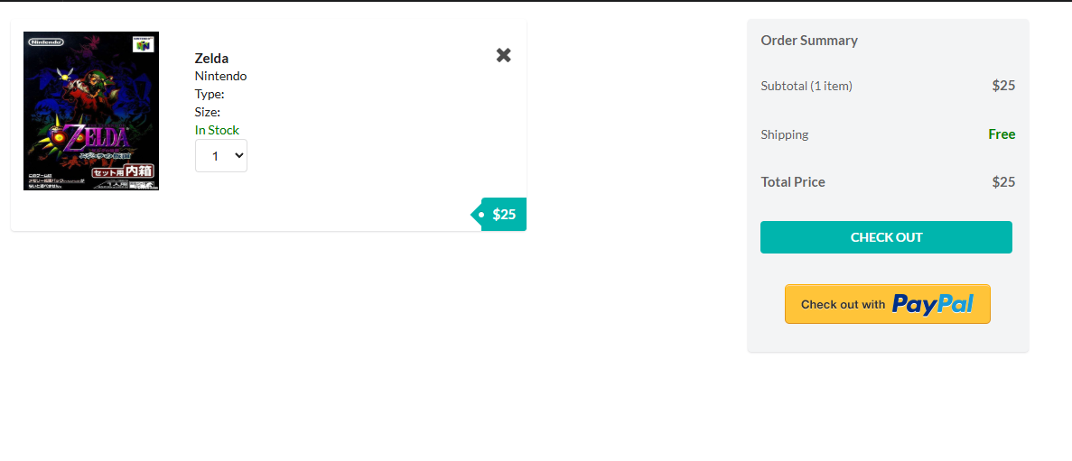
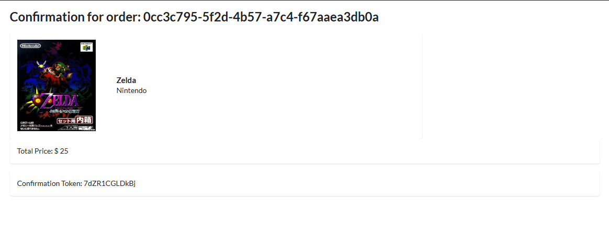
Lesson 8 — Logic Vulnerability
Billing and cart update requests could be processed out of sequence, creating a mismatched paid order.
Start: one item, $25
After race: confirmation still $25
DynamoDB: item quantity stored as 5 while totalAmount stayed 25
Fix: DVSA-ORDER-UPDATE rejects item changes after billing starts.
• Business logic must enforce state transitions server-side
• Payment amount and final stored item list must never diverge
Post-fix: update request blocked
ICS-344 DVSA
12

Slide 13
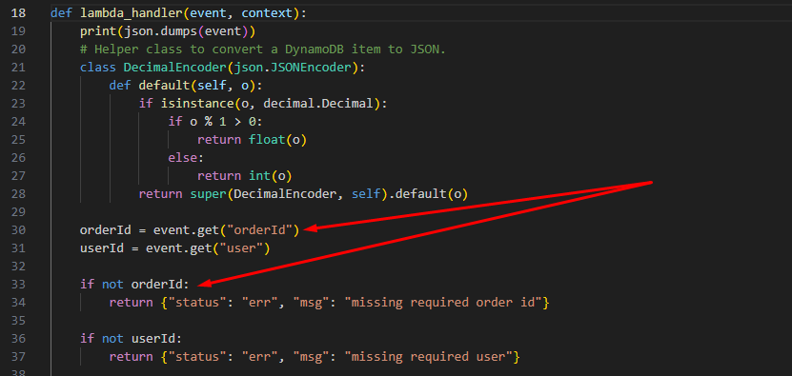
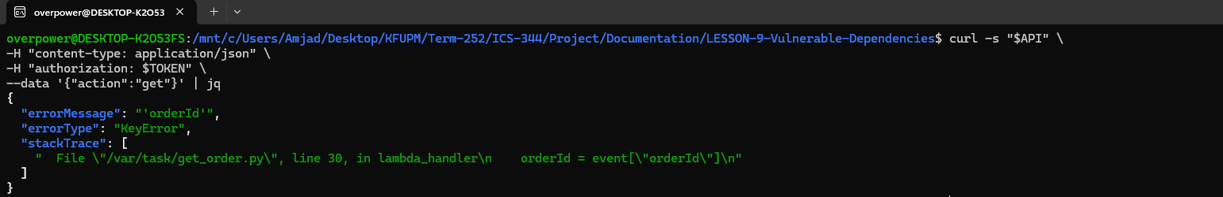
Lesson 10 — Unhandled Exceptions
A malformed get request leaked Python stack trace details until required-field validation was added.
Before: KeyError + stackTrace returned to client
Fix: event.get() + explicit validation
After: controlled client-safe error only
No stackTrace • No /var/task path • No source-code line
ICS-344 DVSA
13

Slide 14
Remediation Patterns Applied
The fixes were not cosmetic; each one restored the intended security boundary for that lesson.
Safe parsing
JSON.parse instead of unsafe deserialization
Availability guardrails
API Gateway throttling for billing flood
Verified identity
Cognito JWKS signature + claim validation
State enforcement
Reject post-billing cart changes
Least privilege
Narrow IAM actions/resources; remove broad managed policies
Safe errors
Validate fields before use; keep details in logs
Cloud hardening
S3 Block Public Access and object validation
Verification repeated with the original exploit input
A fix was considered complete only when the vulnerable behavior disappeared and the intended path still behaved predictably.
ICS-344 DVSA
14

Slide 15
Final Takeaways
DVSA showed that serverless security is distributed across code, identities, cloud configuration, and workflow design.
10
official lessons completed
Most important lessons learned
• Treat all public API input as untrusted data
• Verify identity cryptographically, never by decoding alone
• Design Lambda roles for least privilege from the start
• Protect event-driven workflows at both cloud and code layers
• Make errors useful to developers, not attackers
10
fixes verified after remediation
7
recurring root-cause patterns addressed
Outcome
The final report now contains exploit steps, evidence, exact changes, and post-fix validation for every official DVSA vulnerability.
ICS-344 DVSA
15

