Slide 1

CAPSTONE PROJECT
Secure Data Hiding in Images using Steganography
Presented By: Alsafa Meheboob Arab
Student Name : Alsafa Meheboob Arab
College Name & Department : Dr. Babasaheb Ambedkar Technological Universiy, Lonere - Department of Computer Science & Engineering

Slide 2
OUTLINE
Problem Statement
Technology used
Wow factor
End users
Result
Conclusion
Git-hub Link
Future scope

Slide 3
Problem Statement
With the increasing need for secure communication, traditional encryption methods often attract unwanted attention from cyber attackers. Steganography provides a discreet way to hide sensitive information within digital images, making the presence of hidden data undetectable. This project focuses on implementing a secure data hiding technique using image steganography, ensuring minimal distortion while maintaining high security. The study aims to analyze steganographic methods and evaluate their effectiveness in terms of imperceptibility, robustness, and capacity.

Slide 4
Technology used
1. Programming Language:
Python – For implementing steganography and image processing.
2. Development Environment:
Python IDLE – Writing, testing, and debugging Python code.
3. Libraries & Modules:
OpenCV (cv2) – Image processing and manipulation.
String Module – Handling text data for embedding in images.
OS Module – Managing file paths and automating file operations.

Slide 5
Wow factors
Invisible Data Hiding – Securely embeds information without noticeable changes.
Minimal Image Distortion – Maintains image quality after data embedding.
Fast & Efficient – Quick encoding and decoding using Python & OpenCV.
Real-World Applications – Useful for secure messaging, watermarking, and data protection.

Slide 6
End users
Government & Defence Agencies – Secure military communication and covert operations.
IT & Cybersecurity Sector – Protect sensitive data from cyber threats.
Large MNCs & Corporations – Ensure confidential business communication.
Banking & Finance Industry – Secure financial transactions and client data.
Healthcare & Research Institutions – Protect patient records and research data.

Slide 7

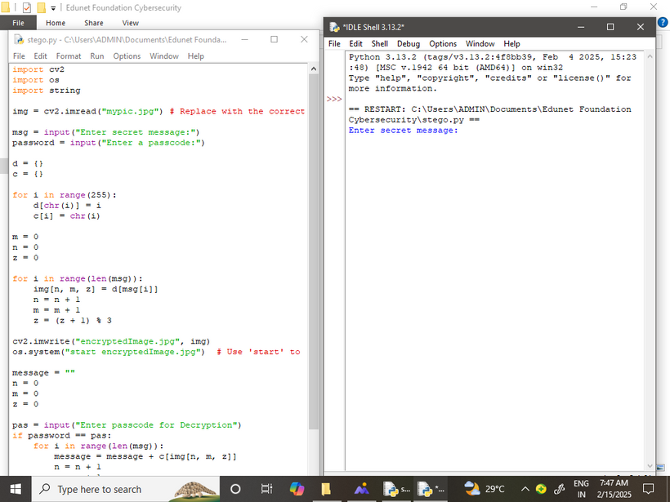
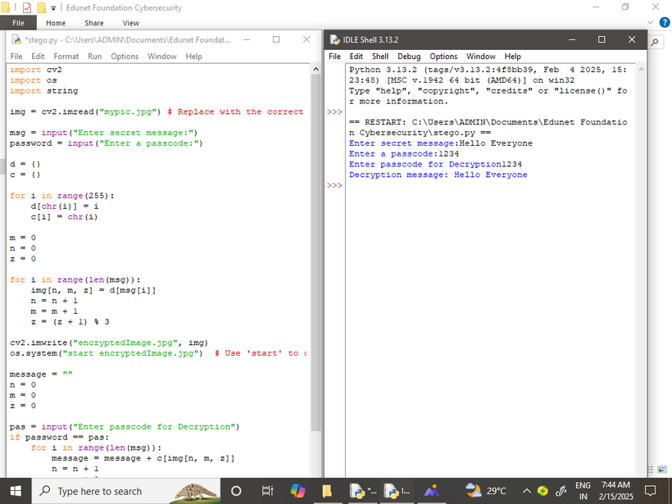
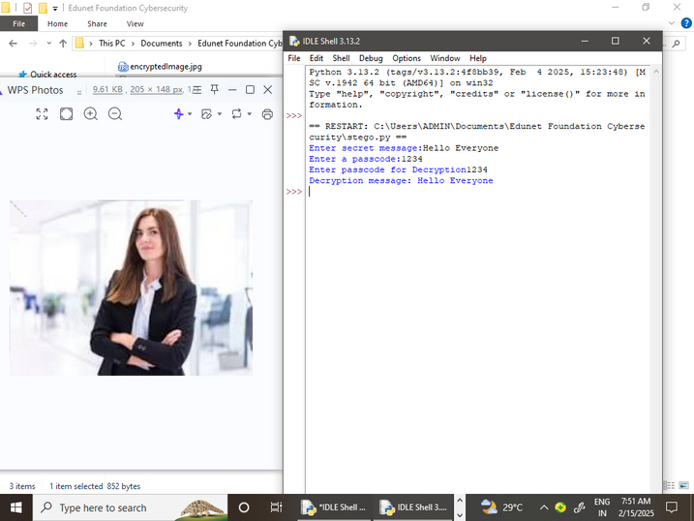
Results

Slide 8
Conclusion
This project successfully implements steganography to hide data securely within images.
The LSB technique with Python and OpenCV ensures high security and minimal image distortion.
It provides an effective solution for covert communication, cybersecurity, and digital data protection.
The results show that hidden data remains undetectable while preserving image quality.

Slide 9
GitHub Link
https://github.com/Alsafa2005/aicte-project.git

Slide 10
Future scope(optional)
Enhanced Security – Integrate encryption to make hidden data even more secure.
AI & Machine Learning – Develop smart steganography that adapts to security threats.
Support for Large Files – Improve techniques to hide larger data in high-resolution images.
Real-World Applications – Extend to watermarking, secure messaging, and digital forensics.
Steganalysis Resistance – Improve methods to evade detection by advanced analysis tools.

Slide 11
THANK YOU

