Slide 1
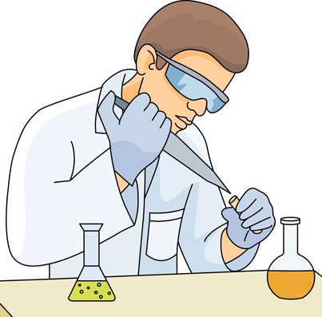
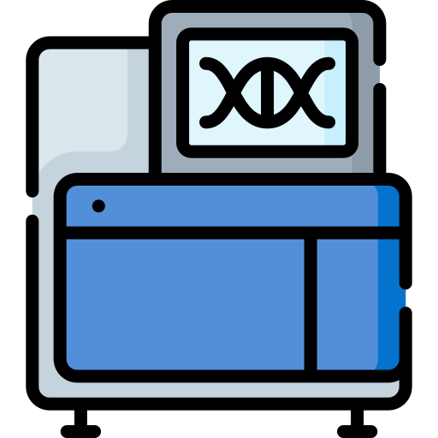
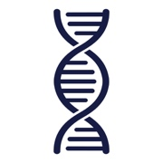
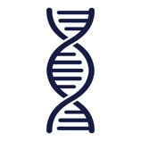
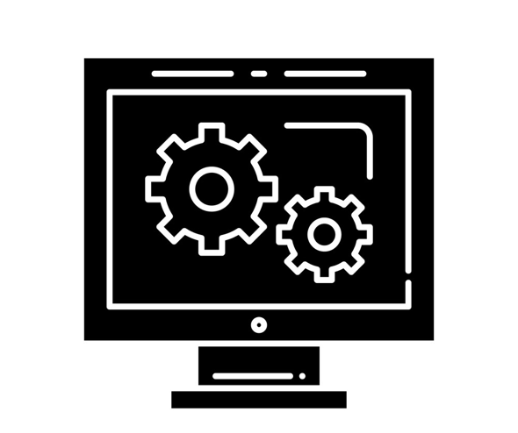
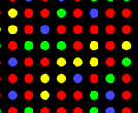
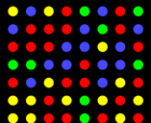

To quickly analyze our DNA using computers
Wet Lab
Chemical DNA molecule
must be first converted into
Chopped DNA Fragments
Sample
Collection
Sequencing
Library Preparation
Dry Lab (computational, what ALSER Lab contributes to)
Digital data that computers understand
String over an alphabet of four letters A, C, G, and T representing adenine, cytosine, guanine, and thymine, respectively
A | G | C | G | T | A | C | G | T
G | G | C | T | T | A | C | C | T
CCTCCTCAGTGCCACCCAGCCCACTGGCAGCTCCCAAACAGGCTCTTATTAAAACACCCTGTTCCCTGCCCCTTGGAAAGAAATCAAGAA…
A | A | A | G | T | G | G | G | G
Reads
Randomized fragments
of a genome
Raw Sequencing Data
Images, videos, or squiggles
Genomic Analyses
Since 1945, we are unable to do such conversion Due to technological & chemical barriers
But this is how we do it instead!

Slide 2
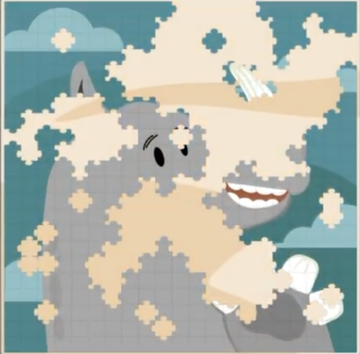
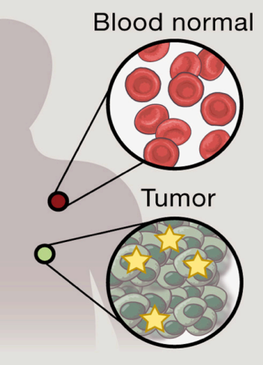


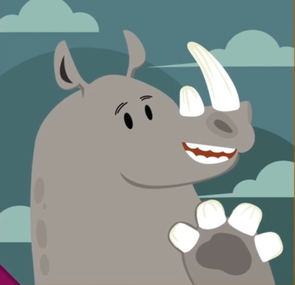
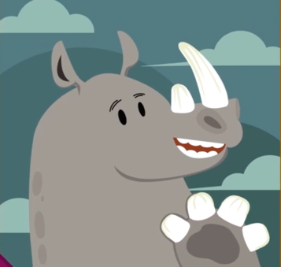

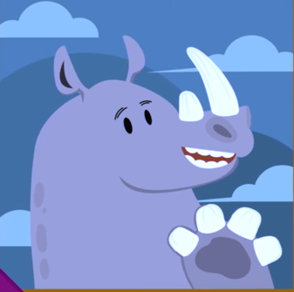
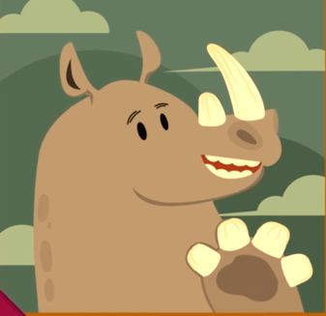
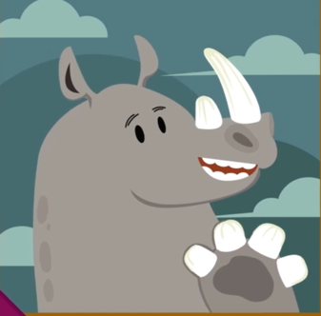
How to build back our complete DNA sequence?
A Difficult Puzzle
When we compare two unsolved puzzles
(e.g., reads from tumor cells compared to reads from healthy cells)
Reads need to be assembled to build back our complete DNA sequence, which is similar to solving a puzzle
A | A | A | G | T | G | G | G | G
G | G | C | T | T | A | C | C | T
A | A | A | G | T | G | G | G | G
T | A | C | C | T | G | G
Solving the Puzzle
By locating each read based on its similarity
with subsequences of a reference genome
A Very Difficult Puzzle
When we do not know the sample donor, we cannot determine which reference genome to be used. We end up using a huge database of all know reference genomes
Reference genome
Reads

