Slide 1
Reflection

Slide 2
Reflection
Reflection is an API that is used to examine or modify the behavior of methods, classes, and interfaces at runtime.
Java Reflection is a process of examining or modifying the run time behavior of a class at run time.
This is provided by the java.lang.reflect package and elements in Class.
Reflection is an important capability, especially when using components called Java Beans.
It allows you to analyze a software component and describe its capabilities dynamically, at run time rather than at compile time.
For example, by using reflection, you can determine what methods, constructors, and fields a class supports.

Slide 3
The package java.lang.reflect includes several interfaces.
Member interface, defines methods that allow you to get information about a field, constructor, or method of a class.
There are also ten classes in this package.
The Blueprint Analogy:
Explain that a standard Object is a house. The Class object (used in reflection) is the blueprint of that house.
Reflection allows you to look at the blueprint while the house is being built to decide where to put the windows, rather than following a fixed plan.

Slide 4
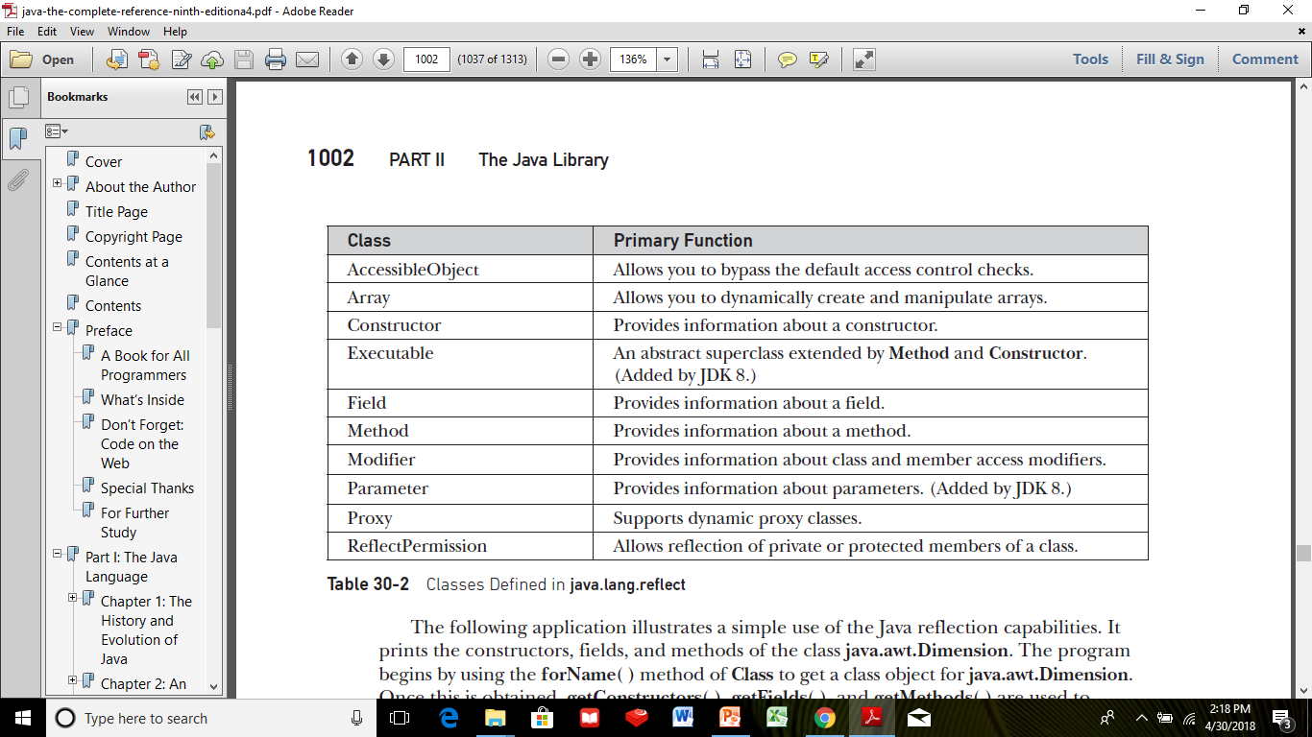

Slide 5
Reflection of Java Classes
In order to reflect a Java class, we first need to create an object of Class.
And, using the object we can call various methods to get information about methods, fields, and constructors present in a class.
There exists three ways to create objects of Class:

Slide 6
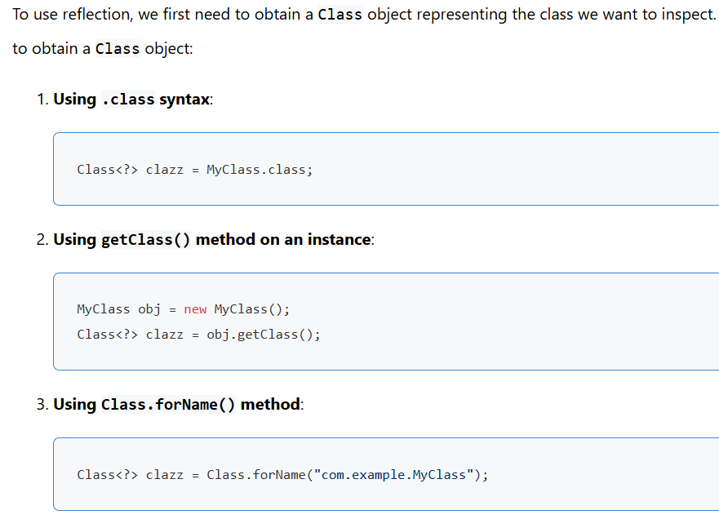

Slide 7
import java.lang.Class;
import java.lang.reflect.*;
class Animal {
}
// put this class in different Dog.java file
public class Dog extends Animal {
public void display() {
System.out.println("I am a dog.");
}
}
// put this in Main.java file
class Main {
public static void main(String[] args) {
try {
// create an object of Dog
Dog d1 = new Dog();
// create an object of Class
// using getClass()
Class obj = d1.getClass();
// get name of the class
String name = obj.getName();
System.out.println("Name: " + name);
// get the access modifier of the class
int modifier = obj.getModifiers();
// convert the access modifier to string
String mod = Modifier.toString(modifier);
System.out.println("Modifier: " + mod);
// get the superclass of Dog
Class superClass = obj.getSuperclass();
System.out.println("Superclass: " + superClass.getName());
}
catch (Exception e) {
e.printStackTrace();
}
}
}

Slide 8
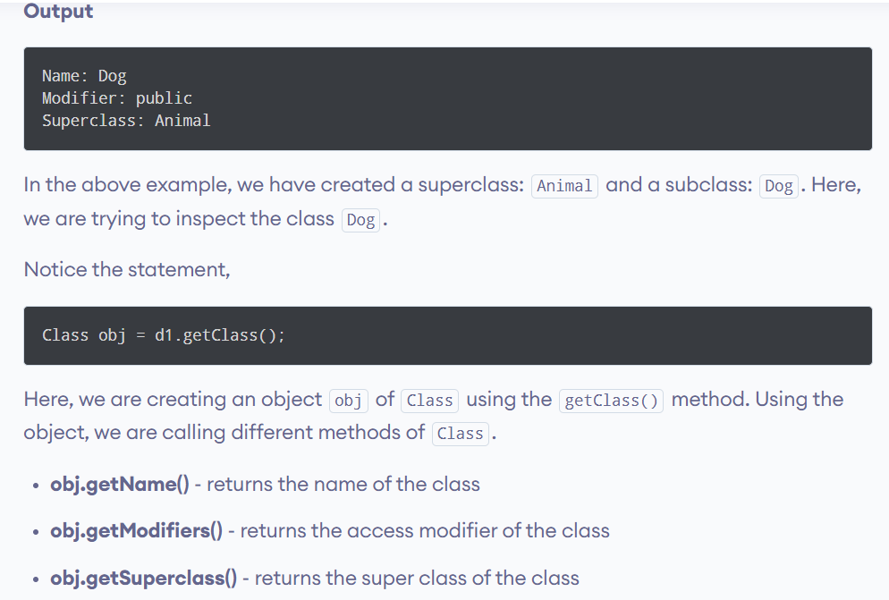

Slide 9
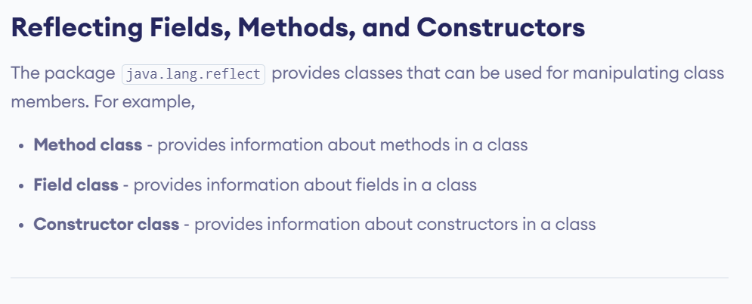

Slide 10
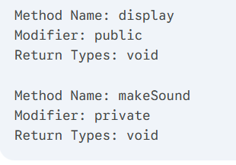
import java.lang.Class;
import java.lang.reflect.*;
class Dog {
// methods of the class
public void display() {
System.out.println("I am a dog.");
}
private void makeSound() {
System.out.println("Bark Bark");
}
}
class Main {
public static void main(String[] args) {
try {
// create an object of Dog
Dog d1 = new Dog();
// create an object of Class
// using getClass()
Class obj = d1.getClass();
// using object of Class to
// get all the declared methods of Dog
Method[] methods = obj.getDeclaredMethods();
// create an object of the Method class
for (Method m : methods) {
// get names of methods
System.out.println("Method Name: " + m.getName());
// get the access modifier of methods
int modifier = m.getModifiers();
System.out.println("Modifier: " + Modifier.toString(modifier));
// get the return types of method
System.out.println("Return Types: " + m.getReturnType());
System.out.println(" ");
}
}
catch (Exception e) {
e.printStackTrace();
}
}
}

Slide 11
2. Reflection of Java Fields
import java.lang.Class;
import java.lang.reflect.*;
class Dog {
public String type;
}
class Main {
public static void main(String[] args) {
try {
// create an object of Dog
Dog d1 = new Dog();
// create an object of Class
// using getClass()
Class obj = d1.getClass();
// access and set the type field
Field field1 = obj.getField("type");
field1.set(d1, "labrador");
// get the value of the field type
String typeValue = (String) field1.get(d1);
System.out.println("Value: " + typeValue);
// get the access modifier of the field type
int mod = field1.getModifiers();
// convert the modifier to String form
String modifier1 = Modifier.toString(mod);
System.out.println("Modifier: " + modifier1);
System.out.println(" ");
}
catch (Exception e) {
e.printStackTrace();
}
}
}

Slide 12
access and modify private fields
import java.lang.Class;
import java.lang.reflect.*;
class Dog {
private String color;
}
class Main {
public static void main(String[] args) {
try {
// create an object of Dog
Dog d1 = new Dog();
// create an object of Class
// using getClass()
Class obj = d1.getClass();
// access the private field color
Field field1 = obj.getDeclaredField("color");
// allow modification of the private field
field1.setAccessible(true);
// set the value of color
field1.set(d1, "brown");
// get the value of field color
String colorValue = (String) field1.get(d1);
System.out.println("Value: " + colorValue);
// get the access modifier of color
int mod2 = field1.getModifiers();
// convert the access modifier to string
String modifier2 = Modifier.toString(mod2);
System.out.println("Modifier: " + modifier2);
}
catch (Exception e) {
e.printStackTrace();
}
}
}

Slide 13
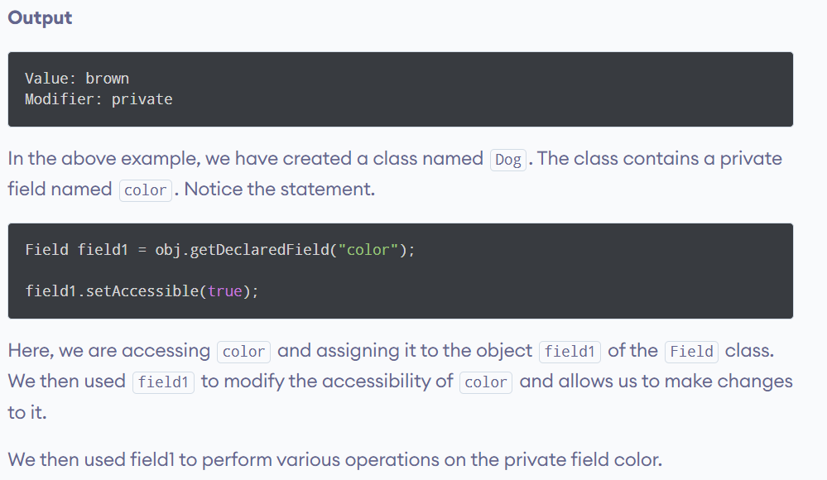

Slide 14
3. Reflection of Java Constructor
import java.lang.Class;
import java.lang.reflect.*;
class Dog {
// public constructor without parameter
public Dog() {
}
// private constructor with a single parameter
private Dog(int age) {
}
}
class Main {
public static void main(String[] args) {
try {
// create an object of Dog
Dog d1 = new Dog();
// create an object of Class
// using getClass()
Class obj = d1.getClass();
// get all constructors of Dog
Constructor[] constructors = obj.getDeclaredConstructors();
for (Constructor c : constructors) {
// get the name of constructors
System.out.println("Constructor Name: " + c.getName());
// get the access modifier of constructors
// convert it into string form
int modifier = c.getModifiers();
String mod = Modifier.toString(modifier);
System.out.println("Modifier: " + mod);
// get the number of parameters in constructors
System.out.println("Parameters: " + c.getParameterCount());
System.out.println("");
}
}
catch (Exception e) {
e.printStackTrace();
}
}
}

Slide 15
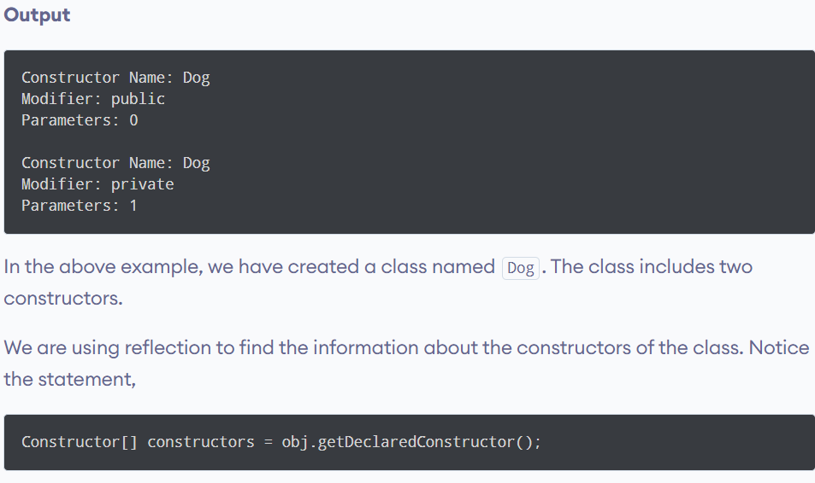

Slide 16
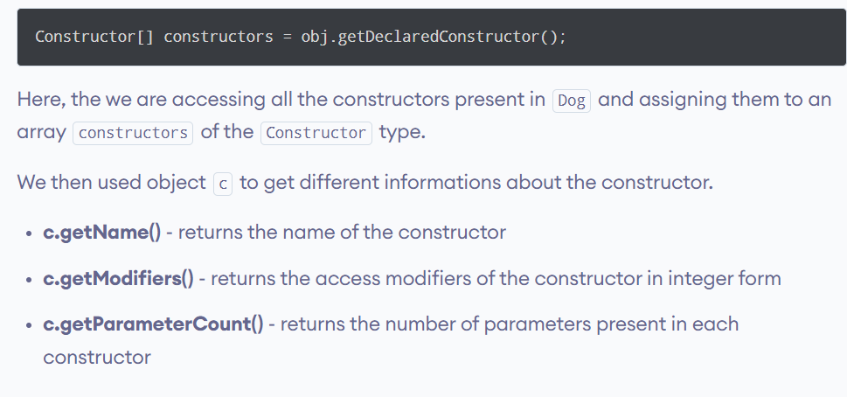

Slide 17
The Reflection API is mainly used in:
IDE (Integrated Development Environment) e.g. Eclipse, MyEclipse, NetBeans etc.
Debugger
Test Tools etc.

Slide 18
Example: Normal vs. Reflection
Let's look at a simple class called Cat.
public class Cat {
private String name = "Kitty";
public void meow() {
System.out.println("Meow! I am " + name);
}
}
The "Normal" Way
This is how you usually write code. You know the class is Cat, and you know the method is meow().
Cat myCat = new Cat();
myCat.meow(); // Output: Meow! I am Kitty

Slide 19
Example: Normal vs. Reflection
The "Reflection" Way
Here, we pretend we don't know the class is a Cat until the program is actually running.
We use the class name as a String.
import java.lang.reflect.Method;
public class ReflectionDemo {
public static void main(String[] args) {
try {
// 1. Load the class using its name as a String
// We are not using the keyword 'Cat' here directly!
Class<?> c = Class.forName("Cat");
// 2. Create an instance (object) of that class
Object myUnknownObject = c.getDeclaredConstructor().newInstance();
// 3. Get the method by its name as a String
Method m = c.getMethod("meow");
// 4. Invoke (run) the method on the object
m.invoke(myUnknownObject);
} catch (Exception e) {
e.printStackTrace();
}
}
}

