Slide 1

Notes App Client–Server System
BUILT WITH JAVA, JAVAFX, SQLITE, MAVEN, AND SOCKETS
BY HASAN, MOHAMMED, AND ANGAD

Slide 2
Technologies Used
• Java
• JavaFX (GUI)
• Maven (Build + Dependency Management)
• SQLite Database
• JDBC Driver
• Client–Server Networking with Sockets
• MVC Structure

Slide 3
System Overview
• A Java-based notes application using a client–server architecture.
• Client GUI built with JavaFX.
• Server handles login, notes insertion, retrieval, and DB operations.
• SQLite database stores user notes persistently.
• Communication achieved through TCP sockets.

Slide 4
System Architecture
Components:
• clientGUI – JavaFX interface
• clientController – Handles actions and communication
• server – Manages user requests and DB operations
• NotesDB – Manages SQLite CRUD operations
Data Flow:
GUI → Controller → Server → Database → Server → GUI

Slide 5
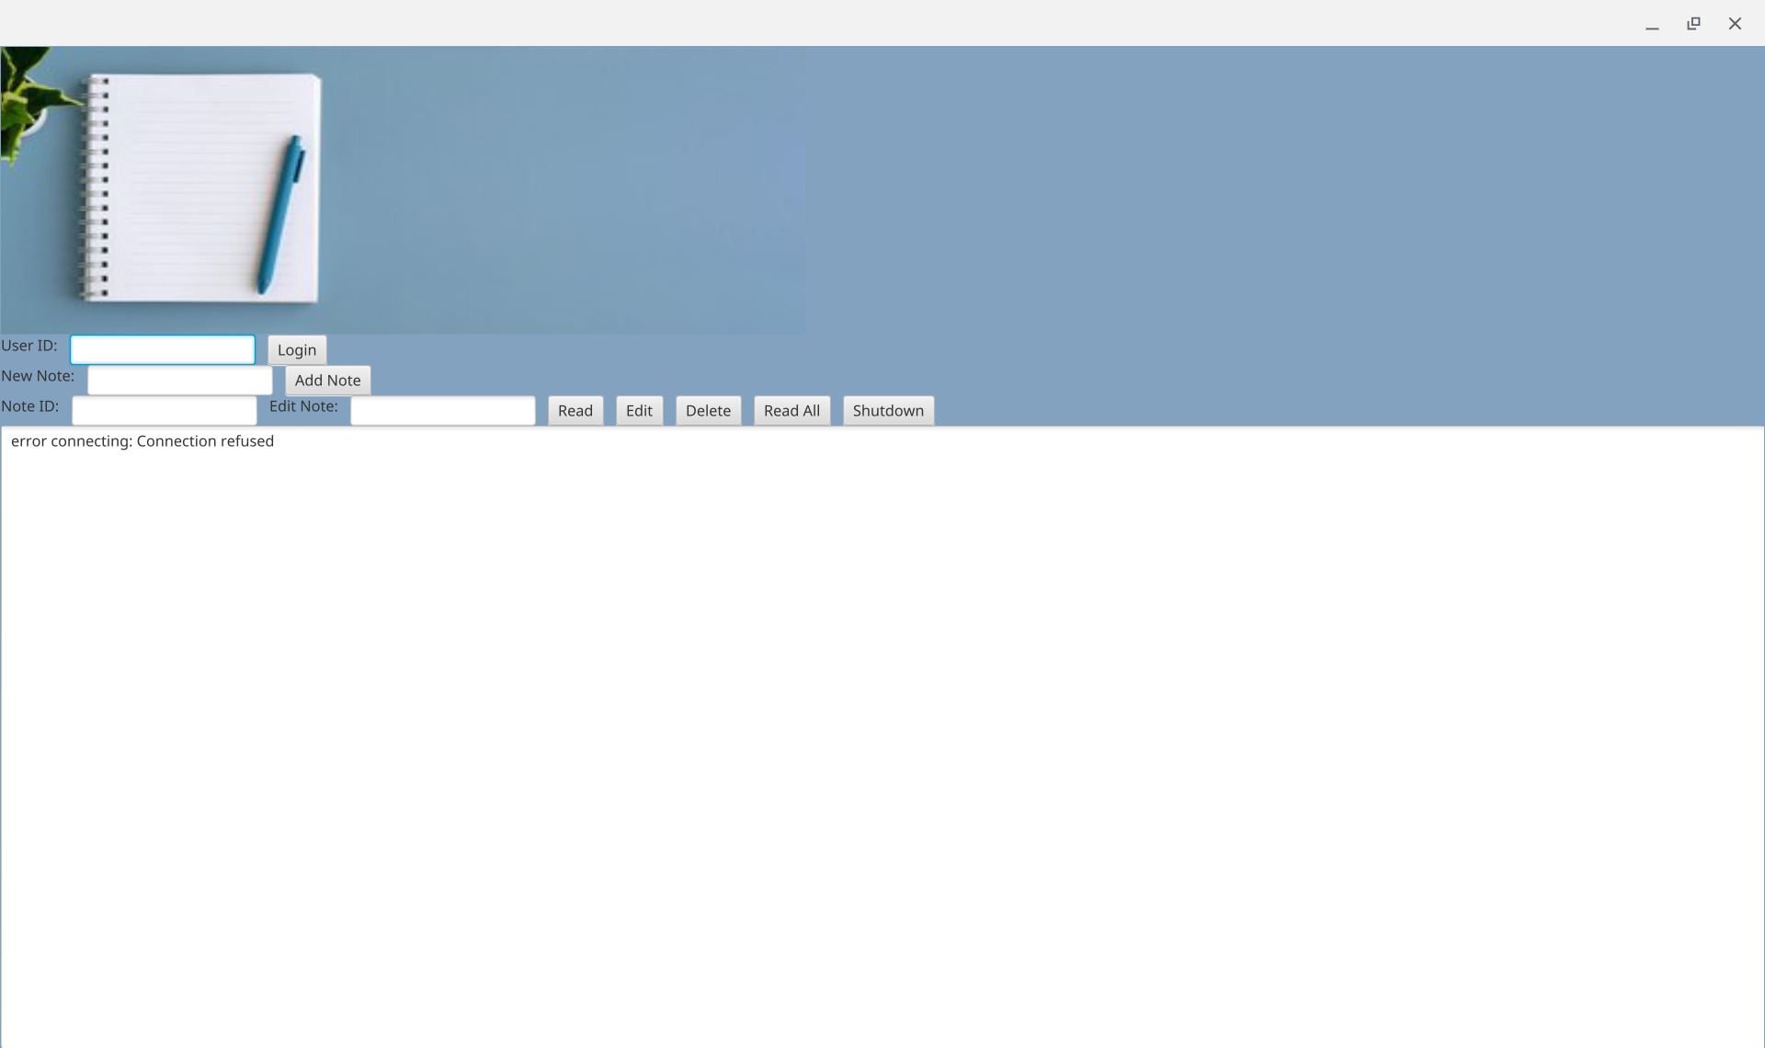
Client GUI (JavaFX)
• Main screen for creating, viewing, and managing notes
• Buttons trigger controller logic
• Uses JavaFX components such as TextArea, Buttons, Labels

Slide 6
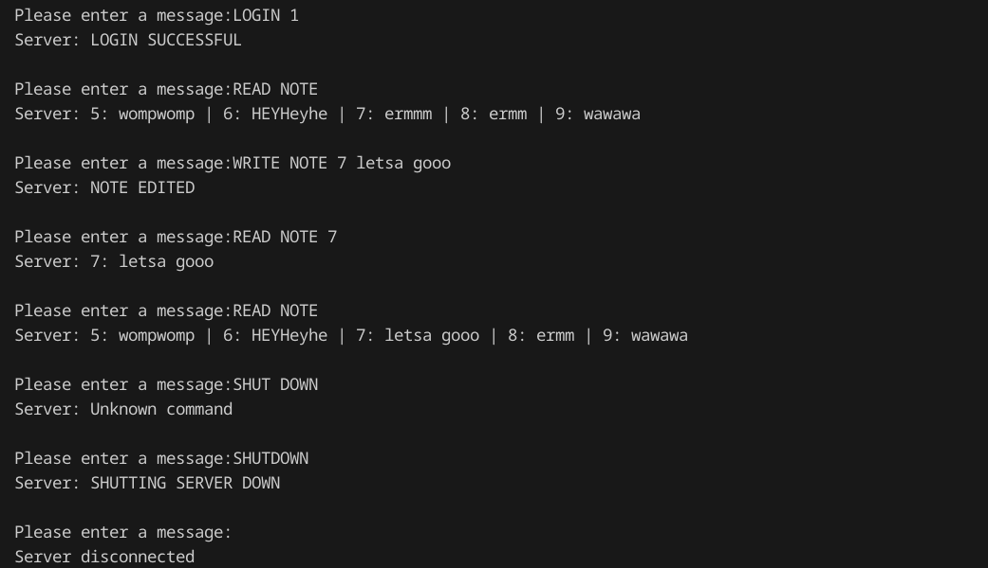
Client Controller
• Handles button actions and user interactions.
• Sends commands to server: LOGIN, NEW NOTE, GET NOTES.
• Parses server responses and updates the GUI.
• Acts as communication layer between GUI and server.

Slide 7
Server
• Listens on port 9000.
• Accepts client commands and processes them.
• Uses NotesDB to read/write SQLite database.
• Multi-threaded: each client runs in its own thread.

Slide 8



NotesDB (SQLite)
• Stores user notes in SQLite database.
• JDBC driver handles database connection.
• Functions include insertNote(), getNotes(), createTable().

Slide 9
Application Features
• User login with ID.
• Create and save new notes.
• Retrieve all notes for a user.
• Real-time communication between client and server.
• Persistent storage using SQLite.

Slide 10
Challenges and Solutions
• SQLite driver issues → Fixed by bundling JDBC inside src folder.
• JavaFX resource loading → Corrected with proper file paths.
• Socket communication bugs → Implemented clear request protocol.
• Merge conflicts → Resolved using git stash and branch cleanup.

Slide 11
Conclusion
• Fully functional client server Notes App.
• Clean architecture using MVC principles.
• SQLite used for persistent note storage.
• JavaFX interface provides a smooth user experience.
• Demonstrates teamwork and real world software engineering skills.

