Slide 1
ClassPass Web Scraping project
George Alster

Slide 2
OVERVIEW
Motivation for this topic
The scraping
Where should you work out?
What should you work out?
How much should you spend?
Future investigations

Slide 3
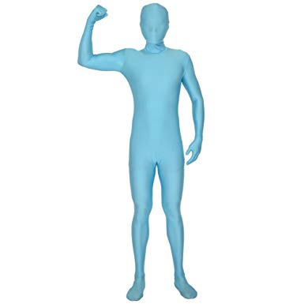
Motivation for this topic
Key data facts
2000+ classes per day
910+ distinct classes
120+ locations
380+ venues
30+ class tags
Proven benefits of exercise
Hormonal
Cardiovascular
Muscular
Neurological
Skeletal
Metabolic

Slide 4
The scraping
Index | Title | Instructor | Rating | Reviews | Time | Duration | Venue | Location | Tags | Price
1377 | Bar Method | Alora Kelley | 4.8 | 18915.0 | 4:30 pm | 60 | The Bar Method | Cobble Hill | Flexibility, Balance, Core, Abs, Barre | 8
2111 | SWERVE RIDE | Kayley Watson | 4.9 | 37088.0 | 6:30 pm | 43 | SWERVE Fitness | Midtown | Cardio, Cycling | 10
2266 | DASH 28 | Karli Alvino | 4.9 | 73417.0 | 7:00 pm | 45 | Mile High Run Club | NoMad | Cardio, Strength Training, Running | 11
252 | All Levels | Kim Stevens-Redstone | 4.9 | 50.0 | 9:30 am | 75 | YogaCentric | Clifton | Flexibility, Balance, Arms, Yoga | 4
1925 | YOGA: Hatha | Nyota Nayo | 4.8 | 521.0 | 6:00 pm | 75 | Sweet Water Dance & Yoga | Concourse Village | Flexibility, Balance, Arms, Yoga | 4
Notes:
Selenium was used. Had to first log into the website, thankfully they have a two week free trial. Each new page was the same url and so selenium had to be used. There were some epmty values so these were replaced with none and then cleaned up afterwards. Sample above of the intial data set collected before any cleaning or orgainsation.

Slide 5
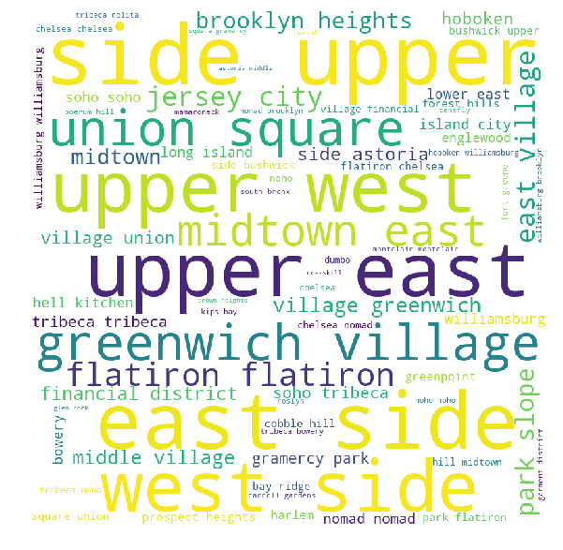
Where should you work out?

Slide 6
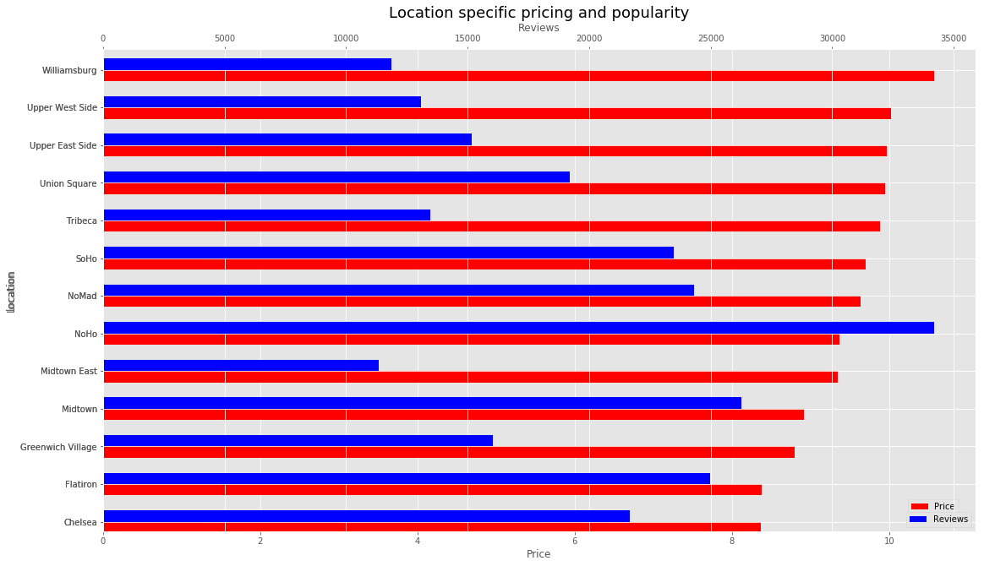
Where should you work out?
Notes:
Note that the most popular isnt the most expensive – also in a separate analysis it was discovered that the average rating barely varies across these locations

Slide 7
Where should you work out?
Location | Venue
Chelsea | Peloton Cycling Studio
Flatiron | Flywheel Sports: Stadium Cycling
Greenwich Village | Liftonic
Midtown | Physique 57
Midtown East | EverybodyFights
NoHo | Mile High Run Club
NoMad | Mile High Run Club
SoHo | Physique 57
Tribeca | Flywheel Sports: Stadium Cycling
Union Square | Switch Playground USA
Upper East Side | Y7 Studio
Upper West Side | Physique 57
Williamsburg | Flywheel Sports: Stadium Cycling
Venue | Location | Expensive? | Highly rated? | Popular? | Long?
Flywheel Sports: Stadium Cycling | East Village | True | True | True | False
Mile High Run Club | NoMad | True | True | True | False
Peloton Cycling Studio | Chelsea | True | True | True | False
Mile High Run Club | NoHo | True | True | True | False
Flywheel Sports: Stadium Cycling | Flatiron | True | True | True | False
Physique 57 | SoHo | True | True | True | True
Flywheel Sports: Stadium Cycling | NoMad | True | True | True | False
Switch Playground USA | Union Square | True | True | True | False
Flywheel Sports: Stadium Cycling | Chelsea | True | True | True | False
Physique 57 | Upper West Side | True | True | True | True
Y7 Studio | Upper East Side | True | True | True | True
Physique 57 | Midtown | True | True | True | True
Most popular venue for each key location
Add wordmap here or next page
Notes:
Upon deciding which location you want to work out in, you are then faced with the question of which is the best gym to go to in that area – here is a list of the most popular gyms for each of the densely populated areas. The table on the right shows most popular classes irrelevant of location. For these classes we can see how tey fair in respect to our key variables – in particular we notice that they are mostly expensive, have high ratings, obvioulsy popular and also see ( as concluded from other analysis) that the duration of the class has little correlation with the popularity

Slide 8
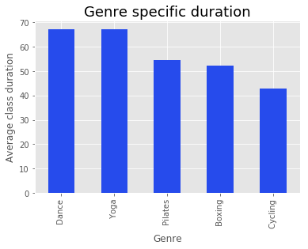
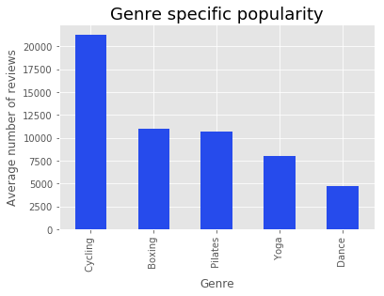
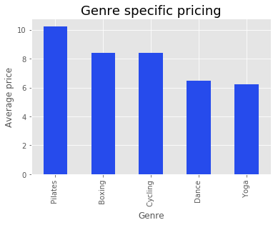
What should you work out?

Slide 9
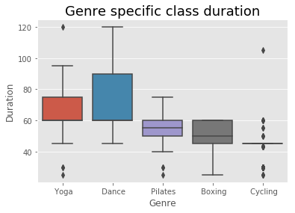
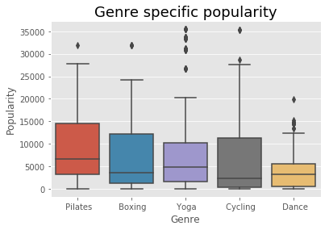
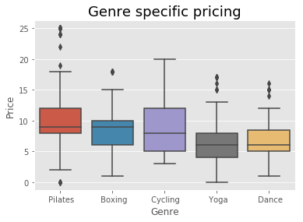
What should you work out?

Slide 10
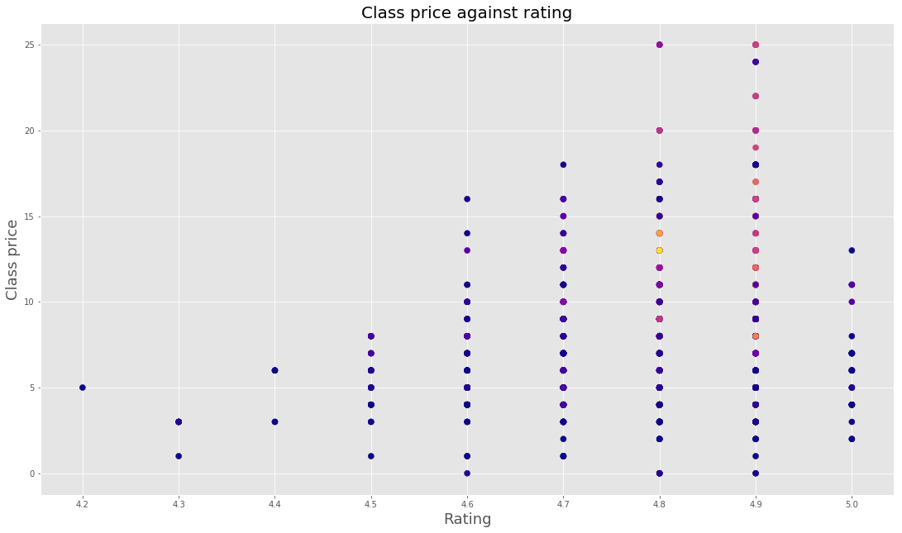
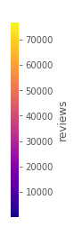
How much should you spend?
Notes:
looks like highest rated classes are actually cheaper. Further analysis- show that the highly rated classes have very few reviews and so not reliable - show fancy graph.

Slide 11
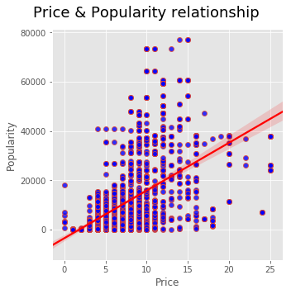
How much should you spend?
Notes:
Therefore, a better measure of popularity is quite simply the number of reviews. After calculating the correlations between all numeric variables it was clear that the highest correlation was that between price and reviews which can be seen here (fancy plot)

Slide 12
Future Investigations
Comparative analysis for each day of the week
Gym and genre specific trends across cities, states and countries

