Slide 1


Modern Slavery
Complain.app

Slide 2


It can be hard to understand that things are going wrong
What bothered you today?
…|
Your location
Complain

Slide 3


Analyze and suggest
Take it easy, hard days happen
You could consult your psychologist
What bothered you today?
…|
Your location
Complain
Forward to NGO
Please contact <location> hotline:
Similar cases were successfully solved
show
+() ………….

Slide 4
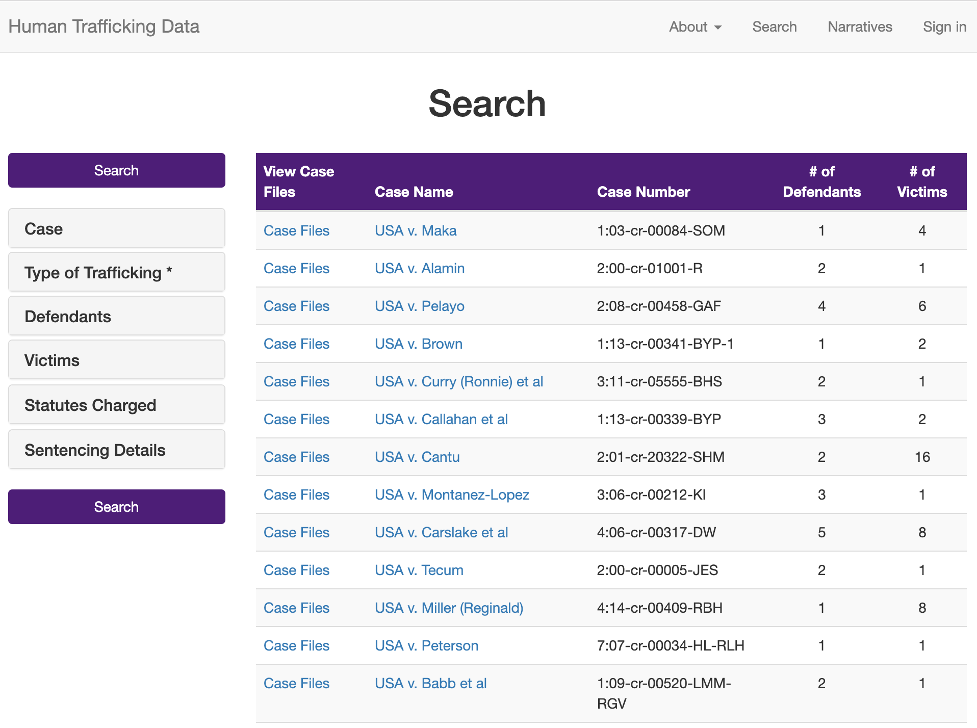
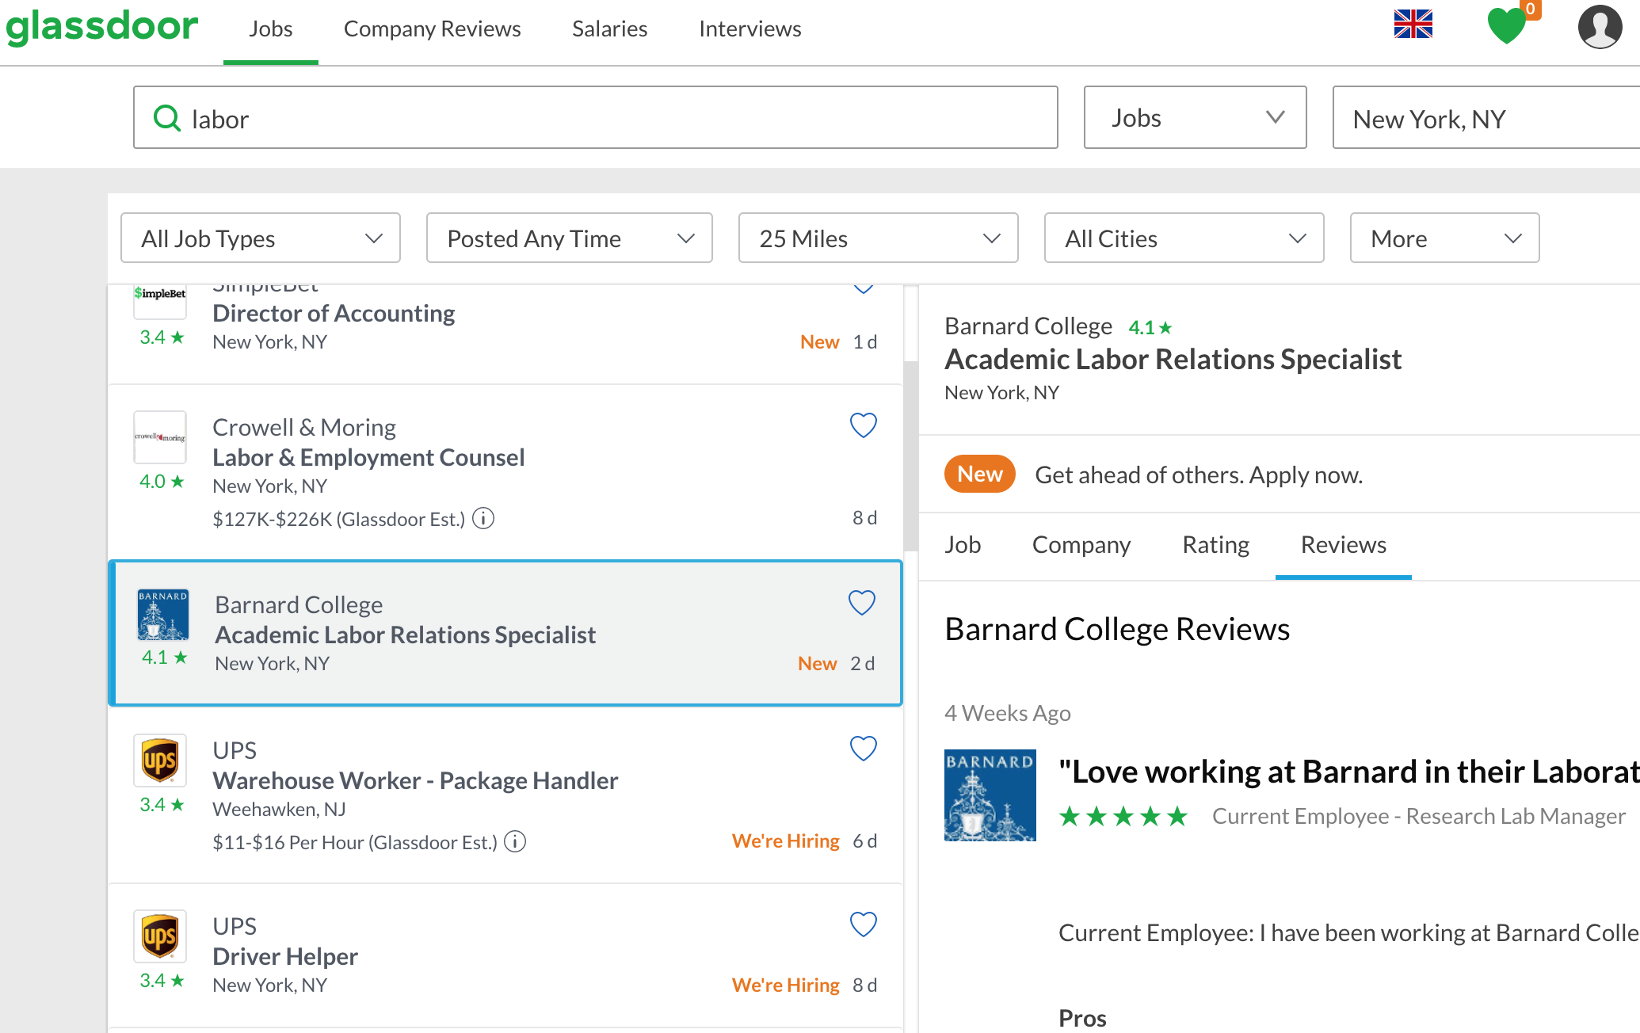
NLP models: Data
Slavery cases
+
General complains
+ Google real stories

Slide 5
NLP models: Analysis

Slide 6
NLP models: Result

