Slide 1
KISHKINDA UNIVERSITY Department of Electronics & Communication Engineering
TEAM MEMBERS :
1)P Lakshmikanth Reddy
2) Gousepeer
3)Pani raj CD
4)B Prakash
5) Altaf basha

Slide 2
Project presentation on “Checkpoint, CheckpointData, CheckpointManager

Slide 3
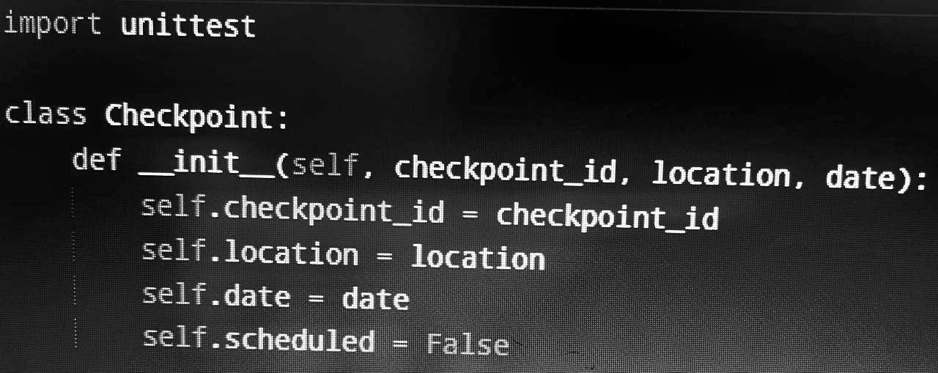
The `Checkpoint` class defines a checkpoint object with three main attributes: `checkpoint_id`, `location`, and `date`. It also includes a `scheduled` attribute, which is set to `False` by default, indicating that the checkpoint is not scheduled initially.

Slide 4
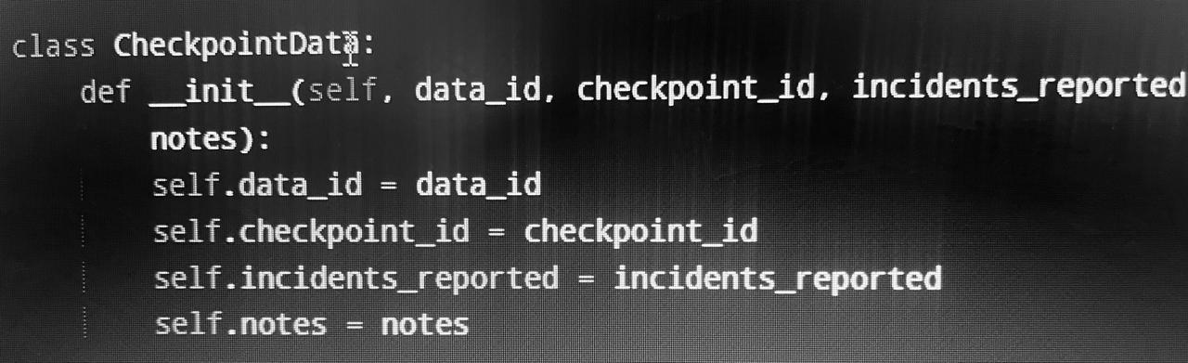
The `CheckpointData` class represents data related to a specific checkpoint. It includes four attributes: `data_id`, `checkpoint_id`, `incidents_reported`, and `notes`, which store information about the checkpoint’s data, including any reported incidents and additional notes.

Slide 5
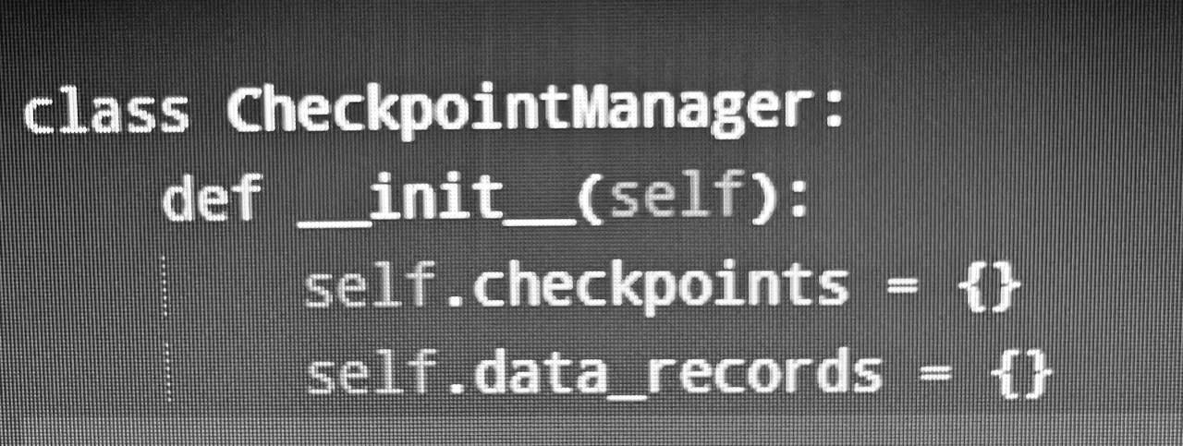
The `CheckpointManager` class manages checkpoints and their associated data. It initializes two dictionaries: `checkpoints`, which stores checkpoint objects, and `data_records`, which holds related data entries.

Slide 6
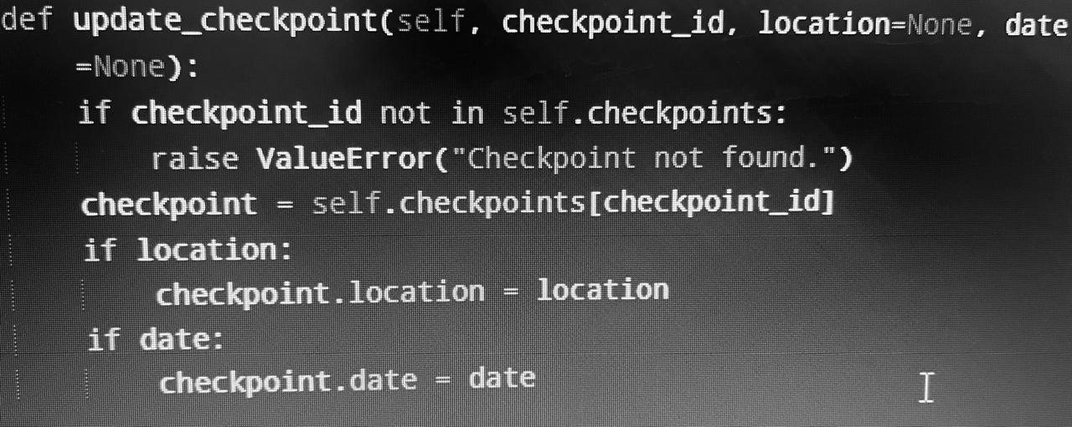
The `update_checkpoint` method updates an existing checkpoint’s details. It takes a `checkpoint_id` and optional `location` and `date` parameters. If the checkpoint is not found, it raises a `ValueError`. If provided, it updates the checkpoint’s location and/or date with the new values.

Slide 7
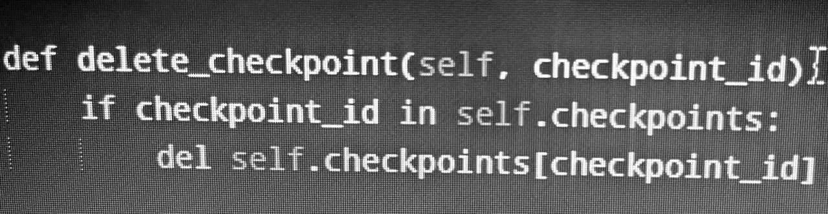
The `delete_checkpoint` method removes a checkpoint from the `checkpoints` dictionary using the specified `checkpoint_id`. If the checkpoint exists, it deletes the corresponding entry.

Slide 8
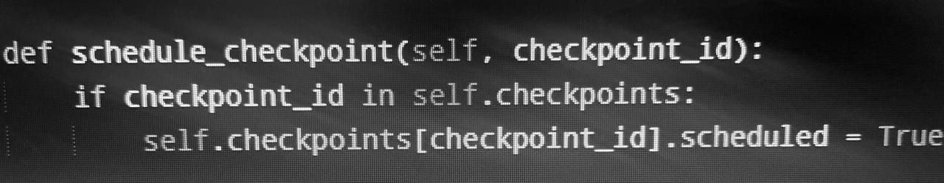
The `schedule_checkpoint` method marks a checkpoint as scheduled by setting its `scheduled` attribute to `True`, provided that the checkpoint exists in the `checkpoints` dictionary.

Slide 9
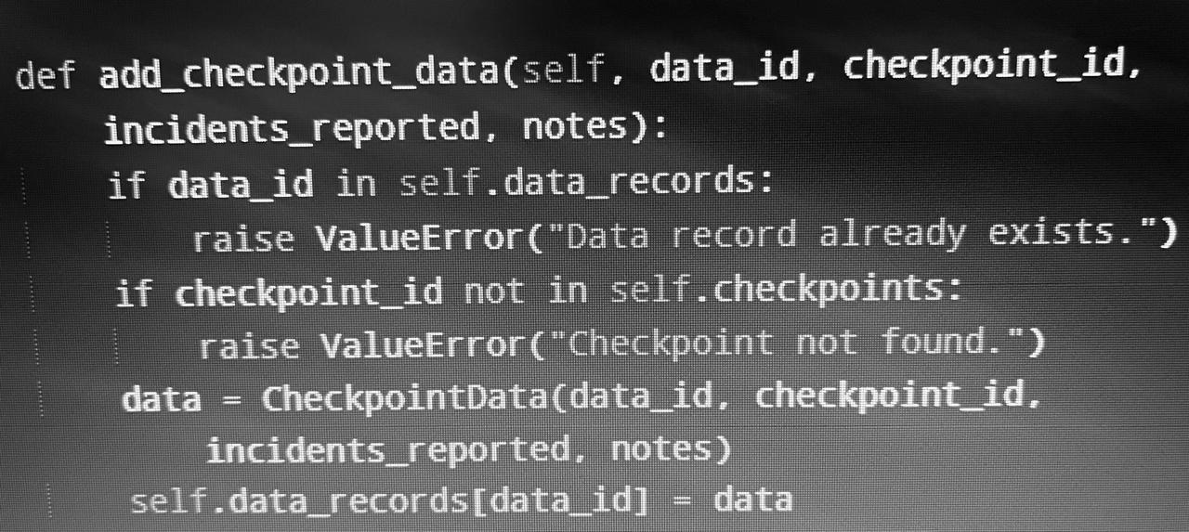
The `add_checkpoint_data` method adds a new data record associated with a checkpoint. It first checks if the `data_id` already exists, raising a `ValueError` if it does. It also verifies that the specified `checkpoint_id` is valid. If both checks pass, it creates a `CheckpointData` object and stores it in the `data_records` dictionary.

Slide 10
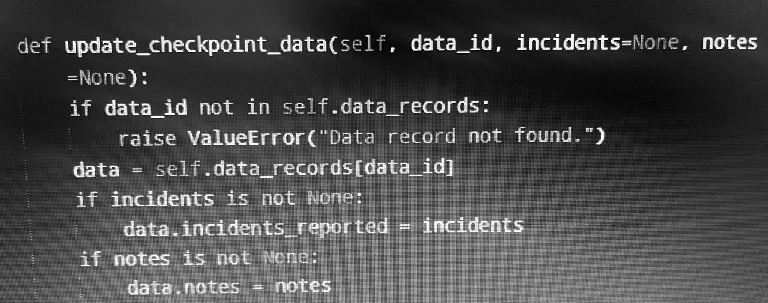
The `update_checkpoint_data` method updates an existing data record identified by `data_id`. If the record is not found, it raises a `ValueError`. If it exists, the method updates the `incidents_reported` and/or `notes` attributes based on the provided values, allowing for selective updates.

Slide 11
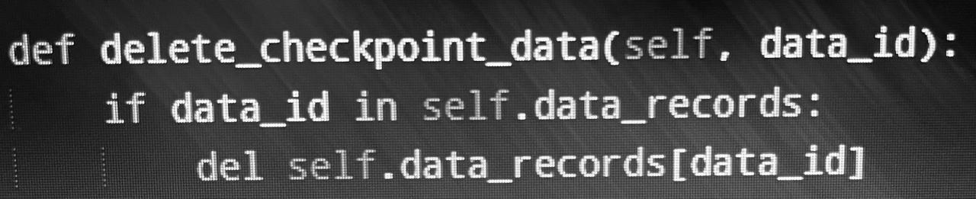
The `delete_checkpoint_data` method removes a data record from the `data_records` dictionary using the specified `data_id`. If the `data_id` exists, it deletes the corresponding entry.

Slide 12
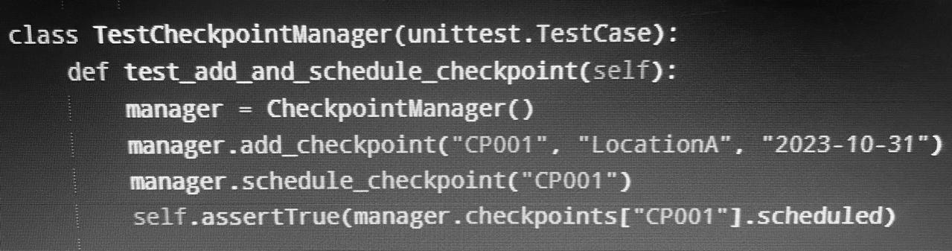
The `TestCheckpointManager` class is a unit test that verifies the functionality of adding and scheduling a checkpoint. In the `test_add_and_schedule_checkpoint` method, a `CheckpointManager` instance is created, a checkpoint is added with ID “CP001”, and then it is scheduled. The test checks that the `scheduled` attribute of the checkpoint is set to `True`, confirming that the scheduling was successful.

Slide 13
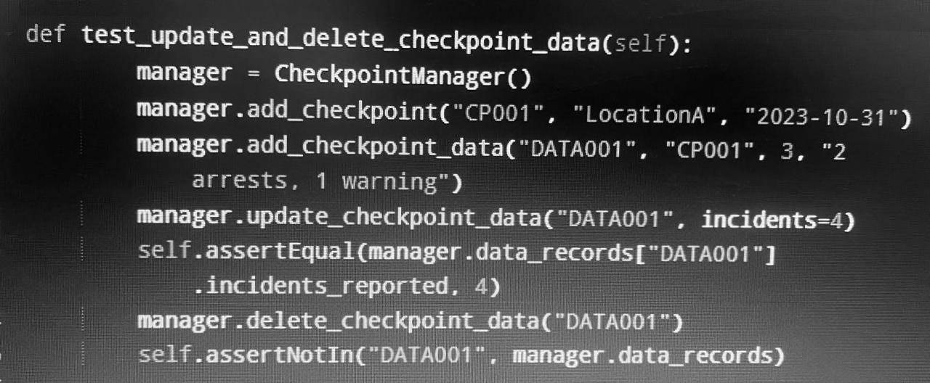
The `test_update_and_delete_checkpoint_data` method tests the functionality of adding, updating, and deleting checkpoint data. It first creates a `CheckpointManager` instance and adds a checkpoint along with its data. It then updates the number of reported incidents to 4 and verifies that the change was successful. Finally, the method deletes the data record and checks that it is no longer present in the `data_records` dictionary, confirming that the deletion was effective.

