Slide 1


GOVERNMENT ENGINEERING COLLEGE
RAICHUR-584135
Welcome to project phase-1 presentation
On
“soil classification and crop suggestion using machine learning”
Presented by
MOHD KHALEEL AHMAD 3GU18CS014
ALTAF 3GU20CS400
TIRAJ 3GU20CS407
VAISHNAVI 3GU20CS409
Under the guidance of
PROF.SUSHMA T SHEDOLE
Asst.Professor,
Department of Computer Science &
Engineering

Slide 2
ABSTRACT
In the last few decades researchers are interested in land mapping and its classification due to various reasons.
Agriculture research is the major source of economy for the country.
Soil is an important key factor for agriculture .There are several soil varieties in India.
In order to predict the type of crop that can be cultivated in that particular soil type we need to understand the features and characteristics of the soil type.
Machine learning techniques provides a flexible way in this case.
Classifying the soil according to the soil nutrients is much beneficial or the famers to predict which crop can be cultivated in a particular soil type
Several type of machine learning algorithms are used such as K-Nearest Neighbour (k-NN), Bagged tree, Support vector machine(SVM) and logistic regression.

Slide 3
CONTENTS
Introduction
Literature Survey
System Requirements
Existing System
Proposed System
Methodology
Advantages
Conclusion

Slide 4
INTRODUCTION
Data mining has been used for analyzing large data sets and establish classification and patterns in the datasets.
The techniques are used to elicit significant knowledge that can be easily predictable by individuals.
Data mining is a challenging technology in the field of agriculture.
Nowadays data mining has been used in the field of agriculture for soil classification, wasteland management, crop and pest management.
The agriculture factors such as rain, weather, soil type, pesticides and fertilizers are the main responsible to increase the production.
The main reason for agriculture is to grow crops.
Crop cultivation depends on the nature and the nutrients of the soil increasing the cultivation of land which brings a loss of supplements present in the soil.
In the crop cultivation soil plays an important role.

Slide 5
LITERATURE SURVEY
As discussed above, the number of researchers are working in this area.
In paper [2], the authors observed that the number of classification algorithms is available in remote sensing methods like minimum distance, maximum likelihood, support vector machine, K-NN, and multilevel classification.
The growth of the plant is completely depending on these factors. In our focus, organic matters are important because it provides the entire major, minor, and micronutrient to the plant.
Edaphic factors are the external factors include the soil moisture, soil air, soil mineral, soil temperature, soil organic matter, soil organism, and soil reactions.
In our focus, organic matters are important because it provides the entire major, minor, and micronutrient to the plant.
The role of the organic component is improving the texture of the soil, helping to increase The water holding capacity of the soil.

Slide 6
SYSTEM REQUIREMENTS
HARDWARE REQUIREMENTS
System
Hard Disk
Monitor
Mouse
RAM
Pentium IV 2.4 GHz.
: 100 GB.
: 15 VGA Color.
: Logitech.
: 1 GB.

Slide 7
SOFTWARE REQUIREMENTS
The software requirements specify the use of all required software products
Operating system
Coding Language
Development Kit
Dataset
Front End
: Windows 7/10
: Python
: Anaconda IDE
: EEG Emotion dataset
: Html,CSS,JS

Slide 8
EXISTING SYSTEM
The authors observed that the number of classification algorithms is available in remote sensing methods like minimum distance, maximum likelihood, support vector machine, K-NN, and multilevel classification.
Another algorithm in vision séance is developed in by A Iriars and others. This group of researchers developed an algorithm for ‘weed detection in the crop by computational vision
A binary classification method was used in this approach. As like [4], researches of this method also consider an image as an input and perform the feature classification with a binary method

Slide 9
PROPOSED SYSTEM
A classification of the soil and identifying the quality level to which a soil belongs and what contents of the soil need to be improved can define the type of the soil.
Knowing such a class or type of soil can be very useful for cultivation.
For analyzing the type of soil in a specific geographical area can be done by collecting soil samples of that area and using different machine learning algorithms classifying them into various classes.
With the emergence of machine learning and its implementation in image processing, the soil sample can be classified efficiently into class to which it belongs.

Slide 10
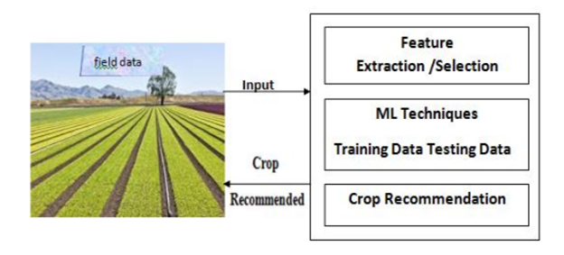

Slide 11
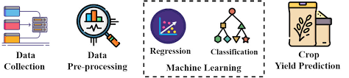

Slide 12
METHODOLOGY
Image Preprocessing :
The images in dataset is preprocessed before going to the next step.
Deep Learning Architecture:
The deep learning architecture learns various important nonlinear features
from the given samples.
Dataset Collection:
Data from two different sources are collected for training and testing the model.
We collected a total of 4 types of soil classes images with each images of 30 images
For training purposes, 80% images of each class are used and the rest of the images
are utilized for testing purposes.

Slide 13
Architecture Development
The learning model is based on CNN which is very useful for pattern recognition from images.
Advantages
The good classifier should handle diversity in the land. It should be hierarchical for deep classification with maximum accuracy.
classifying various kinds of soil series data along with a suitable suggestion for improving the fertility of the soil by detecting the health of the soil

Slide 14
CONCLUSION
Uses of organic matters are good in séance of increasing water-holding capability and to provide major, minor, and micronutrient to the plant.
The good classifier should handle diversity in the land. It should be hierarchical for deep classification with maximum accuracy.
The level of nutrients will be helpful for farmers for the further recommendation of fertilizers.
On the other hand, binary classification is a basic and fast approach, however, its accuracy is low as compared to the fuzzy logic system

Slide 15
REFERENCES
[1] E. Ben-Dor et al., “Using imaging spectroscopy to study soil properties,” Remote Sens. Environ., vol. 113, pp. S38–S55, 2009.
[2] K.Kulkarni et al., ‘ Classification Using Remotely Sensed Data’ International Conference on Computing Methodologies and Communication (ICCMC) Proceedings of the IEEE 2017
[3] Factor affecting crop production-climate- edaphic pbiotic,Physiogaphic and socioeconomic ,eagri.org › eagri50 › AGRO101 › lec09
[4] J carlo et,al. ‘Vision System for Soil Nutrient detection Using Fuzzy Logic’ Proceedings of TENCON 2018 - 2018 IEEE Region 10 Conference (Jeju, Korea, 28-31 October 2018)

Slide 16


