Slide 1
Predicting NCAA Football Game Scores
Chi Jin & Connor Masini

Slide 2
Problem Overview
Predict the scores of NCAA football games using a neural network with parameters evolved by a genetic algorithm
Particularly difficult due to the high rate of player turnover each year
Want to optimize 3 different statistics:
Straight Up: Which team wins the game
Spread: Point differential between the two teams
Over/Under: Total number of points scored by the two teams

Slide 3
Dataset
Data was taken from Seldom Used Reserve
http://www.seldomusedreserve.com/?page_id=8805
Included all games from the 2011-2018 seasons
Used all basic box score average statistics from teams over a 2-year period
Ex. Rushing yards, number of turnovers, yards allowed, etc.
Also generated some statistics that have been found to be indicative of team success
RPI, Strength of Schedule, Glicko, etc.

Slide 4
Multilayer Perceptron Model
output result
input layer
layer 1
layer 2
layer n
Notes:
Here’s the architecture of the multilayer perceptron model implemented using keras
input layer is a matrix of the dimensionality as the number of samples around 12000 games times about 66 features as the game statistics
all hidden layers are set identical with the same number of neurons and activations
the output is a length 2 vector representing the prediction of the game score

Slide 5
Hyper Parameters to Evolve
# of neurons per layer ∊ {16,32,64,128}
# of layers ∊ {1,2,3,4}
Activation function ∊ {relu, elu, tanh, sigmoid}
Optimizer ∊ {rmsprop, adam, sgd, adagrad,adadelta, adamax, nadam}
Notes:
The tunable hyper parameter are …

Slide 6
Fitness Function
Notes:
The fitness score of a good predict should be as closer to 1 as possible, but in the real cases fitness scores are all smaller than 1.

Slide 7
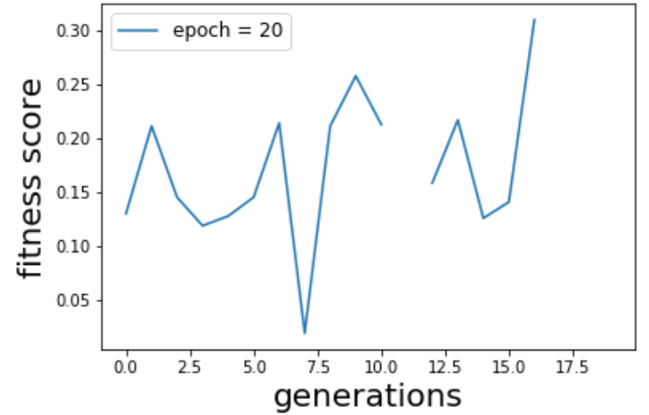
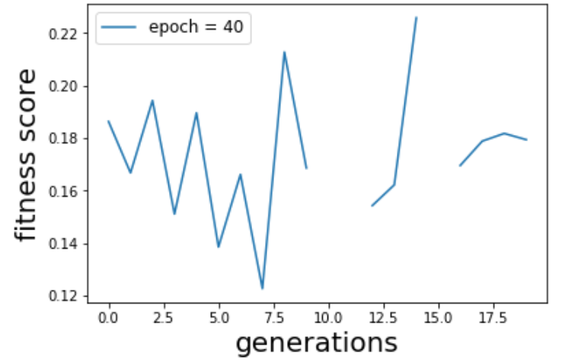
Resulting Accuracies
Notes:
pop=20,

Slide 8
Conference Championships Case Study
Team 1 | Team 2 | Actual Score | Predicted Score | Vegas Score | Over/Under Actual/Vegas/Predicted | Spread Actual/Vegas/Predicted
Ohio State | Northwestern | 45 – 24 | 34.0-21.6 | 40.25 - 23.75 | 69/64/55.6 | 21/12.4/16.5
Alabama | Georgia | 35 - 28 | 39.6-20.0 | 38 - 26 | 63/59.6/64 | 7/19.6/12
Washington | Utah | 10 - 3 | 32.1-31.6 | 24.75 - 20.25 | 13/63.7/45 | 7/.5/4.5
Texas | Oklahoma | 27 - 39 | 16.4-37.5 | 35.5 - 44.5 | 66/53.9/80 | 22/21.1/9
Clemson | Pitt | 42 - 10 | 37.5-16.4 | 41 - 13 | 52/53.9/54 | 32/21.1/28

Slide 9
Prediction Statistics
Percent of winners correctly picked: 71.8%
Mean difference between actual and predicted score: 10.1
Standard Deviation: 15.5
Mean difference between actual and predicted over/under: 14.0
Standard Deviation: 17.8
Mean difference in point spread: 17.22
Standard Deviation: 4.35

Slide 10
Long-Term Comparison with Vegas
Vegas correctly picks winner 74.9% of the time
We correctly pick winner 71.8% of the time
Vegas spread is off by 19.2 points on average
Our spread is 17.2 points off on average
Vegas over/under is off by 13.4 points on average
Our over/under is off by 14.0 points
Beat Vegas spread 51.2% of the time
Beat Vegas over/under 49.98% of the time

Slide 11
Future Outlook
Reconsider the fitness function
Differentiate layers in the same network
Vary dropout values for the models
Test different crossover/mutation rates
Try on convolutional networks, vary # of filters and filter sizes
Notes:
Out future is plan is to assign different numbers of neurons on different layers of one network
vary number of neurons and the activation functions on different layer

