Slide 1

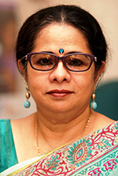
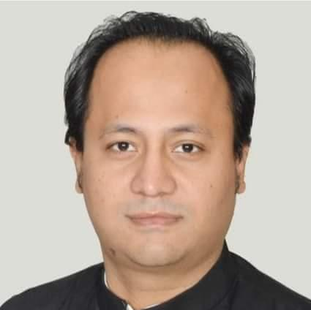
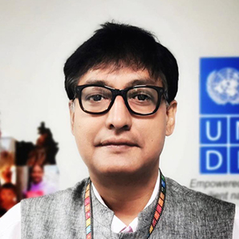
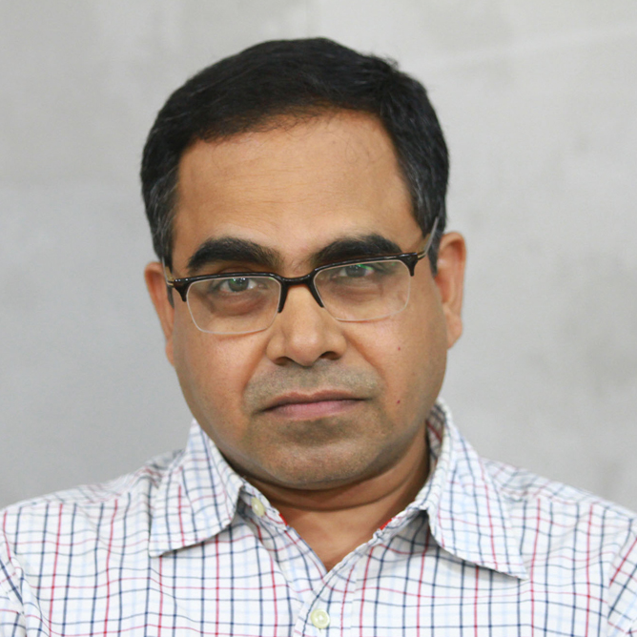



head
Education, empathy and tolerance in shaping Responsive citizenship
Hello how are you doing?
p2n
p1d
p2d
p3n
p4n
p3d
p4d
date
time

Slide 2
hello

