Slide 1

Solid Object Representation
and Advanced Modeling
Techniques 实体模型

Slide 2
Application of Solid Modeling
To distinguish between the inside, outside and surface of a 3D object and to be able to compute properties of the object that depends on this distinction.
To determine whether two objects interfere with each other.
To compute properties such as volume and center of mass.
To determine response to factors such as stress and temperature through finite-element analysis modeling.
Some for graphical techniques, such as modeling refractive transparency, depend on being able to determine where a beam of light enters and exits a solid object.

Slide 3
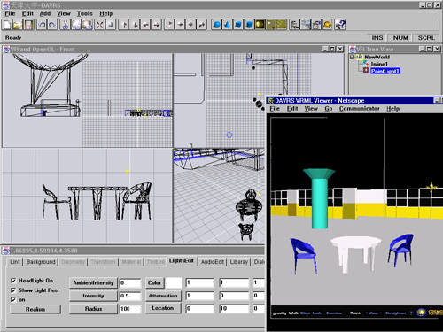

Slide 4
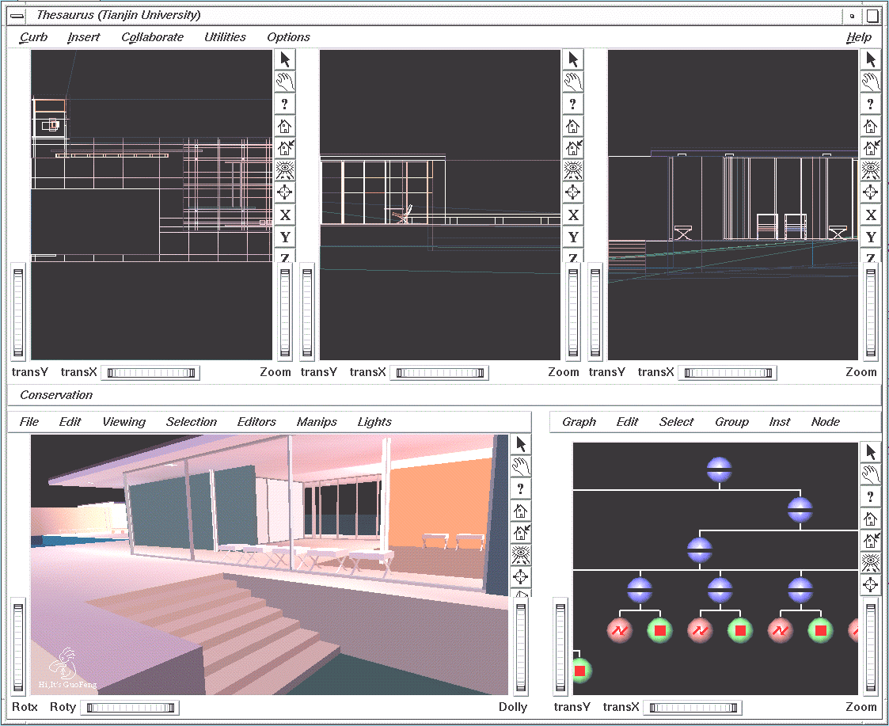

Slide 5
Solid Object Representations
Polygon modeling
Spatial-partitioning
……

Slide 6
Polygon Modeling
Polygons are the dominant force in modeling for real-time graphics
Why?

Slide 7
Polygons Dominate
Everything can be turned into polygons (almost! everything)
  Normally an error associated with the conversion
We know how to render polygons quickly
Many operations are easy to do with polygons
Memory and disk space is cheap
Simplicity

Slide 8
Polygon Meshes
A mesh is a set of polygons connected to form an object
A mesh has several components, or geometric entities:
  Faces
  Edges, the boundary between faces
  Vertices, the boundaries between edges, or where three or more faces meet
  Normals, Texture coordinates, colors, shading coefficients, etc
Some components are implicit, given the others
  For instance, given faces and vertices can determine edges
  Euler’s formula: #Faces + #Vertices – #Edges = 2 - 2Genus, for closed polygon meshes

Slide 9
Meshes from Scanning
Laser scanners sample 3D positions
  One method uses triangulation
  Another method uses time of flight
  Some take images also for use as textures
  Famous example: Scanning the David
Software then takes thousands of points and builds a polygon mesh out of them
Research topics:
  Reduce the number of points in the mesh
  Reconstruction and re-sampling!

Slide 10
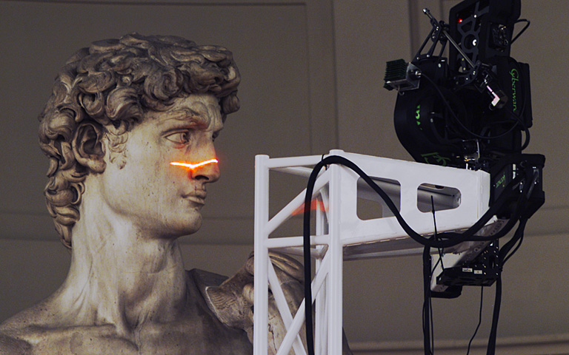
Scanning in Action
http://www-graphics.stanford.edu/projects/mich/

Slide 11
Level Of Detail
Level of detail strategies attempt to balance the resolution of the mesh against the viewing conditions, namely:
  Must have a way to reduce the complexity of meshes
  Must have a way to switch from one mesh to another
  An ongoing research topic, made even more important as laser scanning becomes popular
  Also called mesh decimation, multi-resolution modeling and other things

Slide 12
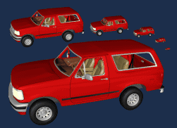
Level of Detail 细节层次
http://www.cs.unc.edu/~geom/SUCC_MAP/

Slide 13
Problems with Polygons
They are inherently an approximation
  Things like silhouettes can never be prefect without very large numbers of polygons, and corresponding expense
  Normal vectors are not specified everywhere
Interaction is a problem
  Dragging points around is time consuming
  Maintaining things like smoothness is difficult
Low level representation
  Eg: Hard to increase, or decrease, the resolution
  Hard to extract information like curvature

Slide 14
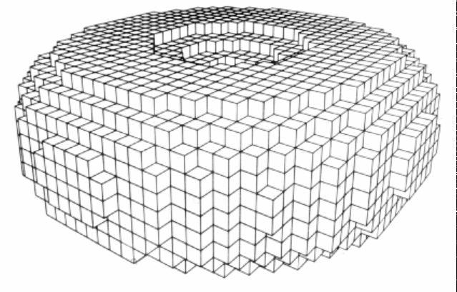
Spartial-Partitioning Representations
- Spatial-Occupancy Enumeration
The solid is decomposed into identical cells (called voxels) arranged in a fixed, regular grid.
To represent an object, we need only to decide which cells are occupied and which are not.
The object can be encoded by a unique and unambiguous list of occupied cells.
Easy for set operation, but need large amount memory space for high accuracy.

Slide 15
Spartial-Partitioning Representations
A solid is decomposed into a collection of adjoining, nonintersecting solids that are more primitive than, although not necessary of the same type as, the original solid.
Primitives may vary in type, size, position, parameterization and orientation, much like the different-shaped blocks in a child’s block set.
Also called Decomposition Representation(D-reps)

Slide 16
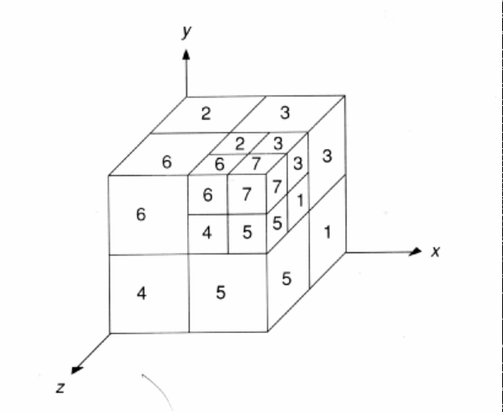
Spartial-Partitioning Representations
- Octrees
Advantages:
  Simple data structure
  Easy for set operation
  Easy for inspecting collision between solid objects
  Easy for calculating object’s properties such as volume, mass, and so on.
Drawback:
  Still need large amount memory
  Difficult to do transformation
  Difficult to transfer to b-reps

Slide 17
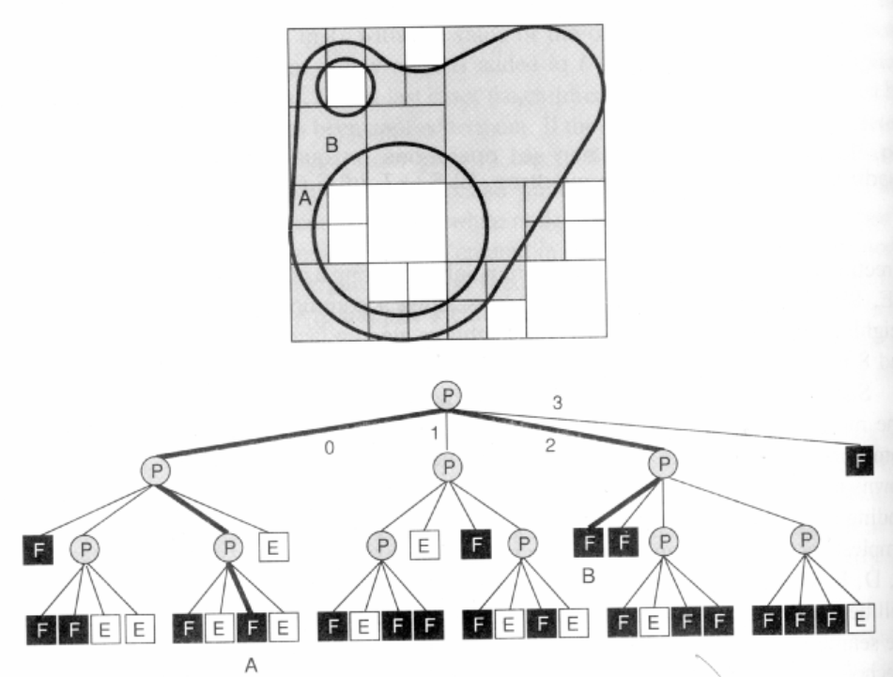
Spartial-Partitioning Representations
- Octrees
2
3
The fundamental idea behind both quadtree and octree is the divide-and-conquer power of binary subdivision.
0
1

