Slide 1
intRo application
server.R
ui.R
shinyServer(
function(session, input, output) {
})
shinyUI(
})
modules/nonparametric/
modules/nonparametric/
helper.R
static.R
observe.R
reactive.R
output.R
ui.R
modules.txt
heading,module
data,sources
data,transform
summaries,graphical
summaries,numerical
statistics,contingency
statistics,regression
statistics,t_test
statistics,nonparametric
nonparametrictable <-
function (intro.data, x, y, conflevel, althyp, hypval) {
cat_and_eval(
paste0(
"wilcox.test(
x=intro.data[,'", x, "'], y=intro.data[,'", y, "'], conf.level=", conflevel, ", alternative='", althyp, "', mu=", hypval, ")"),
mydir = userdir,
env = environment(),
file = "code_nonparametric.R")
}
nonparametric_ui <- tabPanel("Nonparametric",
column(4, wellPanel(
selectizeInput("group1_non", …),
selectizeInput("group2_non", …),
hr(),
selectizeInput("althyp_non", …),
numericInput("hypval_non", …),
sliderInput("conflevel_non", …),
hr(),
tags$button("", id = store_nonparametric", …))),
column(8,
tags$b("Nonparametric Results"),
verbatimTextOutput("nonparametrictable")))

Slide 2
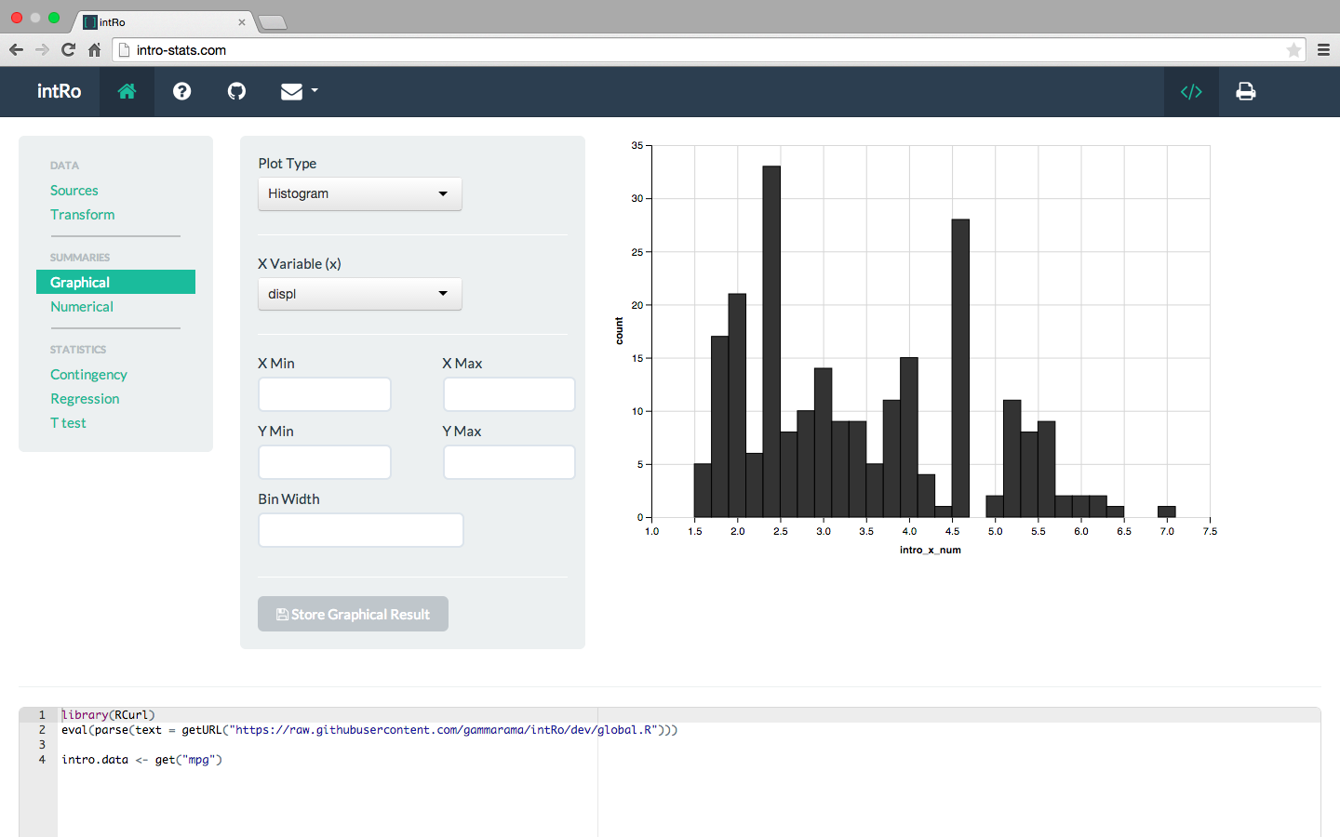
1
cv
2
3
4
cv
cv
5
cv

Slide 3
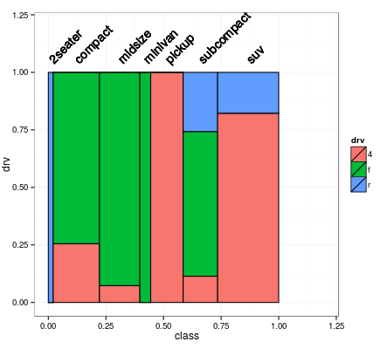


ggplot(plot_data, aes(x_center, y_height)) + geom_bar(stat = "identity", aes_string(width = "margin_x",
fill = "drv"), col = "Black") + geom_text(aes_string(label = "class", x = "x_center",
y = "1.05"), angle = 45, hjust = 0) + xlim(c(0, 1.2)) + ylim(c(0, 1.2)) + xlab("class") +
ylab("drv") + theme_bw() + coord_fixed()
Options

