Slide 1
intRo application
server.R
ui.R
shinyServer(
function(session, input, output) {
})
shinyUI(
})
modules/nonparametric/
modules/nonparametric/
helper.R
static.R
observe.R
reactive.R
output.R
ui.R
modules.txt
heading,module
data,sources
data,transform
summaries,graphical
summaries,numerical
statistics,contingency
statistics,regression
statistics,t_test
statistics,nonparametric
Code goes here
Code goes here

Slide 2
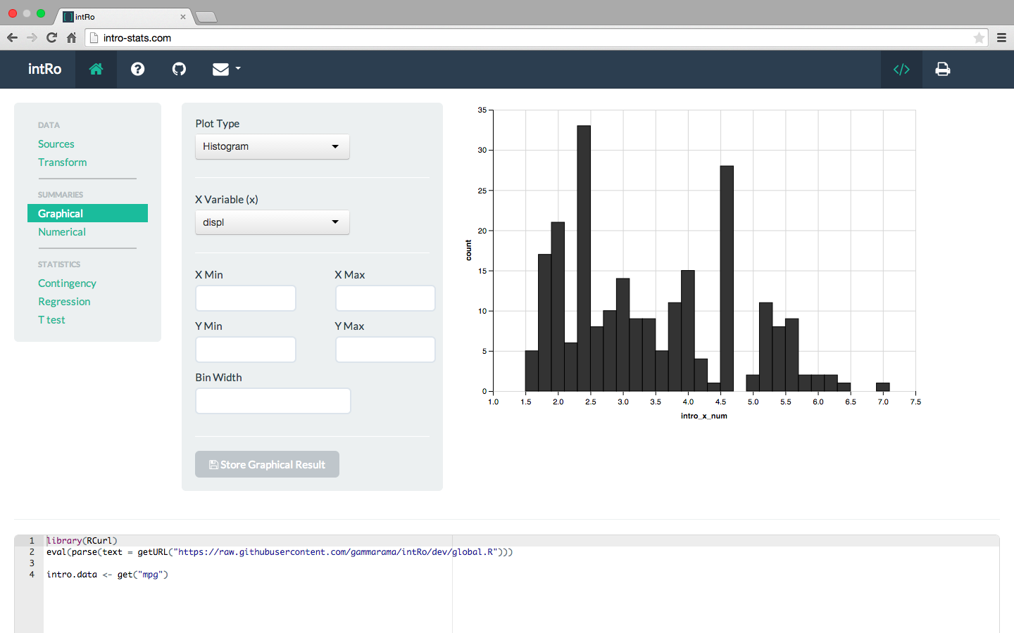
1
cv
2
3
4
cv
cv
5
cv

