Slide 1
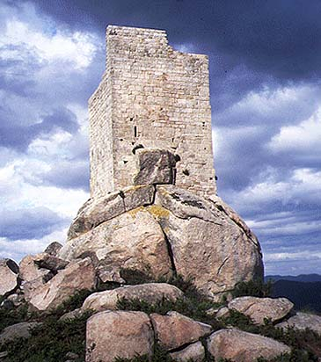
Bitcoin Data Structures
CS19521L
Spring 2019
5 February 2019
Maurice Herlihy
Brown University

Slide 2
Bitcoin Node
File System
LevelDB
block
block
Block Index DB
block
block
block
Chainstate DB
block
block

Slide 3
Bitcoin Node
File System
LevelDB
block
block
Block Index DB
block
Each block lives in a file
block
block
Chainstate DB
block
block

Slide 4
Bitcoin Node
File System
LevelDB
block
block
Block Index DB
Block hash → block info
block
block
block
Chainstate DB
block
block

Slide 5
Bitcoin Node
File System
LevelDB
block
block
Block Index DB
block
block
block
Chainstate DB
Txn hash → txn info
block
block

Slide 6
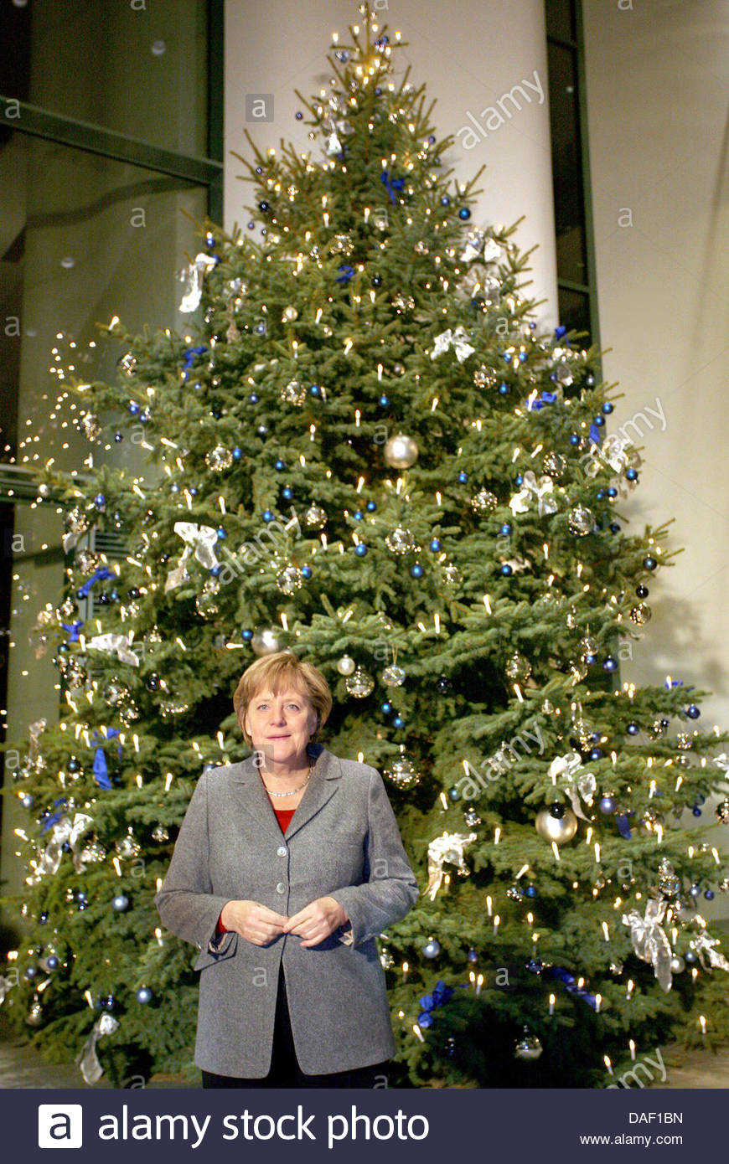
Merkle Tree

Slide 7
Merkle Tree
Fundamental data structure

Slide 8
Merkle Tree
Fundamental data structure
Many variations

Slide 9
Merkle Tree
Fundamental data structure
Many variations
Blockchain itself is a degenerate
Merkle tree

Slide 10
Merkle Tree
BTW, I’m Angela Merkel, not Ralf Merkle, and I did not invent this tree!
Fundamental data structure
Many variations
Blockchain itself is a degenerate
Merkle tree

Slide 11
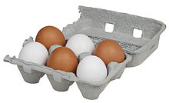
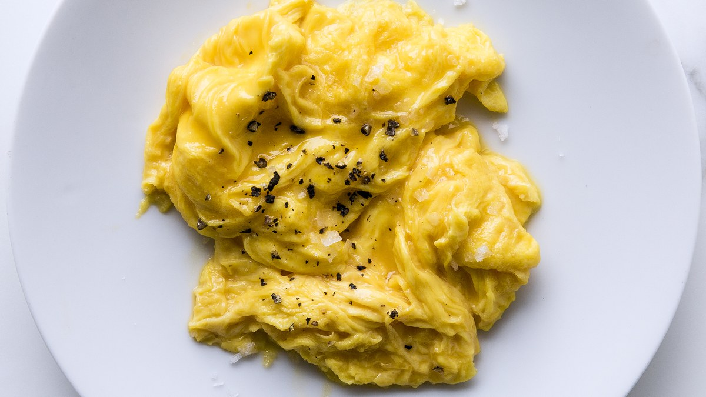
Cryptographic Hash Functions
Easy
Hard

Slide 12
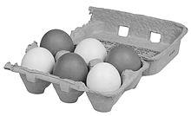
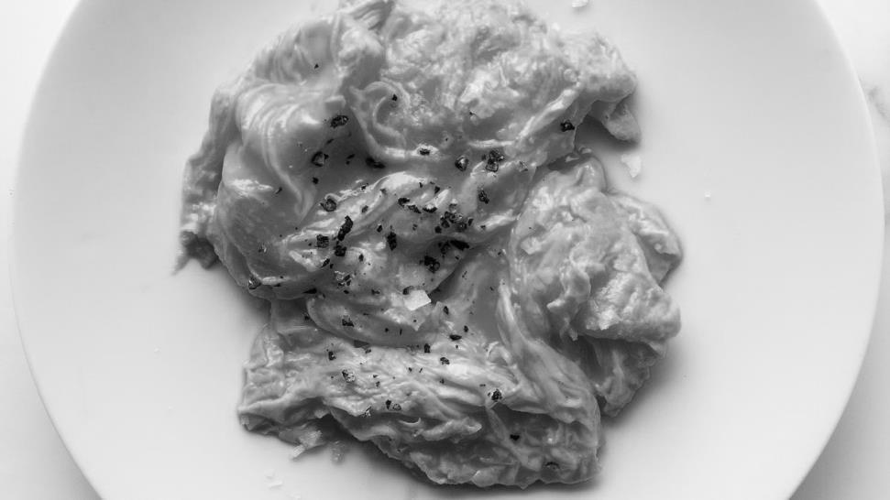
Cryptographic Hash Functions
Hard to reconstruct x from H(x)
Easy
“preimage resistance”
Hard

Slide 13
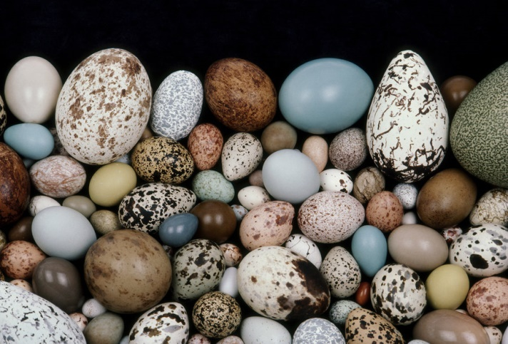
Cryptographic Hash Functions
Given
Hard to find

Slide 14
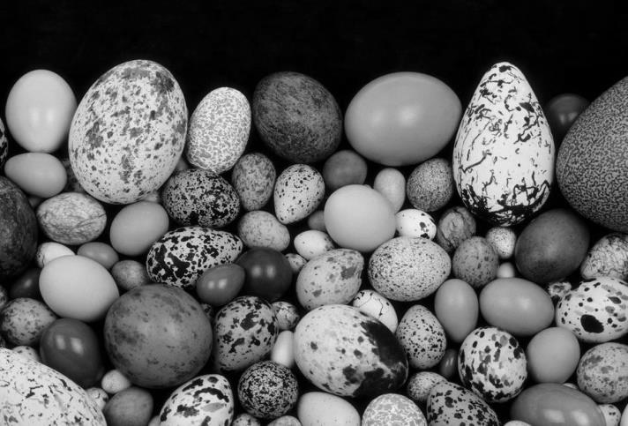
Cryptographic Hash Functions
Given
Hard to find x’ such that H(x’) = H(x)
Hard to find
“2nd preimage resistance”

Slide 15
Cryptographic Hash Functions
Hard to find

Slide 16
Cryptographic Hash Functions
Hard to find
Hard to find any x, x’ such that H(x’) = H(x)
“collision resistance”

Slide 17
Tree
d₀, d₃
d₀, d₁
d₂, d₃
d₀, d₀
d₁, d₁
d₂, d₂
d₃, d₃
d₀
d₁
d₂
d₃

Slide 18
Tree
d₀, d₃
Data at leaves
d₀, d₁
d₂, d₃
d₀, d₀
d₁, d₁
d₂, d₂
d₃, d₃
d₀
d₁
d₂
d₃

Slide 19
Tree
Navigation via internal nodes
d₀, d₃
d₀, d₁
d₂, d₃
d₀, d₀
d₁, d₁
d₂, d₂
d₃, d₃
d₀
d₁
d₂
d₃

Slide 20
Tree
d₀, d₃
d₀, d₁
d₂, d₃
d₀, d₀
d₁, d₁
d₂, d₂
d₃, d₃
d₀
d₁
d₂
d₃
tamper

Slide 21
Tree
shrug …
d₀, d₃
d₀, d₁
d₂, d₃
d₀, d₀
d₁, d₁
d₂, d₂
d₃, d₃
d₀
d₁
d₂
d₃
tamper

Slide 22
Merkle Tree
h₀₃ =H(h_{01,}h₂₃)
h₀₁ =H(h_{0,}h₁)
h₂₃ =H(h_{2,}h₃)
h₀ =H(d₀)
h₁ =H(d₁)
h₂ =H(d₂)
h₃ =H(d₃)
d₀
d₁
d₂
d₃

Slide 23
Merkle Tree
h₀₃ =H(h_{01,}h₂₃)
Data at leaves, as before
h₀₁ =H(h_{0,}h₁)
h₂₃ =H(h_{2,}h₃)
h₀ =H(d₀)
h₁ =H(d₁)
h₂ =H(d₂)
h₃ =H(d₃)
d₀
d₁
d₂
d₃

Slide 24
Merkle Tree
Nodes have hashes of children
h₀₃ =H(h_{01,}h₂₃)
h₀₁ =H(h_{0,}h₁)
h₂₃ =H(h_{2,}h₃)
h₀ =H(d₀)
h₁ =H(d₁)
h₂ =H(d₂)
h₃ =H(d₃)
d₀
d₁
d₂
d₃

Slide 25
Merkle Tree
h₀₃ =H(h_{01,}h₂₃)
h₀₁ =H(h_{0,}h₁)
h₂₃ =H(h_{2,}h₃)
h₀ =H(d₀)
h₁ =H(d₁)
h₂ =H(d₂)
h₃ =H(d₃)
d₀
d₁
d₂
d₃
Nodes have hashes of children

Slide 26
Don’t Mess with the Merkle Tree
h₀₃ =H(h_{01,}h₂₃)
h₀₁ =H(h_{0,}h₁)
h₂₃ =H(h_{2,}h₃)
h₀ =H(d₀)
h₁ =H(d₁)
h₂ =H(d₂)
h₃ =H(d₃)
d₀
d₁
d₂
d₃
tamper

Slide 27
Don’t Mess with the Merkle Tree
!!!
h₀₃≠H(h_{01,}h₂₃)
!!!
h₀₁≠H(h_{0,}h₁)
h₂₃ =H(h_{2,}h₃)
!!!
h₀≠H(d₀)
h₁ =H(d₁)
h₂ =H(d₂)
h₃ =H(d₃)
d₀
d₁
d₂
d₃
tamper

Slide 28
Proof d₁ is in the Tree
h₀₃ =H(h_{01,}h₂₃)
h₀₁ =H(h_{0,}h₁)
h₂₃ =H(h_{2,}h₃)
h₀ =H(d₀)
h₁ =H(d₁)
h₂ =H(d₂)
h₃ =H(d₃)
d₀
d₁
d₂
d₃

Slide 29
Proof d₁ is in the Tree
h₀₃ =H(h_{01,}h₂₃)
Check!
h₀₁ =H(h_{0,}h₁)
h₂₃ =H(h_{2,}h₃)
h₀ =H(d₀)
h₁ =H(d₁)
h₂ =H(d₂)
h₃ =H(d₃)
d₀
d₁
d₂
d₃

Slide 30
Proof d₁ is in the Tree
h₀₃ =H(h_{01,}h₂₃)
h₀₁ =H(h_{0,}h₁)
h₂₃ =H(h_{2,}h₃)
Check!
h₀ =H(d₀)
h₁ =H(d₁)
h₂ =H(d₂)
h₃ =H(d₃)
d₀
d₁
d₂
d₃

Slide 31
Proof d₁ is in the Tree
h₀₃ =H(h_{01,}h₂₃)
h₀₁ =H(h_{0,}h₁)
h₂₃ =H(h_{2,}h₃)
h₀ =H(d₀)
h₁ =H(d₁)
h₂ =H(d₂)
h₃ =H(d₃)
Check!
d₀
d₁
d₂
d₃

Slide 32
Proof d₁ is in the Tree
h₀₃ =H(h_{01,}h₂₃)
Proof “d₁,h₁,h₂₃,h₀₃ ” …
h₀₁ =H(h_{0,}h₁)
h₂₃ =H(h_{2,}h₃)
convinces someone who knows only h₀₃ …
h₀ =H(d₀)
h₁ =H(d₁)
h₂ =H(d₂)
h₃ =H(d₃)
that d₁ is in the tree!
d₀
d₁
d₂
d₃

Slide 33
Updating a Merkle Tree
h₀₃ =H(h_{01,}h₂₃)
h₀₁ =H(h_{0,}h₁)
h₂₃ =H(h₂)
h₀ =H(d₀)
h₁ =H(d₁)
h₂ =H(d₂)
d₀
d₁
d₂

Slide 34
Updating a Merkle Tree
h₀₃ =H(h_{01,}h₂₃)
h₀₁ =H(h_{0,}h₁)
h₂₃ =H(h₂)
h₀ =H(d₀)
h₁ =H(d₁)
h₂ =H(d₂)
h₃ =H(d₃)
d₀
d₁
d₂
d₃

Slide 35
Updating a Merkle Tree
h₀₃ =H(h_{01,}h₂₃)
h₀₁ =H(h_{0,}h₁)
h₂₃ =H(h₂)
nope
h₀ =H(d₀)
h₁ =H(d₁)
h₂ =H(d₂)
h₃ =H(d₃)
d₀
d₁
d₂
d₃

Slide 36
Updating a Merkle Tree
h₀₃
h'₀₃
new tree
h₀₁
h₂₃
h₀₁
h'₂₃
h₀
h₁
h₂
h₀
h₁
h₂
h'₃
d₀
d₁
d₂
d₀
d₁
d₂
d₃

Slide 37
Updating a Merkle Tree
h₀₃
h'₀₃
new tree
h₀₁
h₂₃
h'₂₃
h₀
h₁
h₂
h'₃
d₀
d₁
d₂
d₃

Slide 38
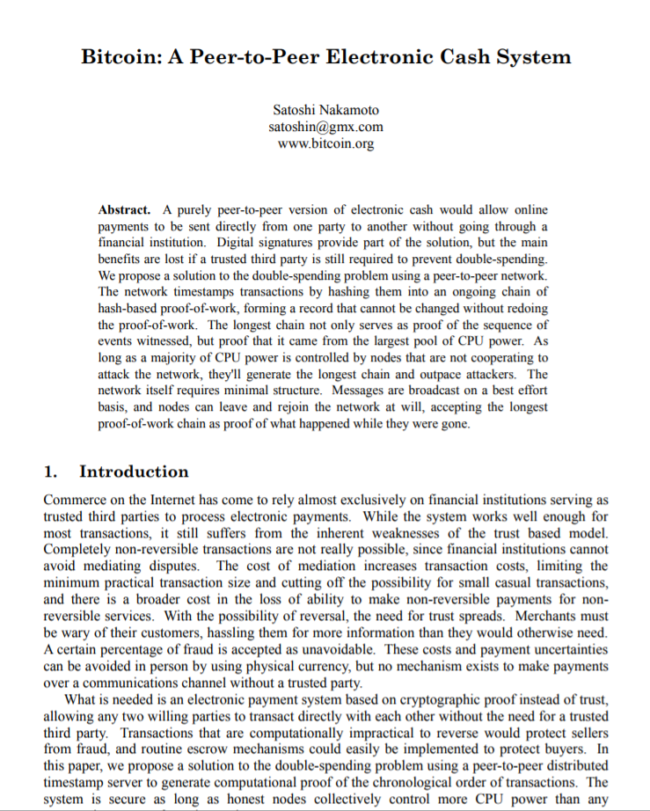
Let’s talk about Bitcoin’s data structures
Notes:
Bitcoin, Ethereum, ICOs, blockchains, etc. are the result of a single paper (and running code) that appeared mysteriously in 2008. I am going to claim it’s all about distributed computing, but it did not come from the distributed computing research community. I feel confident speculating that if this paper had been submitted to PODC in 2008, it would have been rejected for defining consensus weirdly, or not proving any lemmas, ro not providing experiments. Yet here we are, looking at a new, vibrant, and active area of CS. What are we to make of it?

Slide 39
This happened
This happened
This happened
pointer
pointer
pointer
time
Notes:
A Blockchain is just a list, where each element contains a list of events to be recorded, and various cryptographic hashes and signatures. The technical details are not important here.

Slide 40
This happened
This happened
This happened
pointer
pointer
pointer
shrug
shrug
tamper
time
Notes:
A Blockchain is just a list, where each element contains a list of events to be recorded, and various cryptographic hashes and signatures. The technical details are not important here.

Slide 41
This happened
This happened
This happened
pointer
pointer
pointer
tamper
time
Notes:
A Blockchain is just a list, where each element contains a list of events to be recorded, and various cryptographic hashes and signatures. The technical details are not important here.

Slide 42
Merkle-ize it!
This happened
This happened
This happened
hash
hash
hash
time
Notes:
A Blockchain is just a list, where each element contains a list of events to be recorded, and various cryptographic hashes and signatures. The technical details are not important here.

Slide 43
Merkle-ize it!
This happened
This happened
This happened
hash
hash
hash
tamper
time
Notes:
A Blockchain is just a list, where each element contains a list of events to be recorded, and various cryptographic hashes and signatures. The technical details are not important here.

Slide 44
Uh,oh …
Uh,oh …
Merkle-ize it!
This happened
This happened
This happened
hash
hash
hash
tamper
time
Notes:
A Blockchain is just a list, where each element contains a list of events to be recorded, and various cryptographic hashes and signatures. The technical details are not important here.

Slide 45
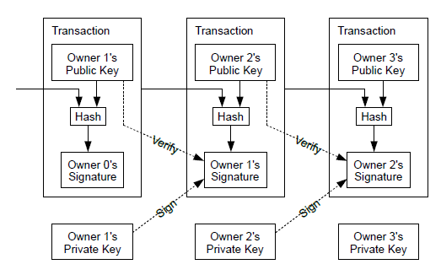
This happened
This happened
This happened
tamper
Uh,oh …
Uh,oh …
hash
predecessor
hash
predecessor
hash
predecessor
time
Notes:
A Blockchain is just a list, where each element contains a list of events to be recorded, and various cryptographic hashes and signatures. The technical details are not important here.

Slide 46
This happened
This happened
This happened
tamper
Uh,oh …
Uh,oh …
hash
predecessor
hash
predecessor
hash
predecessor
time
Notes:
A Blockchain is just a list, where each element contains a list of events to be recorded, and various cryptographic hashes and signatures. The technical details are not important here.

Slide 47
header
hash
transaction
transaction
transaction
transaction
time
Notes:
A Blockchain is just a list, where each element contains a list of events to be recorded, and various cryptographic hashes and signatures. The technical details are not important here.

Slide 48
header
hash
Version, height, PoW nonces, etc.
transaction
transaction
transaction
transaction
time
Notes:
A Blockchain is just a list, where each element contains a list of events to be recorded, and various cryptographic hashes and signatures. The technical details are not important here.

Slide 49
header
hash
transaction
transaction
transaction
transaction
time
Notes:
A Blockchain is just a list, where each element contains a list of events to be recorded, and various cryptographic hashes and signatures. The technical details are not important here.

Slide 50
Each block keeps its transactions in a Merkle tree
header
hash
time
Notes:
A Blockchain is just a list, where each element contains a list of events to be recorded, and various cryptographic hashes and signatures. The technical details are not important here.

Slide 51
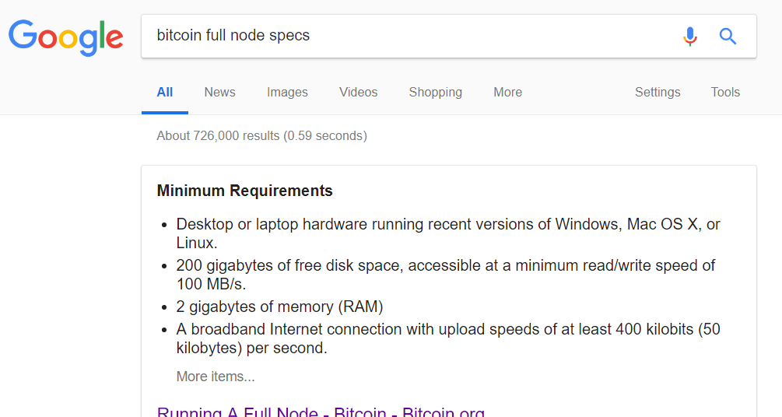
Bitcoin full node
200G disk space
2G memory
50K network
3-4 days initial download

Slide 52
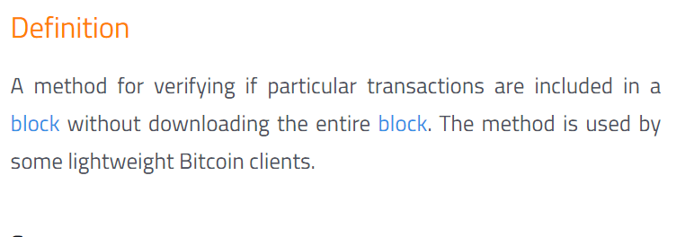
Bitcoin lightweight node
Fits on your phone

Slide 53
Full node
header
hash
time
Notes:
A Blockchain is just a list, where each element contains a list of events to be recorded, and various cryptographic hashes and signatures. The technical details are not important here.

Slide 54
Lightweight node
header
hash
time
Notes:
A Blockchain is just a list, where each element contains a list of events to be recorded, and various cryptographic hashes and signatures. The technical details are not important here.

Slide 55
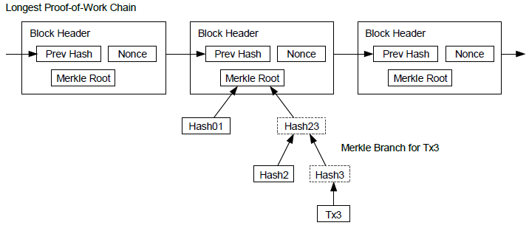
Simplified Payment Verification

Slide 56
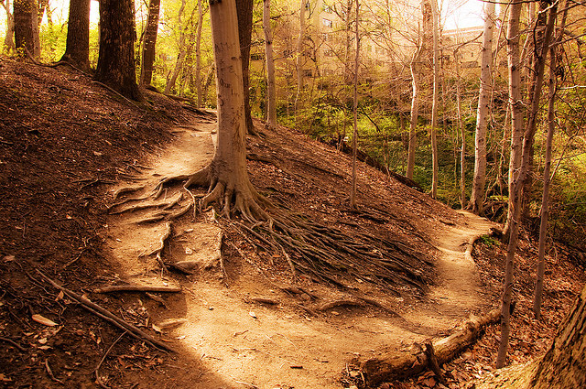
The Road not Taken

Slide 57
Why is the blockchain a chain?
time

Slide 58
Why is the blockchain a chain?
Blocks of interest

Slide 59
Why is the blockchain a chain?
Blocks of interest
Must traverse all

Slide 60
Why is the blockchain a chain?
Blocks of interest
Must traverse all
Must store all headers

Slide 61
Merkleized Skip Lists?
time
Notes:
One efficient way to do it is with a skip-list.
A skip list keeps the elements sorted in nodes that are linked in multiple layers, such that every layer is a sublist of the layer underneath it.
So as you can see, the bottom layer contains all the elements, and in the next layer we skip 2, and so on, so that in the last layer we only have the 0 and 9 nodes. So now if we’re searching for 8, for example,

Slide 62
Merkleized Skip Lists?
Each layer is sub-list of lower levels
Each layer jumps about twice as far
Logarithmic search time
time
Notes:
One efficient way to do it is with a skip-list.
A skip list keeps the elements sorted in nodes that are linked in multiple layers, such that every layer is a sublist of the layer underneath it.
So as you can see, the bottom layer contains all the elements, and in the next layer we skip 2, and so on, so that in the last layer we only have the 0 and 9 nodes. So now if we’re searching for 8, for example,

Slide 63
Merkleized Skip Lists?
time
Notes:
One efficient way to do it is with a skip-list.
A skip list keeps the elements sorted in nodes that are linked in multiple layers, such that every layer is a sublist of the layer underneath it.
So as you can see, the bottom layer contains all the elements, and in the next layer we skip 2, and so on, so that in the last layer we only have the 0 and 9 nodes. So now if we’re searching for 8, for example,

Slide 64
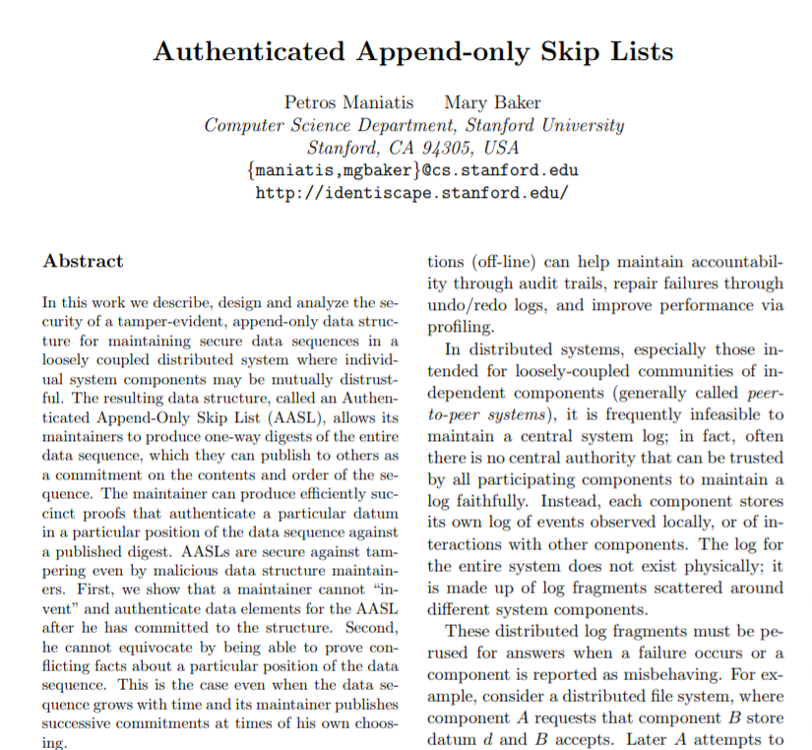
Merkleized skip lists already invented
Pre-blockchain
Research opportunity?

Slide 65
Keep Blocks in Merkle Tree instead of Chain?
h₀₃ =H(h_{01,}h₂₃)
h₀₁ =H(h_{0,}h₁)
h₂₃ =H(h_{2,}h₃)
h₀ =H(d₀)
h₁ =H(d₁)
h₂ =H(d₂)
h₃ =H(d₃)
d₀
d₁
d₂
d₃
time

Slide 66

Certificate Transparency
Certificate authorities issue SSL certificates
So you can be sure you are talking to Amazon, Facebook, etc.
They sometimes mess up

Slide 67
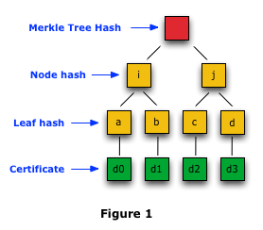
Google Certificate Transparency Project
Publish certificates on public logs
Replicate logs for availability
Each log is a Merkle tree
Not exactly a blockchain, but very close …

Slide 68

Ideas we covered in this lecture
Bitcoin node data storage
Cryptographic hash functions
Merkle Trees
Merkle Tree of Transactions
Lightweight Nodes
Merkle Skip Lists
Google Certificate Transparency one Merkle tree

Slide 69
