Slide 1
Writing-feedback app pilot
Department of Sociology teaching seminar

Slide 2
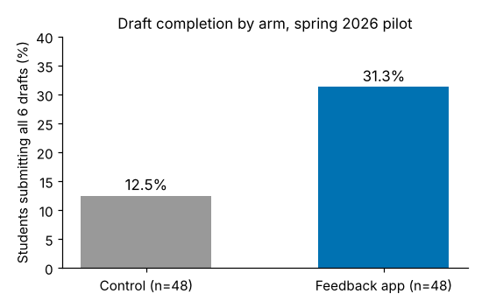
Results
Source: course LMS export, 2026-06-15
Notes:
Walk through the chart; the numbers are only on the figure.

