Slide 1
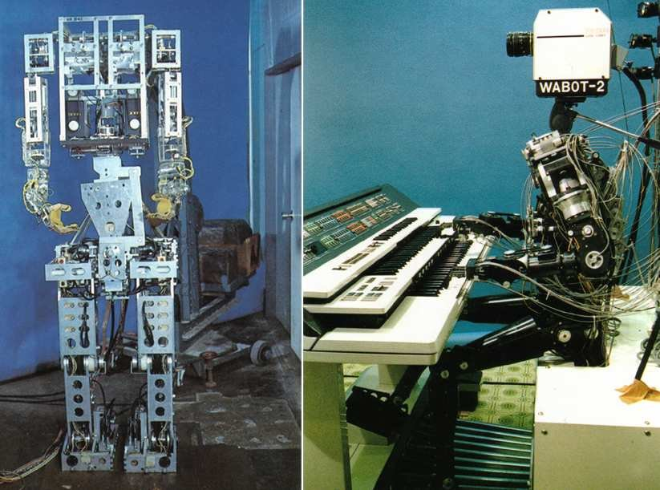
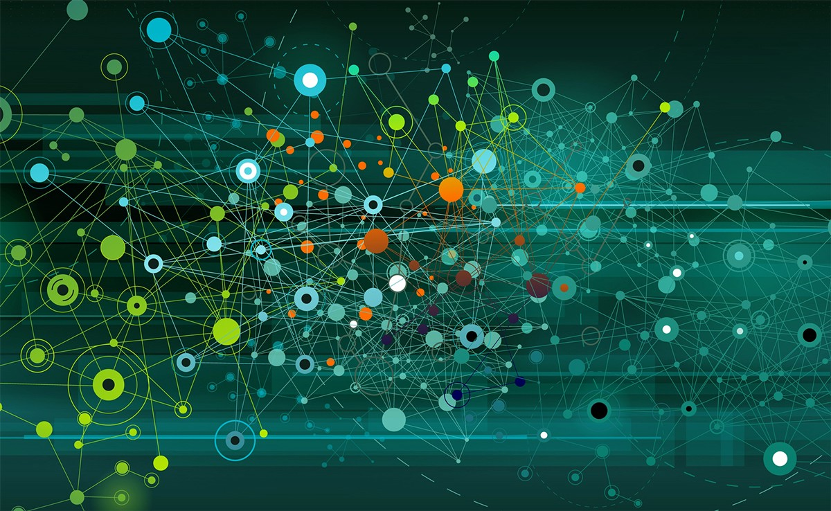
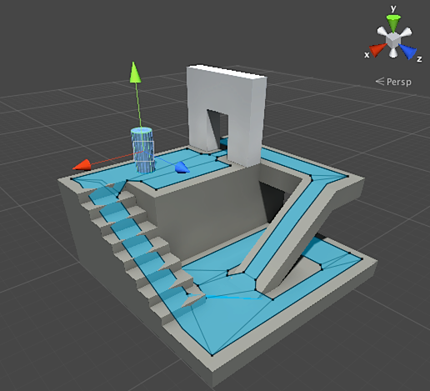
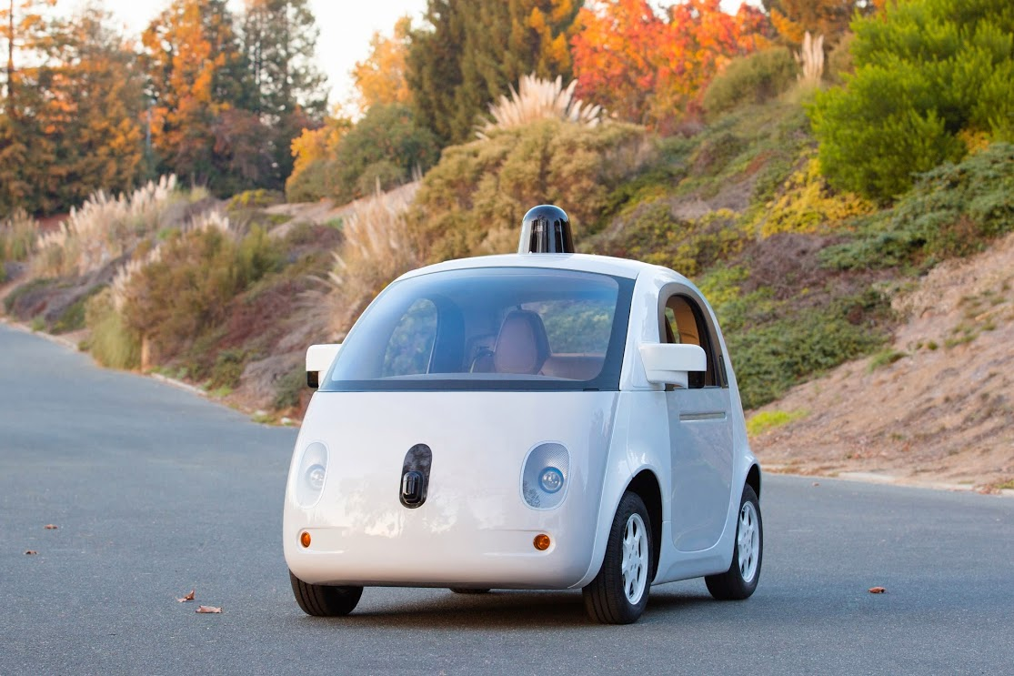
Artificial Intelligence
by Team 5
History
Government Sectors
The concept of AI was introduced to our world in the 19th century. The first ones who came up with the idea of AI and robots were science fiction writers. Many scientists in the early 20th century had a major contribution to computers and artificial intelligence, such as Alan Turing. However, many other scientists also improved on what artificial intelligence could be capable of, such as Weizenbaum’s first chatterbot, “ELIZA.”
AI has applications in many different areas, such as healthcare and the army. In healthcare, AI is getting to a point where it can be possible to diagnose patients without the need of a human doctor. This can be done through several methods, such as precision medicine or the use of neural networks. In the military, AI is being used to improve the work of military planners as well as pilots, which helps with decision-making.
Entertainment
Future
AI has a presence in the entertainment industry. For video games, AI is commonly used by game developers as it’s used to control the player’s enemies and NPCs in-game. For gambling, AI is trained to learn how to play certain games, such as poker, while also used to predict who wins in sporting events. For the movie and TV industry, AI is used for marketing purposes as studios try to improve their advertising.
The future of AI looks very promising. Right now, companies are researching self-driving cars, such as Tesla and Google. As well as this, human-AI symbiosis may become a possibility and humans could become more enhanced beings over this. Finally, AI may one day have an important role in education as it improves the lives of students through personal assistants, either from robots, such as NAO, or devices, such as Alexa.
GitHub Link: https://github.com/AlteredSanta/CS4182-Artificial-Intelligence

