Slide 1






2MJ
4MJ
12MJ
100MJ
1210MJ

Slide 2












DIAG 1: Coal → Liq. → Solid Fuel
90 - 25 = 65
3.25x
65
3.25
1.365MJ
10
2x
40MJ
20
2
5.75
0.84MJ
69MJ
50
1.5MJ
2.1MJ
0.5x
10
0.5
5
0.21MJ
2
E = 0.42 x 5 x 1 / 1
E = 0.21 x 2 x n / 1
Notes:
V
0.42 x 5 =
65/20 = 3.25
0.21*2*3.25

Slide 3

DIAG 2: Coal → Liq. → H.O. Cracking → Solid Fuel
1.625x
65
48.75
0.6825MJ
2
10
6.875x
40MJ
6.875
20
2.8875MJ
50
1.5MJ
7.375
2.1MJ
0.5x
88.5MJ
10
0.5
5
0.21MJ
2
E = 0.42 x 5 x 1 / 1
E = 0.21 x 2 x n / 1
Notes:
V

Slide 4


DIAG 3: Oil → Basic Pr. → Solid Fuel
2.25x
100
45
2.25
0.945MJ
27MJ
2
2.1MJ
5
E = 0.42 x 5 x 1 / 1
E = 0.21 x 2 x 2.25 / 1
Notes:
v

Slide 5


DIAG 4: Oil → Adv. Pr. → Solid Fuel
1.25x
25
1.25
0.525MJ
100
4.5x
45
4.5
1.89MJ
8.5
50
102MJ
2.75x
2.1MJ
55
2.75
5
1.155MJ
2
E = 0.42 x 5 x 1 / 1
E = 0.21 x 2 x n / 1
Notes:
v

Slide 6
DIAG 5: Oil → Adv. Pr. → H.O. Cracking → Solid Fuel
0.625x
25
18.75
0.2625MJ
2
100
6.375x
45
6.375
2.6775MJ
50
9.125
2.1MJ
2.75x
109.5MJ
55
2.75
5
1.155MJ
2
E = 0.42 x 5 x 1 / 1
E = 0.21 x 2 x n / 1
Notes:
v

Slide 7

10
1
10
6MJ
100MJ
120MJ
30
E = 0.150 x 30 x 1 / 0.75
Notes:
v

Slide 8


1
1
1
31.5MJ
1.21GJ
100MJ
90
E = 0.350 x 90 x 1 / 1
Notes:
v

Slide 9




1
19
10
2MJ
10
80GJ – 400GJ
10
E = 0.150 x 10 x 1 / 0.75
Notes:
v

Slide 10



E = P x t_c x n / C
-50% P
+70% P
+50% C
+80% P
-15% C
+10% Yield

Slide 11

DIAG X: Coal → Liq. → H.O. Cracking → Solid Fuel MIN POWER
1.625x
65
48.75
0.1365MJ
2
10
6.875x
40MJ
6.875
20
0.5775MJ
50
1.5MJ
7.375
0.42MJ
0.5x
88.5MJ
10
0.5
5
0.042MJ
2
E = (0.42 x 20%) x 5 x 1 / 1
E = (0.21 x 20%) x 2 x n / 1
Notes:
v

Slide 12
DIAG: Coal → Liq. → H.O. Cracking → Solid Fuel MAX PROD
90 x 130% - 25 = 92
92 x 130% x 75% = 89.7
2.3x
92
89.7
5.9716MJ
11.57 x 130% = 15.041
2
10
11.57x
40MJ
15.041
26
30.040MJ
50
1.5MJ
15.4635
12.982MJ
0.65x
185.562MJ
13
0.4225
5
1.688MJ
10 x 130% = 13
0.325 x 130% = 0.4225
2
E = (0.42 x 340%) x 5 x 1 / (1 x 55%)
E = (0.21 x 340%) x 2 x n / (1 x 55%)

Slide 13
DIAG: Coal → Liq. → H.O. Cracking → Solid Fuel PROD & SPEED
90 x 120% - 25 = 83
83 x 120% x 75% = 74.7
2.075x
83
74.7
2.3966MJ
9.87 x 120% = 11.844
2
10
9.87x
40MJ
11.844
24
11.400MJ
50
1.5MJ
12.204
5.775MJ
0.6x
146.448MJ
12
0.36
5
0.693MJ
10 x 120% = 12
0.3 x 120% = 0.36
2
E = (0.42 x 330%) x 5 x 1 / (1 x 120%)
E = (0.21 x 330%) x 2 x n / (1 x 120%)

Slide 14
10
1.2
10
22.3MJ
120MJ
120MJ
30
E = (0.15 x 260%) x 30 x 1 / (0.75x 70%) = 22.3MJ
Notes:
…

Slide 15

10
1.4
10
94.5MJ
140MJ
120MJ
30
E = (0.375 x 420%) x 30 x 1 / (1.25 x 40%) = 94.5MJ
10
10
1.3
1.3
10
47.5MJ
130MJ
10
35.1MJ
130MJ
120MJ
30
120MJ
30
E = (0.375 x 290%) x 30 x 1 / (1.25 x 55%) = 47.5MJ
E = (0.375 x 410%) x 30 x 1 / (1.25 x 105%) = 35.1MJ
Notes:
…

Slide 16
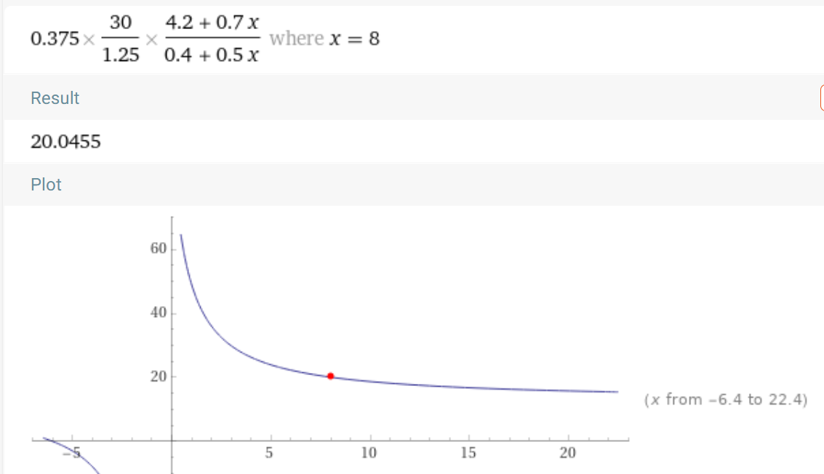
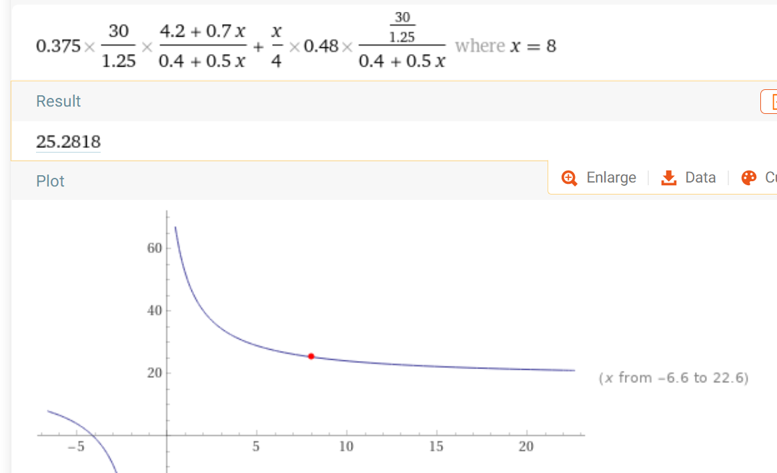
10
1.2
10
22.3MJ
120MJ
120MJ
30
E = (0.15 x 260%) x 30 x 1 / (0.75x 70%) = 22.3MJ
10
1.4
10
94.5MJ
140MJ
120MJ
30
E = (0.375 x 420%) x 30 x 1 / (1.25 x 40%) = 94.5MJ
Notes:
0.15 * 1.30 * 30 / 0.75 / 0.85 = 9.18 (vs 10) 1e1p (vs 10 is useless)
0.15 * 2.50 * 30 / 0.75 / 1.35 = 11.1 (vs 10) 1s1p (vs 10 is useless)
0.375 * 4.10 * 30 / 1.25 / 1.05 = 35.1 (vs 30) 1s3p > 1e3p
0.375 * 4.00 * 30 / 1.25 / 1.70 = 21.2 (vs 20) 2s2p
0.375 * 1.60 * 30 / 1.25 / 0.70 = 20.6 (vs 20) 2e2p
0.375 * 4.90 * 30 / 1.25 / 0.90 = 49 (vs 40 - X/4) 4p + 1sb
0.375 * 5.60 * 30 / 1.25 / 1.40 = 36 (vs 40 - 2X/4) 4p + 2sb, X = 0.48 * 30/(1.25+0.8) = 3.95 -----breakeven
0.375 * 6.40 * 30 / 1.25 / 1.90 = 30 (vs 40 - 3X/4) 4p + 3sb
0.375 * 7.10 * 30 / 1.25 / 2.40 = 27 (vs 40 - 4X/4) 4p + 4sb , X = 0.48 * 30/(1.25+2.4) = 3.95 ----start saving power
0.375 * (1 + 3.2 + 5.6) * 30 / 1.25 / (0.4 + 4) = 20.05 (vs 40 - 8X/4) 4p + 8sb , X = 0.48 * 30/(1.25+4.4) = 2.54867
4prod + xsb
for x = 8 find 0.375*30/1.25*(4.2+ 0.7x) / (0.4 + 0.5x)
for x = 8 find 0.375*30/1.25*(4.2+ 0.7x) / (0.4 + 0.5x) + x/4 * 0.48 * 30 / 1.25 / (0.4 + 0.5x)
AM3 beacons approach total energy use of 20MJ, but don’t go below it. We need less than that so that the overall 40MJ gain surpasses all consumption.
3prod 1s + x sb
for x = 8 find 0.375*30/1.25*(4.1+ 0.7x) / (0.9 + 0.5x) + x/4 * 0.48 * 30 / 1.25 / (0.9 + 0.5x)
(also approaches 20)
3prod 1e + x sb
for x = 8 find 0.375*30/1.25*(3.7+ 0.7x) / (0.4 + 0.5x) + x/4 * 0.48 * 30 / 1.25 / (0.4 + 0.5x)
(also approaches 20)
4prod + x spd+eff bcns
for x = 8 find 0.375*30/1.25*(4.2+ 0.1x) / (0.4 + 0.25x) + x/4 * 0.48 * 30 / 1.25 / (0.4 + 0.25x)
(also approaches 20)
AM2 beacons cannot make the processing energy 0, so the extra 20MJ only catches up with the SF
0.150 * 3.30 * 30 / 0.75 / 1.2 = 16.5 (2p, 1sb) (vs

Slide 17
DIAG 6: Coal vs. oil
10
7.375
⇒
1
0.7375
100
9.125
⇒
1
0.09125
⇒
1
8.08…

Slide 18

5
10

