Slide 1
ALTERNATIVE

Slide 2
Team:
Vanda Maxim
Nosov Alexey
Peretiaha Maxim
Poltavets Mykyta
Lazariev Bohdan
Gennadiy Sakhnyuk
2

Slide 3


Functional requirements
Opportunity to
prioritize alternatives
Log in as
Administrator
View a list of
alternatives
View discipline
description
Edit
Disciplines
Add
discipline
3
Opportunity to choose a specialty
Login using
Google mail
Opportunity to choose
a course and semester
Delete
disciplines

Slide 4
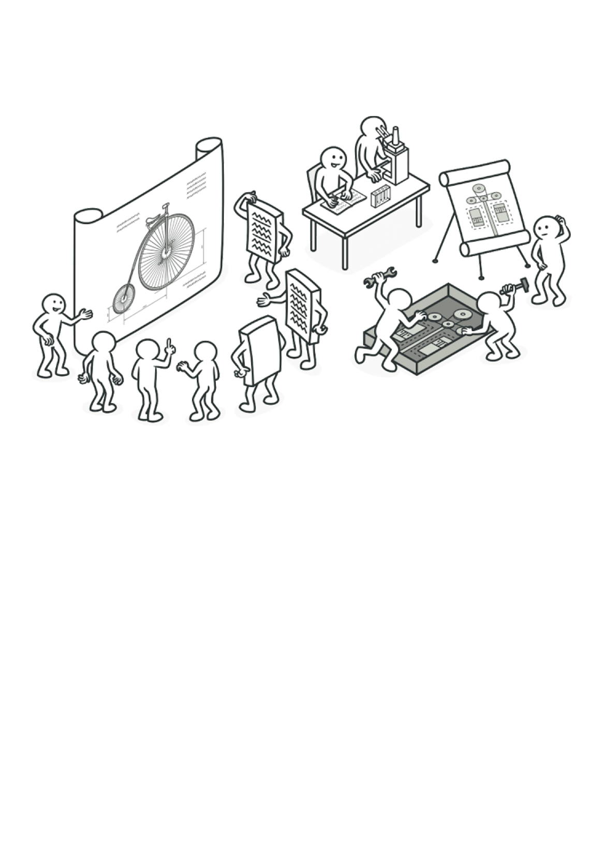
Architecture design
(UML diagrams)
4

Slide 5
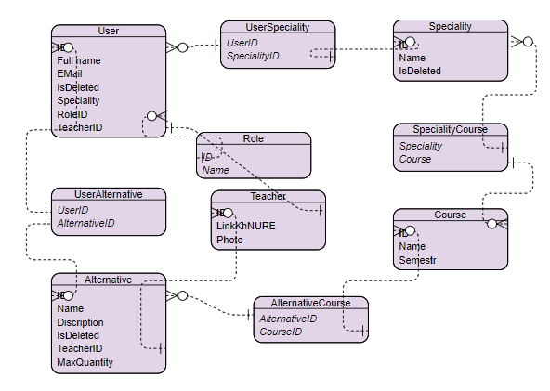
ER-diagram for our project
5

Slide 6
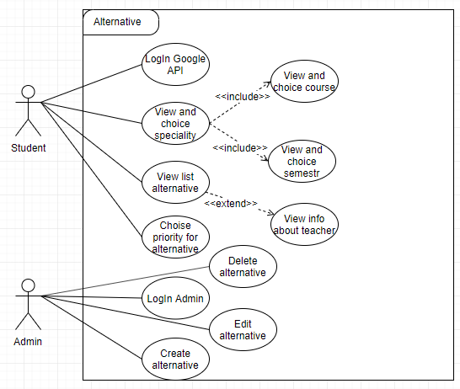
Use-case
diagram for
our project
6

Slide 7
Sequence
diagram for
our project
7

Slide 8
Deployment
diagram for
our project
8

