Slide 1
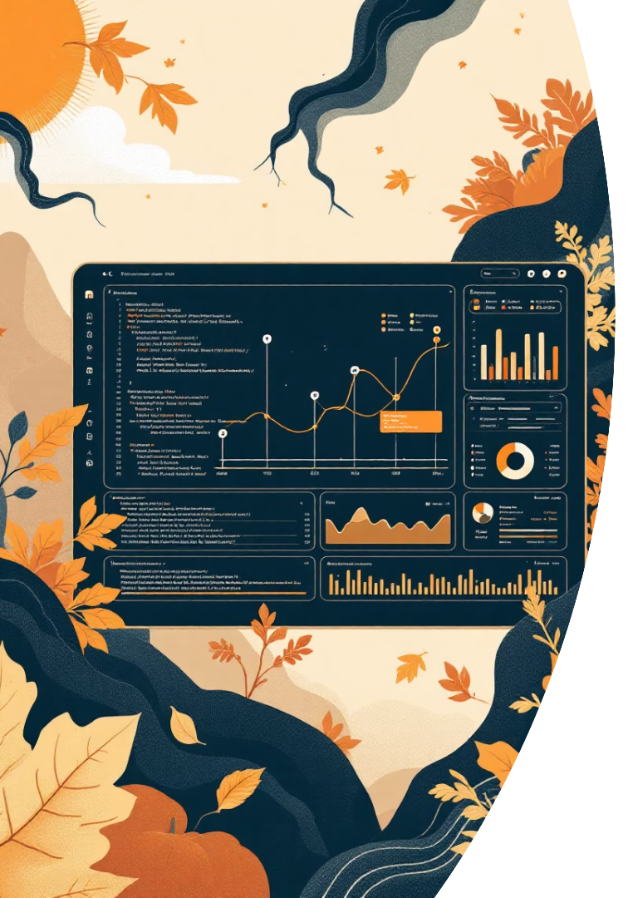
📊 Graph Analytics + Semantic QA: Building Knowledge Graphs in
Streamlit
By:
Shaik Althaf
Vigneswari
Aditya
Iswarya

Slide 2
Project Overview: Key Components
1. Data Loading
Import triples from CSV using pandas and Streamlit caching.
2. Graph Construction
Build directed graph with NetworkX, assign random colors by category.
3. Analytics Engine
Compute centralities, detect communities, visualize with PyVis.
4. Semantic Search
Use SentenceTransformer for question answering over triples.
5. Interactive UI
Streamlit interface for analytics and QA visualization.

Slide 3
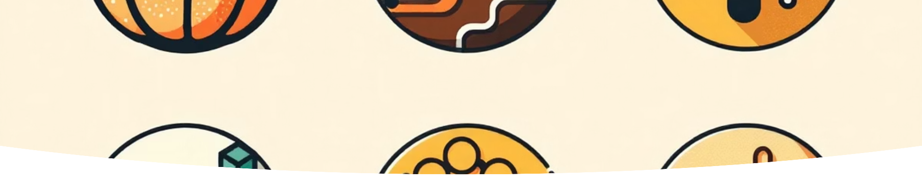
Imports: Setting Up the Environment
Begin by importing essential libraries. This foundational step ensures access to data handling, graph algorithms, semantic embeddings, and visualization tools.
streamlit as st: Builds interactive web app.
pandas as pd: Loads and processes CSV triples.
networkx as nx: Core graph construction and analysis. pyvis.network.Network: Generates interactive HTML visualizations. sentence_transformers: Powers semantic similarity search. matplotlib.pyplot as plt: Plots centrality bar charts.
random: Assigns dynamic colors to categories.

Slide 4

Building the Graph: Core Construction
This phase converts raw knowledge triples into a structured, visual network graph using NetworkX. Nodes and directed edges are created for entities and their relationships, with distinct color-coding for categories.
Initialize Graph: Directed Relationships
Categorization and Coloring
Unique categories from the DataFrame are assigned distinct colors to visually identify related nodes and simplify complex graph structures.
Add Nodes & Edges with Attributes
Nodes for Entity1 and Entity2 are created with categories and colors, then connected by a directed edge labeled with their 'Relation'.
A object is
networkx.DiGraph()
instantiated to represent directional relationships crucial for knowledge graphs.
The result is a visually organized, colored, and labeled knowledge graph, ready for in-depth network analysis and uncovering hidden connections.

Slide 5





Graph Analytics: Centrality Measures
Identify key nodes by analyzing their network roles and inﬂuence within the graph.
Degree Centrality
Counts direct connections.
Betweenness Centrality
Measures control over information ﬂow.
Closeness Centrality
Assesses proximity and efﬁcient reach.
Community Detection
Identiﬁes densely connected node clusters.
Interactive Visualization
Creates dynamic, interactive network graphs.

Slide 6
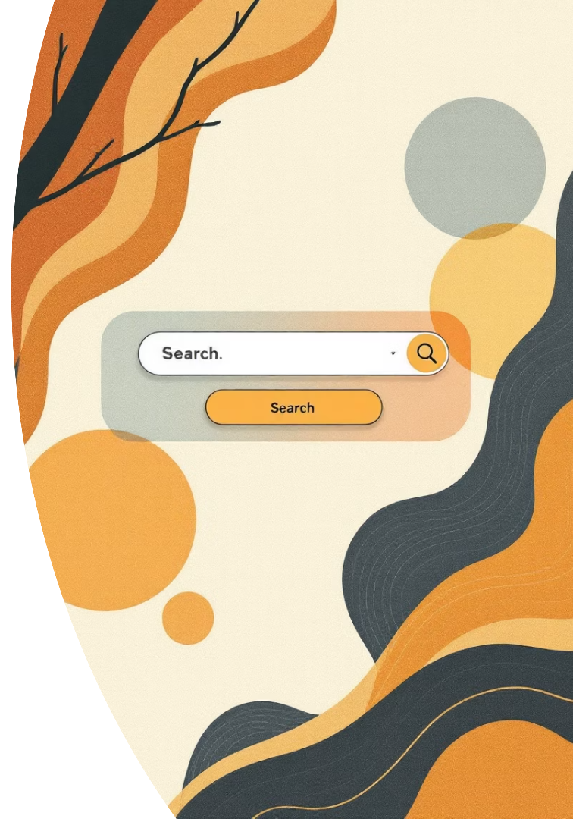



Semantic QA: Core Functions
Our Semantic QA system efﬁciently retrieves and visualizes information through key operational functions.
load_model()
Loads a lightweight SentenceTransformer model for efﬁcient text embeddings.
semantic_search()
Identiﬁes relevant knowledge graph triples by computing semantic similarity.
visualize_node_graph()
Generates interactive subgraphs to clearly visualize entity relationships.

Slide 7
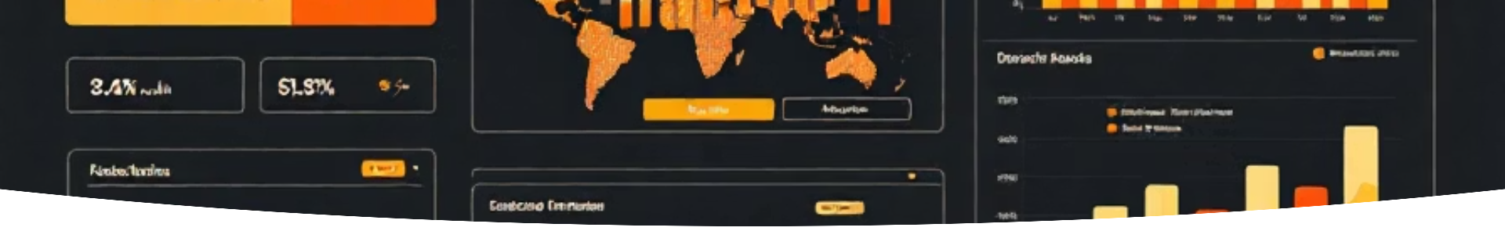
Node Visualization & UI Integration
Visualize context around matched entities; integrate into Streamlit for seamless user experience.
Main Interface
Setup `st.title`, navigation buttons, and text input for queries.
Analytics Display
Show centrality charts and community detection results.
QA Interface
Provide text input for questions and display semantic search results.
Graph Visualization
Embed interactive subgraphs and category color legends for exploration.

Slide 8
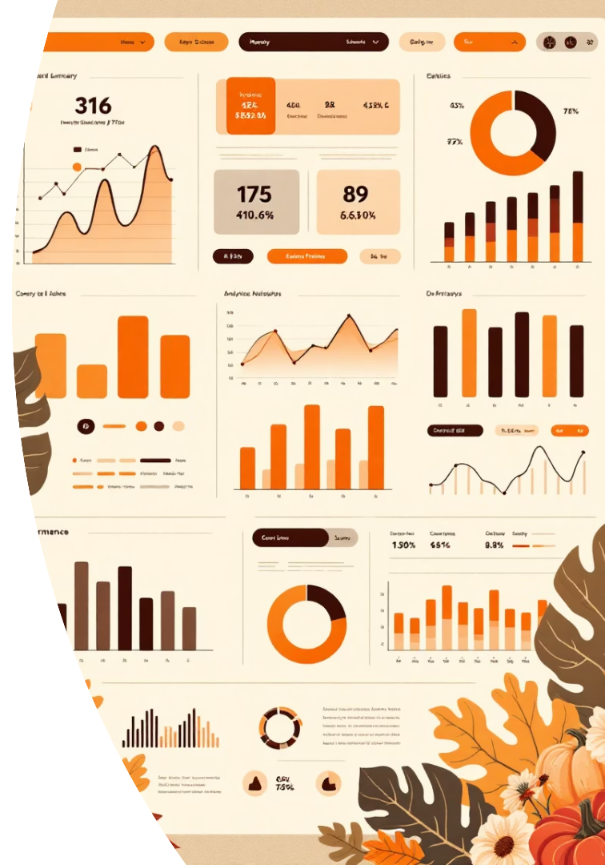
Output Analysis: Insights & Best Practices
The app delivers interactive graph exploration and semantic insights. Key outcomes: Identify hubs, uncover communities, answer entity queries visually.
10
Top Nodes
Centralities reveal inﬂuential entities (e. g., high betweenness bridges domains).
5
Communities
Greedy modularity groups related triples; aids cross- domain linking.
0.85
Similarity Scores
Cosine matches (e.g.
, >0.8) ensure relevant QA; MiniLM model balances speed/accuracy.

Slide 9
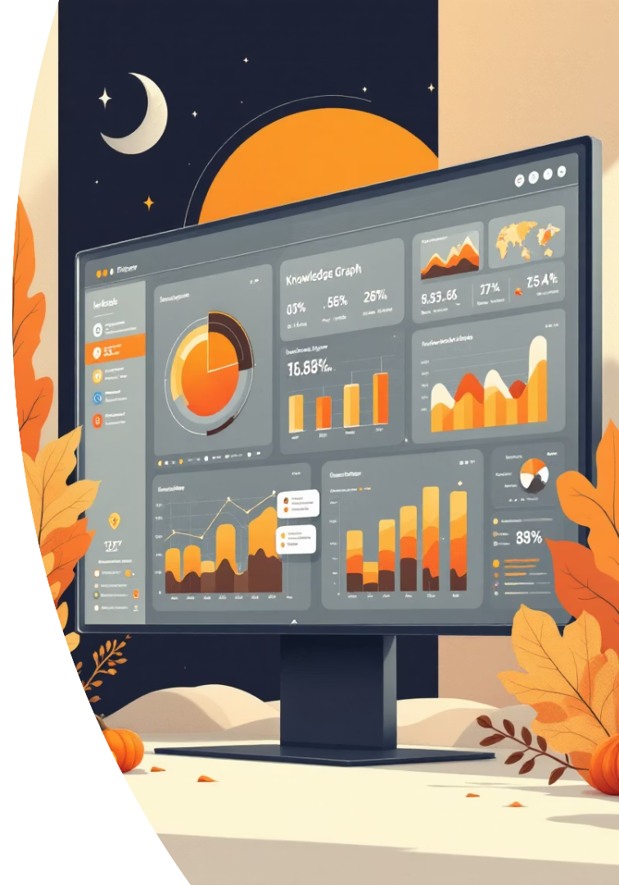
🎯 Project Complete
This project focused on the development of an interactive knowledge graph application.
Key Technologies Utilized:
Python
NetworkX
Streamlit
PyVis
SentenceTransformers
Main Features Achieved:
Graph analytics capabilities
Semantic search functionality
Interactive data visualization
The application successfully integrates graph-based data representation with advanced analytical and visualization tools, providing a robust framework for exploring complex data relationships and extracting actionable insights.

Slide 10
-:Thank You :-

