Slide 1

EasyLancer App
Pitch Deck
Where your TIme Counts

Slide 2
Table of contents
01
02
03
04
05
06
Introduction
Problem
solution
Features
USP
Product demo

Slide 3
01
Introduction

Slide 4

In the rapidly evolving landscape of freelance work, time is not only money—it's a competitive advantage. As freelancers, mastering time management is crucial for productivity, client satisfaction, and personal well-being.

Slide 5
Problems Contained
Client Understanding
Socially loud
Freelancers need to spend time communicating with clients, discussing project requirements, providing updates, and addressing feedback. Poor communication can result in misunderstandings, delays, and dissatisfaction on both sides.
Since being socially loud is an important factor to attain the client, the lack of experience and knowledge in this sector will cause a huge problem for them.also apart from being a non-recognisable person to influencer is a milestone.

Slide 6
Solution
Bridging communication gap
Social Media Advices
Value
From the suggested points regarding their topic of concern ,from which the user will be selecting one option.our interface will be helping them with best tone to communicate with clients
We will be Suggesting the trending hashtags,audios required for their social media posts.which will make them stand out loud.
The value of a product is determined by how much customers are willing to pay for it. It's a combination of factors, including the quality of the product, its features, and how well it meets customer needs

Slide 7
USP
EasyLancer:Your Time-Saving Partner for Client Communication

Slide 8

Product infographic
Visuals
Features
User Friendly interface
All-In-One
Subscription
Users
Initially it will be free as a trial phase
Mainly freelancers
Availability
Updates
Will be available in the playstore
Will be integrating with gmeet

Slide 9
Key ideas in market opportunity
Research new markets
Innovative solutions
the product will be tested at a discount rate or even at a free rate to some beginners in the field of freelance
Utilize technology and customer feedback to come up with novel solutions that meet your customer’s demands or needs
Stay ahead of trends
Seasonal spikes
The ideas to showcase the skill set of the individual and advertise the person to an extend of high marketability.
Emerging of new skill requirement in the market result in the entry of freelancers . causing the individuals with problems due lack of inexperience

Slide 10
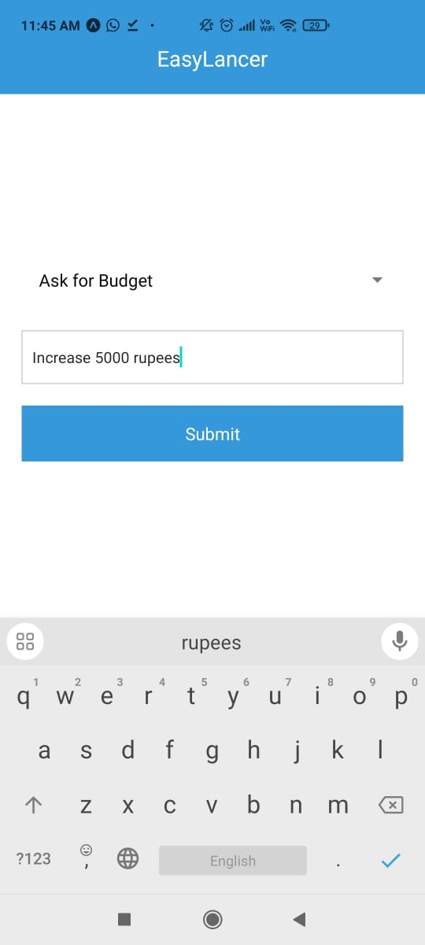
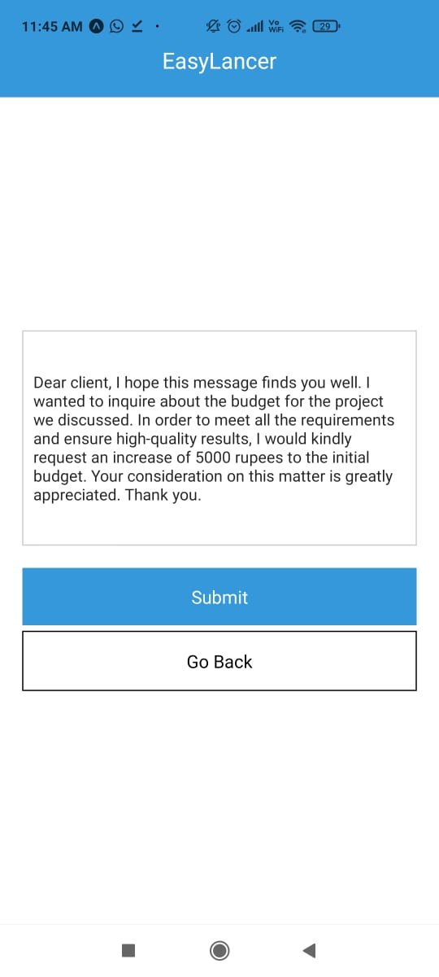
Product

Slide 11
T
S
A
K
H
N
Team Members:-
Salman
Althaf
Amit
Hadi
kasim

