Slide 1

IMPLEMENTATION OF A
MULTI-DEPTH SOIL NUTRIENT PROFILING SYSTEM
WITH EDGE-ADAPTIVE FERTIGATION CONTROL
TEAM 11:
M BHUVANESHWARI ( 9924005212 )
VIDYASRI K S ( 9924005364 )
RAM GOPAN G C ( 9924005346 )
ALTHAF PAKEER MYDEEN S ( 9924005467 )

Slide 2
ABSTRACT
• The system monitors soil moisture and temperature at three sensing depths and measures N, P and K using an RS485 soil nutrient probe.
• An STM32 NUCLEO-F446RE collects sensor data, processes the moisture readings and controls a relay-connected pump.
• An ESP32 receives telemetry from the STM32 over UART and uploads the readings to Firebase through Wi-Fi.
• A prepared, diluted nutrient solution can be placed in the reservoir for fertigation demonstration; the pump delivers the solution when the moisture-control condition is met.
Core idea: Multi-depth sensing + Local control + IoT monitoring
02

Slide 3
PROBLEM STATEMENT
Soil conditions can vary across the root zone, but many small-scale systems monitor only one location.
Single-point sensing
Fixed watering
Limited visibility
A single surface reading may not represent moisture conditions deeper in the soil.
Fixed schedules may supply water even when the monitored soil already has sufficient moisture.
Without connected monitoring, it is harder to observe changes in soil conditions over time.
A multi-depth monitoring and moisture-responsive delivery system can support more informed water and nutrient application.
03

Slide 4
OBJECTIVES
• Measure soil moisture independently at Depth 1, Depth 2 and Depth 3.
• Measure soil temperature at the same three sensing positions.
• Acquire nitrogen, phosphorus and potassium readings from the RS485 NPK probe.
• Use STM32 edge processing to make local pump-control decisions based on soil moisture.
• Send sensor readings and pump status to Firebase through the ESP32 for remote monitoring.
• Demonstrate delivery of a prepared liquid solution through the pump and tubing.
NPK is measured at the installed probe location; the three-depth array applies to moisture and temperature.
04

Slide 5
SYSTEM BLOCK DIAGRAM
Soil sensors
STM32 NUCLEO-F446RE
ESP32
Firebase / Dashboard
3 × moisture
3 × DS18B20
1 × RS485 NPK
Sensor acquisition
Local processing
Pump decision
UART receive
Wi-Fi upload
Latest readings
Remote monitoring
Relay module
DC pump
Solution reservoir
Controlled by STM32
Moves prepared liquid
through tubing
Water + suitable diluted
water-soluble fertilizer
Data: Sensors → STM32 → UART → ESP32 → Wi-Fi → Firebase
05

Slide 6
HARDWARE COMPONENTS
STM32 NUCLEO-F446RE
ESP32 development board
Main controller for sensor acquisition, local processing and pump control.
Receives STM32 telemetry over UART and uploads it to Firebase using Wi-Fi.
3 capacitive moisture sensors
3 DS18B20 sensors
Measure moisture at Depth 1, Depth 2 and Depth 3.
Measure soil temperature at the three sensing positions.
RS485 soil NPK probe
RS485-to-TTL converter
Measures N, P and K at its installed location using RS485/Modbus.
Converts RS485 communication signals into UART signals for the STM32.
Relay and DC pump
Reservoir, tubing and power
Relay switches the pump; the pump moves the liquid solution to the soil.
Hold and deliver the prepared solution; provide suitable, separate power as required.
06

Slide 7
SOIL PARAMETERS MONITORED
Parameter | Sensor | Location | Output
Soil moisture | Capacitive sensor × 3 | Depth 1 / 2 / 3 | Moisture (%)
Soil temperature | DS18B20 × 3 | Depth 1 / 2 / 3 | Temperature (°C)
Nutrients | One RS485 NPK probe | Probe installation point | Nitrogen (N), Phosphorus (P), Potassium (K)
The NPK probe provides one set of nutrient readings at the location where it is installed. Moisture and temperature are monitored at three depths.
07

Slide 8
WORKING PRINCIPLE & FERTIGATION FLOW
1
1. Prepare solution
Prepare a suitable, diluted water-soluble fertilizer solution in the reservoir, following the product label.
2
2. Sense soil
STM32 reads the three moisture sensors, three temperature sensors and RS485 NPK probe.
3
3. Decide locally
STM32 evaluates the average moisture and applies the configured pump-control thresholds.
4
4. Deliver solution
When the pump is triggered, the relay activates the pump and the prepared solution flows through the tube.
5
5. Monitor
STM32 sends sensor data to ESP32; ESP32 uploads it to Firebase for dashboard display.
08

Slide 9
EDGE-ADAPTIVE PUMP CONTROL
Pump ON
Retain state
Pump OFF
Average soil moisture below 30%: STM32 activates the relay and pump.
Average moisture from 30% to below 45%: keep the previous pump state.
Average soil moisture at or above 45%: STM32 switches the pump OFF.
These are the prototype's configured hysteresis thresholds. They should be calibrated for the soil, crop and sensor installation before agricultural use.
Local control continues even if Wi-Fi or Firebase is temporarily unavailable.
09

Slide 10
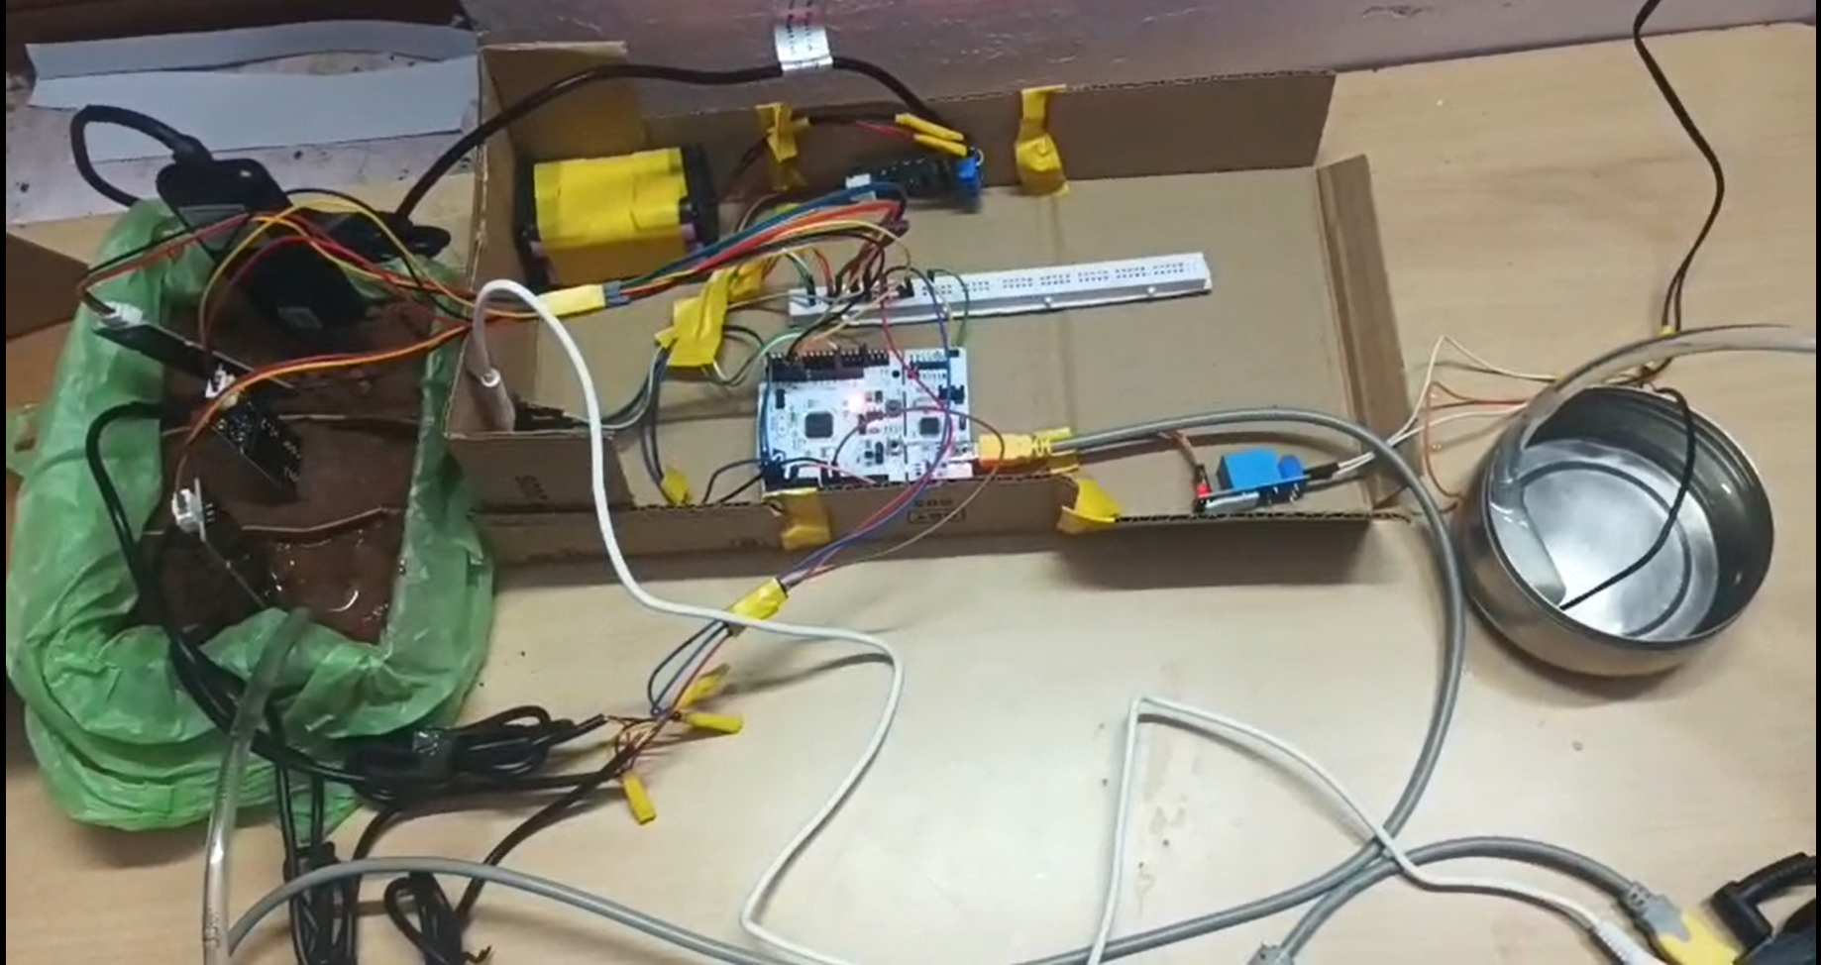
HARDWARE PROTOTYPE
Controller
STM32 NUCLEO-F446RE collects sensor data and controls the relay.
Pump and reservoir
The pump transfers the prepared liquid through the delivery tube.
Demonstration
Show sensor readings and pump switching.
10

Slide 11
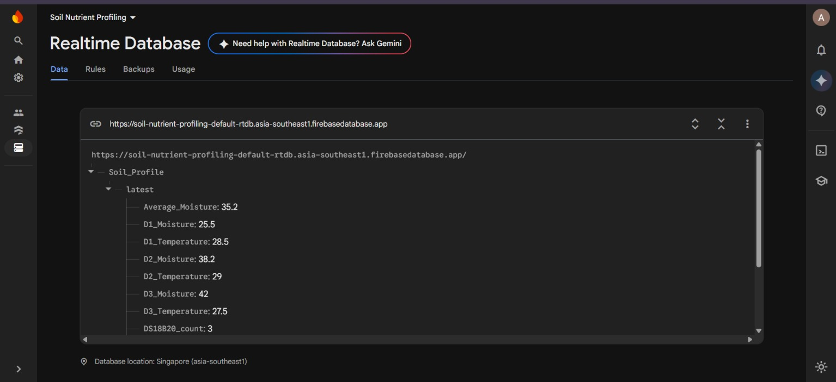
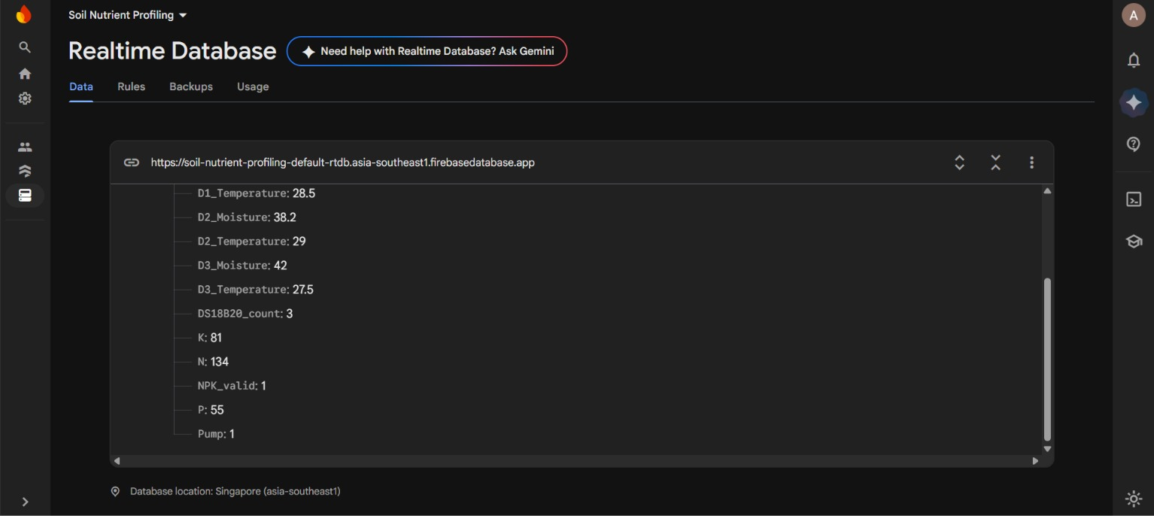
FIREBASE REALTIME DATABASE
Firebase stores the latest telemetry, including depth-wise moisture and temperature, NPK readings, average moisture and pump status.
11

Slide 12
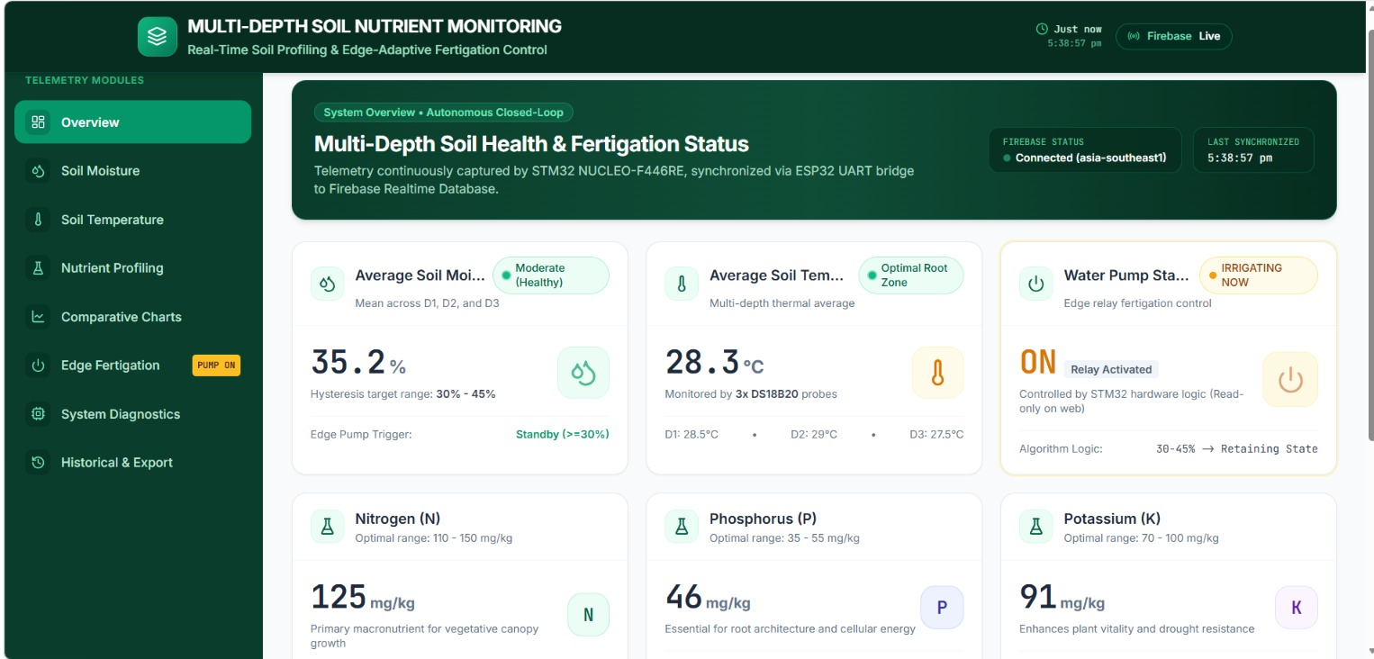
LIVE DASHBOARD OUTPUT
Dashboard displays
• Average soil moisture
• Moisture at Depth 1, 2 and 3
• Temperature at Depth 1, 2 and 3
• N, P and K readings
• Pump status
• Firebase connection status
12

Slide 13
SOFTWARE & COMMUNICATION
STM32CubeIDE
Arduino IDE
Firebase + Dashboard
Embedded C firmware development, peripheral configuration and debugging.
ESP32 firmware for UART reception, Wi-Fi connection and Firebase upload.
Realtime Database stores telemetry and the web dashboard visualizes readings.
Communication path
Sensors → STM32 | STM32 USART2 → ESP32 UART2 (115200 baud) | ESP32 Wi-Fi → Firebase Realtime Database
13

Slide 14
EXPECTED OUTCOMES & CONCLUSION
Expected outcomes
Conclusion
• Depth-wise moisture and temperature visibility
• NPK readings from the RS485 probe
• Local moisture-based pump automation
• Delivery of a prepared liquid nutrient solution
• Remote monitoring through Firebase
The prototype combines multi-depth soil sensing, RS485-based NPK measurement, STM32 edge control and ESP32 cloud connectivity. It controls a pump using soil-moisture feedback and can deliver a prepared, diluted nutrient solution from a reservoir. Firebase provides remote access to the collected sensor data.
Thank you
14

