Slide 1
Car price prediction
Muhammed Althaf K (12205672)
To : Mr. Himanshu Tikle
Course: Machine Learning II

Slide 2

Introduction
Used car prices vary based on many factors: age, mileage, fuel type, and brand.
Manual estimation is inaccurate and inconsistent.
Machine Learning helps predict car prices more accurately using data.
Project goal: Build an ML model that predicts used car prices from features.

Slide 3
Dataset Overview
Dataset features include:
Year → converted to Age
Kms Driven
Fuel Type (Petrol, Diesel, CNG)
Transmission (Manual / Automatic)
Owner Type
Price (Target variable)
Derived Features:
Age (2025 – Year)
log_kms (log-transformed mileage)
high_mileage flag

Slide 4

Data Preprocessing
Steps performed:
Cleaned Kms Driven and Price (converted to numeric)
Removed duplicates and inconsistent rows
Missing values handled using median/mode
Outlier detection using Interquartile Range (IQR)
Standardized column names
Applied One-Hot Encoding for categorical features

Slide 5
Exploratory Data Analysis (EDA)
Key insights:
Older cars and high mileage cars have significantly lower prices
Petrol cars dominate dataset
Automatic cars tend to have higher average price
Mileage and Age show strong negative correlation with Price
Heatmap helped identify relationships between numeric features

Slide 6

ML Models Used
Models implemented:
Linear Regression
Ridge Regression
Lasso Regression
Random Forest Regressor
HistGradientBoosting Regressor
Workflow used:
Train-Test Split (80–20)
Pipeline with scaling & encoding
5-fold Cross-Validation
Evaluation using RMSE, MAE, and R²

Slide 7
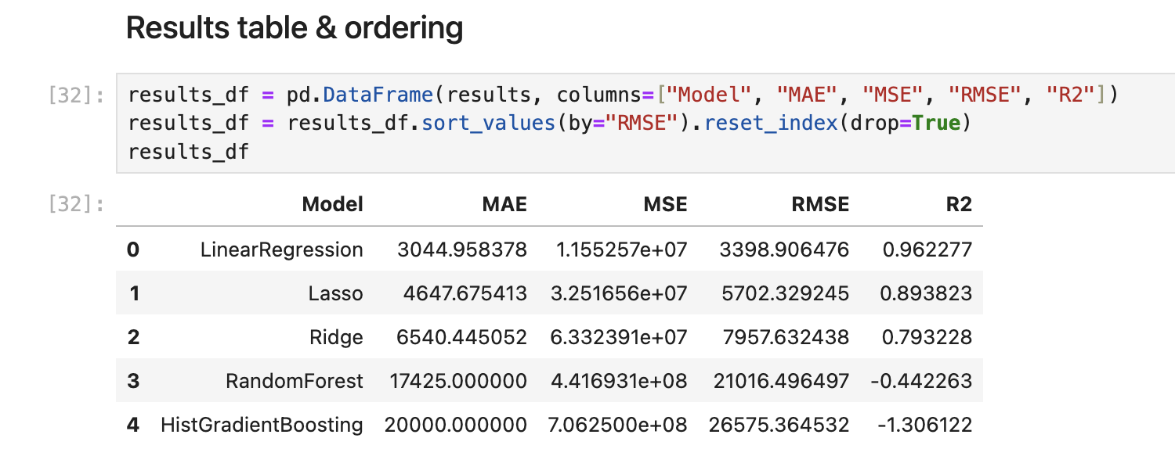
Results & Model Comparison
Linear Regression performed the best
Provided the most stable and accurate predictions
Outperformed Ridge, Lasso, Random Forest, and Gradient Boosting
Linear relationship between features (Age, Kms) and Price made LR suitable
Low RMSE and high R² compared to other models
Important predictive features:
Age
Kms Driven
Fuel Type
Transmission

Slide 8
Conclusion & Future Work
Conclusion:
Built a complete ML pipeline for car price prediction
Linear Regression gave the best performance among all tested models
Dataset showed strong linear patterns (Age & Kms), making LR ideal
Results demonstrate effective use of preprocessing + EDA + ML modeling
Future Enhancements:
Add more detailed features (engine power, torque, service records)
Try polynomial regression for improved accuracy
Deploy model as a simple web app for real-time predictions

Slide 9
THANK YOU

