Slide 1



Data Visualization on Heart Disease Dataset
GeeksforGeeks Complete Machine Learning
and Data Science Program Project
By Muhammed Althaf K (12205672)

Slide 2

CERTIFICATION

Slide 3
Introduction
Objective: Analyze heart disease data using data visualization techniques
Goal: Identify patterns and relationships in the data to understand heart disease better
Tools Used:
Pandas: For data manipulation.
Seaborn,Matplotlib: For creating visualizations
Visualizations: DistPlots, Pie Charts, Violin Plots, Heatmaps, JointPlot, PairPlot

Slide 4

Project Contents
01
02
03
04
05
06
Age (DistPlot)
Categorical Columns (Pie Charts)
ViolinPlot
Correlation (HeatMap)
Correlation (PairPlot)
Correlation - (JointPlot)

Slide 5
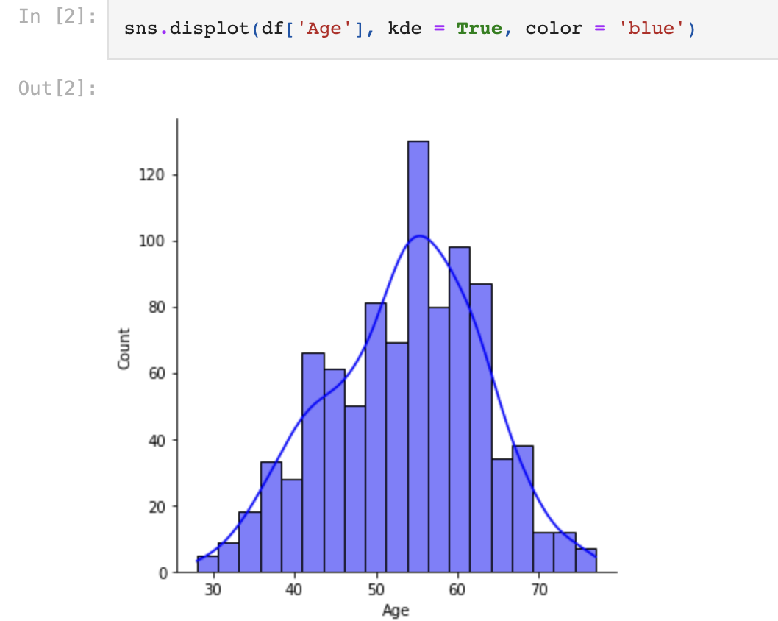
Age (DistPlot)
A DISTPLOT IS A FUNCTION THAT PLOTS A HISTOGRAM, KERNEL DENSITY ESTIMATE (KDE) PLOT, AND/OR RUG PLOT ON A SINGLE FIGURE
IT IS USED TO VISUALIZE THE DISTRIBUTION OF A SINGLE CONTINUOUS VARIABLE.
SO AFTER DOING THE VISUALIZATION WE CAN INFER THAT MINIMUM AGE IS AROUND 30 AND MAXIMUM AGE IS AROUND 80. MAXIMUM OF THE DATA FALLS WITHIN THE RANGE OF 40 TO 70.

Slide 6
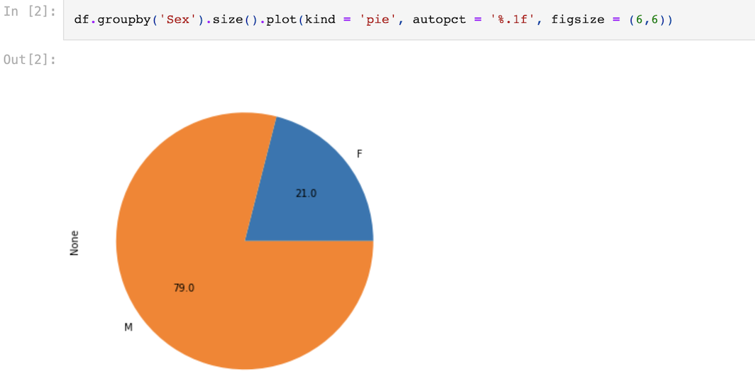
Categorical Columns (Pie Charts)
A PIE CHART IS A CIRCULAR STATISTICAL GRAPHIC, WHICH IS DIVIDED INTO SLICES TO ILLUSTRATE NUMERICAL PROPORTION
WITH THE HELP OF PIE CHART WE CAN SEE THAT 79% OF THE PEOPLE WHO ARE HAVING HEART DISEASE ARE MALES AND 21% ARE FEMALES IN OUR DATASET

Slide 7
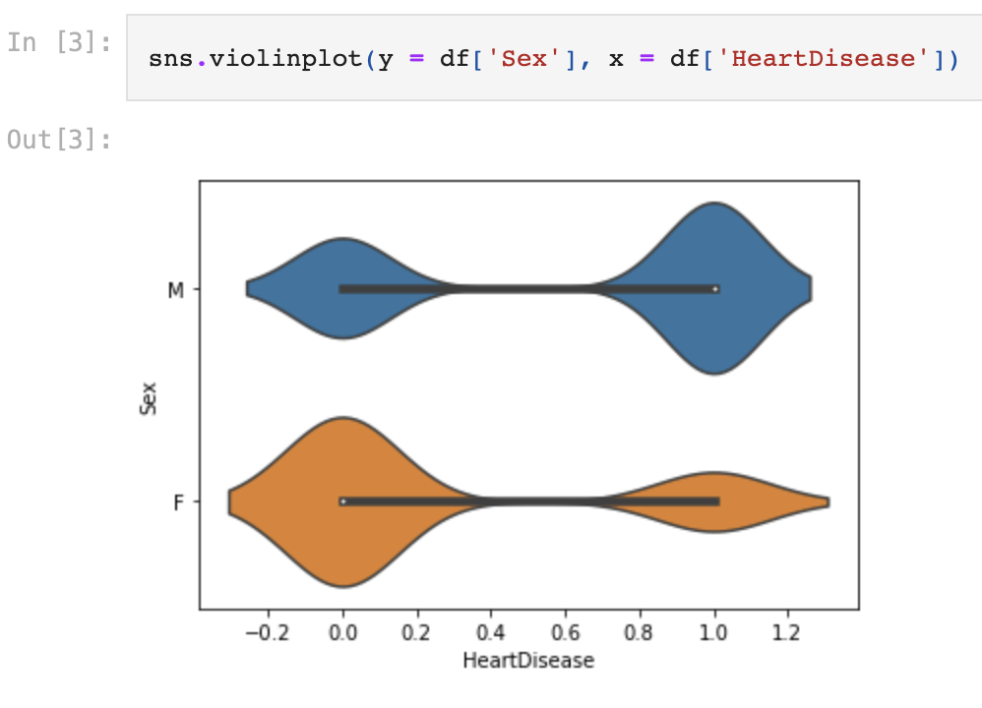
ViolinPlot
A VIOLINPLOT IS A GRAPHICAL REPRESENTATION OF A CONTINUOUS DISTRIBUTION, SHOWING THE PROBABILITY DENSITY OF THE DATA AT DIFFERENT VALUES
SO FROM THIS WE CAN SEE THERE ARE MORE MALES WHO ARE HAVING THE CHANCES OF HAVING A HEART DISEASE COMPARED TO FEMALES

Slide 8
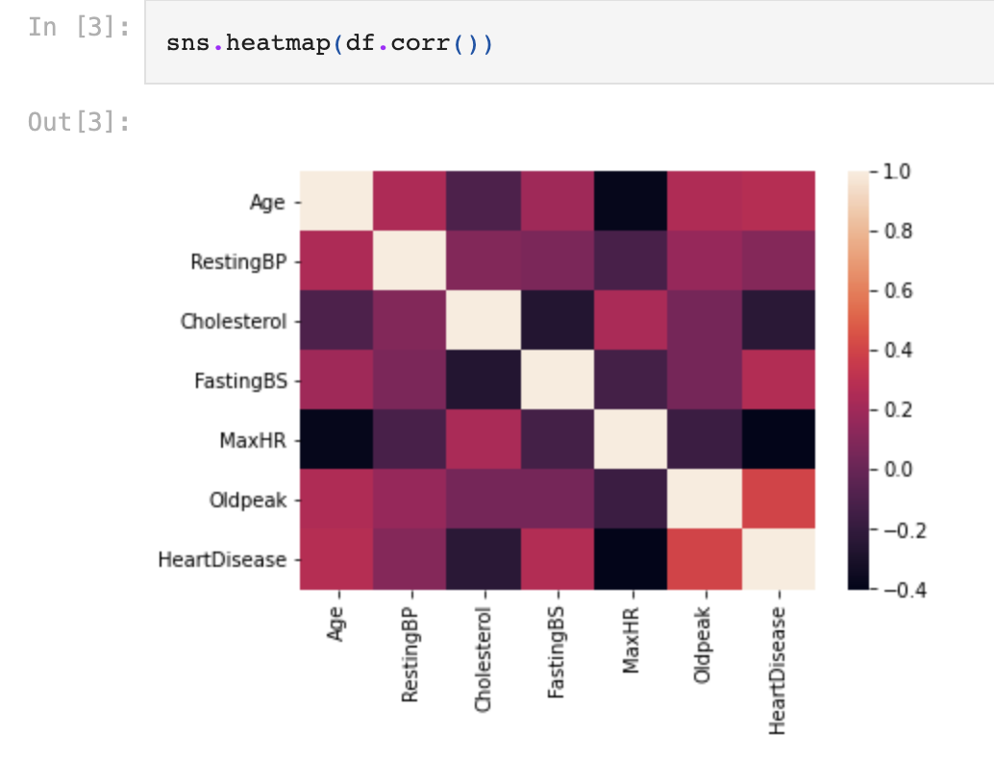
Correlation (HeatMap)
A CORRELATION HEATMAP IS A GRAPHICAL REPRESENTATION OF THE CORRELATION MATRIX OF A DATASET, WHICH SHOWS THE CORRELATION COEFFICIENTS BETWEEN THE DIFFERENT VARIABLES IN THE DATASET.
THE VALUES IN THE MATRIX ARE REPRESENTED AS COLORS, WITH DARKER COLORS INDICATING A STRONGER POSITIVE OR NEGATIVE CORRELATION
THE VALUES IN THE MATRIX ARE THE PEARSON CORRELATION COEFFICIENTS BETWEEN THE DIFFERENT VARIABLES, WITH 1 INDICATING A STRONG POSITIVE CORRELATION, -1 INDICATING A STRONG NEGATIVE CORRELATION, AND 0 INDICATING NO CORRELATION

Slide 9
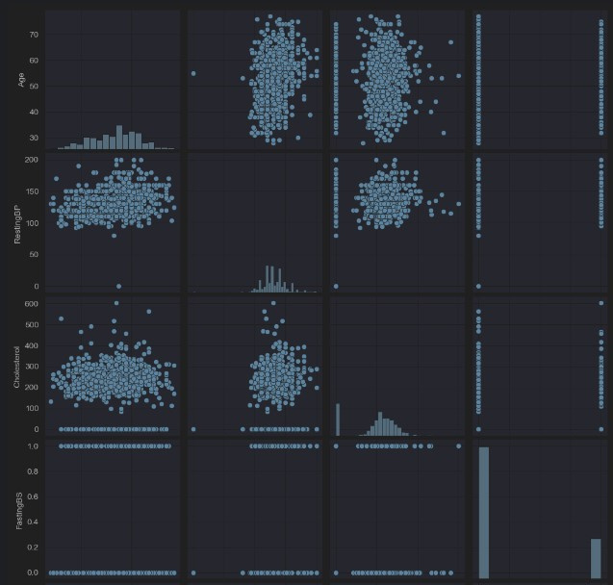
Correlation (PairPlot)
A CORRELATION PAIRPLOT IS A GRAPHICAL REPRESENTATION OF THE PAIRWISE RELATIONSHIPS BETWEEN VARIABLES IN A DATASET
IT IS A MATRIX OF SCATTER PLOTS, WHERE EACH SCATTER PLOT SHOWS THE RELATIONSHIP BETWEEN TWO VARIABLES

Slide 10
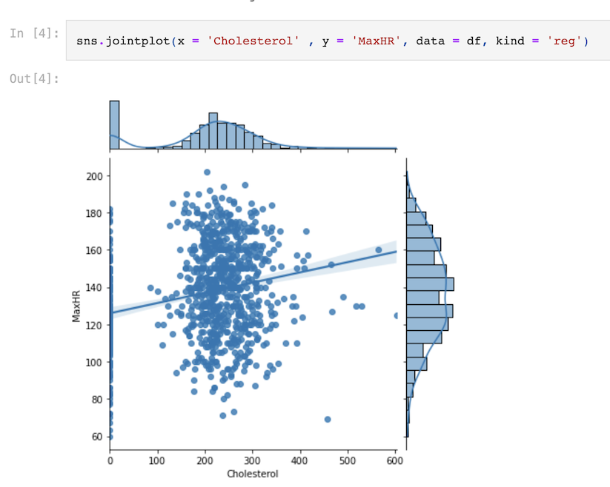
Correlation - (JointPlot)
A CORRELATION JOINTPLOT IS A GRAPHICAL REPRESENTATION OF THE JOINT DISTRIBUTION OF TWO VARIABLES, ALONG WITH THEIR INDIVIDUAL DISTRIBUTIONS
THE PLOT INCLUDES A SCATTERPLOT OF THE DATA, WITH A REGRESSION LINE SHOWING THE TREND, AS WELL AS HISTOGRAMS OR KERNEL DENSITY PLOTS OF THE INDIVIDUAL VARIABLES ON THE X- AND Y-AXES
SO FROM THIS WE CAN SEE BASED ON CHOLESTEROL HOW THE MAXHR IS CHANGING

Slide 11



Conclusion
KEY INSIGHTS:
AGE DISTRIBUTION: MAJORITY OF HEART DISEASE CASES FALL BETWEEN THE AGES OF 40 AND 70.
GENDER DISTRIBUTION:79% OF PATIENTS ARE MALE, 21% FEMALE.
CORRELATIONS: STRONG RELATIONSHIPS FOUND BETWEEN VARIABLES SUCH AS CHOLESTEROL, AGE, AND MAXIMUM HEART RATE.
IMPORTANCE OF VISUALIZATION: HELPS TO QUICKLY UNDERSTAND PATTERNS, RELATIONSHIPS, AND TRENDS IN THE DATASET.
FURTHER ANALYSIS COULD EXPLORE PREDICTIVE MODELING TO IDENTIFY HIGH-RISK INDIVIDUALS.

Slide 12
Reference
DATASET : WWW.KAGGLE.COM/DATASETS/FEDESORIANO/HEART-FAILURE-PREDICTION
COURSE : WWW.GEEKSFORGEEKS.ORG/COURSES/DATA-SCIENCE-LIVE
TOOLS : PANDAS, SEABORN, MATPLOTLIB

