Slide 1

Laptop Price Prediction
Name : Muhammed Althaf K Reg NO. 12205672
Section : K22UG Course code: CSM355

Slide 2
Project Overview
In the digital age, laptops are vital for various spheres. Predicting their price based on specifications is a complex yet valuable task. This project develops a machine learning system to estimate laptop prices using structured data, including features like brand, processor, RAM, storage, and display.
Key Features Project Goals
Brand and Processor Type
RAM and Storage Capacity
Screen Characteristics and GPU
Operating System
Develop a predictive system
Estimate prices accurately
Utilise structured data
Enhance predictive power

Slide 3



Introduction to Laptop Price Prediction
Laptops are indispensable, leading to a market flooded with diverse models. This variation creates pricing challenges for consumers and sellers. Traditionally, pricing relies on manual comparisons, which can be subjective. This project aims to automate and optimise pricing through predictive modelling using machine learning.
Market Complexity
Automated Pricing
Data-Driven Insights
Diverse models and specifications make pricing challenging.
Leveraging machine learning to optimise the pricing process.
Uncovering relationships between features and price using historical data.

Slide 4

Literature Review: Predictive Analytics
Machine learning is a powerful tool in predictive analytics, especially for structured data. Price prediction has been explored in various domains. In electronics, regression-based approaches are common due to their interpretability and suitability for continuous output variables.
Linear Regression (LR)
Widely used baseline, struggles with multicollinearity and non-linear relationships.
Random Forest (RF)
Effective in capturing complex interactions and robust to overfitting.
K-Nearest Neighbors (KNN)
Non-parametric method, intuitive but computationally expensive in high dimensions.

Slide 5





Dataset Description
The dataset contains detailed specifications of various laptops, used for market price prediction. It includes several hundred entries, each representing a unique laptop model and its attributes.
Company
Brand or manufacturer (e.g., Dell, HP).
TypeName
Category (e.g., Ultrabook, Gaming).
RAM
Random Access Memory (in GB).
Weight
Physical weight (in kg).

Slide 6





Data Preprocessing Steps
To ensure accurate laptop price prediction, several data preprocessing steps were performed. These steps included cleaning and converting data types, engineering new features, breaking down storage features, handling categorical variables, and reducing redundant features.
Cleaning and Converting
Stripped units from 'Ram' and 'Weight', converted to numerical types. Extracted features like Touchscreen, IPS, and PPI from
'ScreenResolution'.
Feature Engineering
Created binary features for Touchscreen and IPS. Computed PPI from screen resolution and size. Parsed CPU descriptions into categories.
Storage Breakdown
Split combined 'Memory' column into separate numerical columns
for HDD and SSD.
Categorical Handling
Encoded categorical features (Company, TypeName, CPU brand, GPU, OS) using One-Hot Encoding.
Feature Reduction
Dropped redundant columns like ScreenResolution, Inches, Cpu, and
Cpu Name after extraction.

Slide 7


Methodology: Algorithms and Evaluation
To predict laptop prices, three machine learning algorithms were used and compared: Linear Regression with Lasso Regularization, K-Nearest Neighbors (KNN) Regressor, and Random Forest Regressor. The dataset was split into training and testing sets for unbiased evaluation.
Linear Regression with Lasso
Linear model with L1 regularization for feature selection and overfitting prevention.
K-Nearest Neighbors (KNN)
Non-parametric method predicting prices based on nearest data points.
Random Forest Regressor
Ensemble method building multiple decision trees, robust to overfitting.

Slide 8
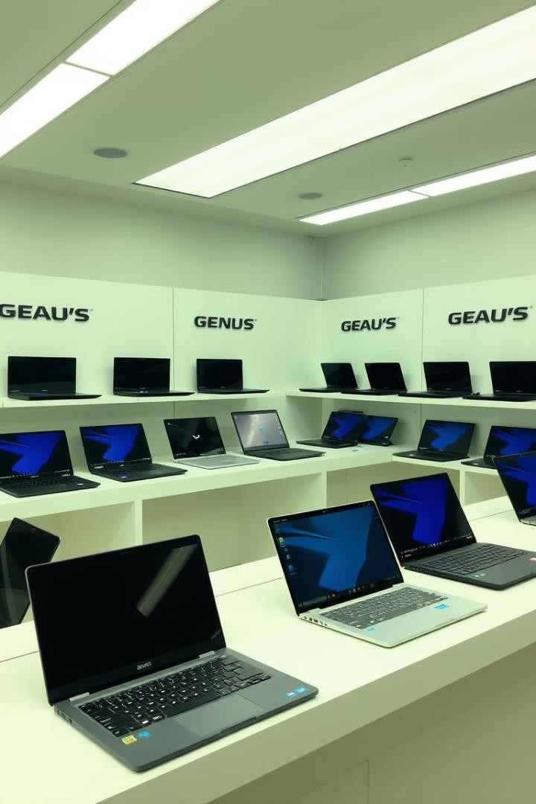
Conclusion
Project successfully built a machine learning model for laptop price prediction using hardware specifications. The preprocessing pipeline ensured clean, structured input, and the models were rigorously evaluated. Random Forest showed strong predictive power, while Lasso Regression and KNN provided valuable insights.

