Slide 1


Silent Burnout: A Multimodal AI Framework for Early Detection of Academic Disengagement
Prepared By: Adil Muhammed K M, Mohammed Sinan A A, Muhammed Althaf K
Regd. No: 12220729, 12220964, 12205672
Roll No: R222UGB59, R222UGB40, R222UNA08
Course Code : CSE461
Current mobile: +91 8281999491, +91 8289814657, +91 7736212397
Email: adilmuhammedkm@gmail.com, mohammedsinanaa5@gmail.com, althafk7171@gmail.com
Research/Project Link: https://github.com/adilmuhammedkm/Silent-Burnout-AI
Submitted To: Mrudula Selokar
Dept: Computer Science and Engineering
University: Lovely Professional University Jalandhar Punjab India

Slide 2
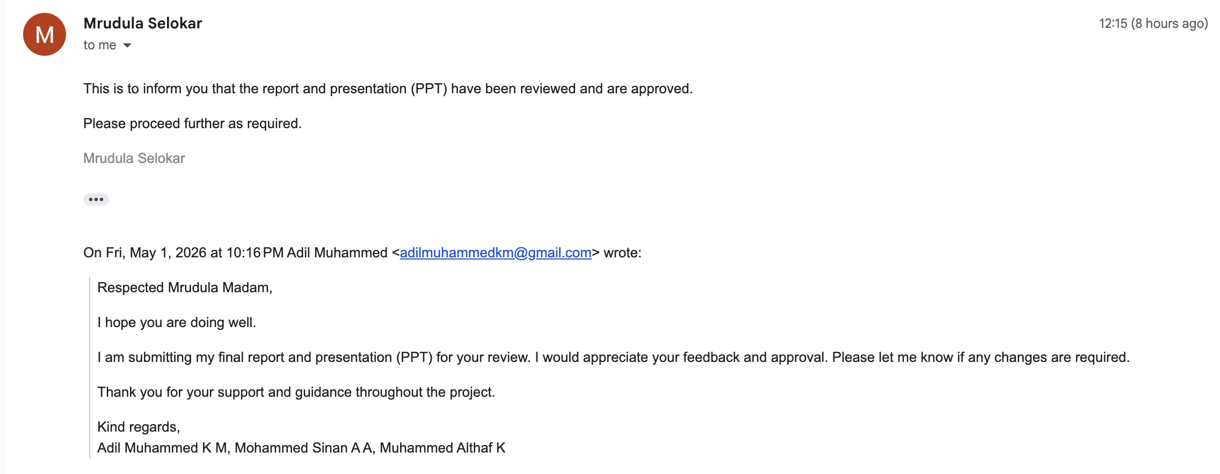
Mentor's Thesis & PPT Approval

Slide 3
Table Of Content
1. Introduction & Project Foundation
2. Requirement Analysis & System Design
3. Data Engineering & Pre-processing
4. Advanced Methodology & Implementation
5. Comprehensive Results & Validation
6. System Integration & Deployment
7. Research Output & Intellectual Property
8. Discussion, Conclusion & Future Scope
9. References & Appendices

Slide 4
Introduction & Project Foundation
Project Objectives:
Detect early signs of student disengagement
Analyze LMS behavioral engagement patterns
Build predictive models using ML algorithms
Enable early intervention using data-driven insights

Slide 5
Introduction & Project Foundation
Problem Statement & Motivation:
Student disengagement is detected only after performance decline
Systems rely mainly on grades and attendance
Behavioral LMS data is underutilized
Need for early warning to enable timely intervention

Slide 6
Introduction & Project Foundation
Literature Synthesis & Research Gap:
Existing studies focus mainly on academic performance prediction
Some works use LMS data but rely on basic interaction features
Limited integration of behavioral + academic data in a single framework
This project proposes a multimodal, behavior-driven approach for early detection

Slide 7
Literature review
Year | Reference of Paper | Research Gap | Proposed Model
2010 | Kotsiantis et al., Predicting Students at Risk Using ML | Mainly academic features, small dataset, limited behavioral modeling | Large-scale LMS behavioral modeling + ensemble ML
2015 | Romero & Ventura, Educational Data Mining Review | Focused on performance analytics, minimal temporal engagement modeling | Engagement trend, diversity & stability features
2016 | Marbouti et al., Early Prediction of At-Risk Students | Focused mainly on academic performance indicators, limited behavioral interaction modeling | Focused mainly on academic performance indicators, limited behavioral interaction modeling
2017 | Behavioral + academic multimodal modeling with ensemble learning | Analyzed online behavior but lacked advanced feature engineering and optimization | Analyzed online behavior but lacked advanced feature engineering and optimization
2019 | OULAD Dataset Study (Kuzilek et al.) | Provided dataset but limited advanced feature engineering | Advanced behavioral aggregation + hyperparameter tuning

Slide 8
Requirement Analysis & System Design
Functional Requirements
Accept student behavioral and academic input data
Process data using trained machine learning model
Predict disengagement risk level (Low / Medium / High)
Display prediction results with probability and insights
Non-Functional Requirements
Provide real-time prediction with low latency
Ensure scalability for large student datasets
Maintain usability with a simple and interactive interface
Ensure accuracy and reliability of predictions

Slide 9
Requirement Analysis & System Design
Proposed System Architecture:
Input: LMS behavioral data and academic performance data
Processing: Data preprocessing and feature engineering
Model: Machine learning model (Gradient Boosting) for prediction
Output: Risk classification with visualization in dashboard

Slide 10
Requirement Analysis & System Design
Data Flow & Workflow:
Data collection from LMS datasets (student activity and assessments)
Data preprocessing and feature extraction
Model processing for risk prediction
Output generation and visualization in dashboard

Slide 11
Data Engineering & Pre-processing
Data Sourcing & Description:
Dataset: Open University Learning Analytics Dataset (OULAD)
Contains student demographic, assessment, and LMS interaction data
Includes features like clicks, activity logs, scores, and submissions
Large-scale dataset with thousands of students and extensive interaction records

Slide 12
Data Engineering & Pre-processing
Exploratory Data Analysis (EDA):
Correlation analysis to identify relationships between engagement and performance
Detection and handling of outliers in activity and score features
Distribution analysis of key variables (clicks, scores, submissions)
Visualizations used to understand patterns and data trends

Slide 13
Data Engineering & Pre-processing
Data Pipeline:
Data cleaning: handling missing values and removing inconsistencies
Feature engineering: creation of behavioral metrics (clicks, engagement trends)
Feature processing: selection and scaling of relevant variables
Data splitting into training and testing sets for model evaluation

Slide 14
Advanced Methodology & Implementation
Final Algorithm Selection:
Multiple models evaluated: Logistic Regression, Random Forest, Gradient Boosting
Gradient Boosting selected for better accuracy and generalization
Handles non-linear relationships and feature interactions effectively
Provides stable and consistent performance on structured tabular data

Slide 15
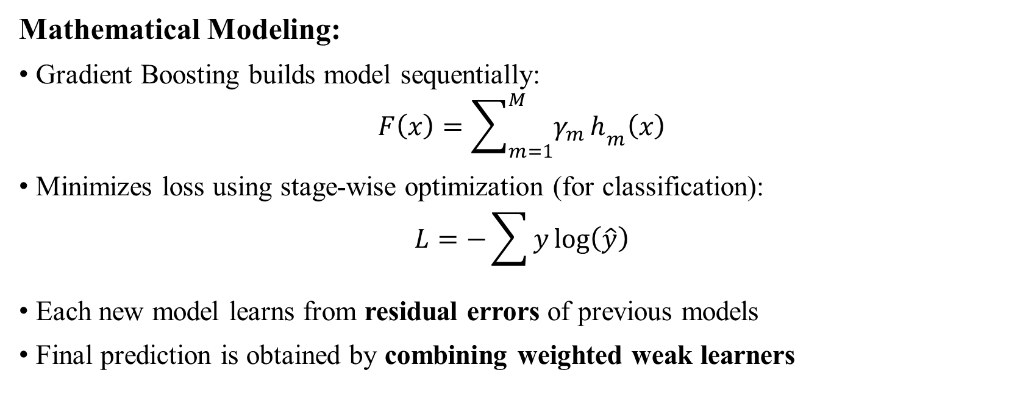
Advanced Methodology & Implementation
Mathematical Modeling:
Gradient Boosting builds model sequentially: $F\left(x\right)=\sum_{m=1}^{M}{γ_{m}}h_{m}\left(x\right)$
Minimizes loss using stage-wise optimization (for classification): $L=−\sum{y}log⁡\left(\hat{y}\right)$
Each new model learns from residual errors of previous models
Final prediction is obtained by combining weighted weak learners

Slide 16
Advanced Methodology & Implementation
Hyperparameter Optimization:
Applied GridSearchCV to tune model parameters systematically
Key parameters optimized: learning rate, number of estimators, max depth
Used cross-validation to ensure robust and unbiased performance
Achieved improved accuracy and better generalization after tuning

Slide 17
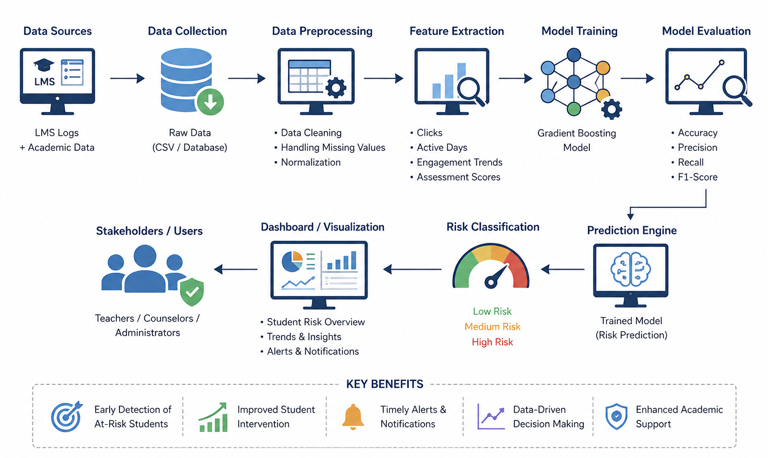
Final proposed system architecture

Slide 18
Comprehensive Results & Validation
Performance Evaluation:
Evaluated using metrics: Accuracy, F1-Score, and ROC-AUC
Achieved ~80% accuracy with consistent model performance
Confusion matrix used to analyze class-wise predictions
Graphical representations include ROC curve and performance plots

Slide 19
Comprehensive Results & Validation
Comparative Analysis:
Compared Gradient Boosting with Logistic Regression and Random Forest
Gradient Boosting achieved higher accuracy and better class separation
Showed improved performance on non-linear and complex feature patterns
Selected as final model due to best overall predictive performance

Slide 20
Comprehensive Results & Validation
Ablation Study:
Evaluated impact of behavioral features vs academic features separately
Model performance decreased when behavioral features were removed
Combining both feature types resulted in highest accuracy
Shows importance of multimodal feature integration for prediction

Slide 21
System Integration & Deployment
Final UI/UX Implementation:
Developed an interactive Streamlit-based web application
Allows user input of behavioral and academic features
Displays risk prediction with probability scores
Includes visualizations (risk graph and engagement profile)

Slide 22
System Integration & Deployment
Deployment Pipeline:
Model deployed locally using saved .pkl files (joblib)
Integrated with Streamlit for real-time prediction serving
Input → preprocessing (imputer + feature order) → model → output
Provides low-latency predictions suitable for interactive use

Slide 23
Data Flow Diagram
Start
Input Data (LMS + Academic)
Data Preprocessing
Feature Engineering
Model (Gradient Boosting)
Risk Level (Low / Medium / High)
Visualization (Dashboard)
End

Slide 24
Research Output & Intellectual Property
Research Paper / Publication:
Research manuscript prepared based on project methodology and results
Targeted for submission to IEEE / Scopus-indexed conference (ICCCNS)
Focus on AI-based early detection of academic disengagement
Paper includes methodology, evaluation, and system implementation details

Slide 25
Research Output & Intellectual Property
IP & Copyright:
Project includes a custom ML pipeline and interactive dashboard design
Potential for software copyright of implementation and UI
Core methodology can be considered for future IP/patent exploration
Currently developed for academic and research purposes

Slide 26
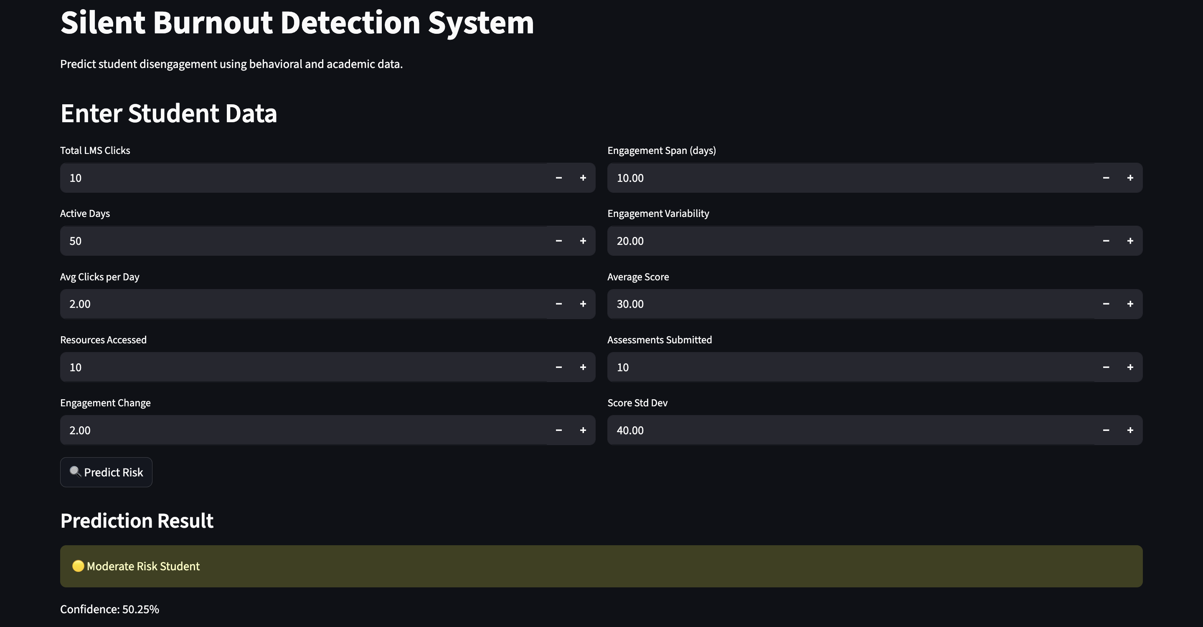
Screenshots and demo of the functional application

Slide 27
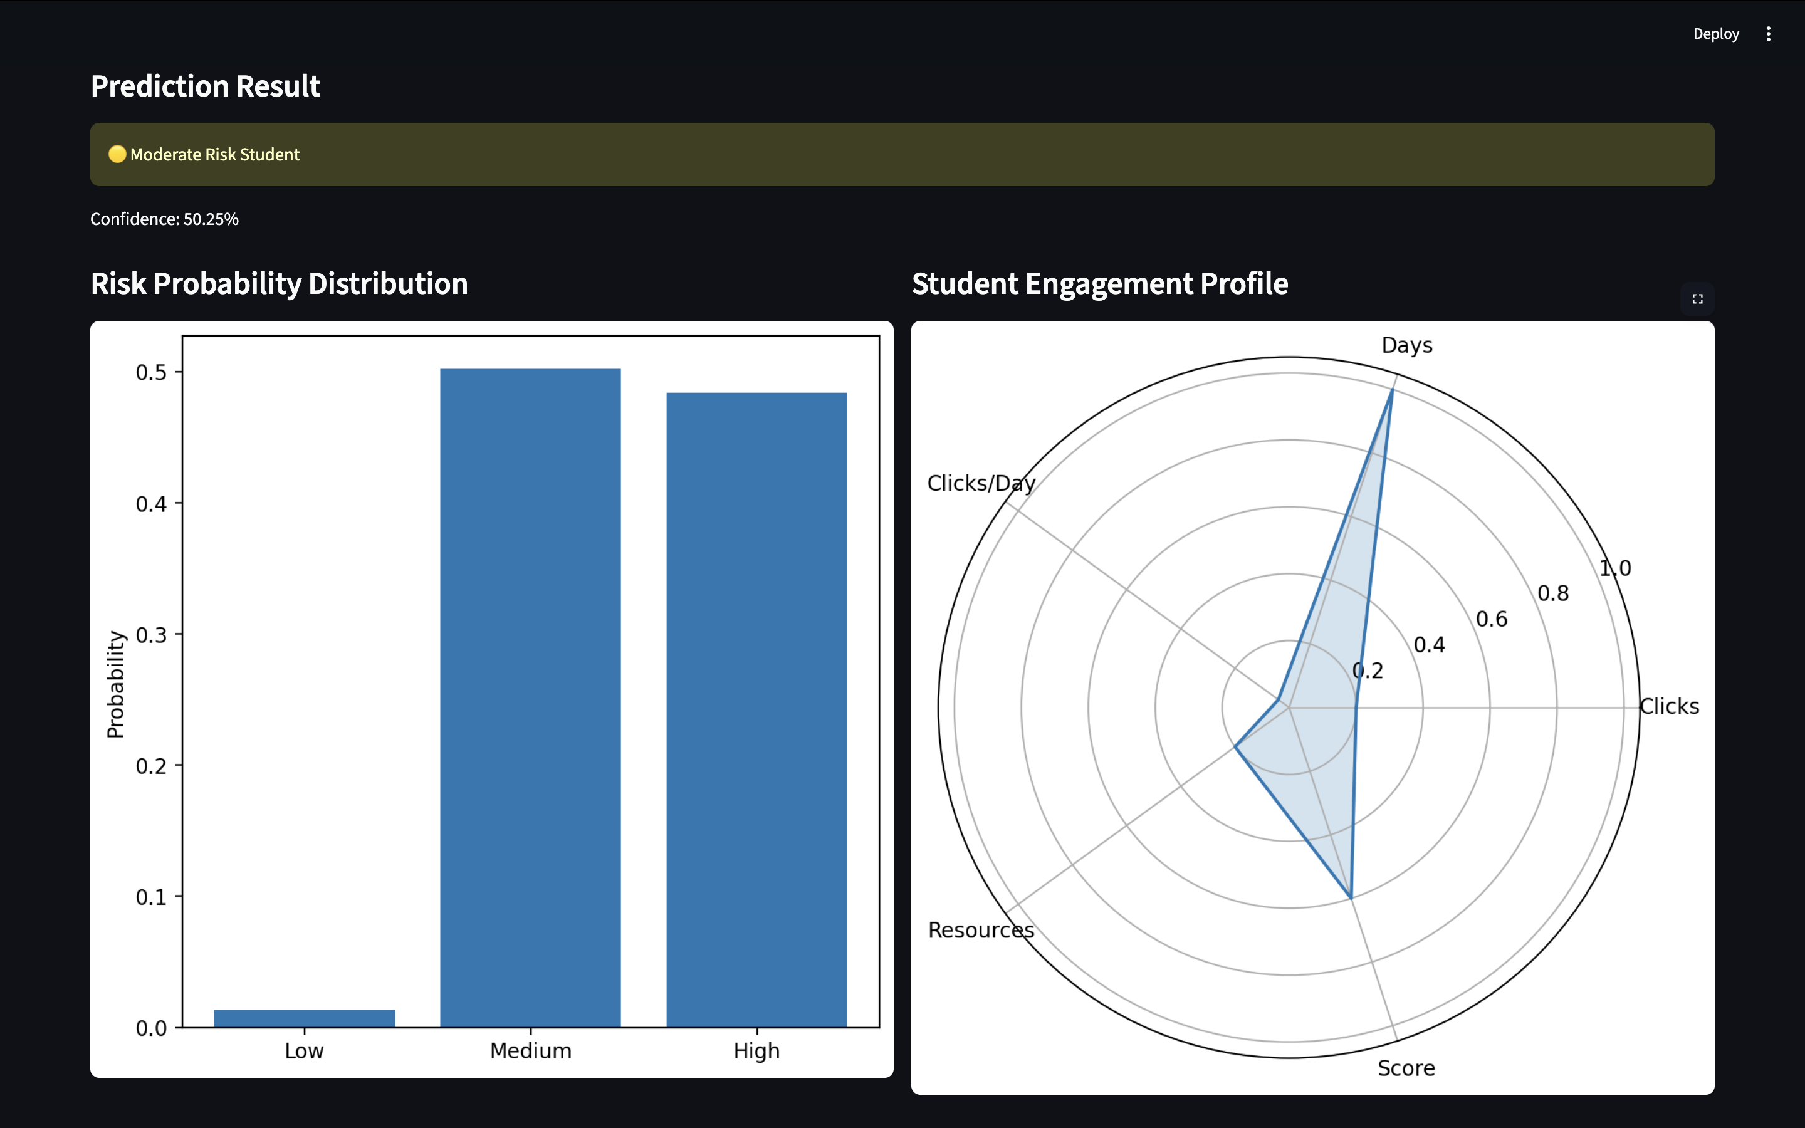
Screenshots and demo of the functional application

Slide 28
Project Timeline
Phase | Task
Week 1–2 | Data Analysis
Week 3–4 | Feature Engineering
Week 5–6 | Model Training
Week 7–8 | Model Optimization
Week 9 | Final Report
Week 10 | Final Submission

Slide 29
Discussion, Conclusion & Future Scope
Technical Challenges & Mitigations:
Handling large and complex LMS datasets → optimized preprocessing and feature selection
Dealing with missing and inconsistent data → applied imputation and cleaning techniques
Model selection and tuning challenges → used GridSearchCV for optimization
Integration of model with frontend → ensured proper pipeline and file handling for deployment

Slide 30
Discussion, Conclusion & Future Scope
Limitations & Constraints:
Relies on historical dataset (no real-time data integration)
Limited to LMS behavioral and academic features only
Model performance depends on data quality and feature representation
Does not include psychological or external influencing factors

Slide 31
Discussion, Conclusion & Future Scope
Conclusion & Future Directions:
Demonstrates effective early detection of academic disengagement using ML
Highlights importance of behavioral data alongside academic performance
Can be extended with real-time data and deeper multimodal features
Future scope includes scalable deployment for institutional use

Slide 32
References & Appendices
Bibliography:
References formatted using IEEE citation style
Includes journals, conferences, and standard ML textbooks
Covers domains: educational data mining, learning analytics, machine learning
All sources properly cited to ensure academic integrity and low plagiarism

Slide 33
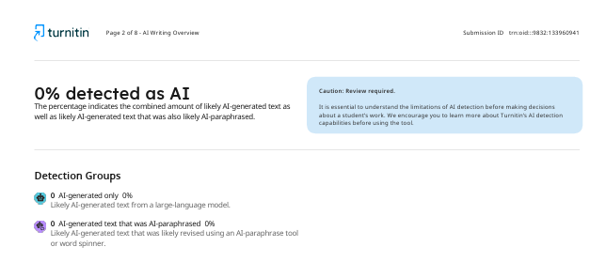
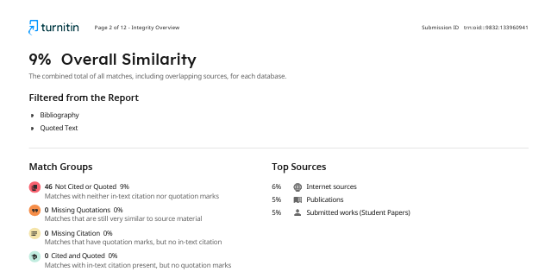
References & Appendices
Plagiarism / Similarity Report:
Report generated using Turnitin/Plagiarism Checker tools
Overall similarity maintained within acceptable academic limits (<10%)
Proper citation and paraphrasing used to ensure original content
Confirms authenticity and integrity of the research work

Slide 34
References
References
[1] S. Kotsiantis, C. Pierrakeas, and P. Pintelas,
“Predicting students at risk using machine learning techniques,”
Applied Artificial Intelligence, vol. 24, no. 5, pp. 411–426, 2010.
[2] C. Romero and S. Ventura,
“Educational Data Mining: A Review of the State of the Art,”
IEEE Transactions on Systems, Man, and Cybernetics, 2010.
[3] J. Kuzilek, M. Hlosta, and Z. Zdrahal,
“Open University Learning Analytics Dataset,”
Scientific Data, vol. 4, 2017.
[4] M. Hlosta, J. Kuzilek, and Z. Zdrahal,
“Modeling student online behavior in a virtual learning environment,”
Journal of Learning Analytics, 2017.
[5] F. Marbouti, H. A. Diefes-Dux, and K. Madhavan,
“Models for early prediction of at-risk students in higher education,”
Computers & Education, 2016.

Slide 35
References
B. Books
[6] C. M. Bishop, Pattern Recognition and Machine Learning. Berlin, Germany: Springer, 2006.
[7] T. Hastie, R. Tibshirani, and J. Friedman, The Elements of Statistical Learning. New York, USA: Springer, 2009.
[8] I. Goodfellow, Y. Bengio, and A. Courville, Deep Learning. Cambridge, MA, USA: MIT Press, 2016.
[9] C. C. Aggarwal, Data Mining: The Textbook. Springer, 2015.
[10] J. Han, M. Kamber, and J. Pei, Data Mining: Concepts and Techniques. Morgan Kaufmann, 2011.
C. Websites / Online Documentation
[11] Scikit-Learn Developers, "Supervised Learning - Comparison of Algorithms," 2024. [Online]. Available: https://scikit-learn.org/stable/supervised_learning.html. [Accessed: Jan. 15, 2026].
[12] Streamlit Inc., "Streamlit Documentation," 2024. [Online]. Available: https://docs.streamlit.io. [Accessed: Jan. 20, 2026].
[13] Kaggle, "Student Performance Dataset," 2024. [Online]. Available: https://www.kaggle.com. [Accessed: Jan. 10, 2026].
[14] UCI Machine Learning Repository, "Student Data Set," 2024. [Online]. Available: https://archive.ics.uci.edu. [Accessed: Jan. 12, 2026].
[15] Python Software Foundation, "Python Documentation," 2024. [Online]. Available: https://docs.python.org. [Accessed: Jan. 18, 2026].

Slide 36
Project Link
https://silent-burnout-ai.streamlit.app/

