Slide 1
AWS DEVOPS CLOUD COMPUTING INTERNSHIP
Hosting a Static Website using
Amazon S3 and Amazon CloudFront
Project Report — Step-by-Step Implementation
Team: Sayyed Althamas • Sai Pradeep • CH Sivani • K Sofiya
Mentors: Mrs Bethala Sumana • Mr Juttuka Lovababu

Slide 2
Team & Mentors
1
2
3
4
Sayyed Althamas
Sai Pradeep
CH Sivani
K Sofiya
Mentors
Mrs Bethala Sumana
Mr Juttuka Lovababu
AWS DevOps Internship Project

Slide 3
To design, deploy, and deliver a static portfolio-style website using core AWS cloud services — demonstrating practical, hands-on skills in cloud storage, global content delivery, and secure access control.
OBJECTIVE
1
Amazon S3
What We
Set Out To Build
Object storage and static website hosting
2
Amazon CloudFront
Global content delivery network (CDN)
3
Origin Access Control
Secure, private access from CloudFront to S3
AWS DevOps Internship Project

Slide 4
Tools & Services Used
1
2
3
Amazon S3
Amazon CloudFront
Origin Access Control
Store and host the static website files
CDN serving the website globally with low latency
Restrict S3 bucket access to CloudFront only
4
5
AWS Management Console
HTML & CSS
Used to configure all services
Build the website content (index.html, style.css)
AWS DevOps Internship Project

Slide 5
Architecture Overview
How a visitor's request securely reaches the website
User
Browser
Amazon
CloudFront
Origin Access
Control (OAC)
Amazon S3
Bucket
HTTPS request
Global CDN edge
Secure signed access
Private origin (website files)
The S3 bucket stays fully private — Block Public Access is ON. Content is served to the world only through CloudFront, authenticated via OAC.
AWS DevOps Internship Project

Slide 6
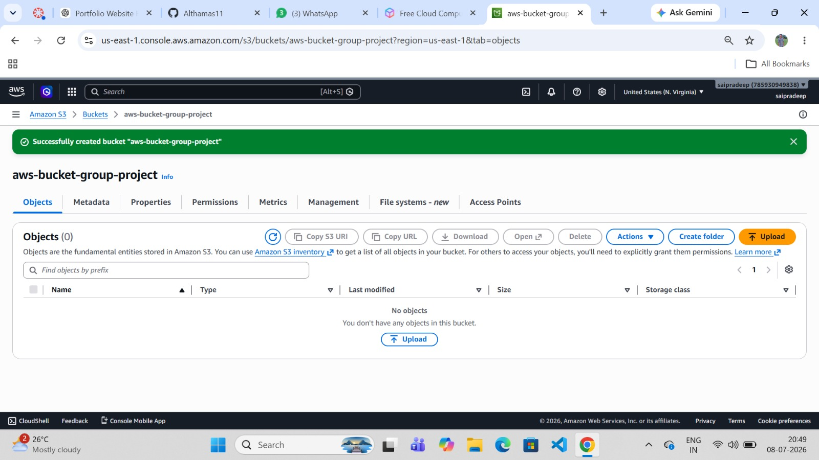
PHASE 1 · S3 SETUP
STEP
01
Create an Amazon S3 Bucket
An S3 bucket named "aws-bucket-group-project" was created in the US East (N. Virginia) region to store the website's files.
AWS DevOps Internship Project · Step 1 of 15

Slide 7
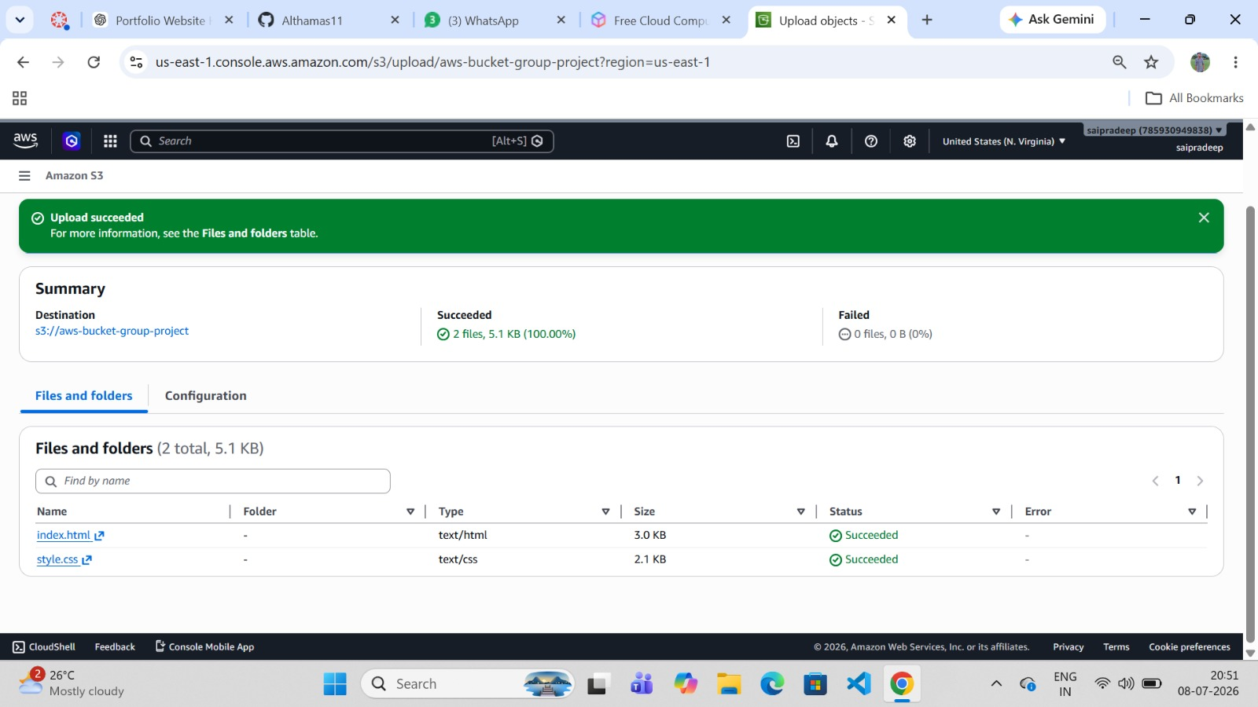
PHASE 1 · S3 SETUP
STEP
02
Upload the Website Files
index.html and style.css were uploaded to the bucket. Upload summary confirms 2 files (5.1 KB total) succeeded.
AWS DevOps Internship Project · Step 2 of 15

Slide 8
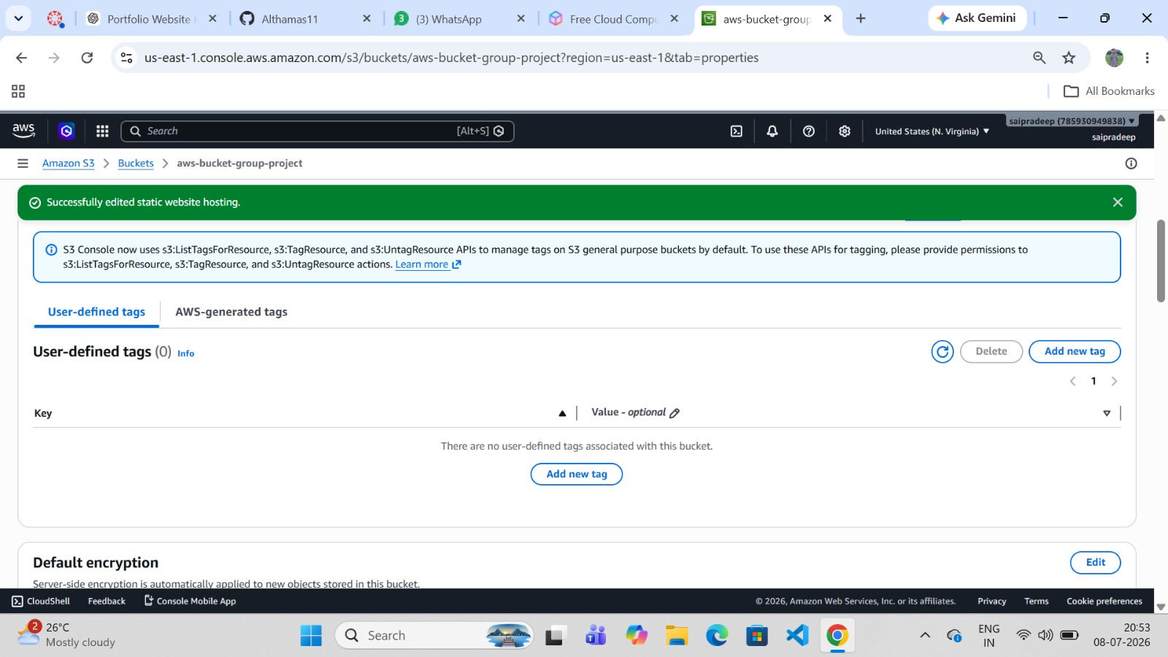
PHASE 1 · S3 SETUP
STEP
03
Enable Static Website Hosting
Static Website Hosting was enabled in the bucket's Properties tab, with index.html set as the index document.
AWS DevOps Internship Project · Step 3 of 15

Slide 9
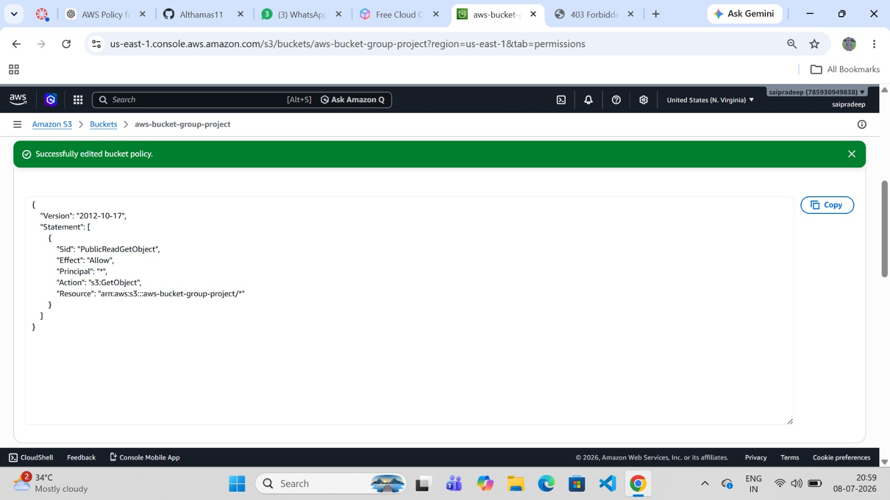
PHASE 1 · S3 SETUP
STEP
04
Configure Initial Public-Read Policy
A PublicReadGetObject bucket policy was attached to allow public GetObject access — the traditional S3 hosting method.
AWS DevOps Internship Project · Step 4 of 15

Slide 10
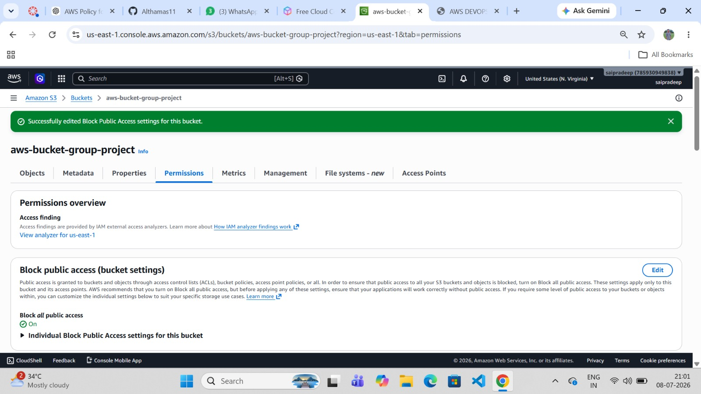
PHASE 1 · S3 SETUP
STEP
05
Review Block Public Access Settings
Block all public access was kept ON at the bucket level, following AWS security best practices — content is instead served via CloudFront.
AWS DevOps Internship Project · Step 5 of 15

Slide 11
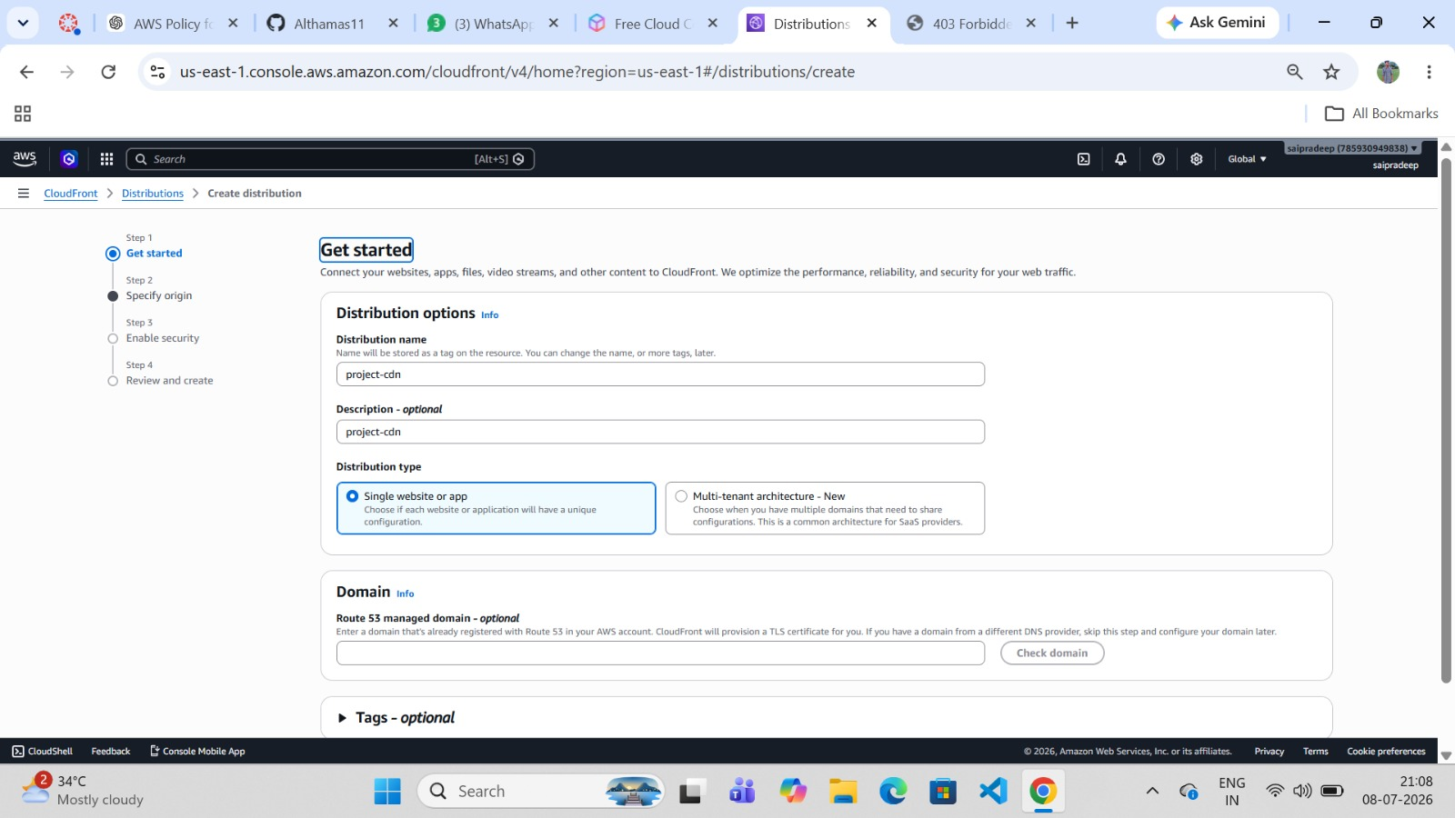
PHASE 2 · CLOUDFRONT DISTRIBUTION
STEP
06
Create a CloudFront Distribution
A new CloudFront distribution named "project-cdn" was created using the "Single website or app" distribution type.
AWS DevOps Internship Project · Step 6 of 15

Slide 12
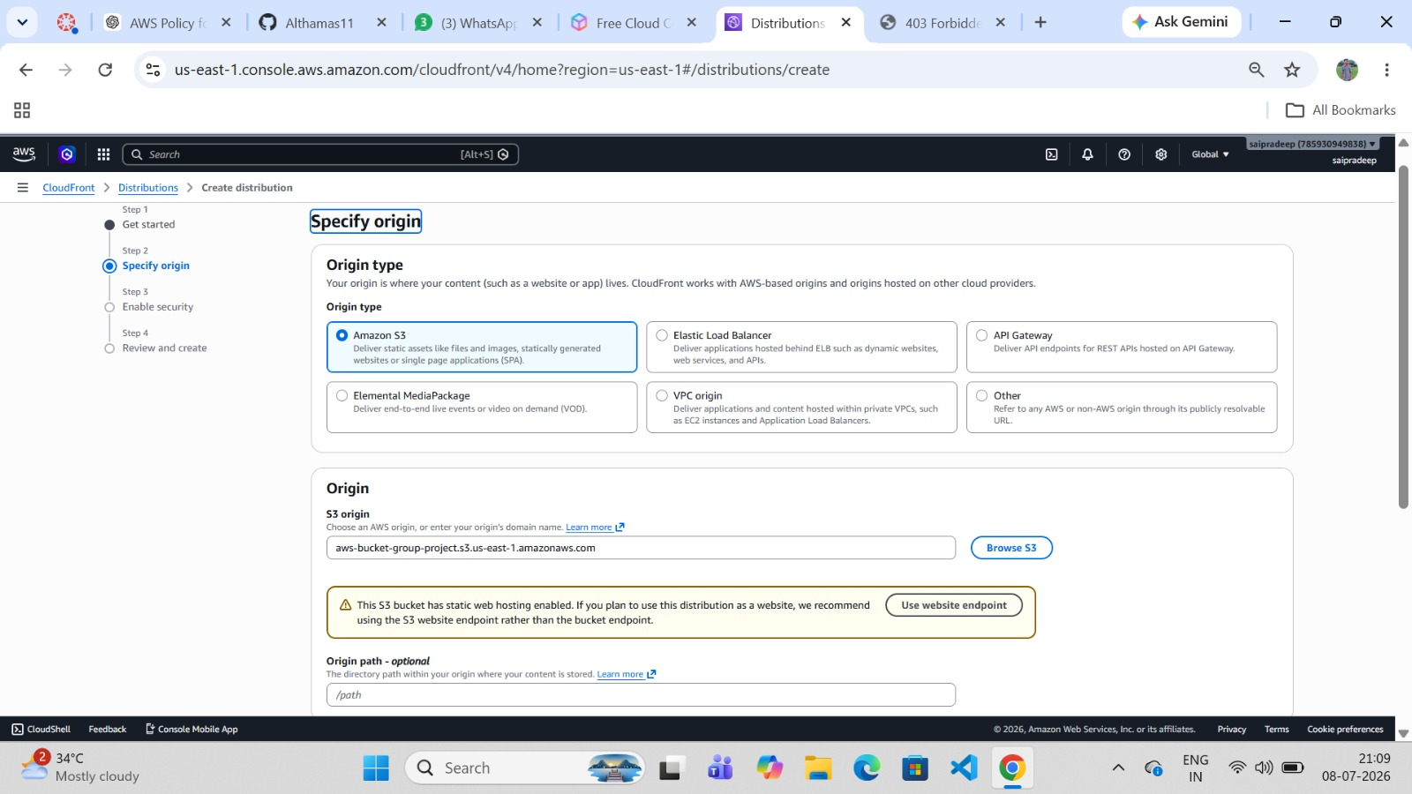
PHASE 2 · CLOUDFRONT DISTRIBUTION
STEP
07
Specify the Origin (S3 Bucket)
The origin type was set to Amazon S3, selecting aws-bucket-group-project.s3.us-east-1.amazonaws.com as the origin.
AWS DevOps Internship Project · Step 7 of 15

Slide 13
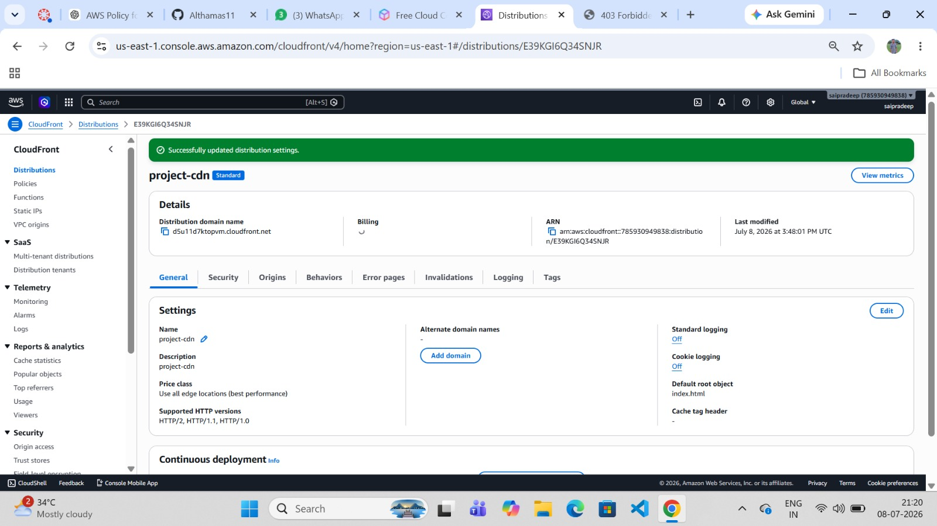
PHASE 2 · CLOUDFRONT DISTRIBUTION
STEP
08
Configure Origin Access Settings
"Allow private S3 bucket access to CloudFront" (recommended) was enabled with recommended origin and cache settings.
AWS DevOps Internship Project · Step 8 of 15

Slide 14
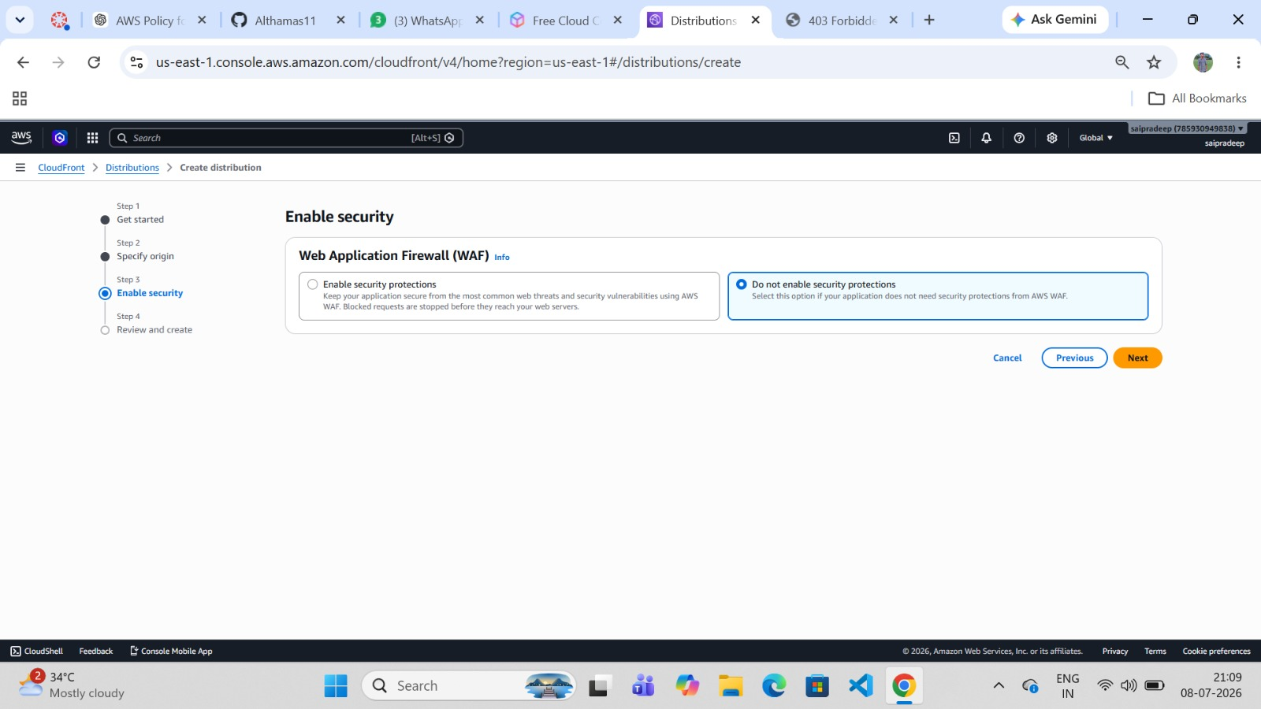
PHASE 2 · CLOUDFRONT DISTRIBUTION
STEP
09
Enable Security Settings (WAF)
"Do not enable security protections" was selected, since AWS WAF was not required for this internship-scale project.
AWS DevOps Internship Project · Step 9 of 15

Slide 15
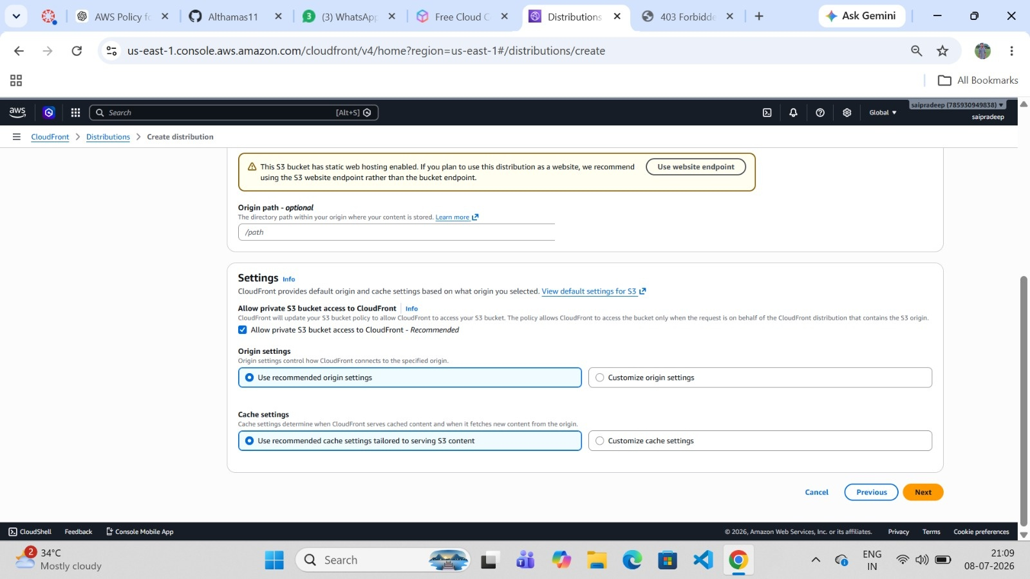
PHASE 2 · CLOUDFRONT DISTRIBUTION
STEP
10
Review & Create the Distribution
The distribution "project-cdn" was created successfully and assigned the domain d5u11d7ktopvm.cloudfront.net.
AWS DevOps Internship Project · Step 10 of 15

Slide 16
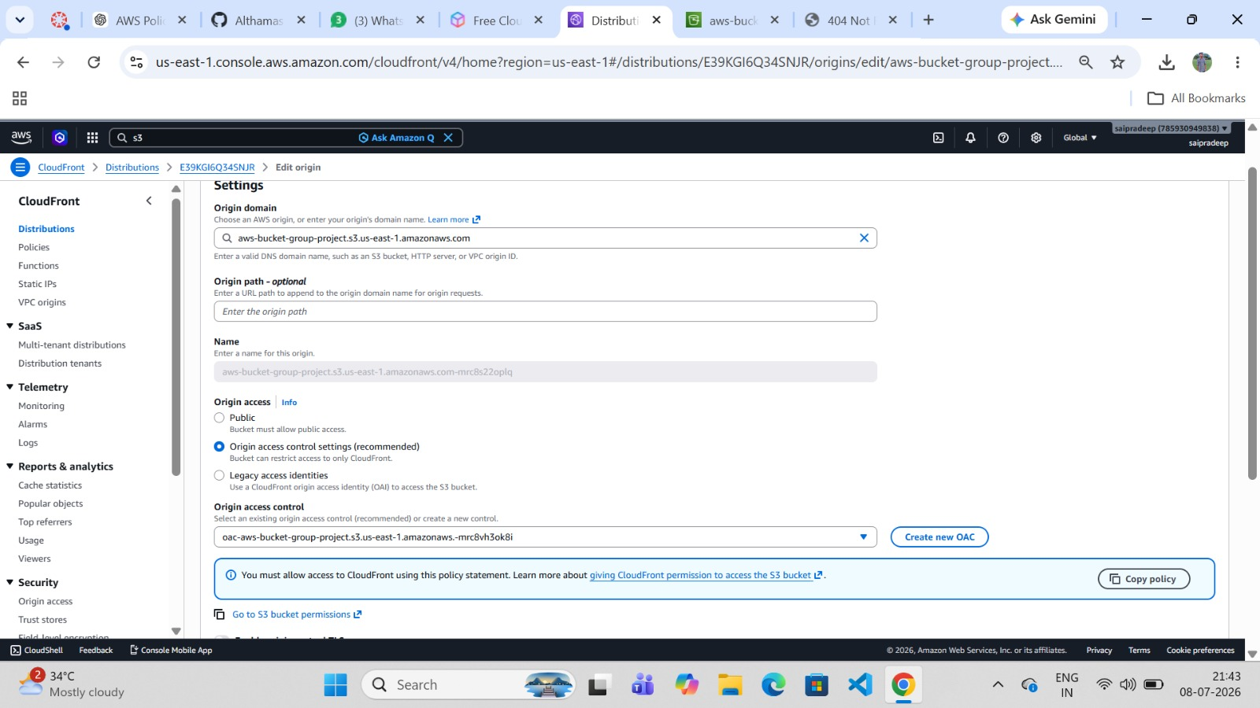
PHASE 3 · SECURING ACCESS (OAC)
STEP
11
Configure Origin Access Control (OAC)
The origin was edited to use "Origin access control settings (recommended)", and a new OAC was created and attached.
AWS DevOps Internship Project · Step 11 of 15

Slide 17
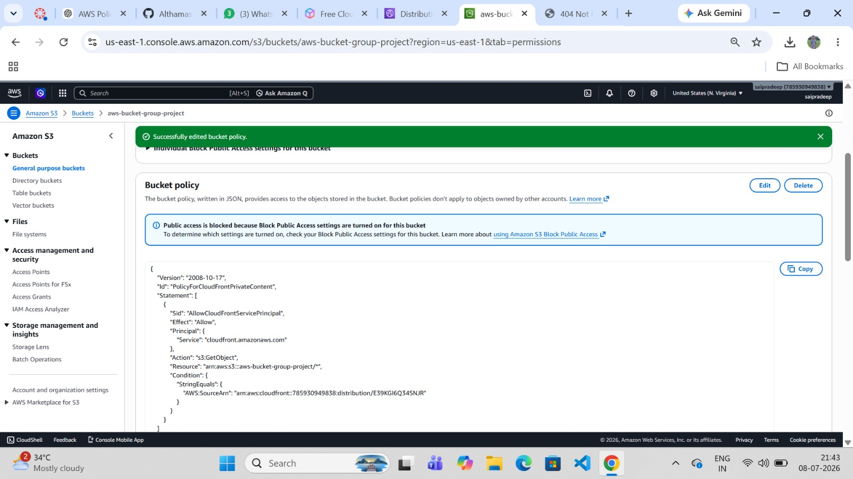
PHASE 3 · SECURING ACCESS (OAC)
STEP
12
Bucket Policy Updated for CloudFront
CloudFront auto-generated an updated bucket policy (AllowCloudFrontServicePrincipal), replacing the earlier public-read policy.
AWS DevOps Internship Project · Step 12 of 15

Slide 18
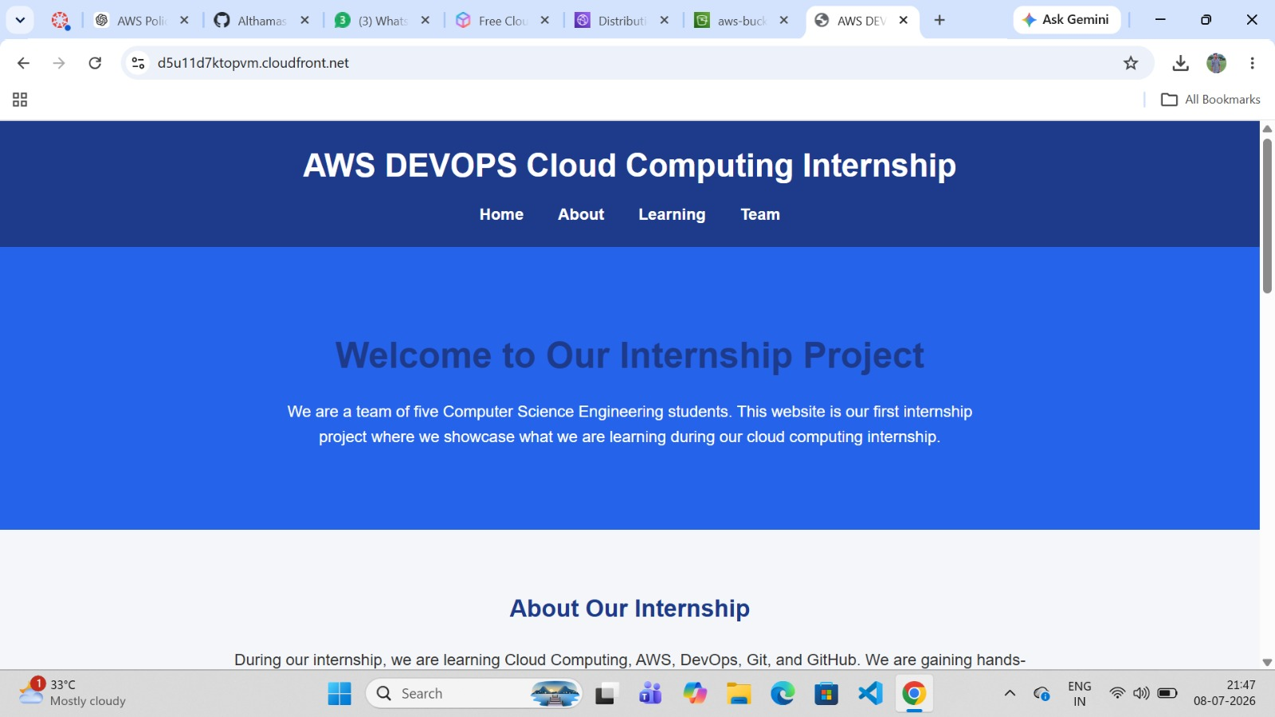
PHASE 4 · LIVE VERIFICATION
STEP
13
Access the Website via CloudFront
The website was accessed via d5u11d7ktopvm.cloudfront.net, confirming the homepage banner, navigation, and welcome section load.
AWS DevOps Internship Project · Step 13 of 15

Slide 19
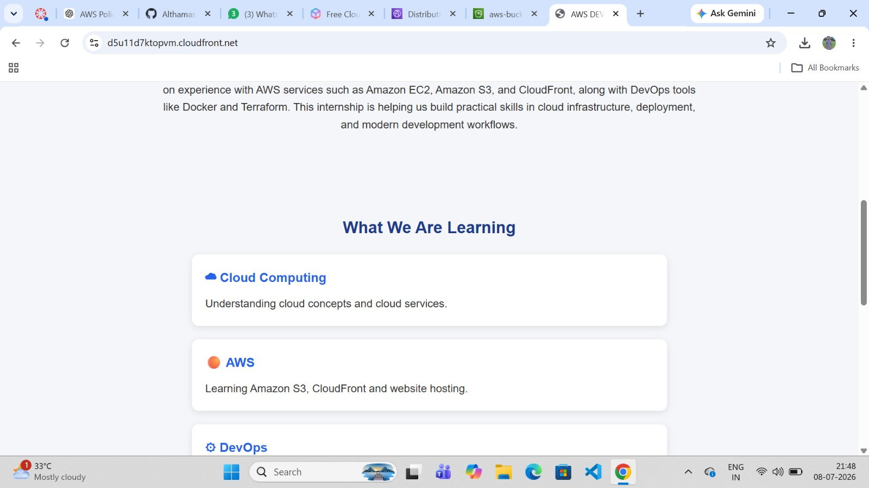
PHASE 4 · LIVE VERIFICATION
STEP
14
Verify the About / Learning Section
The "About Our Internship" and "What We Are Learning" sections render correctly, listing Cloud Computing, AWS, and DevOps.
AWS DevOps Internship Project · Step 14 of 15

Slide 20
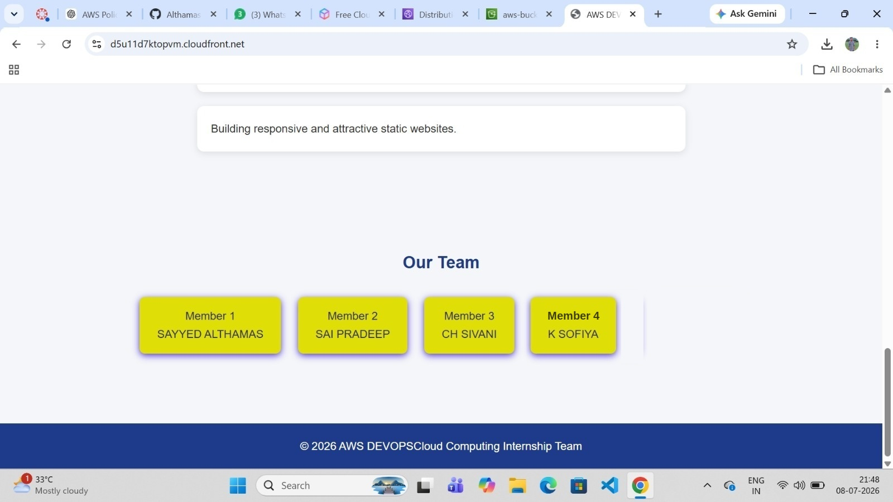
PHASE 4 · LIVE VERIFICATION
STEP
15
Verify the Team Section
The "Our Team" section displays all team members along with the footer copyright — confirming the site is fully live via CloudFront.
AWS DevOps Internship Project · Step 15 of 15

Slide 21
Conclusion
This project demonstrates end-to-end static website deployment on AWS: storing files in Amazon S3, enabling static website hosting, and securely distributing content worldwide using Amazon CloudFront with Origin Access Control.
The S3 bucket stays private while the website remains publicly and securely accessible via CloudFront's global edge network — reflecting real-world AWS DevOps best practices.
Amazon S3
Amazon CloudFront
Origin Access Control
Static Hosting
Global CDN
Thank You

