Slide 1
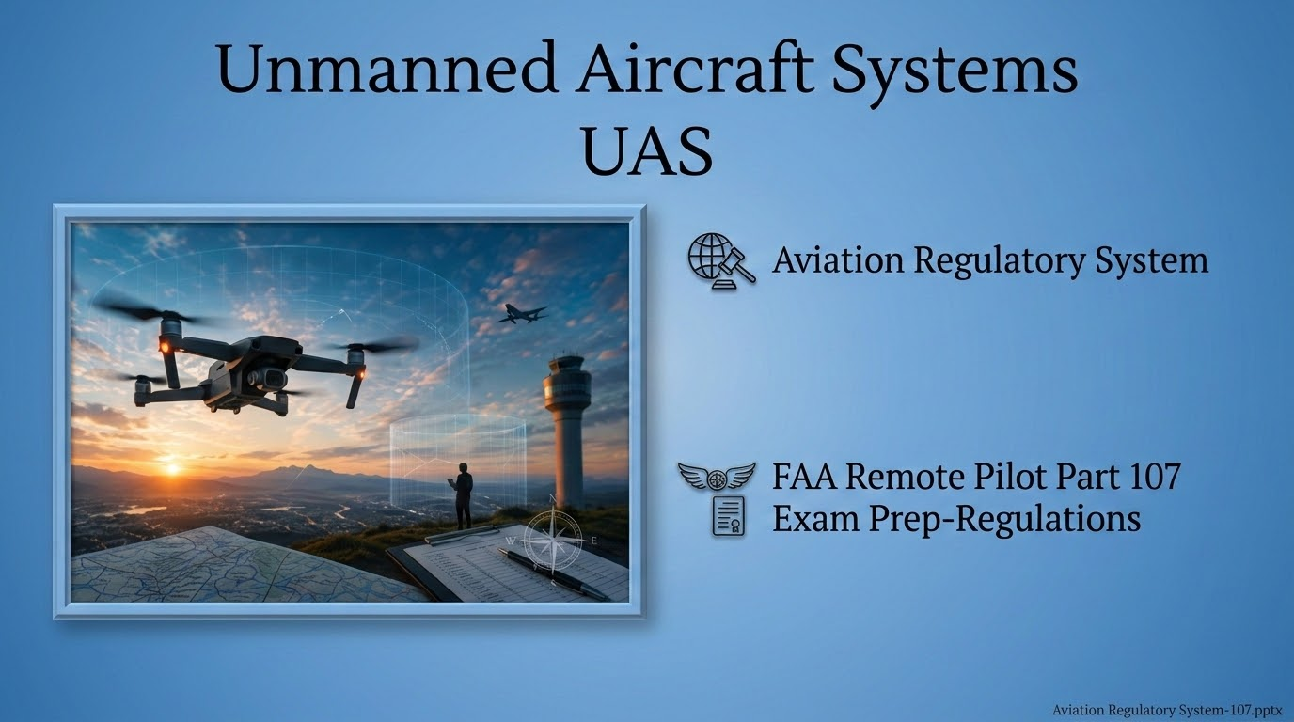

Slide 2
FAA Remote Pilot Test Prep
Topics Covered in this lesson
Remote Pilot Certificate
Remote Pilot Privileges
Supporting Crew Roles
Falsification, reporting, or alteration
Accident reporting
FAA inspections
sUAS registration
Preflight action and inspection
Carriage of hazardous material
Daylight operations
Visual line of sight
Operating limitations
Right-of-way rules
No operation over people
Operation from moving vehicle or aircraft
Privacy and other considerations
Alcohol and Drugs
Change of address
waivers

Slide 3
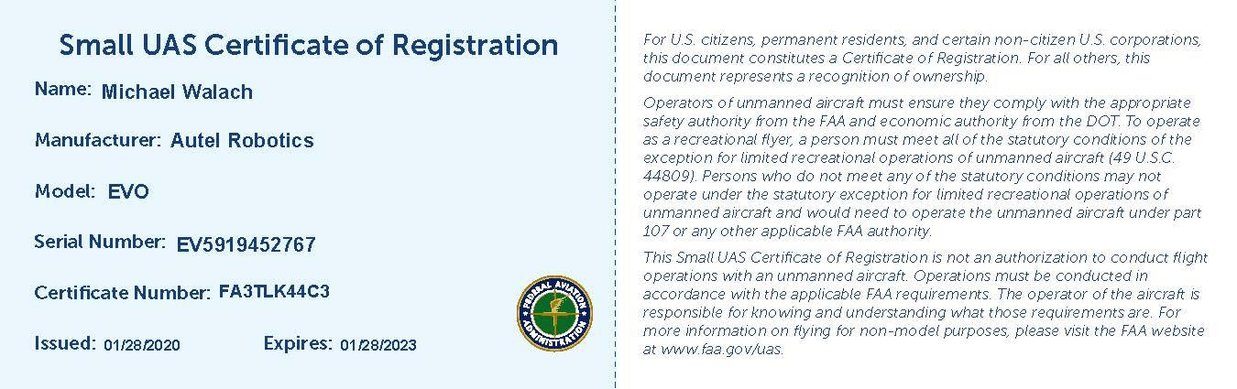
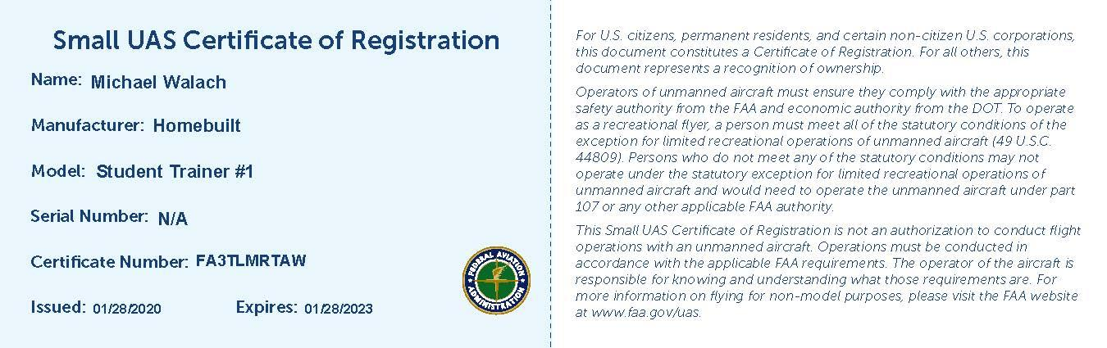
How to register your sUAS
https://faadronezone.faa.gov/#/

Slide 4
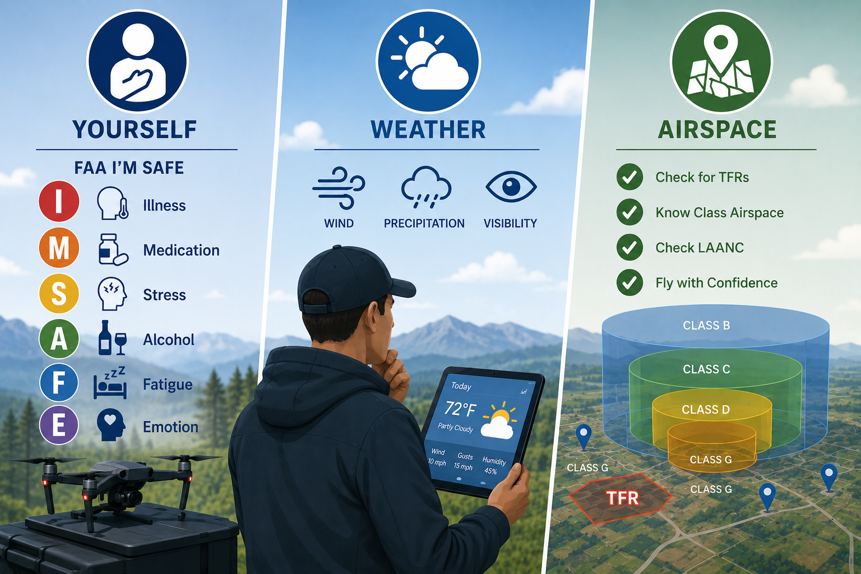

Slide 5
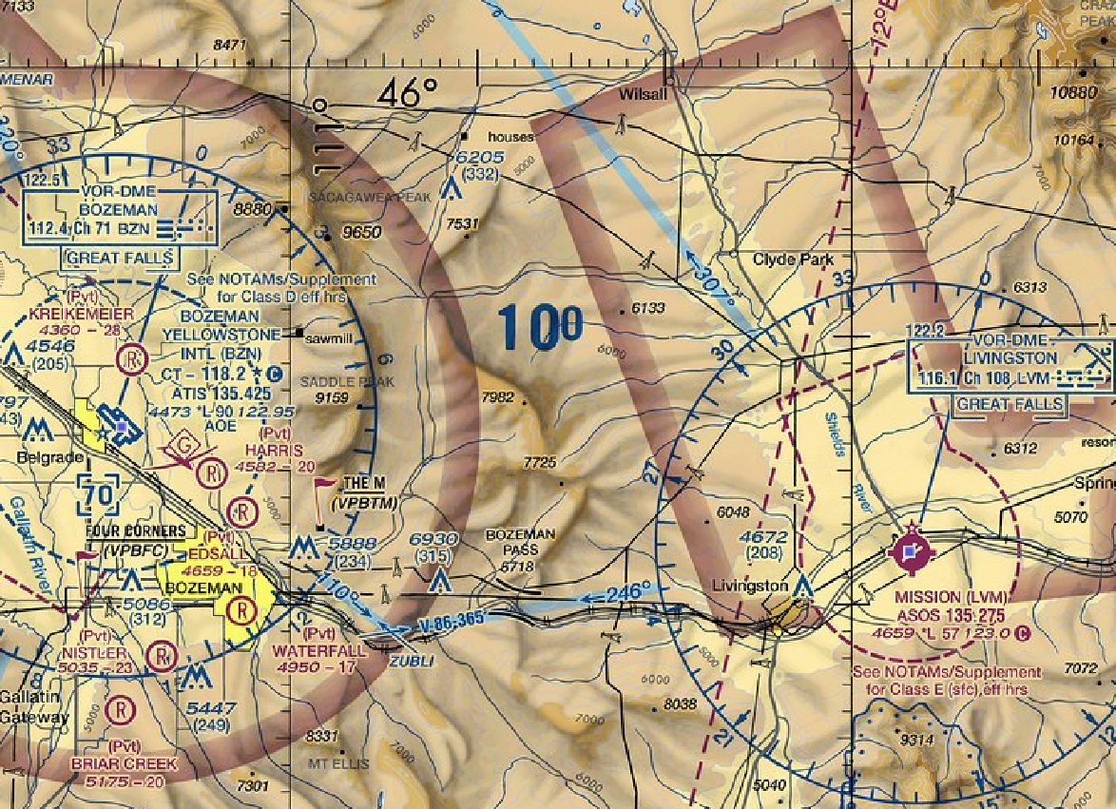
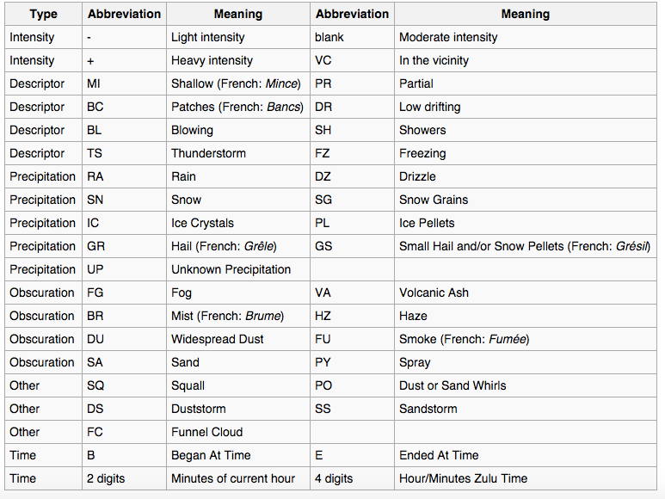
Can you fly?
METAR: KBZN 291356Z 14003KT 6SM BR FEW055 M04/M05 A3016 RMK AO2 SLP254 T10441050
METAR: KLVM 291353Z AUTO 25011KT 10SM BKN047 OVC060 01/M04 A3011 RMK AO2 SLP215 T00111039

Slide 6
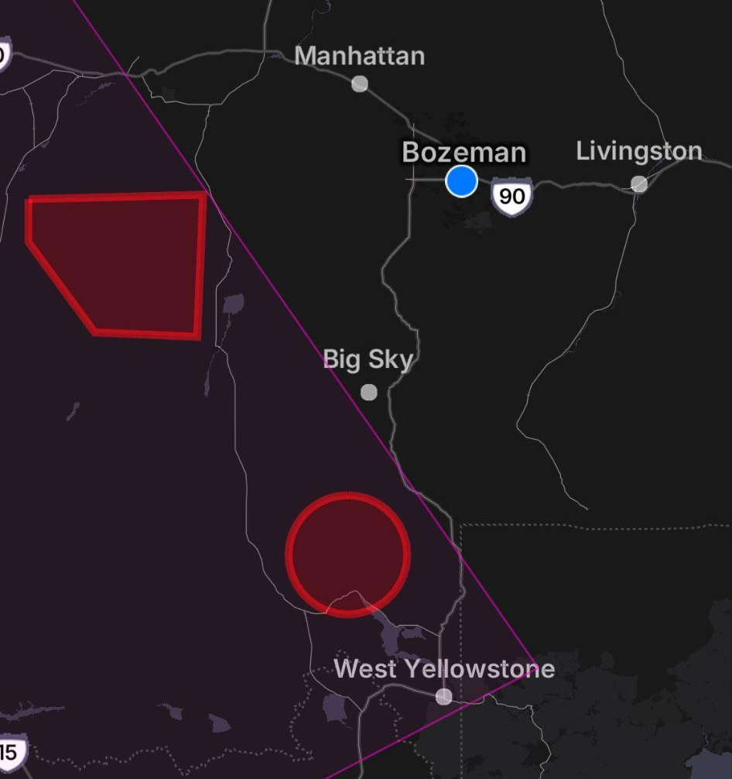
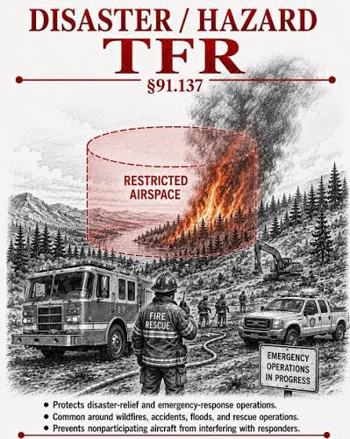
TFR
Temporary Flight Restriction-You cannot fly within a TFR!
Wildfire TFRs are common in the summer in the western US.

Slide 7
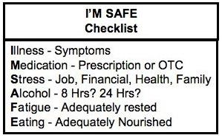
Am I legal to fly?
I’m SAFE?
Weather
Airspace
Check Yourself
Check the Weather
https://www.aviationweather.gov/
https://www.1800wxbrief.com/Website/#!/
https://www.aviationweather.gov/metar
http://vfrmap.com/
https://tfr.faa.gov/tfr2/list.html
Check TFRs, NOTAMS and Airspace
https://www.notams.faa.gov/dinsQueryWeb/

Slide 8
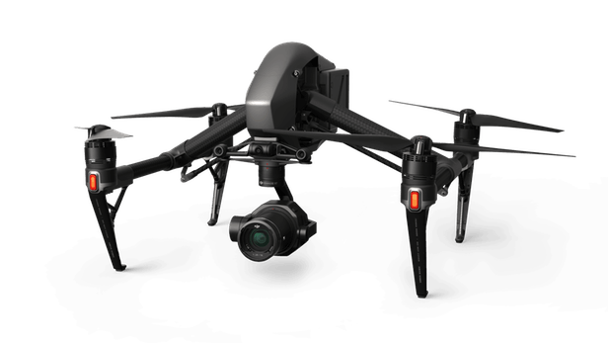
Regulation Basics
UAS are regulated under title 14 Code of Federal Regulations, Part 107 (14 CFR part 107)
An UAS over .55 lbs is regulated under 14 CFR part 107
Small UAS (sUAS) weight between 0.55 lbs to < 55 lbs per part 107
Unmanned aircraft is defined as “without the possibility of direct human intervention from within or on the aircraft”.
Model aircraft for hobby use are exempt from part 107.
Limited to altitude of 400’ AGL (Above Ground Level)
You can use an UAS under part 107 for commercial use.
UAV pilots must comply with all ATC (Air Traffic Control) instructions.

Slide 9
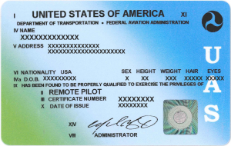
Regulations
Remote Pilot Certification
Initial remote pilot certificate
  Part 61 Pilot certificate holder requires:
    The faasafety.gov initial online course or FAA UAS Knowledge exam
  Any other applicant requires:
    The FAA UAS Knowledge exam
Recurrent Requirements (Every 24 months)
  The FAA UAS Knowledge Exam
    or if a Part 61 pilot certificate holder with current flight review
  The recurrent online course, or the FAA UAS Knowledge exam.

Slide 10
Regulations
Remote Pilot Certification
Applications for Part 107 Remote Pilot Certificate must be processed by a:
  Flight Standards District Office (FSDO)
  Designated Pilot Examiner
  Airman certification representative from a pilot school
  CFI
Recurrent training required every 24 Months
Applicant must be free of any physical or mental condition that would interfere with the safe operation of a sUAS.

Slide 11
Regulations
Privileges
The remote pilot is directly responsible for and is the final authority as to the operation of the sUAS conducted under 14 CFR Part 107.
He or she must:
  Be designated before each flight (but can be changed during the flight).
  Ensure that the operation poses no undue hazard to people, aircraft, or property in the event of a loss of control of the aircraft for any reason.
  Operate the small unmanned aircraft to ensure compliance with all applicable provisions and regulations.
The PIC (Pilot in Command) may not operate more than one sUAS at a time.

Slide 12


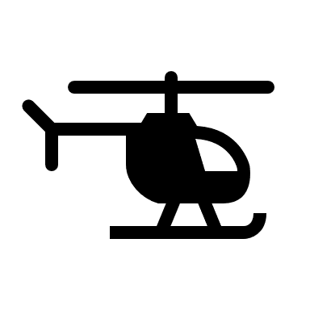


Regulations
Supporting Crew Roles
A PERSON WHO DOES NOT HOLD A PART 107 CERTIFICATE MAY OPERATE THE CONTROLS OF A SUAS UNDER THE DIRECT SUPERVISION OF A PART 107 CERTIFICATED PIC.
PIC MUST BE ABLE TO TAKE CONTROL IMMEDIATELY IF REQUIRED.
IF AIRCRAFT IS OPERATED AUTONOMOUSLY, REMOTE PILOT MUST BE ABLE TO TAKE OVER CONTROL TO FLY AND/OR LAND THE AIRCRAFT SAFELY.
VISUAL OBSERVERS ROLE IS TO ALERT THE REST OF THE CREW ABOUT POTENTIAL HAZARDS DURING SUAS OPERATION. VISUAL OBSERVERS ARE OPTIONAL.
ALL PART 107 OPERATIONS MUST HAVE A REMOTE PIC (PILOT IN COMMAND).

Slide 13

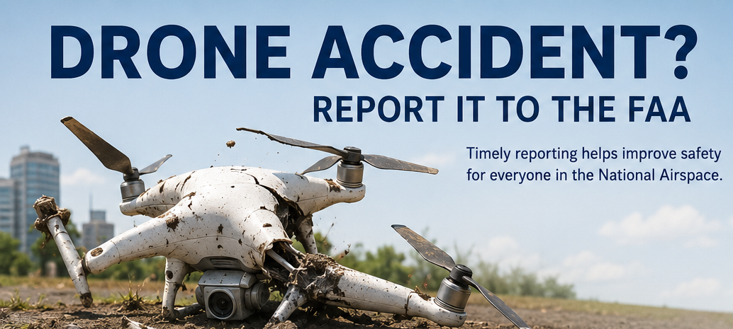

Regulations
Accident Reporting
The remote PIC must report any sUAS accident to the FAA, within ten days of the operation if any of the following thresholds are met:
  Serious injury to any person or any loss of consciousness
  Damage to any property, other than the small unmanned aircraft, if the cost is greater than $500 to repair or replace property (whichever is lower).
Serious injury occurs if a person requires hospitalization, and the injury is fully reversible:
  I.e.; Head trauma, broken bones, lacerations to the skin that requires suturing.

Slide 14

Regulations
FAA Inspections
You must make available to the FAA, upon request, the sUAS for inspection or testing.
Documentation required on-site (Physical or digital):
  Pilot certificate
  Aircraft Registration
  Any waivers or exemptions
  Other documents related to the operation.

Slide 15
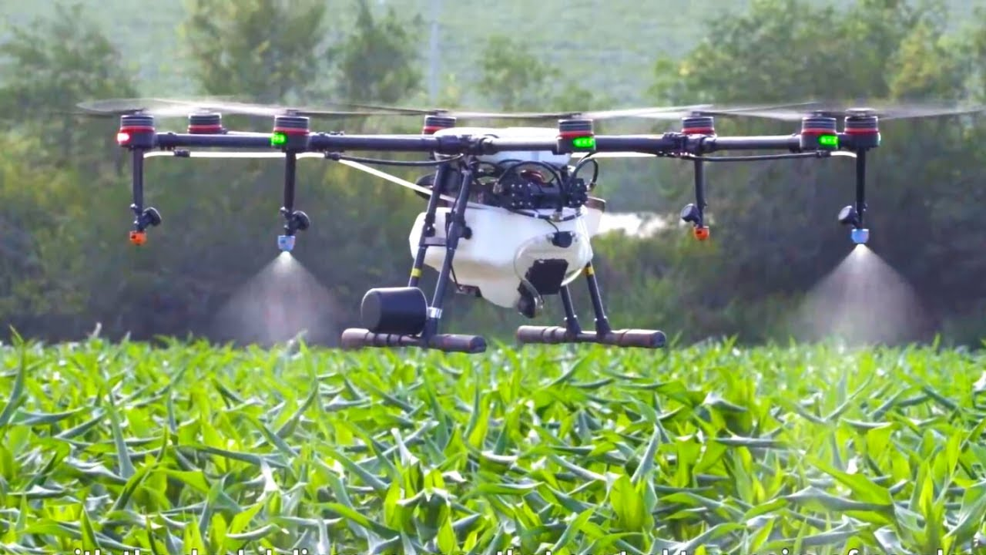
Regulations sUAS Registration
Aircraft must be registered with the FAA if:
  Greater than 0.55 pounds, less than 55 pounds and operated under provision 14 CFR Part 107.
Person must be at least 13 years of age to register aircraft.
https://www.faa.gov/uas/getting_started/registration/

Slide 16
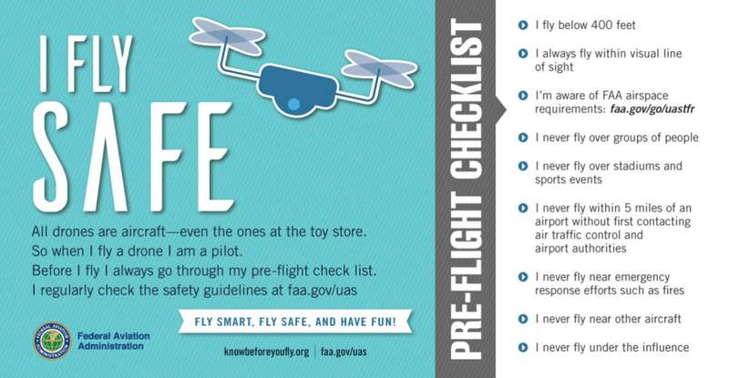
Regulations
Pre-flight action and inspection
The remote PIC is responsible for:
  inspecting the aircraft before each flight.
  Assessing the environment for the flight including weather, airspace, flight restrictions (TFRs), hazards on the ground or in the air.

Slide 17

Regulations
Carriage of Hazardous Material
A SUAS may not carry hazardous material.
Lithium batteries installed on a sUAS for power during operation are NOT considered a hazardous material under part 107.
Extra batteries being carried on-board do qualify as hazardous material.

Slide 18

Regulations
Daylight Operations
A remote PIC may not operate a sUAS at night.
The FAA defines night as “the time between the end of evening civil twilight and the beginning of morning civil twilight”.
Night therefore is 30 minutes after sunset to 30 minutes before sunrise.
An anti-collision light visible for 3 miles must be installed on a sUAS if operated 30 minutes before sunrise or 30 minutes after sunset.

Slide 19
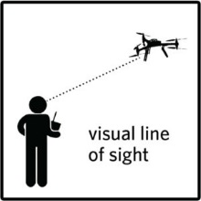
Regulations
Visual Line of Sight
VLOS-Visual Line of sight
A sUAS must remain in VLOS.
Binoculars or other aides may be used only temporarily to aide in vision of aircraft.
The sUAS may be intentionally dropped out of sight briefly as long as VLOS is regained as soon as possible.
The PIC is still required to see and avoid at all times even if VLOS is temporarily lost.

Slide 20
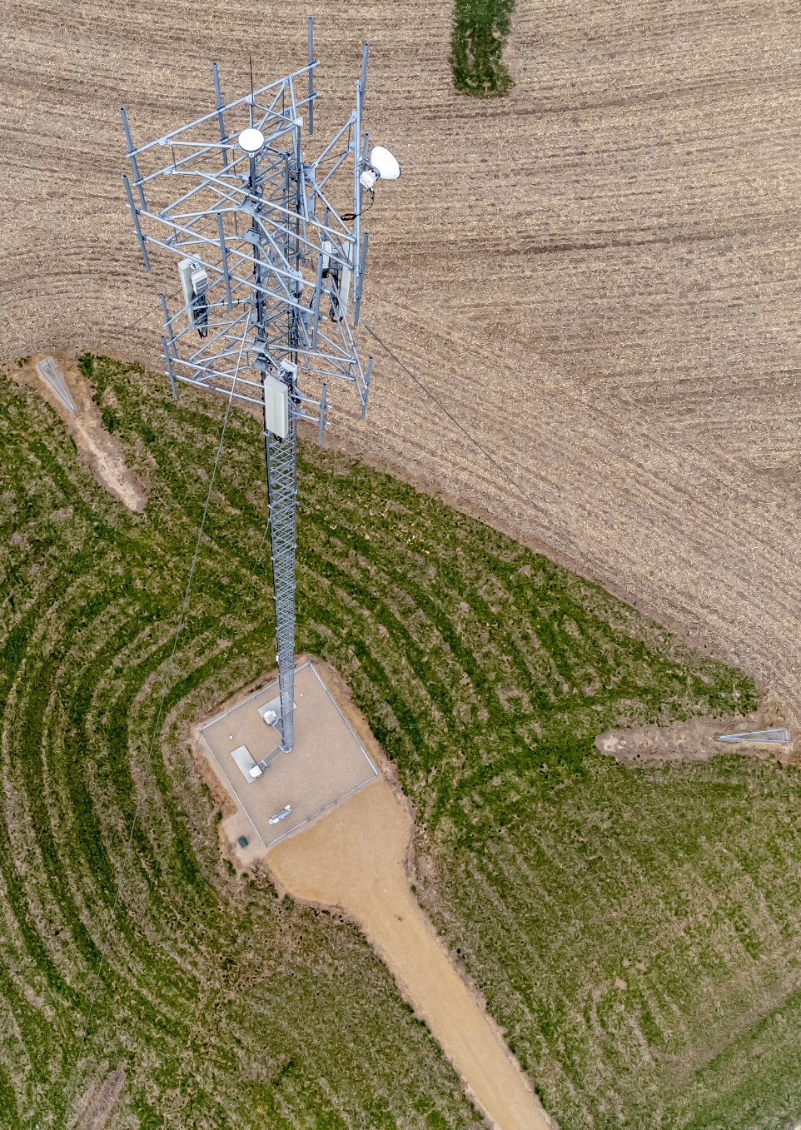
Regulations
Operating Limitations
A sUAS must follow the following operating limitations:
  Cannot be flown faster than a ground speed of 87 knots (100 mph)
  Cannot be flown over 400 feet AGL (above ground level) unless:
    Flown within 400 foot radius of a structure and not flown more than 400 feet above the structure’s immediate uppermost limit.
  Minimum visibility as observed from the location of the control station no less than 3 statute miles.
  Minimum distance from clouds no less than 500 below and 2,000 feet horizontally from a cloud.

Slide 21
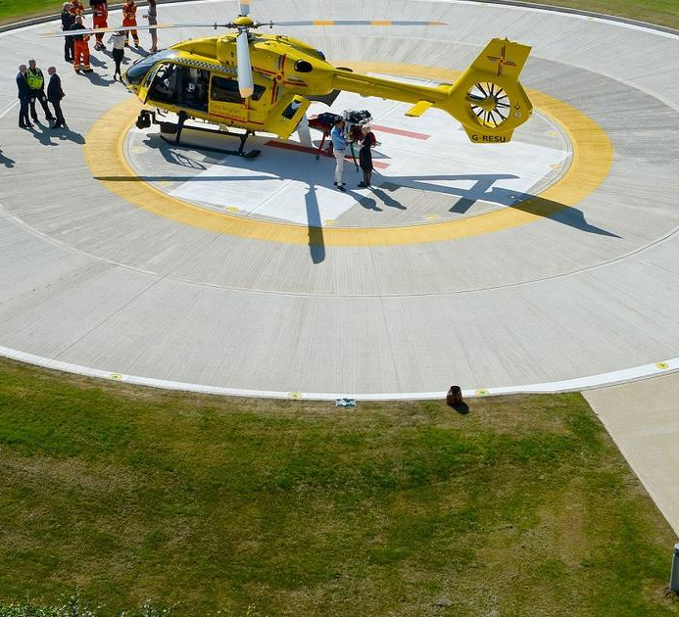
Regulations
Right-of-Way Rules
No sUAS operation at an airport, heliport, or seaplane base that interferes with operations and traffic patterns.
sUAS must yield the right-of-way to all aircraft including those operating on the surface.

Slide 22
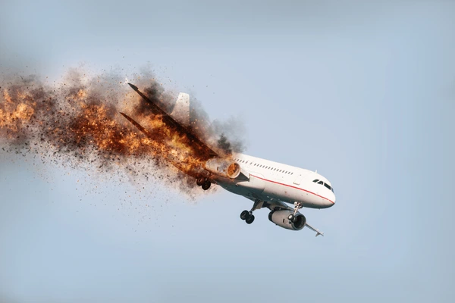

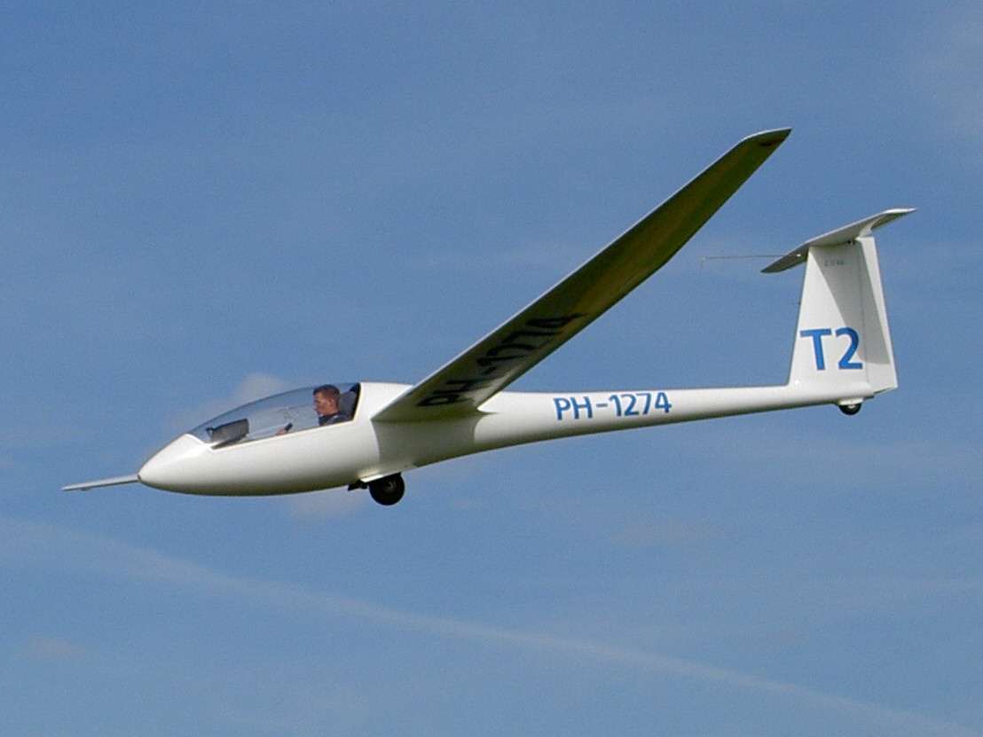
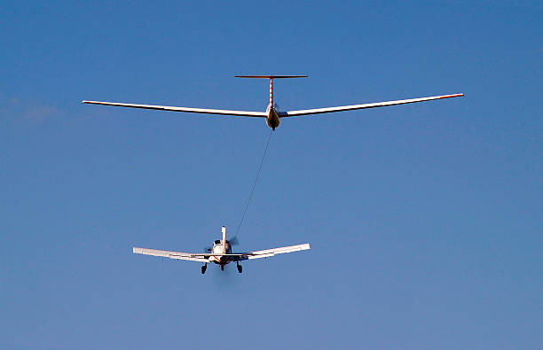
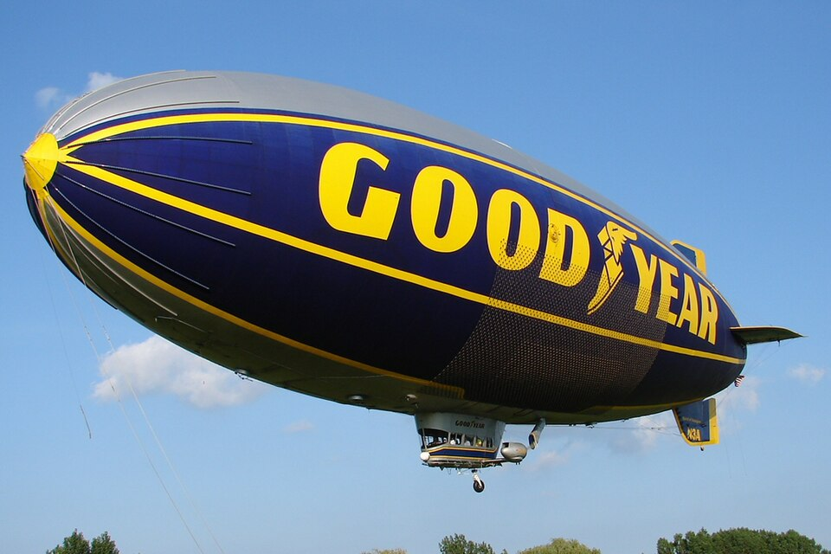

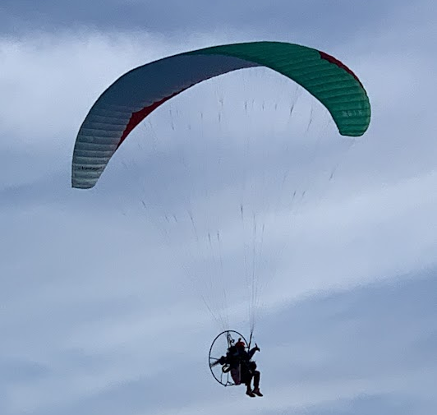
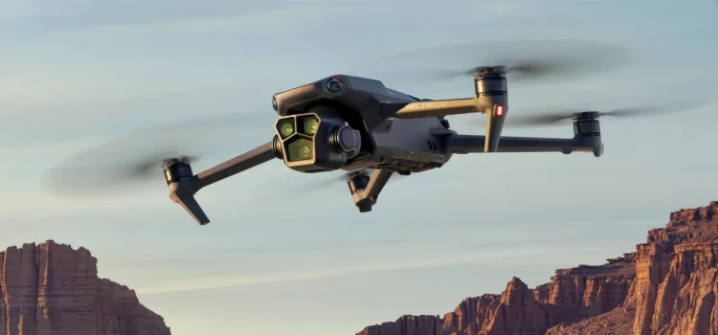
Regulations
Right-of-Way Rules
CFR 14.91.113
In distress. An (*manned) aircraft in distress has the right-of-way over all other air traffic.
(d) Converging. When aircraft of the same category are converging at approximately the same altitude (except head-on, or nearly so), the aircraft to the other's right has the right-of-way. If the aircraft are of different categories—
(1) A balloon has the right-of-way over any other category of aircraft;
(2) A glider has the right-of-way over an airship, powered parachute, weight-shift-control aircraft, airplane, powered-lift, or rotorcraft.
(3) An airship has the right-of-way over a powered parachute, weight-shift-control aircraft, airplane, powered-lift, or rotorcraft.
(4) An aircraft towing or refueling other aircraft has the right-of-way over all other engine-driven aircraft.
*I added the word “manned” above.
https://www.ecfr.gov/current/title-14/chapter-I/subchapter-F/part-91/subpart-B/subject-group-ECFRe4c59b5f5506932/section-91.113

Slide 23
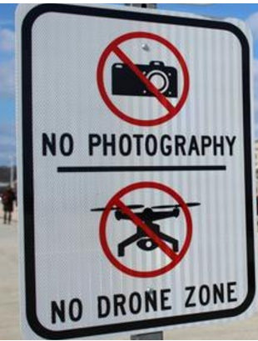
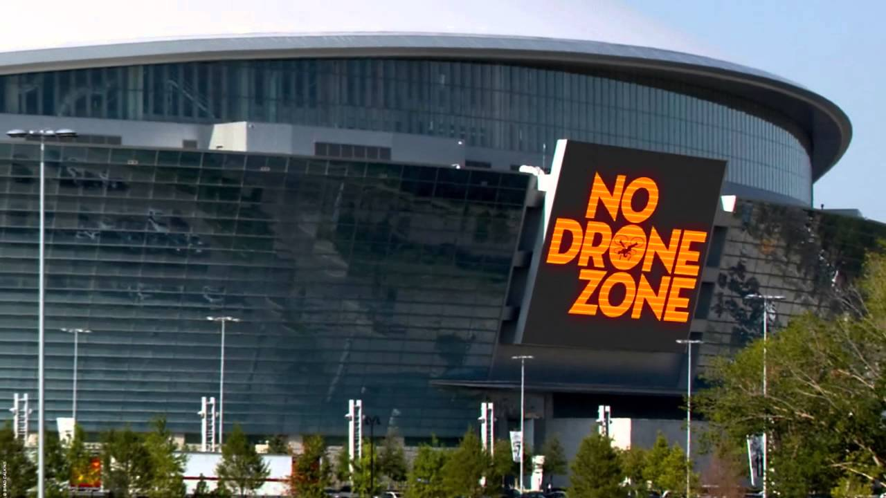
Regulations
No Operation over people
No sUAS may be operated over people unless:
  They are part of the flight crew directly involved with the operation.
  Within safe cover, such as a stationary vehicle that would provide protection in the event of a crash.

Slide 24
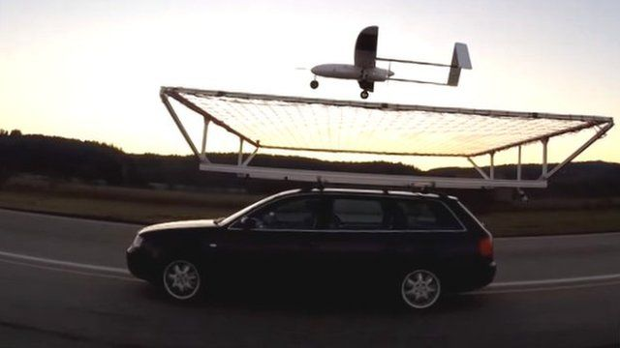
Regulations
Operation from moving vehicle or aircraft
Operation from a land or water borne vehicles is ok unless:
  The sUAS is carrying property for hire.
A sUAV may not be operated from an aircraft.
Must maintain VLOS.
No reckless operation.

Slide 25

Regulations
Privacy and other considerations
No person may operate a sUAS in a careless or reckless manner that would endanger another person’s life or property.
No object may be dropped from a sUAS in a way that causes undue hazards to persons or property.
Transportation of cargo for hire is allowed if:
  Total weight including cargo does not exceed 55lbs
  Flight doesn’t cross state lines
  Flight is not controlled from a moving vehicle.
  No carriage of hazardous materials.

Slide 26

Regulations
Alcohol and Drugs
Part 107 Prohibits a person from serving as a remote PIC, person manipulating the control or VO (Visual Observer) or other crew member if he or she:
  Consumed any alcoholic beverage within the preceding 8 hours.
  Is under the influence of alcohol.
  Has a blood alcohol concentration of 0.04 percent or greater.
  Is using a drug that affects the person’s metal or physical capabilities.

Slide 27


Regulations
Change of Address
If a remote PIC changes his/her address the FAA must be notified within 30 days.

Slide 28
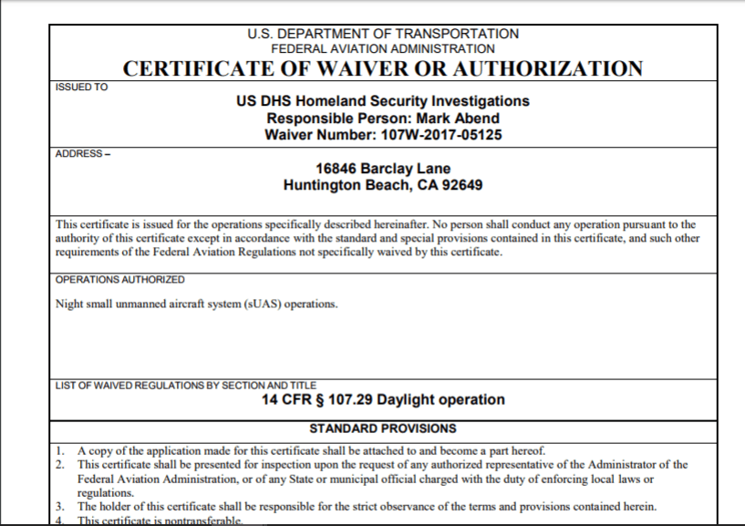
Regulations
Waivers
If a remote PIC wishes to conduct and activity that is not allowed under part 107 a certificate of waiver (CoW) may be applied for.
If the operation can be safely conducted the FAA may provide a waiver.
Only certain provisions can be waived.
Applications for waiver should be made 90 days in advance.
Applications for waiver may be rejected.

Slide 29
Night Flight
Except as provided in paragraph (d) of this section, no person may operate a small unmanned aircraft system at night unless—
(1) The remote pilot in command of the small unmanned aircraft has completed an initial knowledge test or training, as applicable, under § 107.65 after April 6, 2021; and
(2) The small unmanned aircraft has lighted anti-collision lighting visible for at least 3 statute miles that has a flash rate sufficient to avoid a collision. The remote pilot in command may reduce the intensity of, but may not extinguish, the anti-collision lighting if he or she determines that, because of operating conditions, it would be in the interest of safety to do

Slide 30
Flight Over People
No person may operate a small unmanned aircraft over a human being unless—
(a) That human being is directly participating in the operation of the small unmanned aircraft;
(b) That human being is located under a covered structure or inside a stationary vehicle that can provide reasonable protection from a falling small unmanned aircraft; or
(c) The operation meets the requirements of at least one of the operational categories specified in subpart D of this part.

Slide 31
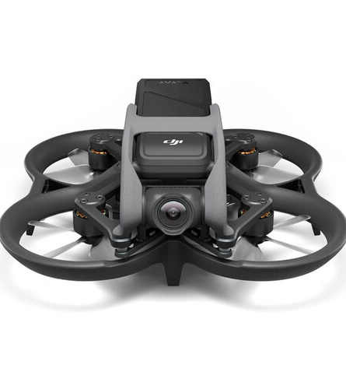
Category 1
Small drones under 0.55lbs.
No exposed rotating parts that can lacerate the skin

Slide 32
Category 2
§ 107.115 Category 2 operations: Operating requirements.
To conduct Category 2 operations—
(a) A remote pilot in command must use a small unmanned aircraft that—
  (1) Is eligible for Category 2 operations pursuant to § 107.120(a);
  (2) Is listed on an FAA-accepted declaration of compliance as eligible for Category 2 operations in accordance with § 107.160; and
  (3) Is labeled as eligible to conduct Category 2 operations in accordance with § 107.120(b)(1).
(b) No remote pilot in command may operate a small unmanned aircraft in sustained flight over open-air assemblies of human beings unless the operation meets the requirements of either § 89.110 or § 89.115(a) of this chapter.

Slide 33
Category 2
§ 107.120 Category 2 operations: Eligibility of small unmanned aircraft and other applicant requirements.
(a) To be eligible for use in Category 2 operations, the small unmanned aircraft must be designed, produced, or modified such that it—
(1) Will not cause injury to a human being that is equivalent to or greater than the severity of injury caused by a transfer of 11 foot-pounds of kinetic energy upon impact from a rigid object;
(2) Does not contain any exposed rotating parts that would lacerate human skin upon impact with a human being; and
(3) Does not contain any safety defects.

Slide 34
Category 2
The applicant for a declaration of compliance for a small unmanned aircraft that is eligible for use in Category 2 operations in accordance with paragraph (a) of this section, must meet all of the following requirements for the applicant's unmanned aircraft to be used in Category 2 operations:
(1) Display a label on the small unmanned aircraft indicating eligibility to conduct Category 2 operations. The label must be in English and be legible, prominent, and permanently affixed to the small unmanned aircraft.
(2) Have remote pilot operating instructions that apply to the operation of the small unmanned aircraft system. The applicant for a declaration of compliance must make available these instructions upon sale or transfer of the aircraft or use of the aircraft by someone other than the applicant who submitted a declaration of compliance pursuant to § 107.160. Such instructions must address, at a minimum—
(i) A system description that includes the required small unmanned aircraft system components, any system limitations, and the declared category or categories of operation;
(ii) Modifications that will not change the ability of the small unmanned aircraft system to meet the requirements for the category or categories of operation the small unmanned aircraft system is eligible to conduct; and
(iii) Instructions for how to verify and change the mode or configuration of the small unmanned aircraft system, if they are variable.
(3) Maintain a product support and notification process. The applicant for a declaration of compliance must maintain product support and notification procedures to notify the public and the FAA of—
(i) Any defect or condition that causes the small unmanned aircraft to no longer meet the requirements of this subpart; and
(ii) Any identified safety defect that causes the small unmanned aircraft to exceed a low probability of casualty.

Slide 35
Category 3
§ 107.125 Category 3 operations: Operating requirements.
To conduct Category 3 operations, a remote pilot in command—
(a) Must use a small unmanned aircraft that—
  (1) Is eligible for Category 3 operations pursuant to § 107.130(a);
  (2) Is listed on an FAA-accepted declaration of compliance as eligible for Category 3 operations in accordance with § 107.160; and
  (3) Is labeled as eligible for Category 3 operations in accordance with § 107.130(b)(1);
(b) Must not operate the small unmanned aircraft over open-air assemblies of human beings; and
(c) May only operate the small unmanned aircraft above any human being if operation meets one of the following conditions:
  (1) The operation is within or over a closed- or restricted-access site and all human beings located within the closed- or restricted-access site must be on notice that a small unmanned aircraft may fly over them; or
  (2) The small unmanned aircraft does not maintain sustained flight over any human being unless that human being is—
    (i) Directly participating in the operation of the small unmanned aircraft; or
    (ii) Located under a covered structure or inside a stationary vehicle that can provide reasonable protection from a falling small unmanned aircraft.

Slide 36
Category 4-(The Regs)
§ 107.140 Category 4 operations.
(a) Remote pilot in command requirements. To conduct Category 4 operations—
  (1) A remote pilot in command—
    (i) Must use a small unmanned aircraft that is eligible for Category 4 operations pursuant to paragraph (b) of this section; and
    (ii) Must operate the small unmanned aircraft in accordance with all operating limitations that apply to the small unmanned aircraft, as specified by the Administrator.
  (2) No remote pilot in command may operate a small unmanned aircraft in sustained flight over open-air assemblies of human beings unless the operation meets the requirements of either § 89.110 or § 89.115(a) of this chapter.
(b) Small unmanned aircraft requirements for Category 4. To be eligible to operate over human beings under this section, the small unmanned aircraft must—
  (1) Have an airworthiness certificate issued under part 21 of this chapter.
  (2) Be operated in accordance with the operating limitations specified in the approved Flight Manual or as otherwise specified by the Administrator. The operating limitations must not prohibit operations over human beings.
  (3) Have maintenance, preventive maintenance, alterations, or inspections performed in accordance with paragraph (c)(1) of this section.
(c) Maintenance requirements for Category 4. The owner must (unless the owner enters into an agreement with an operator to meet the requirements of this paragraph (c), then the operator must) meet the requirements of this paragraph (c):
  (1) Ensure the person performing any maintenance, preventive maintenance, alterations, or inspections:
    (i) Uses the methods, techniques, and practices prescribed in the manufacturer's current maintenance manual or Instructions for Continued Airworthiness that are acceptable to the Administrator, or other methods, techniques, and practices acceptable to the Administrator;
    (ii) Has the knowledge, skill, and appropriate equipment to perform the work;
    (iii) Performs the maintenance, preventive maintenance, or alterations on the small unmanned aircraft in a manner using the methods, techniques, and practices prescribed in the manufacturer's current maintenance manual or Instructions for Continued Airworthiness prepared by its manufacturer, or other methods, techniques, and practices acceptable to the Administrator;

Slide 37
Category 4-(The Regs)
    (iv) Inspects the small unmanned aircraft in accordance with the manufacturer's instructions or other instructions acceptable to the Administrator; and
    (v) Performs the maintenance, preventive maintenance, or alterations using parts of such a quality that the condition of the aircraft will be at least equal to its original or properly altered condition.
  (2) Maintain all records of maintenance, preventive maintenance, and alterations performed on the aircraft and ensure the records are documented in a manner acceptable to the Administrator. The records must contain the description of the work performed, the date the work was completed, and the name of the person who performed the work.
  (3) Maintain all records containing—
    (i) The status of life-limited parts that are installed on, or part of, the small unmanned aircraft;
    (ii) The inspection status of the aircraft; and
    (iii) The status of applicable airworthiness directives including the method of compliance, the airworthiness directive number, and revision date. If the airworthiness directive involves recurring action, the record must contain the time and date of the next required action.
  (4) Retain the records required under paragraphs (c)(2) and (3) of this section, as follows:
    (i) The records documenting maintenance, preventive maintenance, or alterations performed must be retained for 1 year from when the work is completed or until the maintenance is repeated or superseded by other work.
    (ii) The records documenting the status of life-limited parts, compliance with airworthiness directives, and inspection status of the small unmanned aircraft must be retained and transferred with the aircraft upon change in ownership.
  (5) Ensure all records under paragraphs (c)(2) and (3) of this section are available for inspection upon request from the Administrator or any authorized representative of the National Transportation Safety Board (NTSB).
    (d) Compliance with parts 43 and 91 of this chapter. Compliance with part 43 and part 91, subpart E, of this chapter fulfills the requirements in paragraphs (b)(3) and (c) of this section.

Slide 38
The Cliff Notes…
Category 1 is under .55lbs and the blades of the sUAS are protected so they can’t cut people.
Category 2 and 3 need declarations of compliance (DOC)
  Basically means that they meet the FAA rules for CAT 2 or CAT 3
  Label that states the FAA has approved the DOC must be on the drone. This is the responsibility of the person who submits the DOC to the FAA
Category 4 need an airworthiness certificate (basically same rules as a large manned aircraft)
needs to be properly maintained, have maintenance records etc.
No drone can be flown over a moving vehicle with people in it for a sustained flight.

Slide 39
Standard Remote ID-(The Regs)
89.110 Operation of standard remote identification unmanned aircraft.
Unless otherwise authorized by the Administrator, a person may comply with the remote identification requirement of § 89.105 by operating a standard remote identification unmanned aircraft under the following conditions:
(a) Operational requirements. A person may operate a standard remote identification unmanned aircraft only if the person operating the standard remote identification unmanned aircraft ensures that all of the following conditions are met:
  (1) From takeoff to shutdown, the standard remote identification unmanned aircraft must broadcast the message elements of § 89.305.
  (2) The person manipulating the flight controls of the unmanned aircraft system must land the unmanned aircraft as soon as practicable if the standard remote identification unmanned aircraft is no longer broadcasting the message elements of § 89.305.
(b) Standard remote identification unmanned aircraft requirements. A person may operate a standard remote identification unmanned aircraft only if the unmanned aircraft meets all of the following requirements:
  (1) Its serial number is listed on an FAA-accepted declaration of compliance, or the standard remote identification unmanned aircraft is covered by a design approval or production approval issued under part 21 of this chapter and meets the requirements of subpart F of this part.
  (2) Its remote identification equipment is functional and complies with the requirements of this part from takeoff to shutdown.
  (3) Its remote identification equipment and functionality have not been disabled.
  (4) The Certificate of Aircraft Registration of the unmanned aircraft used in the operation must include the serial number of the unmanned aircraft, as per applicable requirements of parts 47 and 48 of this chapter, or the serial number of the unmanned aircraft must be provided to the FAA in a notice of identification pursuant to § 89.130 prior to the operation.

Slide 40
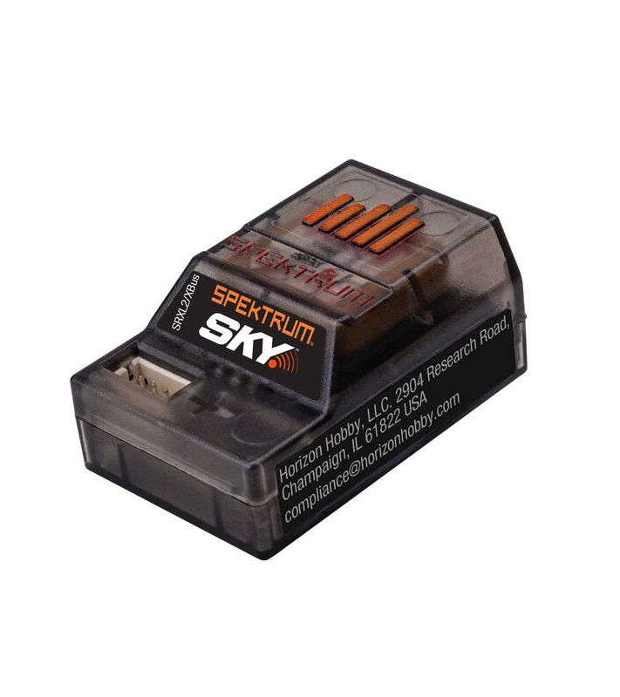
Standard Remote ID-(Cliff Notes)
It needs to be on for the whole flight.
It needs to transmit what the FAA says it need to transmit.
If it stops working, you must land right away.
You must buy a drone that has this already in it. (The manufacturer has done all the stuff the FAA wants to make it compliant)
You can’t tamper with it.

Slide 41
Alternate Remote ID-(The Regs)
89.110 Operation of standard remote identification unmanned aircraft.
Unless otherwise authorized by the Administrator, a person may comply with the remote identification requirement of § 89.105 by operating a standard remote identification unmanned aircraft under the following conditions:
(a) Operational requirements. A person may operate a standard remote identification unmanned aircraft only if the person operating the standard remote identification unmanned aircraft ensures that all of the following conditions are met:
  (1) From takeoff to shutdown, the standard remote identification unmanned aircraft must broadcast the message elements of § 89.305.
  (2) The person manipulating the flight controls of the unmanned aircraft system must land the unmanned aircraft as soon as practicable if the standard remote identification unmanned aircraft is no longer broadcasting the message elements of § 89.305.
(b) Standard remote identification unmanned aircraft requirements. A person may operate a standard remote identification unmanned aircraft only if the unmanned aircraft meets all of the following requirements:
  (1) Its serial number is listed on an FAA-accepted declaration of compliance, or the standard remote identification unmanned aircraft is covered by a design approval or production approval issued under part 21 of this chapter and meets the requirements of subpart F of this part.
  (2) Its remote identification equipment is functional and complies with the requirements of this part from takeoff to shutdown.
  (3) Its remote identification equipment and functionality have not been disabled.
  (4) The Certificate of Aircraft Registration of the unmanned aircraft used in the operation must include the serial number of the unmanned aircraft, as per applicable requirements of parts 47 and 48 of this chapter, or the serial number of the unmanned aircraft must be provided to the FAA in a notice of identification pursuant to § 89.130 prior to the operation.

Slide 42
Alternate Remote ID-(Cliff Notes)
You buy an aftermarket remote ID module
It is working and you don’t tamper with it.
If it stops working you land right away.
It has to do all the things the FAA wants it to do.

Slide 43

LAANC (UAS Data Exchange)
Low Altitude Authorization and Notification Capability
LAANC provides:
Drone pilots with access to controlled airspace at or below 400 feet.
Awareness of where pilots can and cannot fly.
Temporary Flight Restrictions (TFR) information and updates to the Special Use Airspace (SUA) schedule.
Air Traffic Professionals with visibility into where and when drones will operate.

Slide 44
LAANC (UAS Data Exchange)
Summary of LAANC
You need an app that has LAANC service
This is only used to get permission to fly in controlled airspace
You still must follow all other Part 107 rules
If you need to break a part 107 rule, you need to file for a waiver (LAANC does not allow for you to break any part 107 rules)

Slide 45

Companies Providing Public LAANC Services
https://www.faa.gov/uas/getting_started/laanc

Slide 46

How to submit a Waiver
Set up an account with the FAADroneZone https://faadronezone-access.faa.gov/#/
Determine what you need that is restricted under part 107
Be ready to describe:
  Operation Details
  sUAS Details
  Pilot/personnel Details
  Describe the risks and how you will mitigate them
Log into your drone zone account and submit your waiver
(Click on the link below for more detailed information on how to complete and submit your waiver.)
https://www.faa.gov/uas/commercial_operators/part_107_waivers

Slide 47
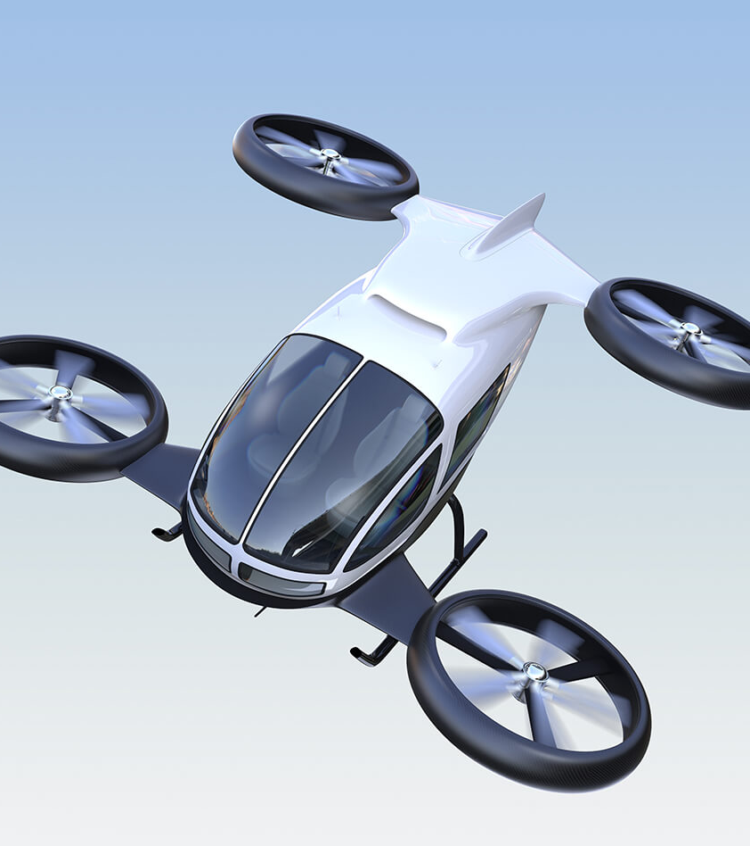
On the RADAR…
UTM- Unmanned Aircraft System Traffic Management
  a system similar to ATM (Air Traffic Management, formerly ATC Air traffic control) to allow BVLOS drone operations.
  need to avoid drone to drone collisions
  Will use a lot of automation and application programming interfaces (API) rather than voice communications.
Advanced Air Mobility and Urban Air Mobility -electric vertical take off and landing vehicles (drone Uber).

Slide 48
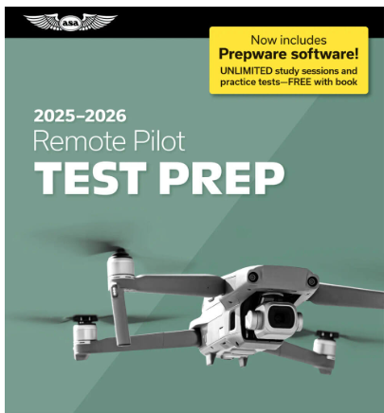
Review
Study Practice Questions from Chapter 1 “Regulations” Remote Pilot Study Guide

Slide 49
References
Marshall, D.; Barnhart, R., Shappee, E., Most, M. (2016). Introduction to Unmanned Aircraft Systems. New York, NY: CRC Press.

