Slide 1
Unmanned Aircraft Systems UAS
Loading and Performance
FAA Remote Pilot Part 107 Exam Prep

Slide 2
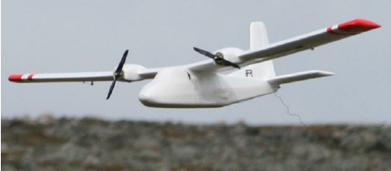
FAA Remote Pilot Test Prep
Topics Covered in this lesson
Introduction
Determining speed and altitude
Loading
Computing weight and balance
Load factor
Stalls
Performance
Notes:
In this lesson, we're going to focus on loading and performance and how these factors affect the safe operation of a small UAS.
We'll begin with some basic concepts related to aircraft performance and navigation, including how we determine an aircraft's speed and altitude.
We'll then move into aircraft loading. With a UAS, adding a battery, camera, sensor, or other payload doesn't just increase the aircraft's weight—it can also change how the aircraft flies.
That leads us into weight and balance. We'll look at how to calculate the aircraft's center of gravity, or CG, and why keeping the CG within the manufacturer's limits is critical for stability and controllability.
Next, we'll discuss load factor and see how maneuvering the aircraft—particularly in steep turns—can dramatically increase the aerodynamic forces acting on the aircraft.
We'll then examine stalls. The key concept will be understanding the relationship between angle of attack, load factor, and stall speed, rather than simply thinking of a stall as something that happens when an aircraft flies too slowly.
Finally, we'll bring these concepts together by looking at aircraft performance. We'll examine how factors such as weight, wind, temperature, altitude, and density altitude affect launch, climb, endurance, and the overall ability of the UAS to safely complete its mission.
These concepts are important for the FAA Remote Pilot knowledge test, but more importantly, they help us make better decisions when we're actually operating a UAS.

Slide 3
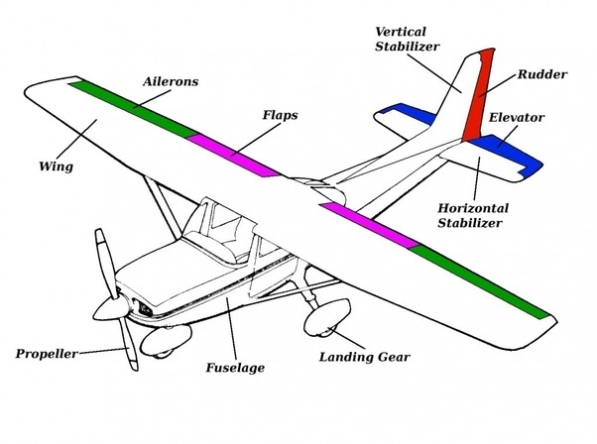
Loading and Performance
Introduction
Prior to each flight, the remote PIC must ensure that any object attached to or carried by the small unmanned aircraft is secure and does not adversely affect the flight characteristics or controllability of the aircraft.
Notes:
Any flight should begin with a control check. Do all of the flight control surfaces move in the correct direction? Do they move freely? If you add a payload does the payload affect the center of gravity? The movement of flight controls? You should know where the center of gravity for your UAS is located and understand how to test the CG before a flight.

Slide 4
Loading and Performance
Introduction
Primary Control Surface | Airplane Movement | Axes of rotation | Type of stability
Aileron | Roll | Longitudinal | Lateral
Elevator/Stabilator | Pitch | Lateral | Longitudinal
Rudder | Yaw | Vertical | Directional
Notes:
On a fixed-wing UAS, the primary flight controls are the ailerons, elevator, and rudder. Each control surface moves the aircraft around one of its three axes.
The ailerons control roll, which is rotation around the aircraft’s longitudinal axis, running from the nose to the tail. Aileron movement causes one wing to rise while the other lowers, allowing the aircraft to bank left or right. Roll is associated with the aircraft’s lateral stability.
The elevator controls pitch, which is rotation around the lateral axis, running from wingtip to wingtip. Moving the elevator changes whether the nose pitches up or down. Pitch is associated with the aircraft’s longitudinal stability.
The rudder controls yaw, which is rotation around the vertical axis. Rudder movement causes the nose to move left or right. Yaw is associated with the aircraft’s directional stability.
On a typical Mode 2 RC transmitter, the right stick controls the ailerons and elevator. Moving the stick left or right commands roll, while moving it up or down commands pitch. The left stick controls the throttle and rudder. Moving it up or down changes throttle, while moving it left or right commands yaw.
A simple way to remember the controls is: right stick = pitch and roll; left stick = throttle and yaw

Slide 5
Loading and Performance
Determining Speed and Altitude
Dead reckoning – navigation solely by means of computations based on time, airspeed, distance, and direction. The products derived from these variables, when adjusted by wind speed and velocity, are heading and ground speed.
Pilotage – navigation by reference to landmarks or checkpoints.
The Wind Triangle – navigation using triangulation. The true heading and ground speed can be found by drawing a wind triangle of vectors. One side of the triangle is the wind direction and velocity, another side is the true heading and true airspeed, the last side is the track, or true course, and the ground speed. Each side of a wind triangle is the vector sum of the other two sides.
Notes:
Dead reckoning is navigation based on calculations rather than looking at landmarks. The pilot uses time, airspeed, distance, and direction to determine where the aircraft should be. Because the wind affects the aircraft's movement over the ground, we must account for wind direction and speed to determine the correct heading and ground speed.
Pilotage is much simpler. It means navigating by looking at recognizable landmarks or checkpoints on the ground. These might include roads, rivers, towns, mountains, towers, or other easily identifiable features. Essentially, we compare what we see on the ground with what we see on our map.
The wind triangle helps us understand how wind changes the aircraft's actual path over the ground. It consists of three vectors: the aircraft's heading and true airspeed, the wind direction and velocity, and the resulting ground track and ground speed.
Think of it this way: where we point the aircraft is not necessarily where the aircraft travels. A crosswind can push the aircraft sideways, so we may need to point slightly into the wind to maintain our desired course. The wind triangle allows us to calculate that correction.

Slide 6
Loading and Performance
Determining Speed and Altitude
Altitude determination on a sUAS: [sUAS must remain below 400 feet AGL (Above Ground Level)]
  Install a calibrated altimeter that reports MSL (mean sea level) altitude back to control station. AGL (above ground level) altitude must be converted by adding or subtracting field elevation from MSL altitude.
  GPS reported altitude from sUAS.
  Have a visual observer pace off 400’ to establish a rough visual reference of 400 feet.
  Use the height of known terrain or obstructions.
  Use a measurement of distance if control station is so equipped.
Notes:
Under Part 107, we generally operate a small UAS at or below 400 feet above ground level, or AGL. It is important to remember that AGL means the aircraft's height above the surface directly below it—not its elevation above sea level.
There are several ways we can determine or estimate our altitude:
Barometric altimeter: Some UAS use a barometric altimeter to determine altitude. If the system provides altitude referenced to mean sea level (MSL), we need to account for the elevation of the terrain to determine our approximate AGL altitude. For example, if the aircraft reports 5,400 feet MSL and the terrain below it is at 5,000 feet MSL, the aircraft is approximately 400 feet AGL.
GPS/GNSS altitude: The aircraft may also provide altitude information using its GPS/GNSS receiver. Pilots need to understand exactly what altitude reference their particular system displays, because different systems may report altitude differently.
Visual estimation: A visual observer can help establish a rough reference for what 400 feet looks like. For example, you can measure 400 feet horizontally on the ground before the flight to give the crew a sense of that distance. This is only an approximation and should not replace reliable altitude information from the aircraft.
Known terrain or structures: Objects of known height—such as towers, buildings, hills, or other terrain features—can provide another useful visual reference.
Control-station information: Many modern UAS control stations directly display the aircraft's altitude or height relative to its takeoff point. The remote pilot should understand how that particular UAS calculates and displays altitude, especially when operating over changing terrain.
One important distinction for students is that 400 feet above the takeoff point is not always the same as 400 feet AGL. If the aircraft flies toward rising or falling terrain, the distance between the aircraft and the ground changes even if the altitude displayed by the controller does not.

Slide 7
Loading and Performance
Loading
Empty weight - includes the airframe, power source, all fixed equipment, and unusable fuel.
Useful load – power source (battery or fuel) and payload equipment.
Launch weight – empty weight plus useful load.
Landing weight – launch weight minus any fuel used or jettisoned load.
Notes:
When discussing aircraft loading and performance, we need to understand several different types of weight.
Empty weight is the weight of the aircraft before we add anything needed for a particular mission. It generally includes the airframe and permanently installed equipment. Depending on the aircraft and definition being used, it may also include items such as unusable fuel.
Useful load is everything we add to the aircraft to make it ready for the mission. For a UAS, this can include the battery or usable fuel, cameras, sensors, cargo, and other payload equipment.
Launch weight is the empty weight plus the useful load. This is what the aircraft actually weighs when it begins the flight. Launch weight is particularly important because increasing weight affects takeoff distance, climb performance, stall speed, maneuverability, and endurance.
Landing weight is the aircraft's weight when it returns. For a battery-powered UAS, the landing weight will usually be nearly the same as the launch weight because using electrical energy does not meaningfully reduce the battery's mass. For a fuel-powered aircraft, landing weight will be lower because fuel has been consumed. It can also be lower if the aircraft releases or delivers a payload during the mission.
The key idea is that weight directly affects performance. The more weight we add, the more lift and power the aircraft needs to remain airborne.

Slide 8
Loading and Performance
Computing weight and balance
Arm - horizontal distance measured in inches from the datum line to a point on the aircraft.
Datum line - a reference point along the longitudinal axis indicated by the manufacturer.
Moment – product of the weight of an object multiplied by its arm and is expressed in pound-inches (lbs.-in).
C.G. (center of gravity) – The total moment divide by the total weight equals the CG.
  C.G. represents the number of inches from the datum that the airplanes balances.
While longitudinal stability is typically the focus of weight and balance , lateral CG is also a concern. (eg. fuels used in the wings must be used evenly or the aircraft can become laterally unstable).
Notes:
To understand weight and balance, we need to understand four basic terms: datum, arm, moment, and center of gravity.
The datum line is an imaginary reference point established by the aircraft manufacturer. All of our weight-and-balance measurements are taken relative to this point. The datum does not have to be located on the aircraft—it is simply the starting reference for our measurements.
The arm is the horizontal distance from the datum to the location of a particular item. For example, a battery, camera, or payload might be located 15 inches behind the datum. Its arm would therefore be 15 inches.
The moment tells us how much that weight tends to rotate or balance the aircraft around the datum. We calculate moment by multiplying the item's weight by its arm:
Moment = Weight × Arm
If we measure weight in pounds and arm in inches, the moment is expressed in pound-inches (lb-in).
Once we know the weight and moment of everything on the aircraft, we can calculate the center of gravity, or CG:
CG = Total Moment ÷ Total Weight
The resulting number tells us how far the aircraft's balance point is located from the datum.
CG location is extremely important to aircraft stability and controllability. A CG that is too far forward generally makes the aircraft more stable but can make it difficult to pitch the nose up. A CG that is too far aft reduces longitudinal stability and can make the aircraft difficult or even unsafe to control.
We usually focus on longitudinal CG—forward and aft balance—but lateral balance also matters. Uneven loading between the left and right sides of the aircraft can create a lateral imbalance. On larger aircraft, uneven fuel use between wing tanks is one example. On a UAS, mounting a heavy battery, sensor, or payload off-center can create the same problem.
For UAS operations, the practical lesson is simple: where we place the payload can be just as important as how much the payload weighs.

Slide 9
Loading and Performance
Computing weight and balance
Loading an aircraft outside of its CG limits can make the aircraft difficult or impossible to control.
It is the responsibility of the remote PIC to use the most current weight and balance data when planning a flight and operating the sUAS.
Example of a weight and balance calculation
Weight x Arm = Moment/1000
Aircraft empty weight: 1639lbs 39.29 64.4 in/lbs.
Pilot & Front Passenger: 340 lbs. 37” 12.58 in/lbs.
Fuel: 53 gallons (max) 318 lbs. 48” 15.26 in/lbs.
Rear passenger 80 lbs. 72” 5.76 in/lbs.
Baggage: 30 lbs. 76” 2.28
Total: 2,407 lbs. 100.28
Center of gravity =total moment/total weight = [100.28/2407 x 1000] = 41.66” from Datum
Notes:
This slide puts the terms we just discussed—weight, arm, moment, and center of gravity—into an actual calculation.
Before every flight, the remote PIC needs to make sure the aircraft is loaded within its allowable CG limits. An aircraft loaded outside those limits may become difficult or even impossible to control. For a UAS, changing batteries, cameras, sensors, or other payloads can change both the aircraft's total weight and its CG.
The example shown here uses a manned aircraft, but the calculation works exactly the same way for a fixed-wing UAS.
We start by listing everything contributing to the aircraft's weight. For each item, we need two numbers: its weight and its arm, which is the distance from the aircraft's datum.
For each item, we calculate its moment:
Moment = Weight × Arm
We then add all of the individual weights to determine the total aircraft weight, and add all of the individual moments to determine the total moment.
In this example, the total weight is 2,407 pounds, and the total moment is 100.28 thousand pound-inches. Because the moment values in the table have been divided by 1,000 to make the numbers easier to work with, we multiply the total moment by 1,000 when calculating CG.
So:
CG = (100.28 × 1,000) ÷ 2,407 = 41.66 inches
That means the aircraft's center of gravity is located 41.66 inches from the datum.
But calculating the CG is only half the job. We then need to compare that value with the manufacturer's allowable CG range. A CG calculation of 41.66 inches doesn't tell us whether the aircraft is safe until we know whether 41.66 inches falls within the approved limits.
For our UAS, the process is the same: weigh it, determine where each weight is located, calculate the moments, find the CG, and verify that the CG is within limits before flight.

Slide 10
Loading and Performance
Load Factor
Load - in aerodynamics, load is the force or imposed stress that must be supported by a sUAS structure in flight.
Load Factor – The loads imposed on the wings or rotors in flight.
G force – the force an object or person experiences due to acceleration.
An aircraft in straight and level unaccelerated flight experiences 1 G. Gravity applies and acceleration force of 1 G.
G force is increased or decreased in turns, climbs, dives, accelerations, and decelerations.
Notes:
When we talk about load in aerodynamics, we're talking about the forces or stresses that the aircraft's structure must support during flight. The wings, fuselage, control surfaces, and other components all experience these forces.
Load factor describes how much aerodynamic load the aircraft is experiencing compared with its weight. We commonly express this in terms of G's.
In straight-and-level, unaccelerated flight, the aircraft experiences a load factor of approximately 1 G. The wings are producing enough lift to support the aircraft's weight.
When the aircraft maneuvers, the load factor can change. During a turn, for example, some of the wing's lift must act horizontally to turn the aircraft. To maintain altitude, the aircraft must produce additional lift. This increases the load on the wings.
The steeper the bank while maintaining altitude, the greater the load factor becomes. At a 60-degree bank, for example, the aircraft experiences approximately 2 G. That means the wings must produce roughly twice the aircraft's weight in lift.
Load factor can also change during pull-ups, pushovers, abrupt control inputs, turbulence, and other accelerated maneuvers.
This is important for UAS operations because increasing load factor places additional stress on the aircraft structure and also increases stall speed. An aircraft can therefore stall at a higher airspeed during a steep or aggressive maneuver than it would during normal straight-and-level flight.
The key point is: the aircraft may not get any heavier during a maneuver, but the forces acting on the aircraft can become much greater.

Slide 11
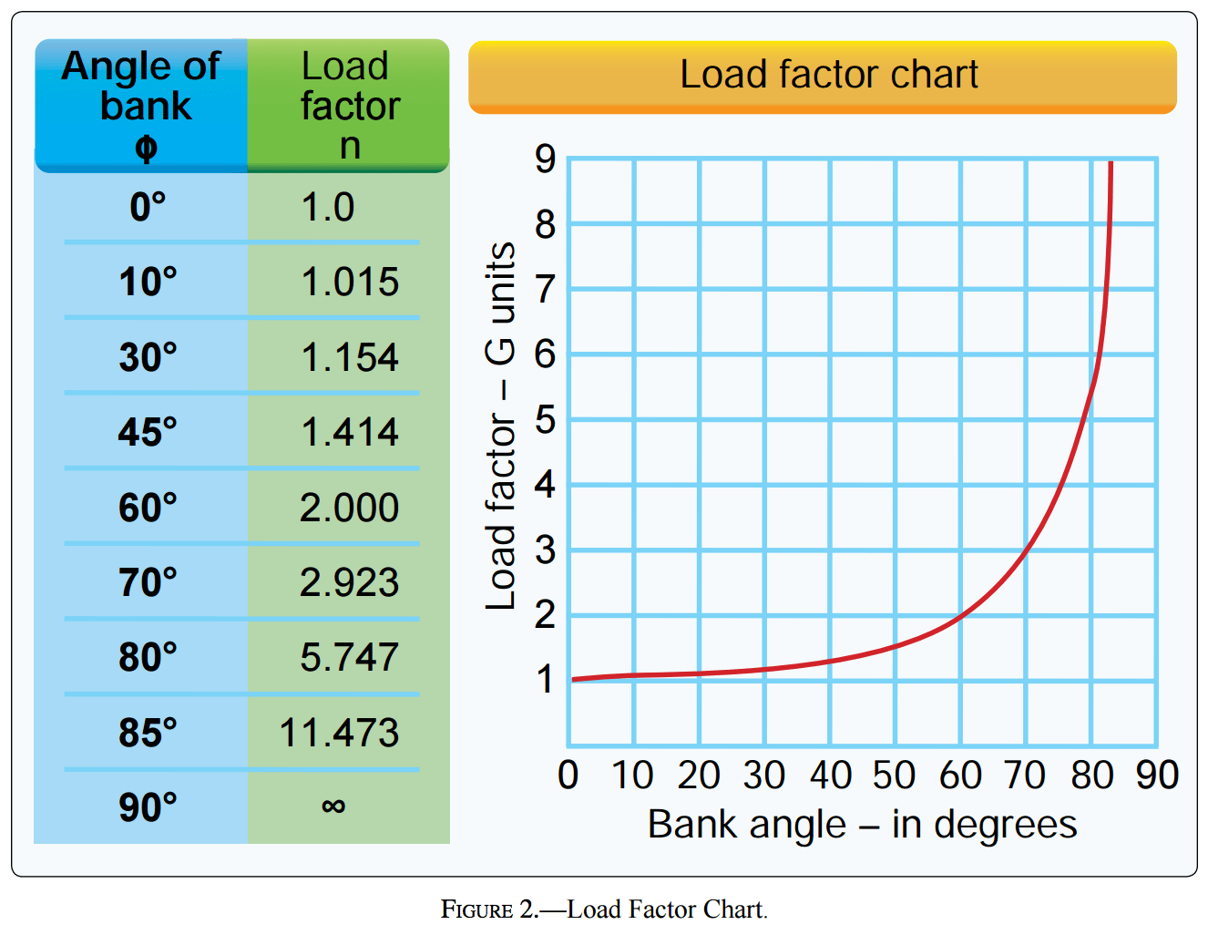
Loading and Performance
Load Factor
Notes:
This chart shows how bank angle affects load factor during a level, coordinated turn.
At 0 degrees of bank, the aircraft is in straight-and-level flight and experiences a load factor of 1 G. As we increase the bank angle, the wings must generate more lift to keep the aircraft at the same altitude, so the load factor increases.
At relatively shallow bank angles, the increase is small. At 30 degrees, the load factor is only about 1.15 G, and at 45 degrees it increases to about 1.4 G.
Once we get beyond 45 degrees, however, the load factor starts increasing very rapidly. At a 60-degree bank, the aircraft experiences 2 G. In other words, the wings must produce twice as much lift as they do in straight-and-level flight.
At 70 degrees, we're approaching 3 G, and at 80 degrees, we're approaching 6 G.
Notice what happens as we approach a 90-degree bank. The required load factor theoretically approaches infinity. That's because, at exactly 90 degrees, the lift vector is entirely horizontal—there is no vertical component of lift available to support the aircraft's weight. A conventional fixed-wing aircraft therefore cannot maintain a level, constant-altitude turn at 90 degrees of bank using wing lift alone.
For UAS pilots, the important lesson is that steep turns dramatically increase the forces on the aircraft. Higher load factors increase structural loads, require more lift, and increase stall speed.
So as bank angle increases, remember:
More bank → more required lift → higher load factor → higher stall speed.

Slide 12
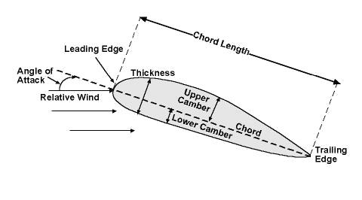
Loading and Performance
Stalls
Airfoil – a structure or body that produces a useful reaction to air movement.
Chord Line – an imaginary straight line from the leading edge to the trailing edge of an airfoil.
Relative wind - the wind “felt” or experienced by an airfoil.
Angle of attack – angle between the chord line of the airfoil and the relative wind.
Notes:
Before we talk about stalls, we need to understand a few aerodynamic terms that explain what causes a stall.
An airfoil is a shape designed to produce a useful aerodynamic force as air moves around it. On a fixed-wing UAS, the most obvious airfoil is the wing, although propeller blades and control surfaces also use airfoil shapes.
The chord line is an imaginary straight line drawn from the leading edge to the trailing edge of the airfoil. We use this line as a reference when measuring angle of attack.
Relative wind is the airflow the wing actually experiences as it moves through the air. Relative wind acts opposite the aircraft's flight path. This is important because angle of attack is based on the direction of the relative wind—not simply the aircraft's attitude relative to the horizon.
The angle of attack, or AOA, is the angle between the chord line and the relative wind. As angle of attack increases, lift generally increases—up to a point.
Eventually, the wing reaches its critical angle of attack. Beyond this angle, airflow begins to separate significantly from the upper surface of the wing, causing a rapid reduction in lift. That is a stall.
One of the most important concepts to remember is that an aircraft stalls because it exceeds its critical angle of attack—not simply because it is flying too slowly.
Low airspeed makes a stall more likely because the aircraft must typically increase its angle of attack to maintain lift, but an aircraft can stall at any airspeed, altitude, or attitude if the critical angle of attack is exceeded.
This also connects directly to our previous discussion about load factor: as load factor increases, the aircraft can reach its critical angle of attack at a higher airspeed.

Slide 13
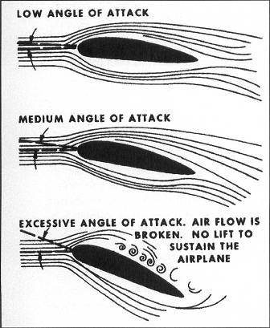
Loading and Performance
Stalls
Stalls occur when the critical angle of attack is exceeded (18-20 degrees for most airfoils). During a stall, the smooth airflow over the airfoil becomes separated from the airfoil.
Turbulence caused by the separation of airflow becomes so great the airfoil stops producing enough lift to maintain flight.
A wing will always stall at the critical angle of attack regardless of altitude, airspeed, or weight.
Increases in load factor will increase an aircraft’s stall speed.
Notes:
A stall occurs when the wing exceeds its critical angle of attack. For many conventional airfoils, this occurs somewhere around 15 to 20 degrees, but the actual critical angle depends on the particular airfoil and aircraft design.
As we increase angle of attack, the wing initially produces more lift. However, eventually the airflow can no longer remain smoothly attached to the upper surface of the wing.
As the critical angle of attack is reached and exceeded, the airflow begins to separate from the wing. This creates turbulent airflow and causes a significant reduction in lift. At that point, the wing is stalled.
The diagram shows this progression. At a low angle of attack, airflow remains relatively smooth and attached. As angle of attack increases, separation begins to develop. At an excessive angle of attack, significant separation occurs and the wing can no longer produce enough lift for the flight condition.
An important point is that a wing always stalls when its critical angle of attack is exceeded. It doesn't matter whether the aircraft is high or low, fast or slow, or whether the nose is pointed up or down.
We often associate stalls with low airspeed because slowing an aircraft generally requires us to increase angle of attack to maintain lift. But airspeed itself does not cause the stall—the excessive angle of attack does.
This also connects to our discussion of load factor. When we increase the load factor—for example, during a steep level turn—the wing must produce additional lift. As a result, the aircraft will reach its critical angle of attack at a higher airspeed.
So remember these two relationships:
Critical angle of attack exceeded → Stall
Higher load factor → Higher stall speed

Slide 14
Loading and Performance
Performance
The remote PIC is responsible for ensuring that every flight can be accomplished safely, does not pose an undue hazard, and does not increase the likelihood of a loss of positive control.
The effect of runway slope on launch distance is due to the component of weight along the inclined path of the aircraft. An upslope would contribute a retarding force component, while a downslope would contribute an accelerating force component.
Weight, altitude, temperature and unfavorable wind are the most critical factors in launch performance of a sUAS.
The maximum endurance condition is obtained at the point of minimum power required (least fuel or battery power required to maintain flight).
Notes:
The remote PIC is ultimately responsible for determining whether the UAS can safely complete the planned flight. Before launching, we need to consider the aircraft, payload, environmental conditions, launch area, and the performance required for the mission. If those factors create an unacceptable risk or increase the likelihood of losing positive control of the aircraft, we should not launch.
For a fixed-wing UAS that uses a runway or rolling takeoff, runway slope can affect the distance required to become airborne. An upslope increases resistance, so the aircraft generally requires more distance to accelerate to launch speed. A downslope assists acceleration and can reduce the required distance. For hand-launched or catapult-launched UAS, runway slope may not be relevant, but the same basic idea applies: anything that makes it harder to reach the required airspeed affects launch performance.
Four particularly important performance factors are weight, altitude, temperature, and wind. A heavier aircraft requires more lift and generally needs a higher launch speed. Higher density altitude—often caused by higher elevation and higher temperature—reduces air density, which can decrease aerodynamic and propeller performance. Wind is also important: a headwind generally improves launch performance, while a tailwind increases the ground speed and distance needed to achieve the required airspeed.
Finally, maximum endurance means keeping the aircraft airborne for the greatest amount of time. For a fixed-wing aircraft, this occurs near the condition where the minimum power is required to maintain flight. For an electric UAS, that means operating where the propulsion system requires the least battery power necessary to remain airborne.
It is useful to distinguish endurance from range: endurance asks, “How long can I stay airborne?” Range asks, “How far can I travel?” The airspeed for maximum endurance is not necessarily the same as the airspeed for maximum range.

Slide 15
References
Marshall, D.; Barnhart, R., Shappee, E., Most, M. (2016). Introduction to Unmanned Aircraft Systems. New York, NY: CRC Press.

