Slide 1

Unmanned Aircraft Systems UAS
Operations
FAA Remote Pilot Part 107 Exam Prep-Regulations

Slide 2
FAA Remote Pilot Test Prep
Topics Covered in this lesson
Introduction
Communication Procedures
sUAS Frequencies
Emergency Procedures
Lost link
Flight termination
Flyaways
Loss of GPS
Battery Fires
Aeronautical Decision Making
Physiology
Maintenance and Inspection Procedures
Notes:
This lesson moves beyond simply knowing the regulations and focuses on how we safely operate a UAS in the real world.
We'll begin with communication procedures. Good communication between the remote PIC, visual observer, and other members of the flight crew is essential. Everyone needs to understand their responsibilities and know how to communicate hazards or changing conditions quickly and clearly.
We'll also discuss UAS radio frequencies and the different wireless links that may be used for aircraft control, telemetry, GPS/GNSS, and video. Understanding these systems helps us recognize potential interference and communication problems.
A major portion of this lesson deals with emergency procedures. We need to think about emergencies before they happen rather than trying to invent a solution while the aircraft is already in trouble.
One of the most important emergencies is lost link, where communication between the control station and the aircraft is interrupted. We'll discuss how different UAS respond to lost link and why the remote PIC needs to understand and configure those behaviors before flight.
We'll also look at flight termination, or situations where intentionally ending the flight may be safer than allowing the aircraft to continue.
For fixed-wing UAS, we'll discuss flyaways and what can happen when the aircraft no longer responds as expected. We'll also examine loss of GPS, including how the aircraft's behavior may change when position-hold or autonomous navigation is no longer available.
We'll spend some time on lithium battery fires because batteries introduce hazards that are different from those associated with traditional aircraft fuel systems. Proper charging, handling, storage, and emergency response are important parts of safe UAS operations.
We'll then introduce Aeronautical Decision Making, or ADM. ADM gives us a systematic way to recognize hazards, evaluate risk, and make good decisions before and during a flight.
We'll also discuss human physiology and human factors. Fatigue, stress, illness, medications, alcohol, dehydration, and other factors can affect our ability to safely operate an aircraft—even when we're standing on the ground.
Finally, we'll cover maintenance and inspection procedures. The remote PIC needs to ensure that the aircraft is in a condition for safe operation before every flight.
The common theme throughout this lesson is risk management: recognizing what can go wrong, planning for it ahead of time, and knowing what to do when something doesn't go according to plan.

Slide 3
Operations
Introduction
The remote PIC of an sUAS is responsible for determining whether that aircraft is in condition for safe flight.
The remote PIC must inspect the sUAS before each flight.
Preflight inspection should be a thorough and systematic means by which the remote PIC determines that the aircraft is in a safe condition for flight.
When in doubt, remove and replace any damaged part.
Always consult with the manufacturer for the proper procedure for the repair and/or replacement of parts.
Notes:
Before every flight, the remote PIC is responsible for determining that the UAS is in a condition for safe operation. We cannot assume that an aircraft is safe simply because it flew successfully on the previous flight.
A preflight inspection should be systematic and thorough. Using the same procedure or checklist every time helps prevent us from overlooking something important.
For a fixed-wing UAS, we should inspect the airframe, wings, control surfaces, hinges, control linkages, propeller, motor, landing gear or launch equipment, antennas, payload, and electrical connections. We should also verify that batteries are properly charged, securely installed, and show no signs of damage or swelling.
We also need to perform functional checks. Make sure the ailerons, elevator, and rudder move freely and in the correct direction when commanded. Verify the propulsion system, communications link, GPS/GNSS, telemetry, and any other systems required for the mission.
Pay particular attention to anything that has changed since the previous flight. A hard landing, transportation damage, payload change, repair, firmware update, or battery replacement may introduce a new problem.
If we find a damaged or questionable component, don't simply decide that it is “probably good enough.” When in doubt, remove the aircraft from service and repair or replace the affected component.
Repairs and replacement parts should follow the manufacturer's recommendations and procedures whenever they are available.
The key idea is simple: the remote PIC makes the final decision that the aircraft is safe to fly—and that decision needs to be made before every flight.

Slide 4
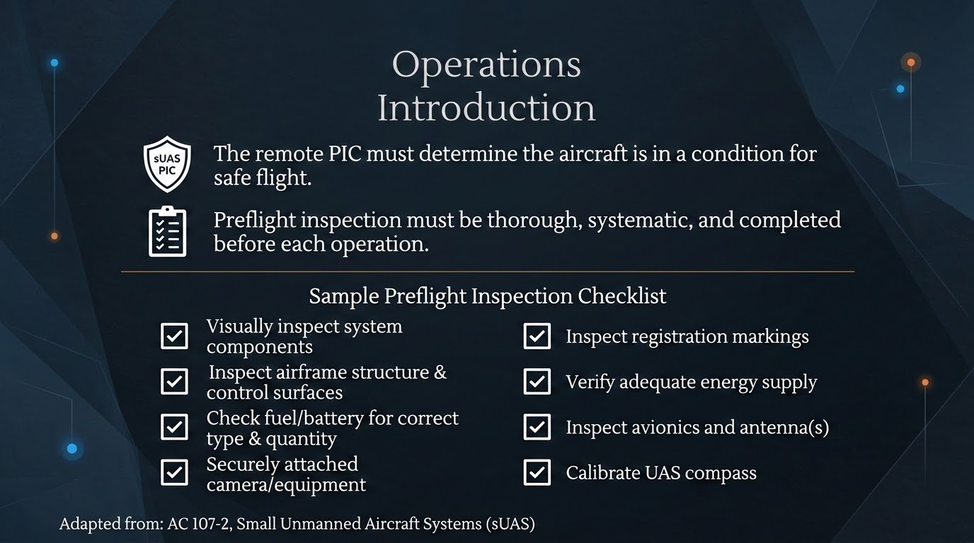
Notes:
This is an example of a systematic preflight inspection. The exact checklist will vary depending on the UAS, but the goal is always the same: determine that the entire system is ready for safe flight.
Start with a visual inspection. Look over the aircraft for anything that appears damaged, loose, cracked, bent, or out of place. For a fixed-wing UAS, pay particular attention to the wings, fuselage, control surfaces, hinges, linkages, propeller, motor, and attachment points.
Next, verify the fuel or battery system. Make sure we have the correct battery or fuel, that we have enough energy to complete the mission with an appropriate reserve, and that batteries are not damaged, swollen, or improperly secured.
Any payload equipment—such as cameras or sensors—needs to be securely attached. A loose payload can affect the aircraft's center of gravity and could potentially separate from the aircraft during flight.
Check the aircraft's registration markings and any other required identification.
We also need to inspect the avionics, antennas, wiring, and communication systems. Remember that we're not just preflighting an aircraft; we're preflighting an entire UAS, including the controller, ground station, communications link, and supporting equipment.
Compass or other sensor calibration should be performed when required by the manufacturer or operating conditions. We don't necessarily want to recalibrate a compass before every flight unless the manufacturer calls for it.
For a fixed-wing aircraft, I would also add an important functional check that isn't specifically shown here: verify control direction. Move the transmitter sticks and physically confirm that the ailerons, elevator, and rudder move in the correct direction.
A good habit is to use the checklist every time—even when you've flown the aircraft hundreds of times. Familiarity is exactly when it's easy to start skipping steps.
The remote PIC ultimately makes the decision: Is this aircraft—and the entire UAS—ready for safe flight?

Slide 5
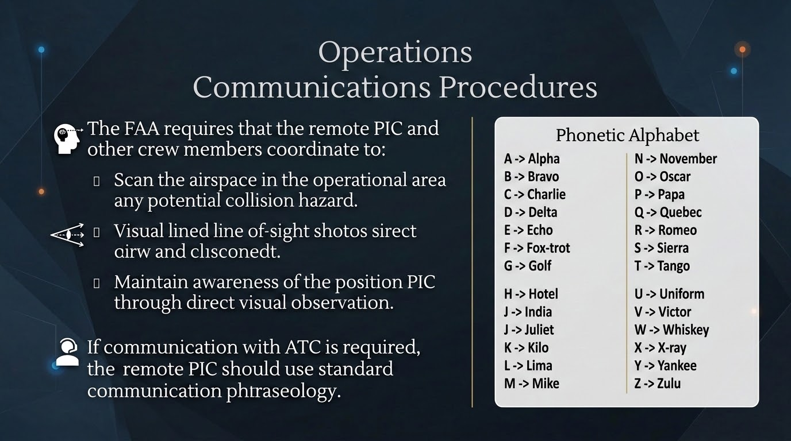
Notes:
Good communication is an important part of crew resource management during UAS operations. The remote PIC, visual observer, and any other crew members need to understand their responsibilities and communicate clearly throughout the flight.
One of the crew's most important responsibilities is maintaining situational awareness. We need to continuously scan the surrounding airspace for other aircraft, people, obstacles, or anything else that could create a collision hazard.
The remote PIC must also be able to maintain the required visual line of sight with the UAS. A visual observer can assist the remote PIC by watching the aircraft and surrounding airspace, but the crew needs an effective way to communicate what the observer sees.
For example, simply saying “airplane!” isn't very helpful. We want to communicate where the traffic is located. We might say, “Traffic, two o'clock, low, moving left to right.” That immediately gives the remote PIC useful information.
The crew should also agree on important terminology before the flight. Commands such as abort, land, hold, traffic, or lost link should have a clear meaning to everyone on the crew.
If communication with Air Traffic Control is required for a particular operation, we should use standard aviation terminology and phraseology. Communications should be brief, clear, and professional.
This is where the ICAO phonetic alphabet becomes useful. Instead of saying individual letters that might sound alike over a radio—such as B, D, E, or P—we use words such as Bravo, Delta, Echo, and Papa.
One small correction on the slide: the phonetic alphabet should read I = India and J = Juliett. Juliett is officially spelled with two T's in the ICAO alphabet.
The main idea is that effective UAS communication isn't about talking more—it's about making sure the right information gets to the right crew member quickly and unambiguously.

Slide 6
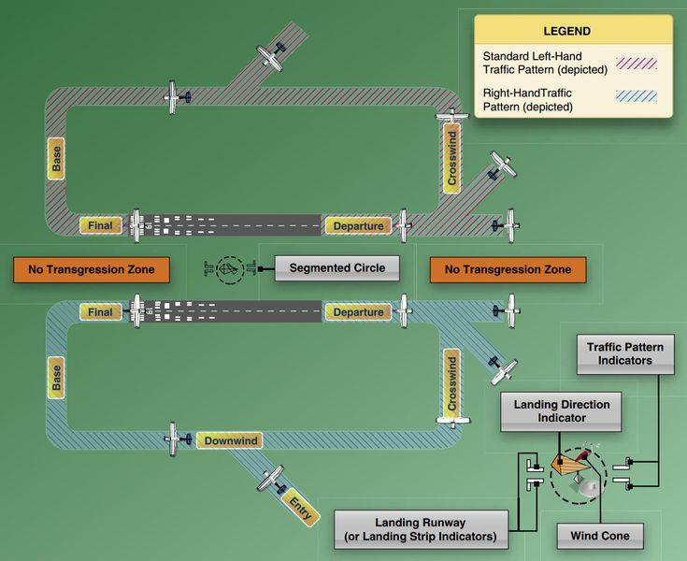
“On the 45 for 18”
“Entering a left downwind for 18”
“Turning left base runway 36”
“Final 36”
“Turning final 36”
“Short final 36”
“turning left crosswind 18”
“upwind 36 departing the area to the NW”
“departing runway 18 will remain in the pattern”
“Departing 36 close traffic”
“You are operating your sUAS:
1 mile north of the airport
¼ mile east of the airport
2 miles north west of the airport.
Notes:
When operating a UAS near an airport, we need to understand how manned aircraft move through the airport traffic pattern. This allows us to anticipate where aircraft are likely to be rather than waiting until we see one.
A standard traffic pattern consists of several legs: departure or upwind, crosswind, downwind, base, and final. Most standard traffic patterns use left turns, although some runways use right-hand patterns because of terrain, obstacles, noise considerations, or other operational requirements.
Pilots at non-towered airports often announce their position using the runway number and traffic-pattern leg. For example, you might hear:
“Entering left downwind Runway 18.”
That tells us the aircraft is flying parallel to Runway 18, in the opposite direction from landing traffic, and is making a left-hand pattern.
If we hear:
“Turning left base Runway 36,”
the aircraft is getting closer to landing and will soon turn onto final approach.
And:
“Short final Runway 36”
means the aircraft is very close to the runway and about to land.
Departing aircraft may announce that they are departing the area in a particular direction or that they will remain in the traffic pattern.
This information becomes extremely important to us as UAS pilots. Imagine we're operating one mile north of the airport. We need to look at the runway orientation and traffic pattern and ask: Where will arriving and departing aircraft be relative to our UAS?
The same applies if we're operating a quarter-mile east or two miles northwest. Our distance from the airport alone doesn't tell us the risk. We need to understand the runway being used, the traffic-pattern direction, and where aircraft are likely to be climbing, descending, or turning.
Also remember that not every aircraft will make a radio call, and not every aircraft has a radio. Listening to the CTAF can improve situational awareness, but it does not replace visually scanning for traffic.
For UAS operations, the objective isn't to participate in the airport traffic pattern. It's to understand the pattern well enough to predict where crewed aircraft may appear and keep the UAS safely out of their way.

Slide 7
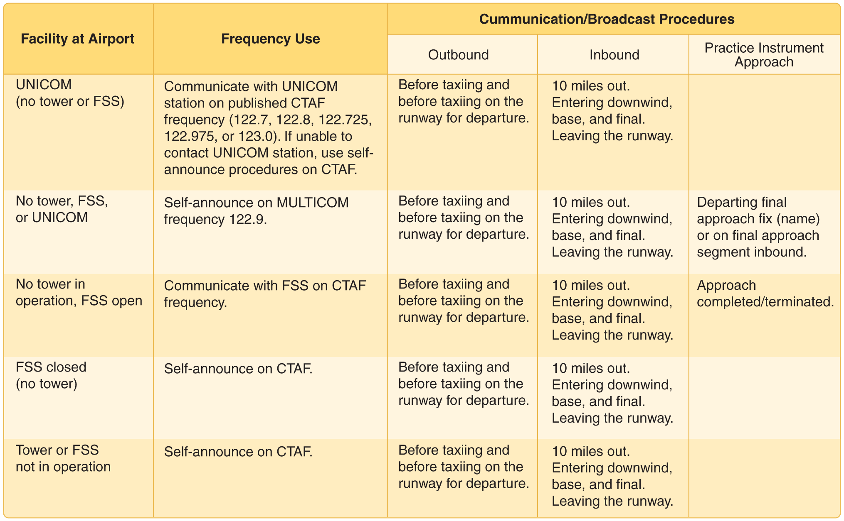
Operations
Communication Procedures
The remote PIC and all crew members should be familiar with common communication frequencies and when radio calls and position reports are expected.
Notes:
When operating a UAS near an airport, it is useful to understand the radio frequencies used by crewed aircraft and the types of position reports we may hear.
At a non-towered airport, pilots commonly communicate using the Common Traffic Advisory Frequency, or CTAF. Pilots use CTAF to announce their position and intentions so that other pilots in the area can build situational awareness.
Some airports also have a UNICOM frequency. UNICOM is a nongovernment communication service that may provide airport information, but at many non-towered airports the UNICOM frequency also serves as the CTAF.
The table shows some of the typical radio calls we might hear. An inbound aircraft may make a call approximately 10 miles from the airport and then announce positions such as downwind, base, and final. A departing aircraft may announce before entering or taxiing onto the runway and again as it departs.
For us as UAS pilots, these calls provide valuable information. If we hear:
“Bozeman traffic, Cessna 1234 Alpha, ten miles west, inbound Runway 12…”
we now know an aircraft is approaching the airport, where it is coming from, and where we should begin looking for it.
However, an important distinction is that Part 107 does not generally require a remote pilot to monitor CTAF or make radio calls simply because we're operating near a non-towered airport. In fact, we don't want unnecessary transmissions interfering with normal aviation communications.
Instead, our goal is to understand these frequencies and calls so we can use them to improve situational awareness when appropriate.
And remember: never rely solely on the radio for traffic avoidance. Some aircraft may not have a radio, may be using a different frequency, or may simply not make a call. Our primary responsibility remains maintaining awareness of the surrounding airspace and yielding the right of way to all other aircraft.

Slide 8
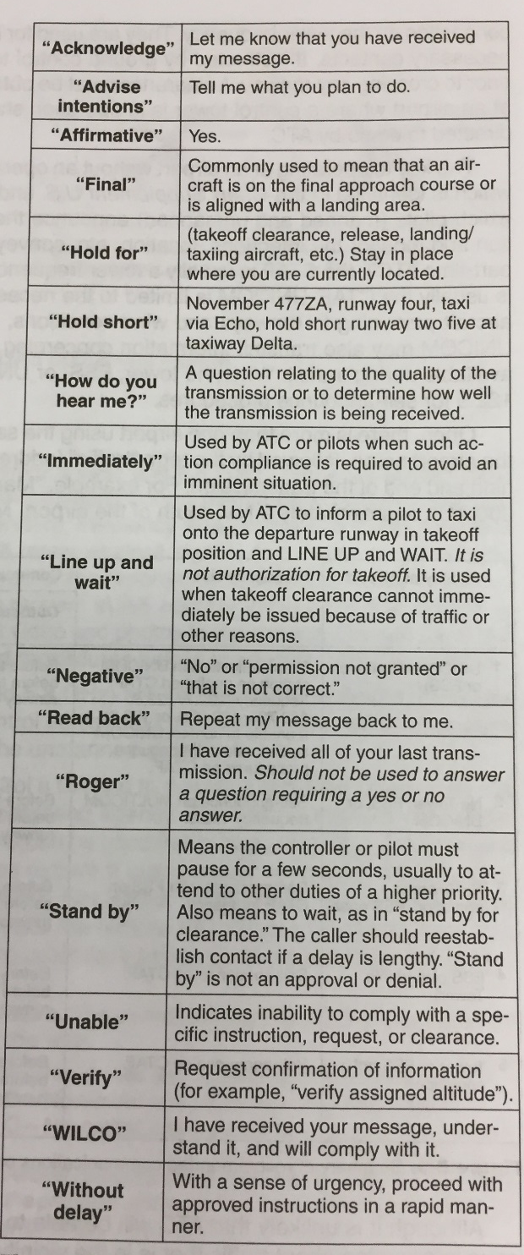
Operations
Communication Procedures
Aircraft call signs should be spoken in their entirety, using the phonetic alphabet.
Numbers are spoken individually.
The remote PIC and all crew members should understand common phrases used in air traffic radio communication.
Notes:
Aviation radio communication is designed to be short, standardized, and unambiguous. We want everyone listening to understand exactly what is being communicated without unnecessary conversation.
Aircraft call signs are used to identify who is transmitting. When making initial contact, the complete call sign is normally used. Letters are pronounced using the phonetic alphabet to reduce confusion between similar-sounding letters.
Numbers are generally pronounced one digit at a time. For example, an aircraft with the call sign N123AB would be spoken as “November One Two Three Alpha Bravo.”
There are also several standard words and phrases that have very specific meanings in aviation.
“Affirmative” means yes, while “Negative” means no.
“Roger” means I have received your transmission. It does not mean yes, and it does not necessarily mean that you will comply with an instruction.
“Wilco” means I understand your message and will comply with it.
“Say again” means repeat your last transmission. We generally avoid using the word “repeat” in aviation communications.
“Stand by” means wait; I will get back to you.
“Unable” means that the pilot cannot comply with a particular instruction or request.
“Verify” asks someone to confirm information, while “read back” asks the pilot to repeat an instruction to ensure that it was understood correctly.
As UAS pilots, we may not routinely communicate directly with ATC, but we should still understand this terminology. If we're monitoring aviation frequencies near an airport, understanding these phrases helps us interpret what crewed aircraft and controllers are doing and what may happen next.
The goal isn't to sound like an airline pilot. The goal is to communicate and understand information clearly, briefly, and accurately.

Slide 9
Operations
Communication Procedures
The term “initial radio contact” or “initial callup” means the first radio call you make to a given faculty, or the first call to a different controller or flight service specialist within a facility. Use the following format:
  Name of the facility being called.
  Your full aircraft identification as filed in the flight plan.
  Type of message to follow or your request if it is short.
  The word “over” if required. This is typically omitted and is no longer commonly used.
Notes:
The term initial radio contact, or initial callup, refers to the first radio transmission you make to a particular ATC facility. It can also refer to your first transmission after being handed off to a different controller or Flight Service specialist.
There is a basic order we follow when making that first call.
First, state the name of the facility you are calling. This gets the controller's attention and confirms that you're transmitting on the correct frequency.
Next, give your full aircraft identification or call sign. On the initial call, we normally use the complete call sign rather than shortening it.
Then, briefly tell the controller what you want or the type of request you're making. Keep the initial transmission concise. The controller can ask for additional information if needed.
For example:
“Bozeman Tower, UAS November One Two Three Alpha Bravo, request.”
Or, when appropriate, the request can be included:
“Bozeman Tower, November One Two Three Alpha Bravo, request transition through Class Delta airspace.”
The word “over” traditionally indicates that you've finished transmitting and expect a response. In normal VHF aviation communications, however, “over” is generally unnecessary and is rarely used today.
A simple way to remember the initial call is:
WHO you're calling → WHO you are → WHAT you want.
One correction to the original wording: it should be “facility,” not “faculty.”

Slide 10
Sample Communication Phraseology
What does all of this mean?
Aircraft- “Bozeman approach skyhawk niner two lima Charlie”
ATC “Skyhawk niner two lima Charlie say request”
Aircraft “We would like VFR flight following to Sierra Delta Yankee, Sidney-Richland. Currently 6 thousand three hundred climbing seven thousand five hundred niner two lima charlie”
ATC “niner two lima Charlie squawk 3461 and ident”
Aircraft “3461 niner two lima Charlie”
ATC “niner two lima charlie radar contact 5 mile SE Bozeman field, climb maintain seven thousand five hundred, maintain VFR, Bozeman altimeter two niner zero niner”
Aircraft “climb maintain seven thousand five hundred, two niner zero niner Skyhawk niner two lima Charlie”
Notes:
This example shows a typical conversation between a VFR aircraft and Bozeman Approach. At first, aviation radio communication can sound extremely fast and complicated, so let's break it down one transmission at a time.
The pilot begins with:
“Bozeman Approach, Skyhawk Niner Two Lima Charlie.”
This is the initial call. Remember our format: who I'm calling, who I am. The pilot is essentially saying, “Bozeman Approach, this is Skyhawk 92LC.”
ATC responds:
“Skyhawk Niner Two Lima Charlie, say request.”
The controller has acknowledged the aircraft and is asking, “What would you like?”
The pilot requests VFR flight following to Sierra Delta Yankee, Sidney-Richland, and reports the aircraft's current altitude and intended altitude. Flight following means the pilot is flying under Visual Flight Rules, but ATC will provide radar traffic advisories and other assistance as workload permits.
The pilot says they are “currently six thousand three hundred, climbing seven thousand five hundred.” That means the aircraft is presently at 6,300 feet MSL and intends to climb to 7,500 feet MSL.
ATC then says:
“Squawk 3461 and ident.”
The controller wants the pilot to enter 3461 into the aircraft's transponder. “Ident” means press the IDENT button, which temporarily highlights that aircraft's radar return so the controller can positively identify it.
The pilot reads back:
“3461, Niner Two Lima Charlie.”
This confirms that the pilot received the correct transponder code.
Next, ATC reports:
“Radar contact, five miles southeast of Bozeman Field.”
The controller has now positively identified the aircraft on radar and is confirming its position.
ATC then tells the pilot to climb and maintain 7,500 feet and maintain VFR. “Maintain VFR” means the pilot remains responsible for complying with Visual Flight Rules, including maintaining appropriate visibility and cloud clearance.
Finally, ATC gives the Bozeman altimeter setting of 29.09 inches of mercury. The pilot uses this setting to correctly calibrate the aircraft's barometric altimeter for the current atmospheric pressure.
The pilot reads back the important information—the altitude assignment and altimeter setting—and finishes with the aircraft call sign.
For UAS pilots, you may not routinely have this type of conversation with ATC, but understanding it helps you make sense of what you're hearing when monitoring aviation traffic near an airport.
The important lesson is that ATC communication follows a predictable pattern. Once you learn the vocabulary, what initially sounds like a stream of numbers and strange words starts to become very logical:
Who are you? → What do you want? → Identify yourself → Receive instructions → Read back important information.

Slide 11
Operations sUAS Frequencies
Radio frequency bands are regulated by the Federal Communications Commission (FCC).
Most common sUAS frequencies are 2.4GHz and 5.8 GHz.
These frequencies are close to wireless network frequencies and can cause interference.
  Frequency interference increases fly away risk near densely populated areas.
5.8GHz used for control.
2.4 GHZ used to transmit photos and videos.
Consult the FCC for frequency licensing info at
www.fcc.gov/licencing-databases/licencing
Notes:
UAS depend on radio-frequency links for command and control, telemetry, and often the transmission of video or other data. In the United States, use of the radio-frequency spectrum is regulated by the Federal Communications Commission, or FCC.
Two frequency bands commonly used by consumer and commercial UAS are 2.4 GHz and 5.8 GHz. These are unlicensed spectrum bands also used by many other devices, including Wi-Fi networks, so interference can be an important consideration.
One correction to the slide is important: we should not teach that 5.8 GHz is always used for control and 2.4 GHz is always used for video. That was more common with some older systems, but modern UAS may use either band—or automatically switch between them—for command, telemetry, and video transmission. The exact implementation depends on the manufacturer and system.
Interference can become more significant in areas with large numbers of Wi-Fi networks and other radio devices. This can result in reduced range, degraded video, increased latency, or loss of the command-and-control link.
However, interference should not automatically result in a flyaway. A properly configured UAS should have a predetermined lost-link procedure, such as returning home, holding position, or landing. That's why we need to understand and configure lost-link behavior before the flight.
Radio propagation is also affected by obstacles. Buildings, terrain, trees, vehicles, and even the orientation of our antennas can reduce signal quality. Generally, higher-frequency signals such as 5.8 GHz are particularly dependent on maintaining a good line-of-sight radio path.
If we're designing our own UAS or using specialized transmitters rather than manufacturer-approved equipment, we also need to determine whether the equipment and frequencies comply with FCC rules and whether a license is required.
For current FCC information, use the FCC Wireless Telecommunications Bureau.
The operational takeaway is: know what frequencies your UAS uses, understand the potential sources of interference, and know exactly what your aircraft will do if the radio link is lost.

Slide 12
Operations
Emergency Procedures
Lost Link - Loss of communications link between PIC and aircraft. Notify ATC if in controlled airspace.
Flight Termination – Intentional process of controlled flight into the ground to terminate a flight.
Flyaways – Typically occurs after a loss link. Aircraft flys uncontrolled and unpredictably. If in ATC controlled airspace, notify ATC immediately.
Loss of GPS – Pilots should not become over reliant on GPS. Remote PIC should have plan in place if loss of GPS occurs. Loss of GPS is not typically an emergency.
Battery Fires – Lithium metal and lithium-ion batteries are highly flammable, and subject to thermal runaway. Pose a significant hazard to sUAS. Never use damaged batteries.
Notes:
As the remote PIC, we need to think about abnormal and emergency situations before they occur. The goal is to have a predetermined response rather than trying to develop one while the aircraft is already in trouble.
Lost link means we've lost the command-and-control communication link between the control station and the aircraft. Before flight, we need to know exactly what the UAS is programmed to do if this happens. Depending on the system, it may return to home, loiter, continue a programmed route, or land. If the event could create a hazard to other aircraft or affect controlled airspace, appropriate ATC notification may be necessary.
Flight termination means intentionally ending a flight when continuing would create a greater hazard. Depending on the aircraft, that might mean commanding an immediate landing or activating a dedicated flight-termination system. The important idea is that sometimes sacrificing the aircraft is preferable to allowing it to endanger people or other aircraft.
A flyaway occurs when we lose the ability to control the aircraft and it continues flying in an unintended manner. Lost link can contribute to a flyaway, but other causes can include navigation failures, incorrect programming, sensor problems, or system malfunctions. If a flyaway could enter controlled airspace or create a hazard to other aircraft, ATC should be notified as quickly as practical with whatever information we have about the UAS's location, altitude, direction of flight, and remaining endurance.
Loss of GPS/GNSS is another situation we should plan for. GPS failure does not necessarily mean that we've lost control of the aircraft. Many UAS can still be manually controlled without GPS, although functions such as position hold, autonomous navigation, and return-to-home may be degraded or unavailable. Pilots should understand how their particular aircraft behaves without a valid GPS position and practice the appropriate response when it can be done safely.
Finally, lithium battery fires deserve special attention. Lithium-ion and lithium-polymer batteries can experience thermal runaway, where a damaged or overheated cell enters a self-heating reaction that can spread to neighboring cells. Batteries that are swollen, punctured, physically damaged, unusually hot, or otherwise questionable should be removed from service.
The common theme with all of these situations is preparation. Before launching, we should be able to answer: What will the aircraft do if something fails, and what will I do in response?

Slide 13
Operations
Aeronautical Decision Making
Develop a culture of safety
Situational awareness – obtain as much information as possible before a flight. Knowledge of airspace, weather, privacy, and ATC requirements all contribute to a remote PICs situational awareness.
Risk-based Aeronautical Decision Making (ADM) – a systematic approach to the metal process used by pilots to consistently determine the best course of action in response to a given set of circumstances.
Crew Resource Management (CRM) – the effective use of all available resources, human, hardware, information, etc., prior to, and during flight, to ensure a successful outcome of the operation.
Safety Management Systems (SMS) – the formal, top-down business-like approach to managing safety risk, which includes a systemic approach to managing safety, including the necessary organizational structures, accountabilities, policies and procedures.
Notes:
Aeronautical Decision Making, or ADM, is really about developing a culture of safety. Good pilots don't simply react to problems after they occur. We continuously gather information, identify hazards, evaluate risk, and make decisions that keep those risks at an acceptable level.
Situational awareness means understanding what is happening around us and anticipating what could happen next. Before a UAS flight, that includes knowing the airspace, weather, terrain, obstacles, people on the ground, nearby airports, aircraft activity, and regulatory requirements. Situational awareness also has to continue throughout the flight because conditions can change.
Risk-based ADM gives us a systematic way to make decisions. Instead of saying, “I think we'll be okay,” we identify the hazards, determine how likely they are to cause a problem and how serious the consequences could be, and then decide how we can reduce that risk. Sometimes the correct decision is to delay, modify, or cancel the flight.
Crew Resource Management, or CRM, recognizes that the remote PIC doesn't have to manage everything alone. We should make effective use of our visual observers, other crew members, equipment, checklists, weather information, maps, and other available resources. Good CRM also means creating an environment where any crew member is comfortable speaking up when they see a safety concern.
Finally, a Safety Management System, or SMS, takes these ideas beyond an individual flight. SMS is an organizational approach to managing safety. It establishes policies, responsibilities, procedures, risk-management processes, and methods for learning from incidents and improving future operations.
These concepts work together:
Situational Awareness: What is happening?
ADM: What should we do about it?
CRM: How can we use our people and resources effectively?
SMS: How do we build safety into the entire organization?
The goal is not to eliminate every possible risk—that isn't realistic in aviation. The goal is to identify risk, manage it deliberately, and avoid allowing several small problems to combine into a serious accident.

Slide 14
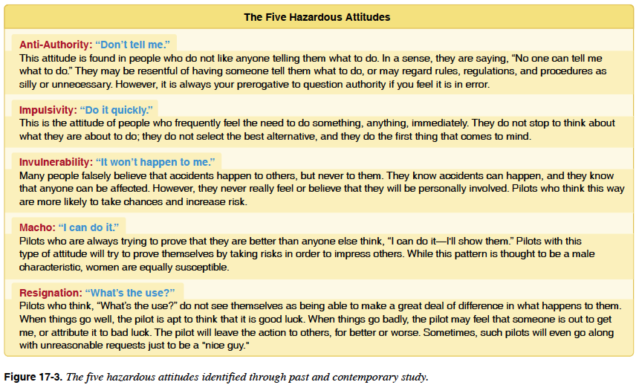
Operations
Aeronautical Decision Making
Notes:
Good aeronautical decision making isn't just about understanding the aircraft or the regulations. We also need to recognize that our own attitudes can affect the decisions we make.
The FAA identifies five hazardous attitudes that can lead pilots toward poor decisions.
Anti-authority — “Don't tell me.”
This is the attitude that rules or procedures don't apply to us. We might think, “I know what I'm doing; I don't need that checklist.” In aviation, procedures usually exist because someone learned the lesson the hard way. The antidote is: Follow the rules—they are usually right.
Impulsivity — “Do it quickly.”
This is the urge to act immediately without considering the alternatives. For example, we lose GPS and immediately start pushing buttons instead of first determining what the aircraft is actually doing. The antidote is: Not so fast—think first.
Invulnerability — “It won't happen to me.”
We recognize that accidents happen, but assume they'll happen to somebody else. A UAS pilot might fly with a questionable battery because “I've done it before and nothing happened.” The antidote is: It could happen to me.
Macho — “I can do it.”
This involves taking unnecessary risks to prove our ability. Maybe the wind is beyond our normal limits, but we decide to launch because we want to demonstrate that we can handle it. The antidote is: Taking chances is foolish.
Finally, Resignation — “What's the use?”
This occurs when a pilot feels that there's nothing they can do to improve the situation. In an emergency, they may simply give up or allow events to dictate the outcome. The antidote is: I'm not helpless—I can make a difference.
These attitudes can affect any pilot, regardless of experience. In fact, experience can sometimes create its own problem because repeated success can make us increasingly comfortable accepting risk.
The important skill is being able to recognize these attitudes in ourselves and in other members of the flight crew.
A useful question to ask yourself before making a questionable decision is:
“Am I making this decision because it is the safest option—or because I want the flight to happen?”
That distinction is at the heart of good aeronautical decision making.

Slide 15
Operations
Physiology
Hyperventilation – a deficiency of carbon dioxide within the body. Can be the result of rapid breathing from stress, anxiety or fear.
Dehydration - Critical loss of water from the body. (headaches, fatigue, cramps, sleepiness, and dizziness are symptoms).
Heatstroke – Any inability of the body to regulate temperature. (symptoms common to dehydration symptoms but can also become complete collapse of victim).
Hypothermia – excessively low body temperature. (shivering, clumsiness, slurred speech, confusion, low energy, discoloration of the skin (red or blue) loss of consciousness).
Stress – Causes by many factors including working with new or inexperienced crew members, having spectators or government officials on hand etc. Prior proper planning can help reduce stress.
Fatigue – Acute (short term) and chronic (prolonged) tiredness. Fatigue is a factor in many aviation accidents. Fatigue can be caused by lack of sleep, stress, length of time spent on a specific task etc. Chronic fatigue can be caused when acute fatigue has not been fully recovered from.
Chronic Stress – Long term untreated stress. Best way to treat stress is to remove or limit stressors. Chronic stress can weaken the immune system, cause high blood pressure, anxiety, confusion, mental errors, insomnia.
Notes:
Even though we're operating the aircraft from the ground, human physiology still affects our ability to safely operate a UAS. Physical and mental conditions can reduce our judgment, situational awareness, reaction time, and ability to make good decisions.
Hyperventilation occurs when someone breathes too rapidly or deeply, often because of stress, anxiety, or fear. This lowers the amount of carbon dioxide in the blood and can cause dizziness, tingling, lightheadedness, confusion, or even fainting. If it occurs, the pilot should recognize the cause, slow their breathing, and discontinue flight duties if necessary.
Dehydration is particularly important because UAS crews may spend hours outside in the sun, wind, heat, or cold. Even moderate dehydration can contribute to headaches, fatigue, dizziness, muscle cramps, and reduced concentration. Don't wait until you're thirsty to start drinking water.
Heat exhaustion and heatstroke are more serious heat-related conditions. Heatstroke occurs when the body's ability to regulate temperature fails and is a medical emergency. Confusion, altered behavior, collapse, or loss of consciousness are especially serious warning signs.
At the opposite extreme, hypothermia occurs when the body loses heat faster than it can produce it. Early symptoms can include shivering and loss of coordination. As it progresses, judgment deteriorates, speech may become slurred, and the person may become confused or lose consciousness. This is especially relevant for UAS crews operating outdoors during winter.
Stress can come from many sources—difficult weather, equipment problems, inexperienced crew members, time pressure, spectators, or simply the pressure to complete a mission. Some stress can help us stay alert, but excessive stress can narrow our attention and lead to poor decisions.
Fatigue is one of the most important human factors in aviation. Lack of sleep is an obvious cause, but fatigue can also result from long missions, repetitive tasks, stress, heat, cold, and sustained concentration. A fatigued pilot may react more slowly and overlook things they would normally catch.
Finally, chronic stress is prolonged stress that doesn't go away after the immediate situation ends. Over time, it can affect concentration, sleep, decision making, and overall performance.
The important point is that being physically present doesn't necessarily mean we're fit to fly. Part of the remote PIC's preflight assessment should include evaluating the condition of the pilot and crew—not just the condition of the aircraft.

Slide 16
Operations
Maintenance and Inspection Procedures
Follow all manufacturer maintenance recommendations to achieve the longest and safest service life of the sUAS.
If no procedures exist, it is recommended that the remote PIC develop his/her own procedures.
Follow the most restrictive limitations or component cycle life in order error on the side of safety.
It is the remote PIC’s responsibility to make sure the UAS (as well as the remoter pilot) is in a safe condition for flight.
Notes:
Safe UAS operations don't begin when we launch the aircraft. They begin with proper inspection and maintenance.
Whenever possible, we should follow the manufacturer's recommended maintenance procedures, inspection intervals, and component replacement schedules. The manufacturer knows the design limitations of the aircraft and may specify when particular components need to be inspected, serviced, or replaced.
For some UAS—especially custom-built or experimental systems—there may not be a complete manufacturer maintenance program. In that case, the operator should develop a documented maintenance and inspection procedure appropriate for that aircraft.
This might include tracking flight hours, number of flights, battery cycles, motor hours, propeller condition, servo operation, control linkages, structural components, and firmware changes.
If different components have different inspection or replacement intervals, we should generally follow the most restrictive applicable limitation. For example, if a component is rated for a certain number of operating cycles, don't continue using it simply because it still appears to work.
Maintenance records are also a good practice. If we replace a propeller, repair a wing, update firmware, change a flight controller, or install a new payload, documenting that work helps us understand the aircraft's history and identify recurring problems.
After maintenance or repairs, we should perform appropriate functional checks before returning the aircraft to normal operations. With a fixed-wing UAS, that includes verifying control-surface movement and direction, propulsion, communications, navigation systems, and structural integrity.
Ultimately, the remote PIC is responsible for determining that the UAS is in a condition for safe operation.
And as we discussed with physiology, we need to inspect the other critical component of the system as well—the pilot. A perfectly maintained aircraft isn't safe if the person operating it isn't fit to fly.
So before every operation, we should really be asking two questions:
Is the aircraft ready to fly?
Am I ready to fly?

Slide 17
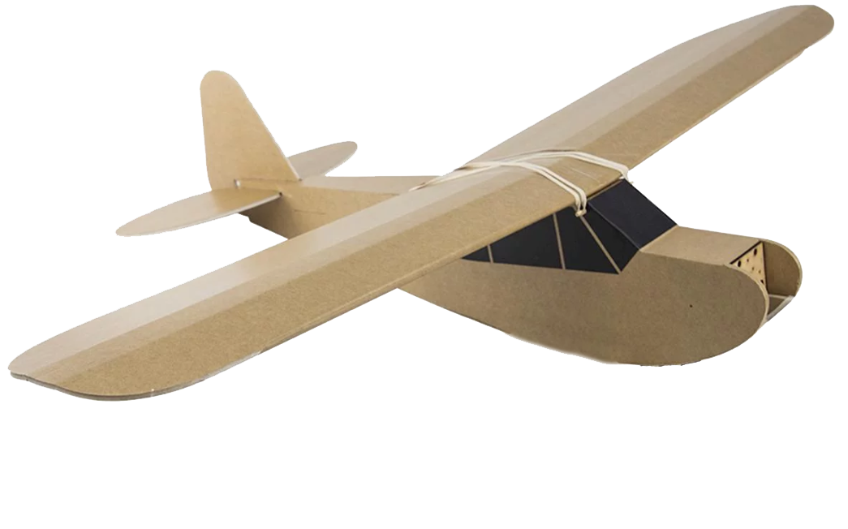
What does a training flight look like?
Check weather
Establish a flight zone.
Establish an observer area.
Establish a pilot and trainer area.
Pre-flight aircraft
  Flight controls free and correct
  Battery secure
  Dual control check
  Visual inspection of aircraft
  Check airspace (visually and on VFR sectional)
Preflight student
  alert
  distractions removed/mitigated
  Understand controls/what will happen next
Notes:
When we're conducting a training flight, our goal isn't simply to get the aircraft into the air. We want to create a controlled learning environment where the student can make mistakes without those mistakes becoming dangerous.
We begin by checking the weather. For a new pilot, our acceptable conditions may be much more conservative than the aircraft's actual limitations. Strong winds or gusty conditions make learning considerably more difficult.
Next, we establish a flight zone. This is the area where we intend to keep the aircraft. The student should know those boundaries before we launch.
We also establish an observer area and a separate pilot and instructor area. Keeping people organized on the ground reduces distractions and keeps spectators away from the aircraft's operating area.
Then we preflight the aircraft. For a fixed-wing UAS, one of the most important checks is:
Controls free and correct.
Move every control and physically watch the airplane. Right aileron input should produce the correct aileron movement, elevator commands should move correctly, and the rudder should respond in the proper direction. Don't just verify that the servos move—verify that they move in the correct direction.
We check that the battery is charged and securely installed, inspect the airframe for damage, and confirm that the surrounding airspace is clear.
When we're using a trainer or buddy-box system, we also test the dual controls before launch. The instructor needs to know that they can immediately regain control of the aircraft if necessary.
But we're not only preflighting the airplane—we're also preflighting the student.
Is the student alert and ready to fly? Are distractions minimized? Do they understand the controls? Most importantly, do they know what is going to happen next?
Before launch, I want the student to understand the plan: I'll launch the airplane and establish a safe altitude. I'll transfer control to you. You'll practice this maneuver in this area. If you become uncomfortable or lose orientation, tell me and I'll take the aircraft.
Clear transfer of control is especially important. We should use positive verbal communication such as:
“You have control.”
“I have control.”
The other person acknowledges the transfer so there is never any question about who is flying the aircraft.
A successful training flight is therefore highly structured:
Brief → Preflight → Launch → Establish a safe flight condition → Transfer control → Practice → Recover → Debrief.
The objective isn't just to teach someone how to manipulate the sticks. We're teaching them to operate an aircraft safely and systematically.

Slide 18
References
Marshall, D.; Barnhart, R., Shappee, E., Most, M. (2016). Introduction to Unmanned Aircraft Systems. New York, NY: CRC Press.

