Slide 1
Unmanned Aircraft Systems UAS
Weather
FAA Remote Pilot Part 107 Exam Prep-Regulations

Slide 2
Comms Review
Three forks traffic warrior 53Lima Sierra on the 45 for two one full stop.
Three forks traffic skyhawk 72140 turning left base runway 3, will remain close traffic.
Big Sky approach Archer 63 Charlie Tango inbound with papa.
  Archer 63 Charlie Tango Radar contact 10 miles SW of the field, squawk 0234.
Southwest 1511 turn right heading 180 contact departure 118.975.

Slide 3
Weather pics
https://lightroom.adobe.com/shares/71dedbf9494d4468a990b86ed27c44de/albums/421c81b0307b4badb47ff6138ca42501/assets/e02b23145cf04fea9b8a052904efac19

Slide 4
FAA Remote Pilot Test Prep
Topics Covered in this lesson
Introduction
Wind
Air masses and fronts
Atmospheric Stability
Visibility and Clouds
Thunderstorms
Icing
Fog
Density Altitude
Weather Briefing
Weather reports, forecasts and charts
Surface weather observations
Aviation weather reports
Aviation routine weather report (METAR)
Aviation forecasts
Terminal Aerodrome Forecasts
Convective significant meteorological Information (WST)

Slide 5
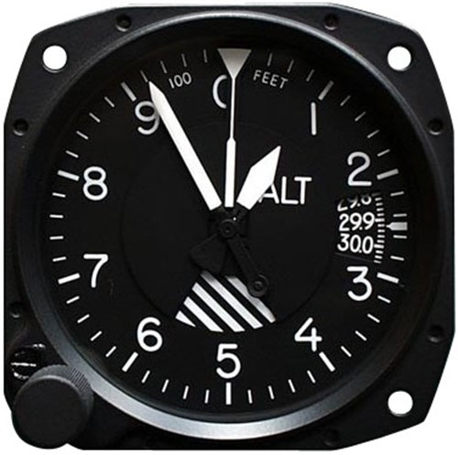
Weather
Introduction
Weather factors can greatly influence sUAS performance and safety of flight.
Every physical process of weather is accompanied by, or is a result of, unequal heating of the earth’s surface.
All altimeter settings are corrected to sea level. Unequal heating of the earth’s surface causes pressure differences.

Slide 6
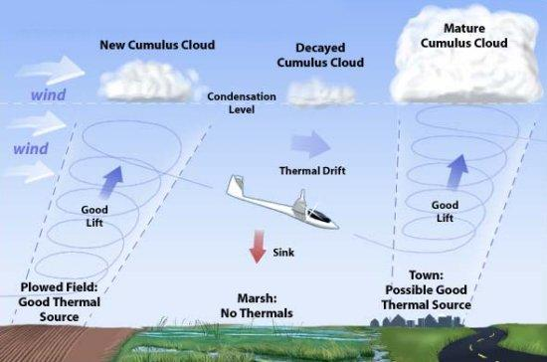
Weather
Thermals
Thermals are updrafts in convective currents dependent on solar heating. A temperature inversion would result in stable air with very little, if any, convective activity.
Dry areas get hotter than moist areas. Dry fields or dry ground of any nature are better thermal sources than moist areas. This applies to woods or forests, which are poor sources of thermals because of the large amount of moisture given off by foliage.

Slide 7
Weather
Evaporation & Sublimation
As water vapor condenses or sublimates on condensation nuclei, liquid or ice particles begin to grow.
Some condensation nuclei have an affinity for water and can induce condensation or sublimation even when air is almost, but not completely, saturated.
Clouds, fog or dew form when water vapor is present.
Evaporation-the process of turning from liquid into vapor.
Sublimation-When a solid turns into a gas without going through a liquid stage.

Slide 8
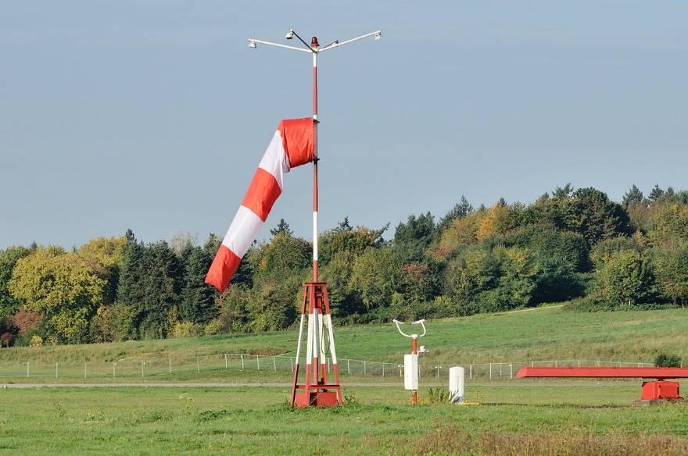
Weather
Wind
Local conditions, geological features, and other anomalies can change the wind direction and speed close to the earth’s surface, making it difficult to control and maneuver a sUAS.
Strong winds can make a sUAS difficult or impossible to control and can reduce aircraft performance.
Wind sheer is a sudden, drastic change in wind speed and/or direction over a very small area.
Wind sheer can occur at any altitude.
Wind sheer close to the ground is particularly dangerous.

Slide 9
Weather
Air Masses and Fronts
Front - the division line between two differing air masses. Air masses can differ in temperature and moisture.
Ridge - an elongated area of high pressure.
Trough - an elongated ridge of low pressure.
Temperature change is one of the most easily recognized discontinuities across a front.
Cold fronts move (about 2 times) faster than warm fronts.
Warm fronts have more widespread impact on weather.
Warm fronts contain: low ceilings, increased precipitation, reduced visibility.

Slide 10
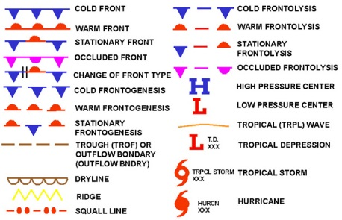
Weather
Air Masses and Fronts

Slide 11
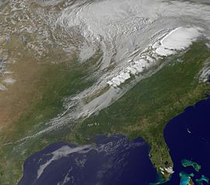
Weather
Air Masses and Fronts
Frontal passage is indicated by the following:
  A temperature change
  A continuous decrease in pressure followed by an increase as the front passes.
  A shift in the wind direction, speed or both.

Slide 12
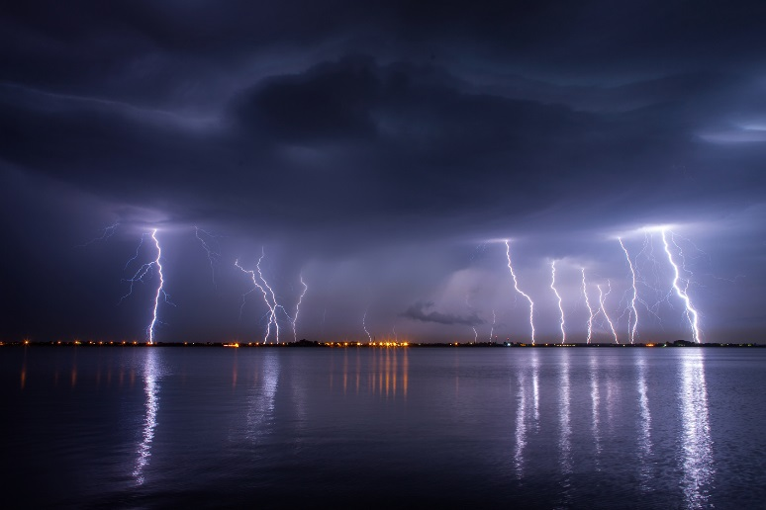
Weather
Air Masses and Fronts
Thunderstorms and heavy rain are common, although not always, associated with cold fronts.
Cold dry air is very stable and resists vertical movement-generally produces good clear weather.

Slide 13
Weather
Atmospheric Stability
Unstable Air | Stable Air
Cumuliform Clouds | Stratiform clouds and fog.
Showery precipitation | Continuous precipitation
Rough air (turbulence) | Smooth air
Good visibility except in blowing obstructions. | Fair to poor visibility in haze and smoke.

Slide 14
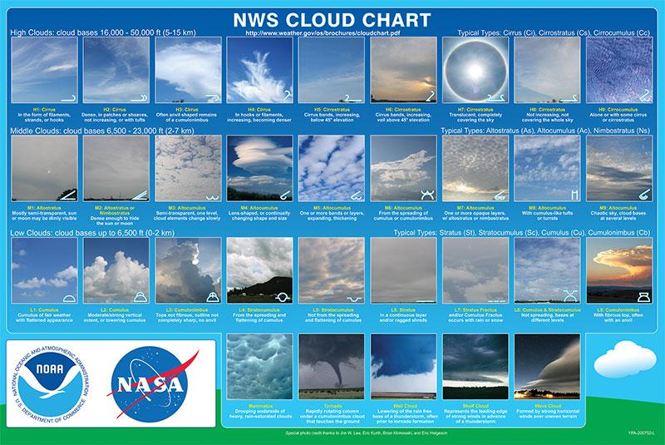
https://www.weather.gov/images/jetstream/clouds/cloudchart_nws.jpg

Slide 15
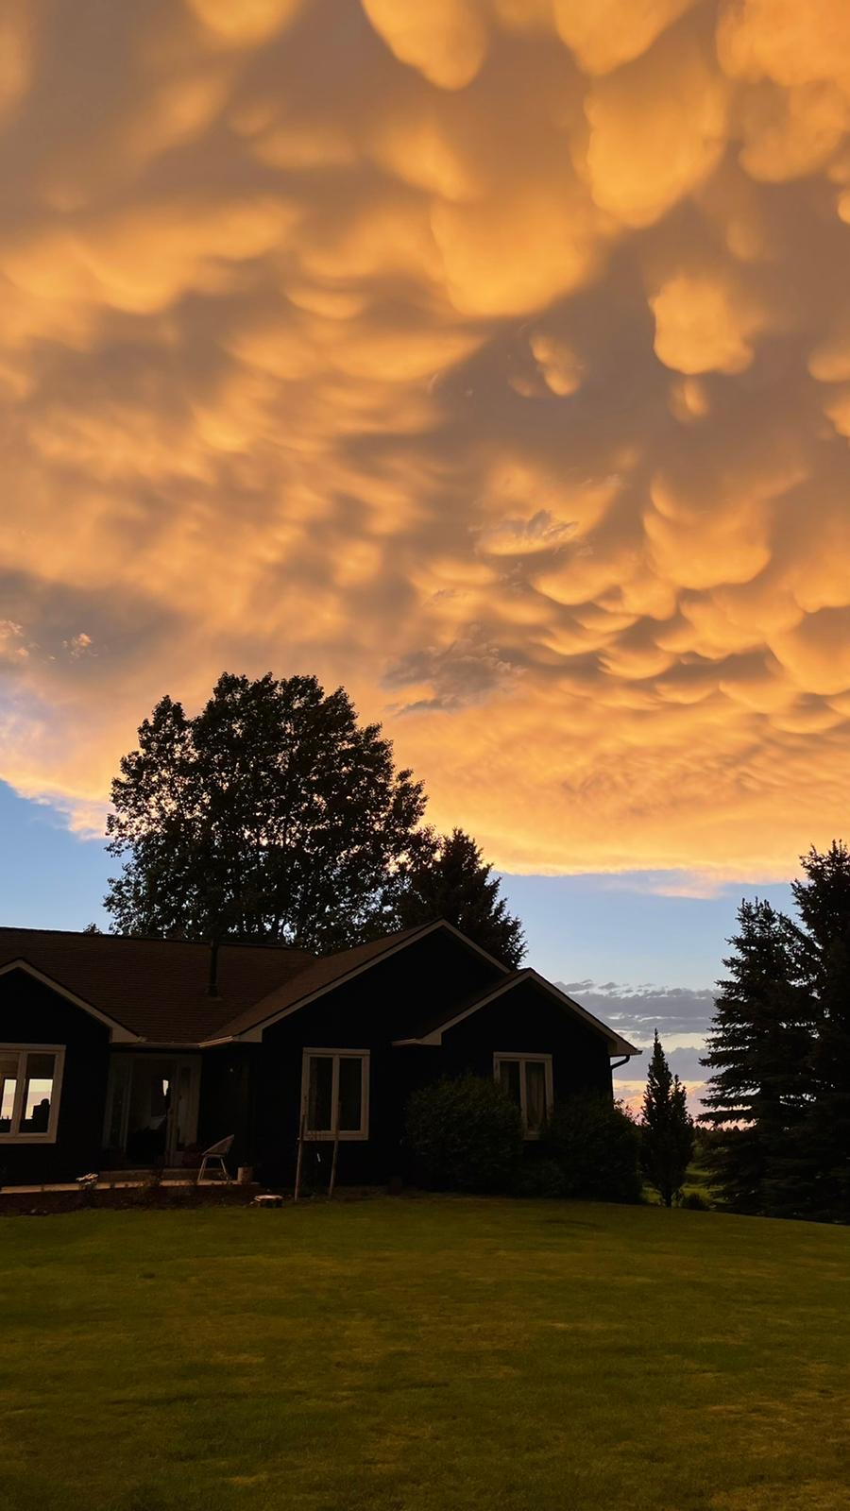

Slide 16
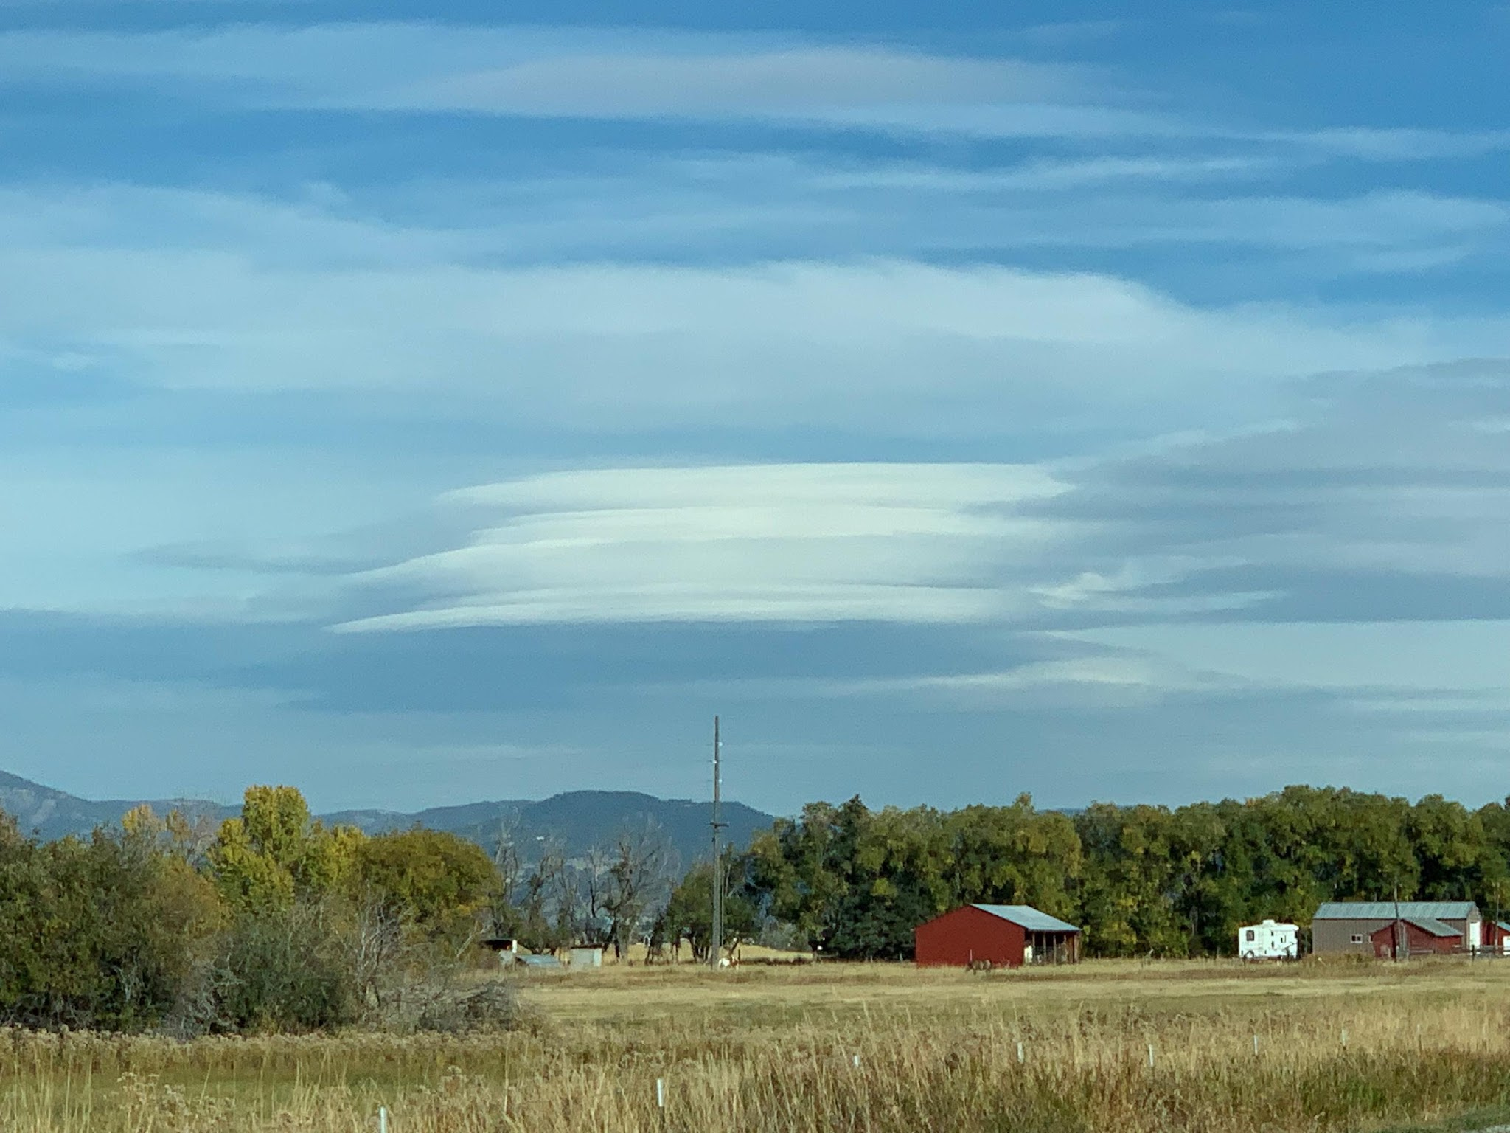

Slide 17
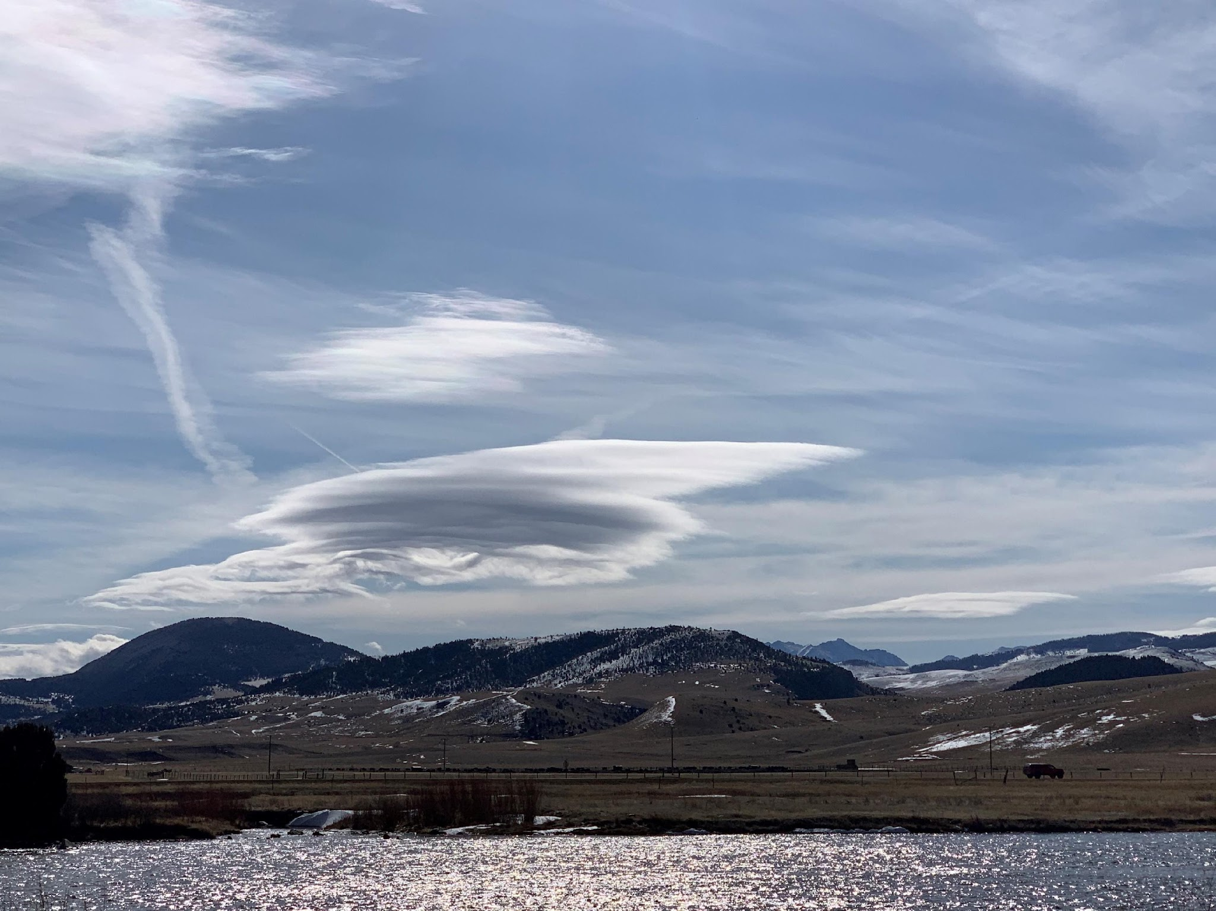

Slide 18
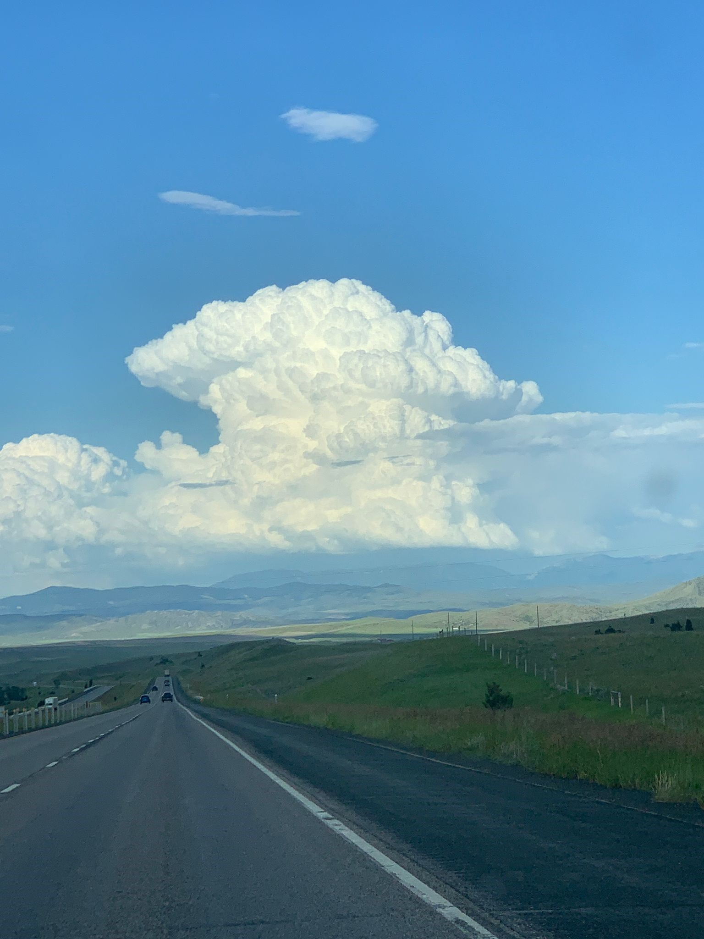

Slide 19
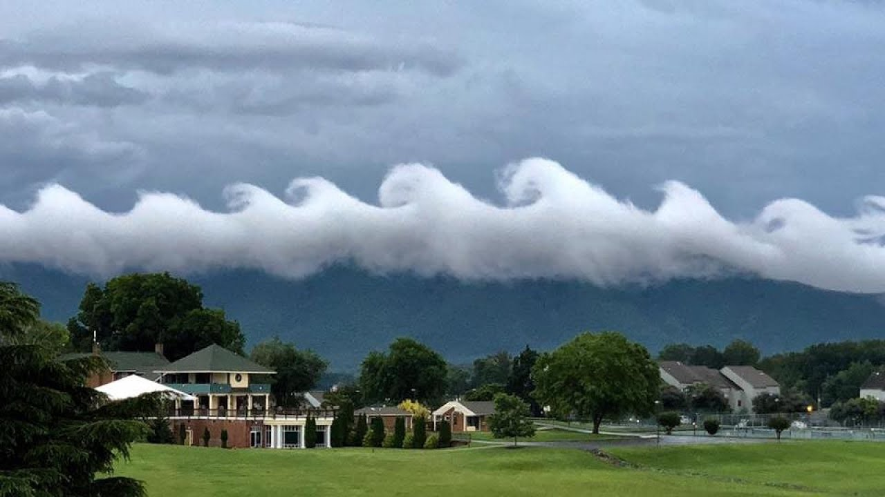

Slide 20
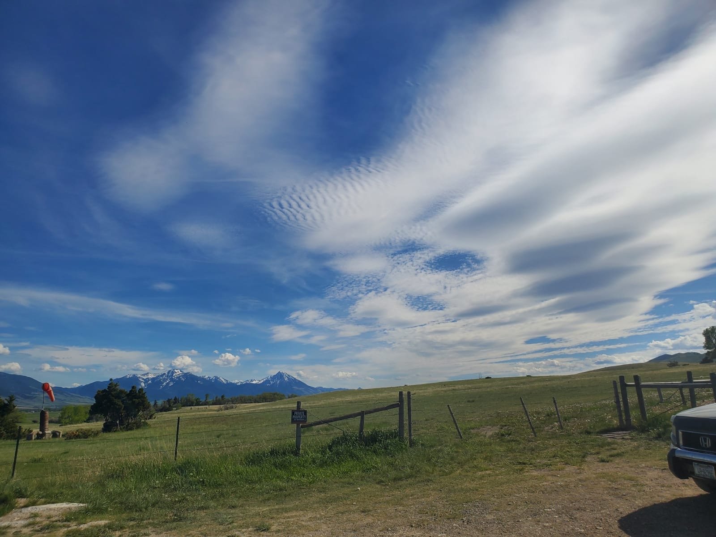

Slide 21
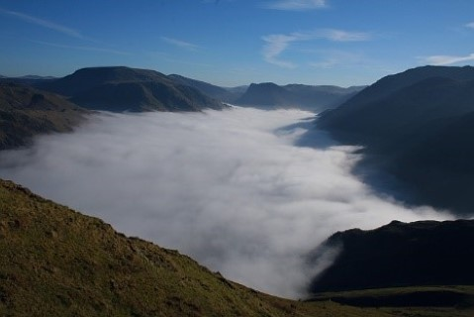
Weather
Atmospheric Stability
“The difference between the existing lapse rate of a given mass of air and the adiabatic rates of cooling in upward moving air determines if the air is stable or unstable”.
Adiabatic cooling - the process of reducing heat through a change in air pressure caused by volume expansion.
Lapse rate - the rate at which air temperature falls with increasing altitude.
Temperature inversion - when the temperature of the air rises with altitude.
The air at the top of an inversion is warm and acts as a lid holding the air below it. Smoke, fog, and/or pollutants can become trapped in an inversion reducing visibility.

Slide 22

Weather
Visibility and Clouds
Part 107 operations must not be conducted in visibility less than 3 statute miles as observed from the location of control station.
Part 107 operations require the minimum distance of the aircraft from clouds must be no less than 500 feet below the cloud and 2,000 feet horizontally from the cloud.

Slide 23
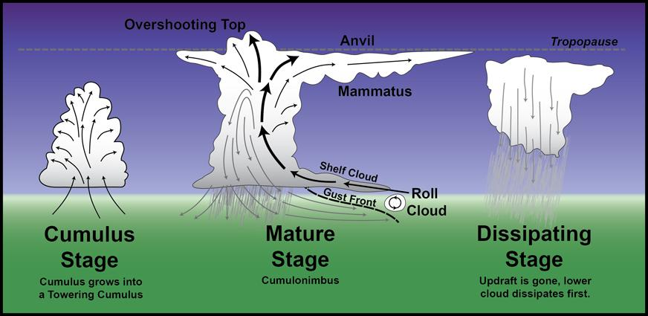
Weather
Thunderstorms
Thunderstorms can produce high levels of turbulence and wind sheer.
Operation in or near thunderstorms should be avoided.
Thunderstorms go through a life cycle.

Slide 24
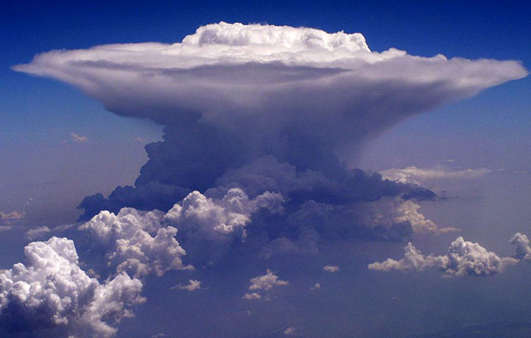
Weather
Thunderstorms
The key feature of the cumulus stage is an updraft. Precipitation beginning to fall from the cloud base is the signal that a downdraft had developed also and a cell has entered the mature stage.
For a cumulonimbus cloud or thunderstorm to form, the air must have:
  Sufficient water vapor.
  An unstable lapse rate and
  An initial upward boost (lifting) to start the storm process in motion.

Slide 25
Weather
Thunderstorms
Thunderstorms are at their greatest intensity during the mature stage.
A downdraft signifies the dissipating stage of a thunderstorm cell and the storm rapidly dies.
Squall line thunderstorms are the most dangerous to aircraft.
Squalls can happen at and affect any altitude.
Squall line storms are typically very long and intense offering no path over, around, or through. The present the most intense hazard to small aircraft.
Wind sheer in the invisible hazard associated with all thunderstorms. Wind sheer can occur at any altitude in any direction. Wind sheer is the biggest hazard to aircraft associated with thunderstorms.

Slide 26
Weather
Icing
Icing can have the following effects on aircraft:
  Decrease lift
  Weight and stalling speed increase for fixed wind and propellers may stall on rotary wing.
  Thrust decreases
  Drag increases.

Slide 27
Weather
Icing
Ice pellets always indicate freezing rain at higher altitudes.
A condition favorable for rapid accumulation of clear icing is freezing rain below a frontal surface.
Two conditions are necessary for structural icing in flight:
  The aircraft must be flying through visible water such as rain or cloud droplets and
  The temperature at the point where the moisture strikes the aircraft must be (0 degrees Celsius/32 degrees Fahrenheit) or colder.

Slide 28
Weather
Icing
“On cool, clear, calm nights, the temperature of the ground and objects on the surface can cause temperatures of the surrounding air to drop below the dew point. When this occurs the moisture in the air condenses and deposits itself on the ground. This moisture is known as dew and sometimes can be seen on grass and other objects in the morning. If the temperature is below freezing, the moisture is deposited in the form of frost”.
Dew point - the atmospheric temperature (varying according to pressure and humidity) below which water droplets begin to condense and dew can form.

Slide 29
Weather
Fog
When the air temperature and dew point temperature are the same or close, fog is likely to form.
Three types of fog based on how it forms:
  Radiation fog (ground fog) - formed when terrestrial radiation cools the ground, which in turn cools the air in contact with it. When the air is cooled to its dew point (or within a few degrees), fog will form. This fog will form most readily in warm, moist air over low, flatland areas on clear, calm(no wind) nights.
  Advection fog (sea fog) - formed when warm, moist air moves (wind is required) over colder ground or water (e.g. an air mass moving inland from the coast in the winter).
  Upslope fog - formed when moist, stable air is cooled to its dew point as it moves up along sloping terrain (wind is required). Cooling will be at the dry adiabatic lapse rate of approximately 3 degree Celsius per 1,000 feet.

Slide 30
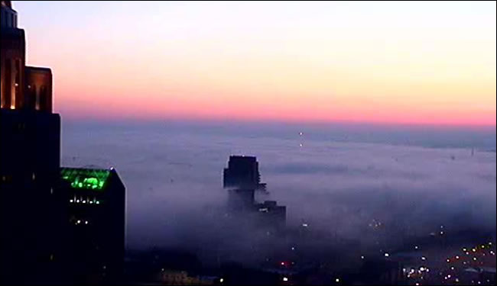
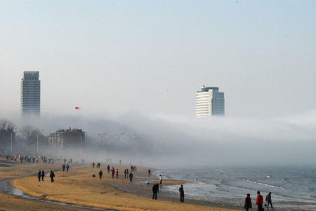

Weather
Fog
Radiation fog (ground fog)
Advection fog (sea fog)
Upslope fog

Slide 31
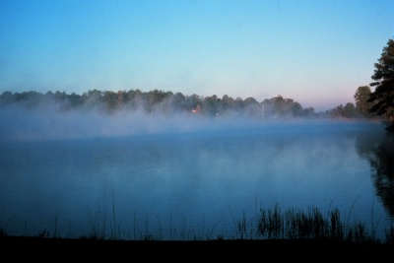
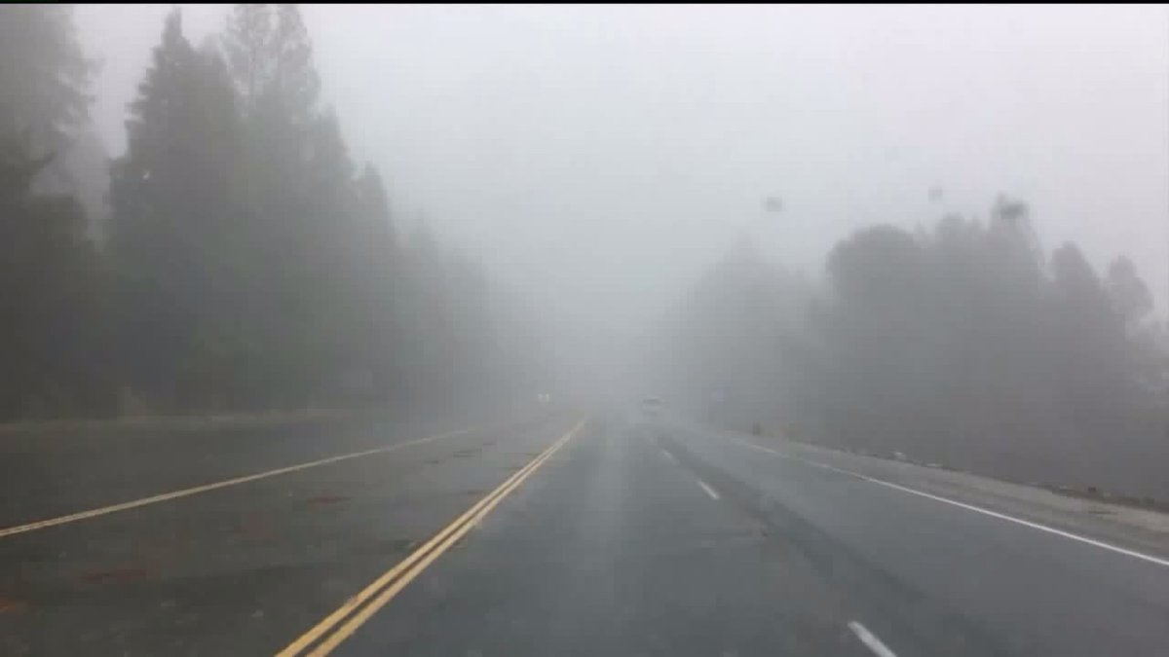
Weather
Fog
Precipitation induced fog typically is caused by warm rain falling through cooler air.
Steam fog forms in the winter when cold dry air passes over warm water.
Steam Fog
Precipitation Fog

Slide 32
Weather
Density Altitude
Density altitude is the height when measured in terms of the density of the air rather than the distance from the ground.
Standard sea level pressure is 29.92 inches of mercury.
Standard sea level temperature is 15 degree Celsius (59 F).
The following will decrease aircraft performance:
  Increase in altitude. (in flight or when operating from higher elevations)
  Decrease in atmospheric pressure.
  Increase in temperature.
  Increase in humidity. (has a minimal effect on sUAS)

Slide 33
Weather
Density Altitude
The effect of high density altitude on an aircraft:
  Less air for the wings (or rotor blades) to produce lift.
  Less air to produce thrust from propeller.
  Less air from a fuel burning engine to operate.
All of these factors reduce the performance of aircraft and result in:
  Longer take-off distance
  Longer landing distance
  Slower climb rates

Slide 34
Weather
Weather Briefing
sUAS operators are encouraged to get a weather briefing before flight operations.
Briefing can be obtained from:
  www.aviationweather.gov
  1-800-wxbrief
  www.1800wxbrief.com
  http://tfr.faa.gov (to obtain Temporary Flight Restrictions)
  To get a complete weather overview for a planned flight a pilot should obtain a standard briefing if no previous briefing has been obtained.

Slide 35
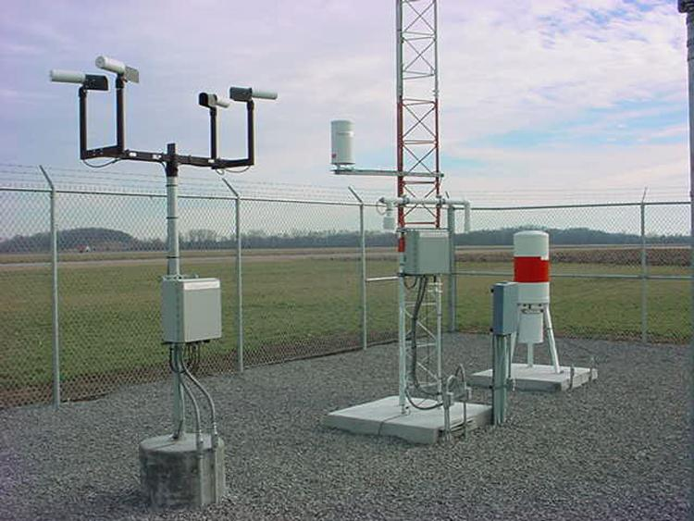
Weather
Weather reports, forecasts, and charts
Automated Surface Observing System (ASOS)
Automated Weather Observing System (AWOS)
METAR(Meteorological Terminal Air Report)-international weather reporting code forecast.
Weather observation station

Slide 36
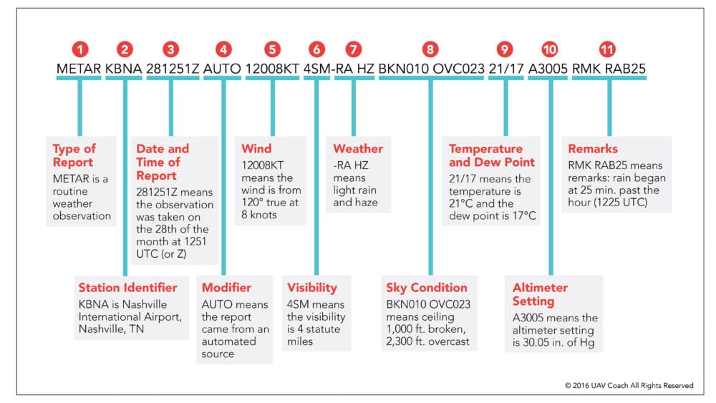
Weather
Aviation weather reports

Slide 37
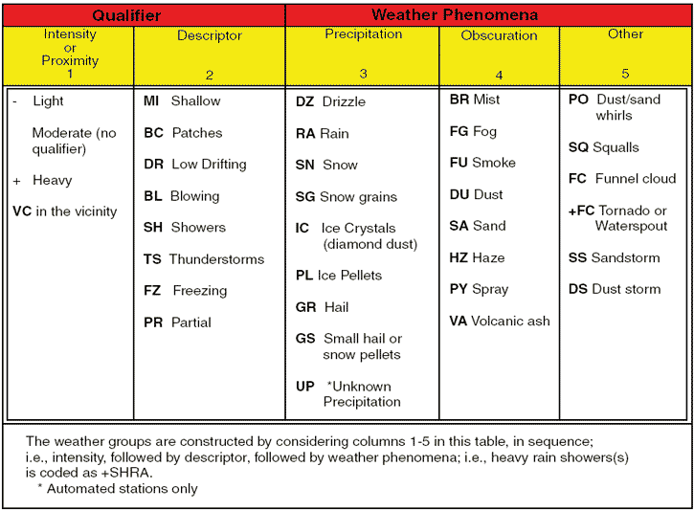
Weather
Aviation weather reports

Slide 38
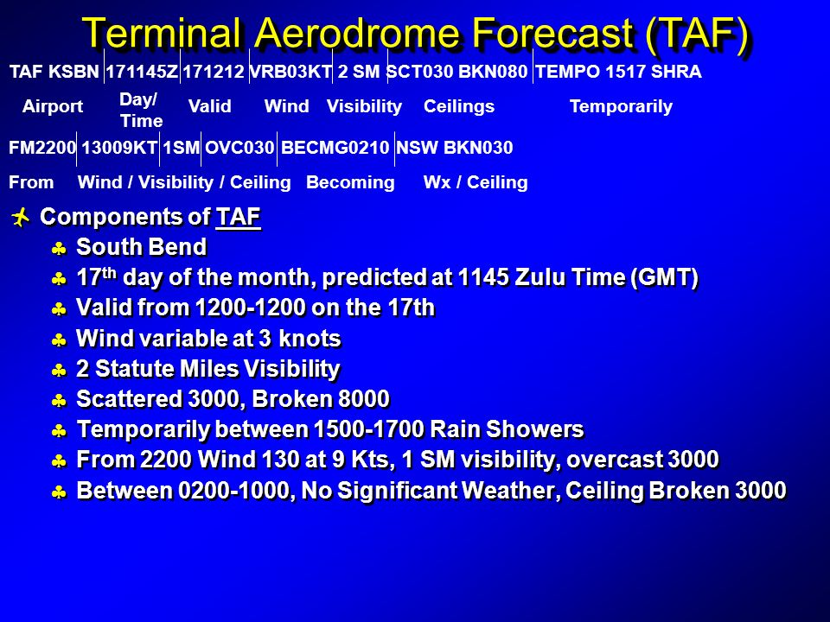
Weather
Aviation Forecasts-TAFS

Slide 39
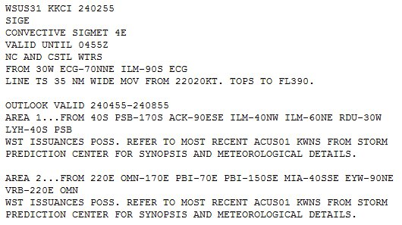
Weather
Aviation Forecasts-Convective Significant Meteorological Information (WST)
Convective SIGMETs are issued for severe thunderstorms with surface winds greater than 50 knots, hail at the surface greater than or equal to ¾” in diameter, or tornadoes.
Also issued to advise pilots of embedded thunderstorms, lines of thunderstorms, or thunderstorms with heavy or greater precipitation that effect 40 percent or more of a 3,000 square mile or greater region.
Convective SIGMETs signify severe weather and it is not advised to operate sUAS in an area under a convective SIGMET.

Slide 40
References
Marshall, D.; Barnhart, R., Shappee, E., Most, M. (2016). Introduction to Unmanned Aircraft Systems. New York, NY: CRC Press.

