Slide 1
S&P 500 Report Analysis
Gujia (Altman) Ma
May 24th, 2024

Slide 2
Summary

Slide 3
Observation of Metrics’ Changes and Relations
EPS has increased to 3,750 billion, with 125% changing rate compared to that at the beginning of 2017. Meanwhile, market cap has increased to 43,087 billion and total trading volume has increased to 43,087 billion, both sharing similar changing rate with EPS of 133% and 123% relatively. Also, EPS’s and market cap’s trends of changing are also similar; both increased slowly but with fluctuations from 2017 to 2020,decreased in 2020 and keep steady growth since then.
Total Revenue, Total Assets, and Total Liabilities share similar trend and change rate from 2017 to 2020. All of them sustain steady growth in a stable speed, with changing rates around 35%~37%.
Cost of Revenue, Total Debt and Operating Margin have increased in an exactly same rate of 17%. Also, their trends of changing are similar. All metrics has a general trend of increasing, but with a few shocks in the period. In addition, they get smooth in recent few months.

Slide 4
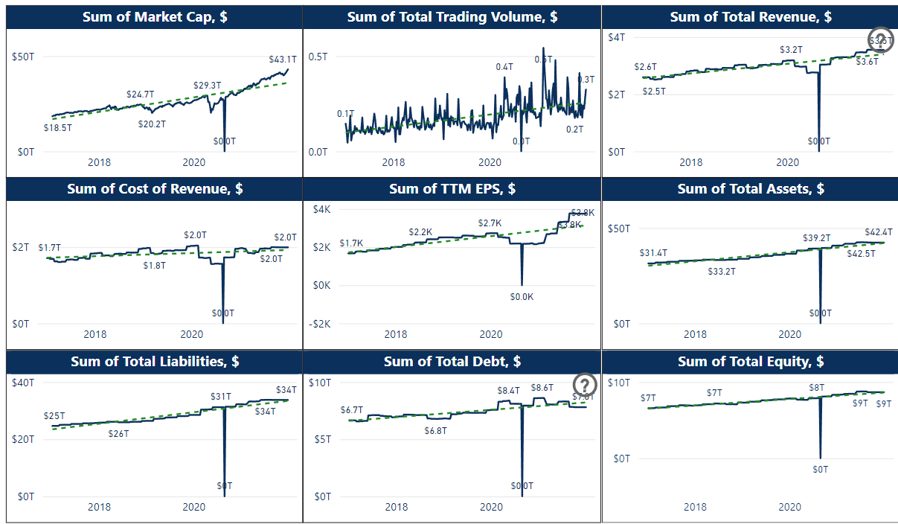
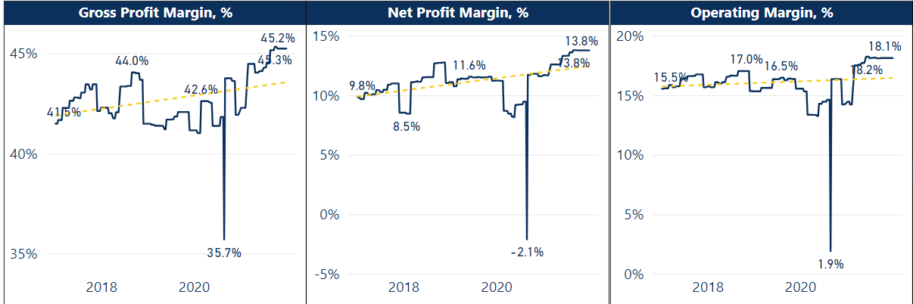
Analysis of Factors Leading to Changes of Metrics
The most significant influence on all graphs is the shock of Covid-19 in 2020, decreasing market cap, total revenue, cost of revenue, EPS while increased liabilities and debts. Additionally, there is an obvious bad data point taken on Aug 28th , 2020.
The lowering of the U.S. corporate income tax rate from 35% to 21% in January 2018 significantly increased the net profit margin, while the gross profit margin and operating margin was unaffected since they do not take tax into account.

Slide 5
Analysis of Each Single Charts

Slide 6
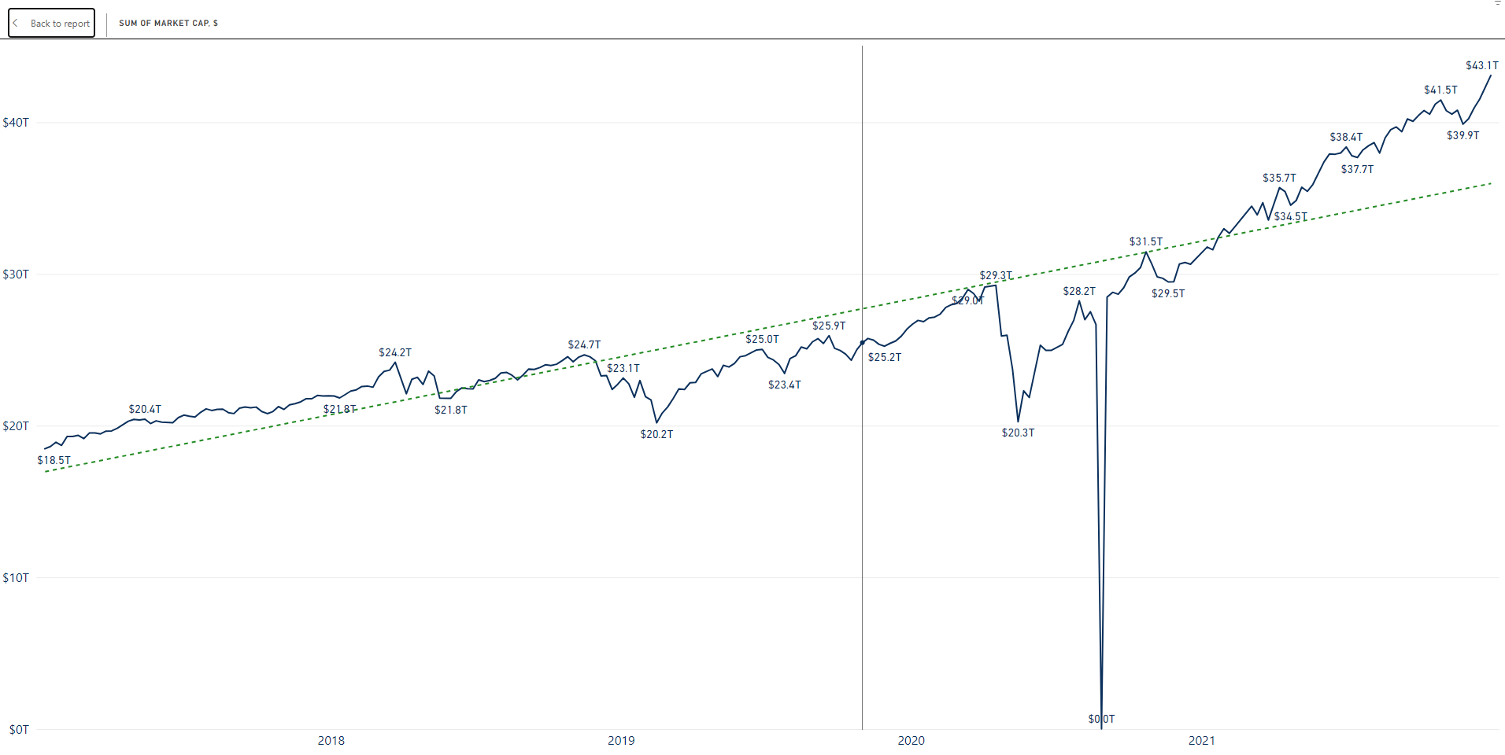
During the period under analysis, the sum of market cap increases from 18,475 billion to 43,087 billion, with 133% increase.
The minimum occurred at the beginning of the period under investigation on Jan 6th, 2017, with 18,475 billion while the maximum occurred at the end on Dec 31st, 2021, if not taking the obviously abrupted data on Aug 28th, 2020, into account.
Although there were small fluctuations throughout, the overall trend of the data has been gradually and steadily increasing.

Slide 7
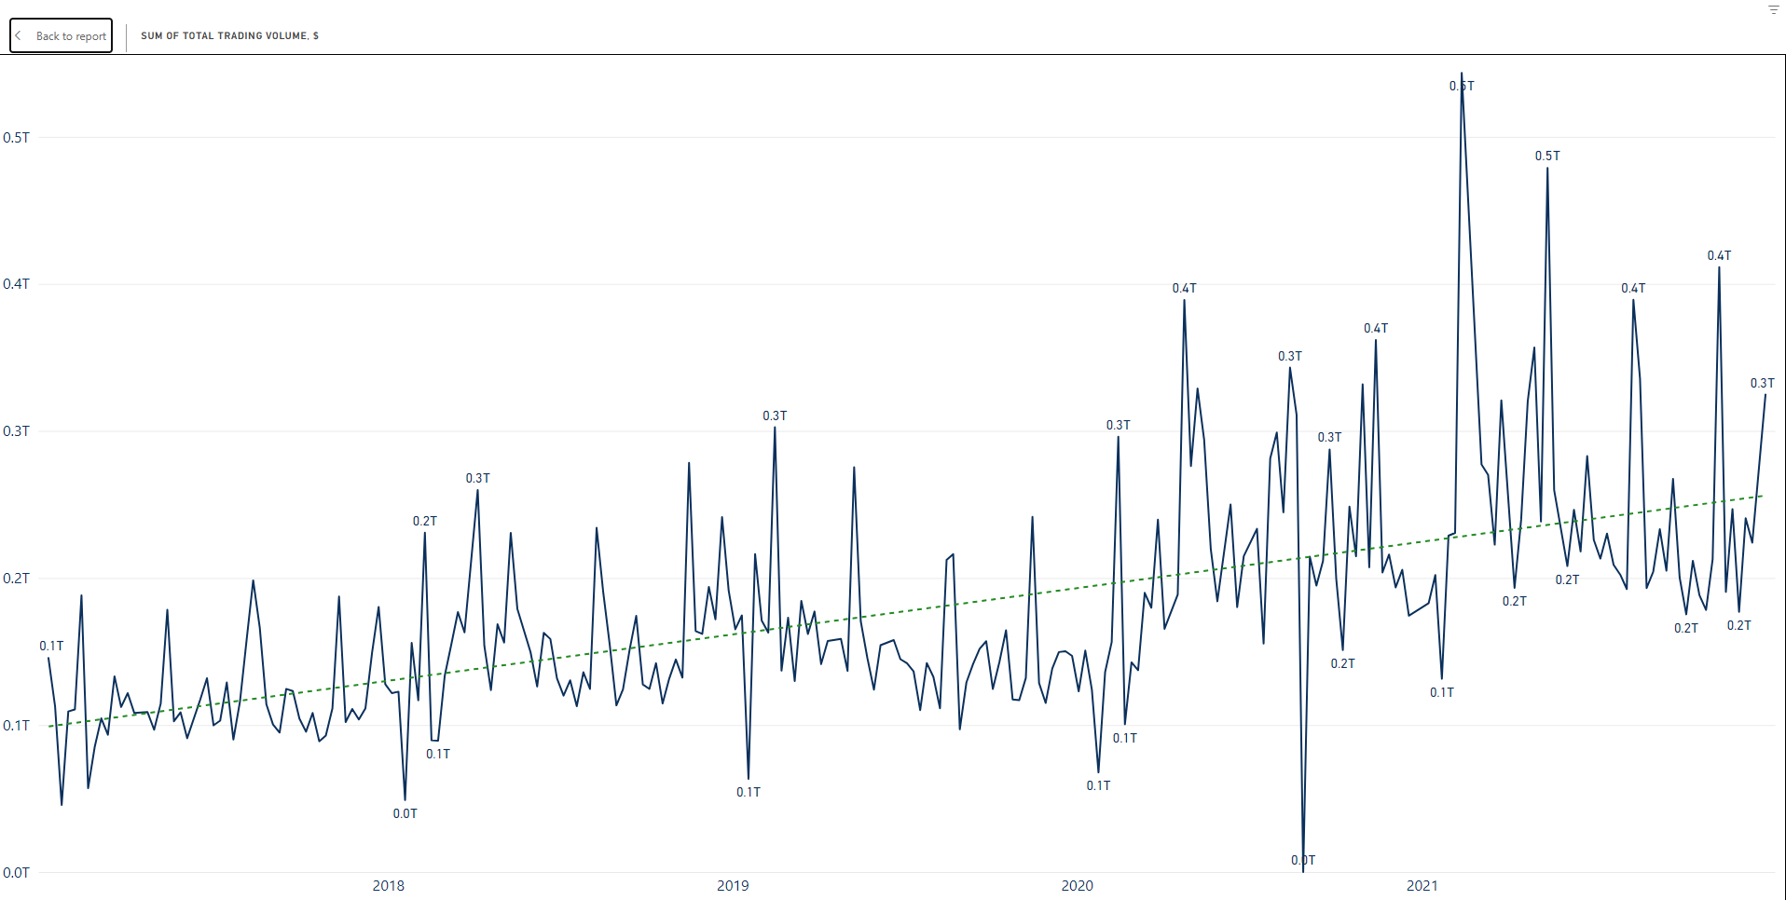
Sum of Total Trading Volume increases from 146 billion to 325 billion, with 123% increase.
The minimum of data occurred on Jan 20, 2017, with 456 billion if not taking the disrupted data of 2.8 million on Aug 28th, 2020, into account, and the maximum of the data occurred on Feb 12th, 2021, with 544 billion.
The data experienced significant volatility; however, excluding the period likely affected by Covid-19 in 2020, the overall trend shows a steady increase.

Slide 8
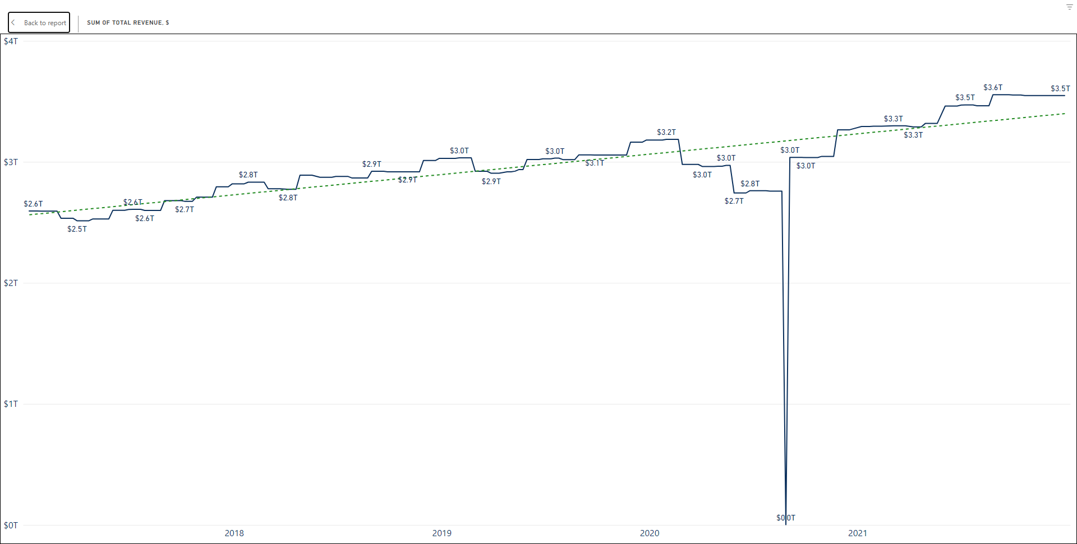
During the period under analysis, the sum of total revenue increases from 2,594 billion to 3,548 billion, with 37% rate of increasement.
The minimum occurred on April 7th, 2017, with 2,513 billion while the maximum occurred on Aug 27th, 2021, with 3,555(not taking the obviously abrupted data on Aug 28th, 2020, into account).
Except during 2020, the data keeps steadily increasing during the period.

Slide 9
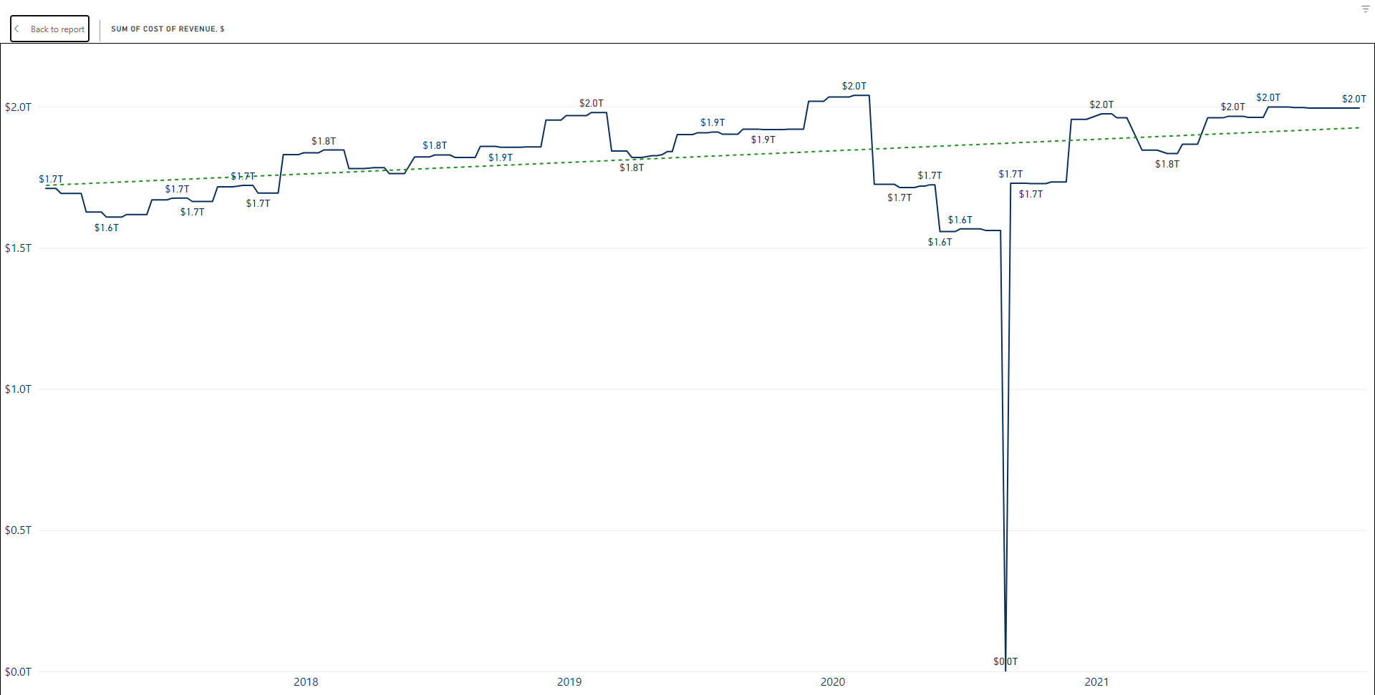
During the period under analysis, the sum of cost of revenue increases from 1,710 billion to 1,995 billion, with 17% rate of increasement.
The minimum occurred on Jun 12th, 2020, with 1,557 billion while the maximum occurred on Jan 31st, 2020, with 2,039(not taking the obviously abrupted data on Aug 28th, 2020, into account).
The data kept fluctuating during the period, and the total assets of the sector increased slightly.

Slide 10
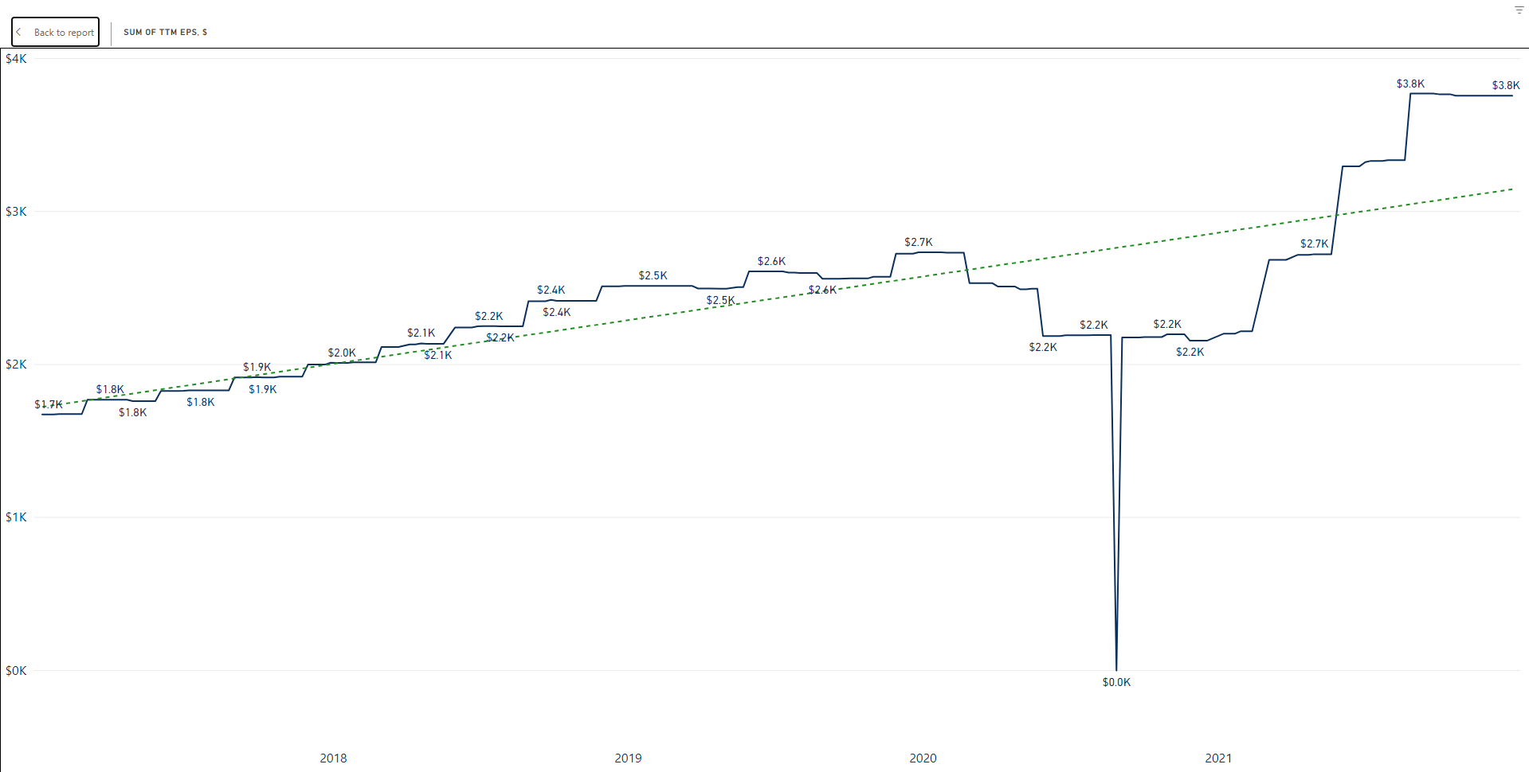
During the period under analysis, the sum of TTM EPS (Earnings Per Share Trailing 12 Months) increases from 1,670 to 3,754, with 125% rate of increasement.
The minimum occurred at the beginning on Jan 6th, 2017, with 1,670 while the maximum occurred on Aug 27th, 2021, with 3,768(not taking the obviously abrupted data on Aug 28th, 2020, into account).
Earning Per Share, grows

Slide 11
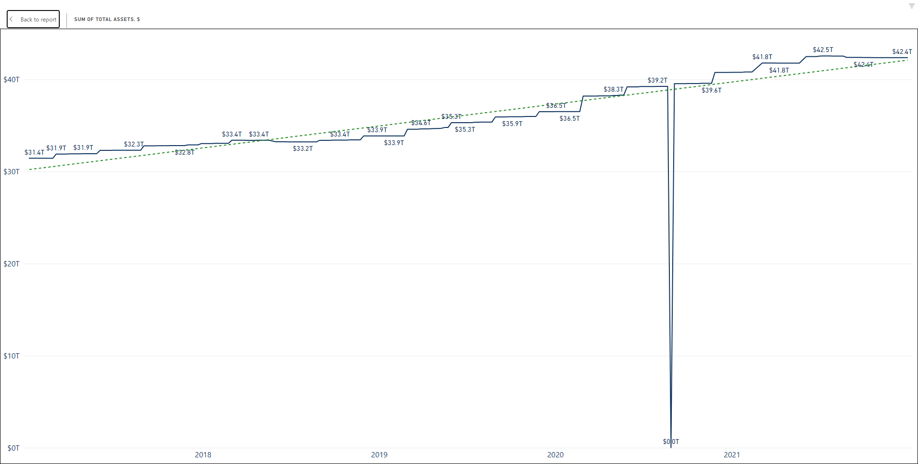
During the period under analysis, the sum of Total Asset increases from 31,438 billion to 42,369 billion, with 35% rate of increasement.
The minimum occurred at the beginning on Jan 6th, 2017, with 31,438 billion, while the maximum occurred on Jul 16th, 2021, with 42,554 billion(not taking the obviously abrupted data on Aug 28th, 2020, into account).
The total assets of the sector increased steadily, if not taking the data taken on Aug 28th, 2020, into account.

Slide 12
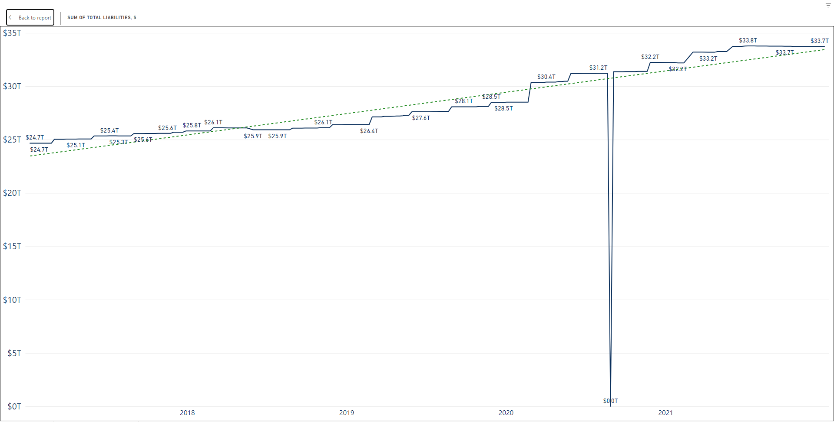
During the period under analysis, the sum of Total Liabilities increases from 24,667 billion to 33,735 billion, with 37% rate of increasement.
The minimum occurred around the beginning on Feb 3rd, 2017, with 24,662 billion, while the maximum occurred on Jul 9th, 2021, with 33,780 billion(not taking the obviously abrupted data on Aug 28th, 2020, into account).
The total assets of the sector increased steadily, if not taking the data taken on Aug 28th, 2020, into account.

Slide 13
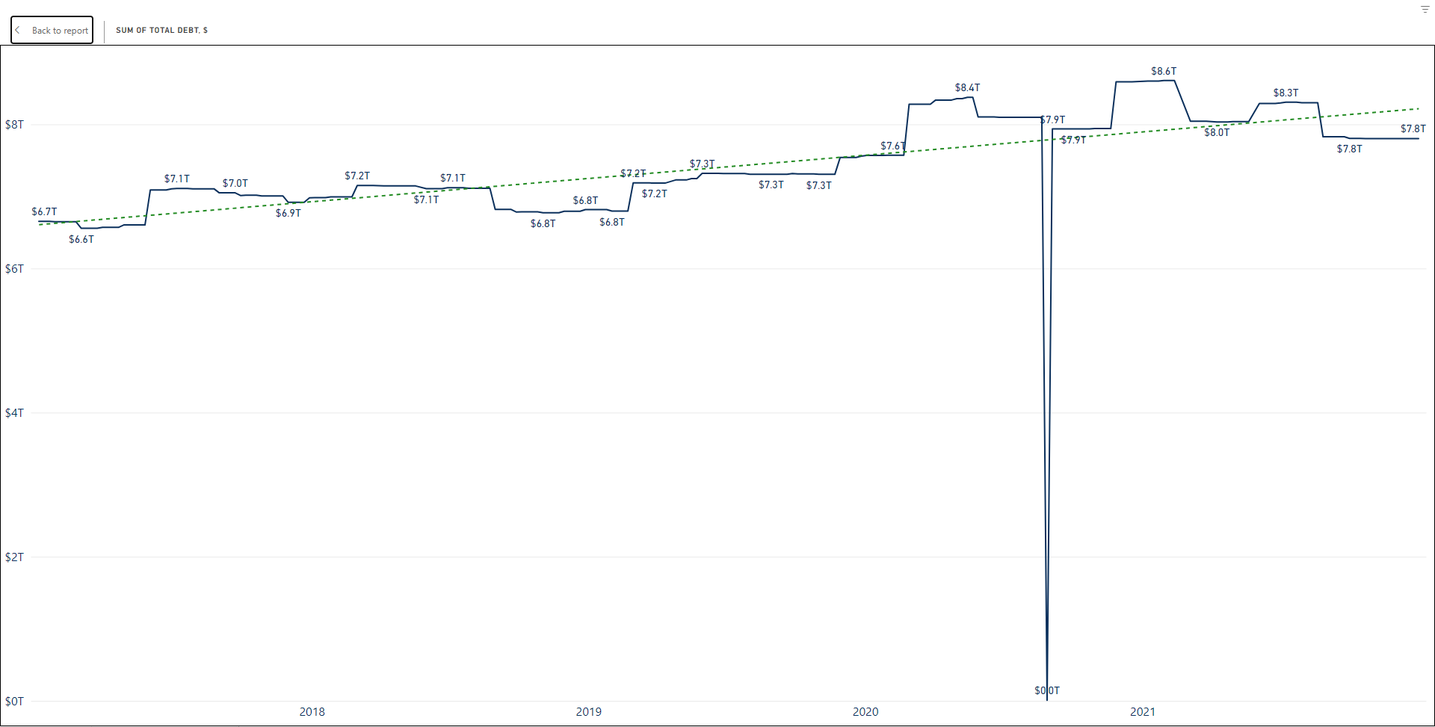
During the period under analysis, the sum of Total Debt increases from 6,654 billion to 7,803 billion, with 17% rate of increasement.
The minimum occurred on Mar 10th, 2017, with 6,557 billion, while the maximum occurred on Jan 29th, 2021, with 8,607 billion(not taking the obviously abrupted data on Aug 28th, 2020, into account).
While fluctuating, the total assets of the sector increased slightly, if not taking the data taken on Aug 28th, 2020, into account.

Slide 14
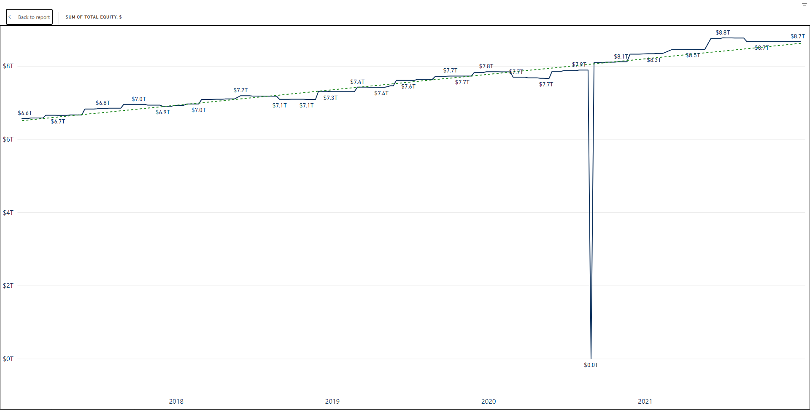
During the period under analysis , the sum of Total Equity increases from 6,566 billion to 8,669 billion, with 32% rate of increasement.
The minimum occurred at the beginning on Jan 6th, 2017, with 6,566 billion, while the maximum occurred on Jul 2nd, 2021, with 8,771 billion(not taking the obviously abrupted data on Aug 28th, 2020, into account).
The total assets of the sector increased Steadily during the period, if not taking the data taken on Aug 28th, 2020, into account.

Slide 15
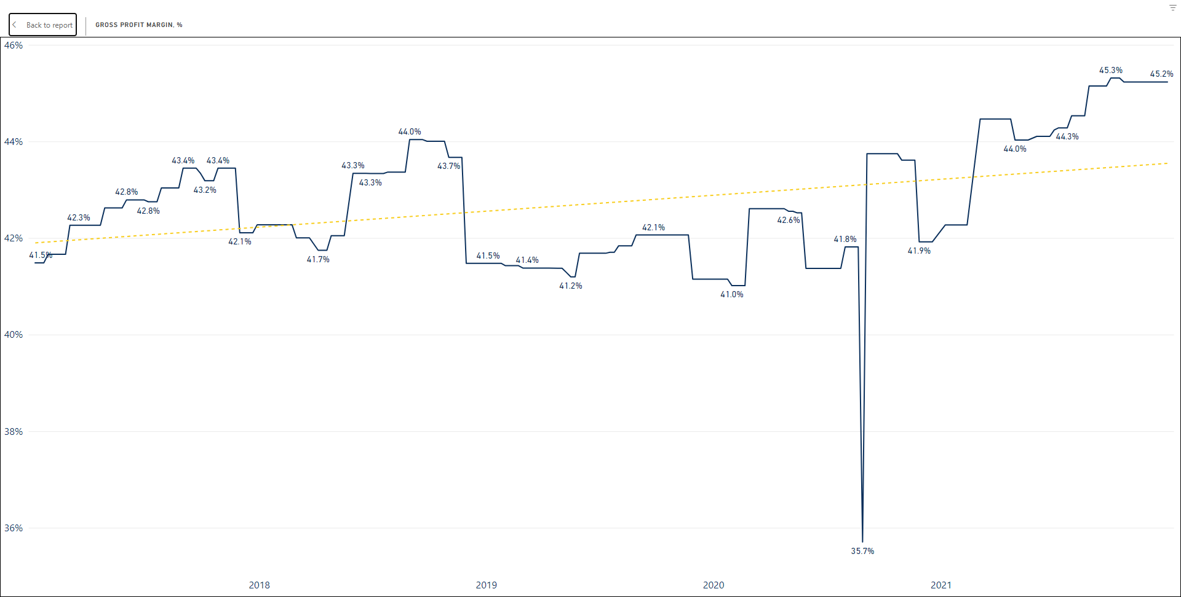
During the period under analysis , Gross Profit Margin increases from 41.48% to 45.23%, with 9% rate of increasement.
The minimum occurred at the beginning on Jan 31st, 2017, with 41.01%, while the maximum occurred on Oct 8th, 2021, with 45.31% billion(not taking the obviously abrupted data on Aug 28th, 2020, into account).
The data was fluctuating before 2020, and after 2020 it increased steadily.

Slide 16
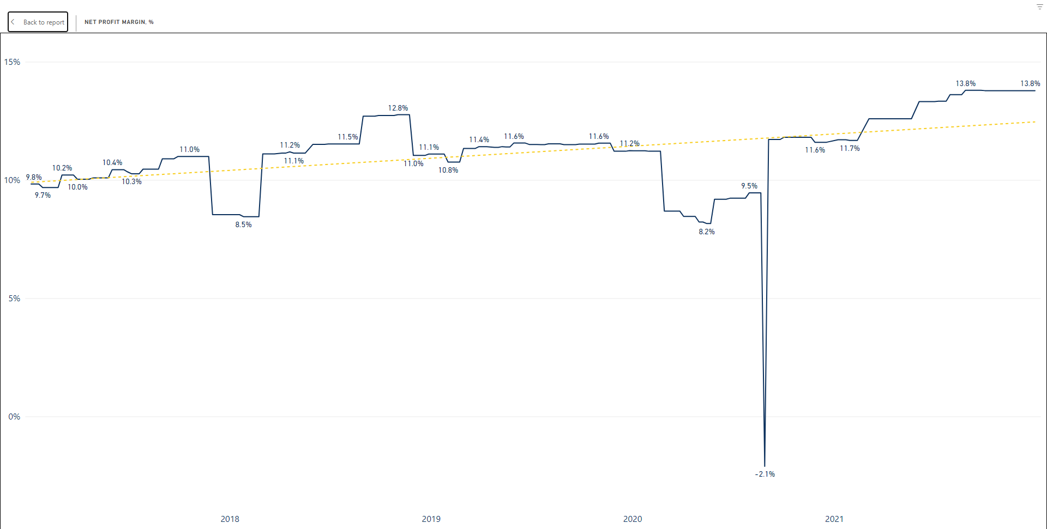
During the period under analysis , Net Profit Margin increases from 9.83% to 13.78%, with 40% rate of increasement.
The minimum occurred at the beginning on May 15th, 2020, with 8.16%, while the maximum occurred on Sept 3rd, 2021, with 13.8% billion(not taking the obviously abrupted data on Aug 28th, 2020, into account).
While experiencing significant volatility, the total assets of the sector increased slightly during the period, if not taking the data taken on Aug 28th, 2020, into account.

Slide 17
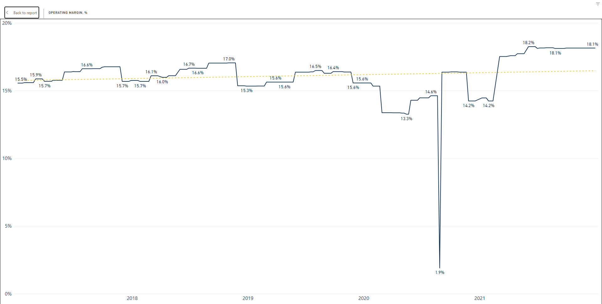
During the period under analysis, Operating Margin increases from 15.55% to 18.14%, with 17% rate of increasement.
The minimum occurred at the beginning on May 15th, 2020, with 13.26%, while the maximum occurred on Jun 11th, 2021, with 18.25% billion(not taking the obviously abrupted data on Aug 28th, 2020, into account).
The total assets of the sector increased very slightly during the period, if not taking the data taken on Aug 28th, 2020, into account.

Slide 18
Personal Understandings and Questions

Slide 19
