Slide 1
Work by: Evgeny Maslennikov,
Altman Ma,
Siyu Ren
In Jun 2024

Slide 2
Definition of Best Performing Stocks
In this process, we analyze the performance of stocks basing on 4 metrics:
Debt/ EBITDA
Dividend Yield
EPS Yield
FCF Yield
A good-performing stock should have low Debt/ EBITDA and high in other 3 metrics
First, Stocks with negative EBITDA are dropped to simplify calculation.
Then, stocks are sorted into four list based on the above metrics.
Top X stocks in each list are picked and combined to get a preliminary set.
Then each stock in the preliminary set is checked, and if it is among the bottom Y stocks on any of the four lists, it should be removed from the set.
The stocks remained in the set after being checked is defined as the best performing stocks.
In each sector, based on the number of the stocks in the sector and the metrics’ distribution, X and Y are chosen to be different pairs of numbers, to get a final investing portfolio with a size of between 5 to 20.
For example, in the Healthcare sector, X is selected to be 30 and Y is selected to be 75, while in the Energy Sector X is 50 and Y is 100.

Slide 3
Basic Materials Sector
Among all 353 stocks in financial services sector, 225 of which move forward to analysis process. Other stocks are dropped because: 8 stocks lack EPS data; 35 stocks lack debt data; 7 stocks lack shares data; 2 stocks lack EBITDA data; 75 stocks paid zero dividend; 1 stock lacks FCF data.
After eliminating outliers in the stocks by IQR method with sensitivity = 1.5 (This may drop out some best-performing stocks), the stocks in Financial Services sector have the following distribution:
Factors for Best-performing Filter:
X = 75, Y = 120,
Final Size of Portfolio = 18
 | Max | Min | Mean | Median
Debt/EBITDA | 17.19 | -7.82 | 3.51 | 2.32
Dividend Yield | 0.22 | 0.00 | 0.05 | 0.04
EPS Yield | 0.27 | -0.11 | 0.08 | 0.08
FCF Yield | 0.41 | -0.20 | 0.09 | 0.08

Slide 4
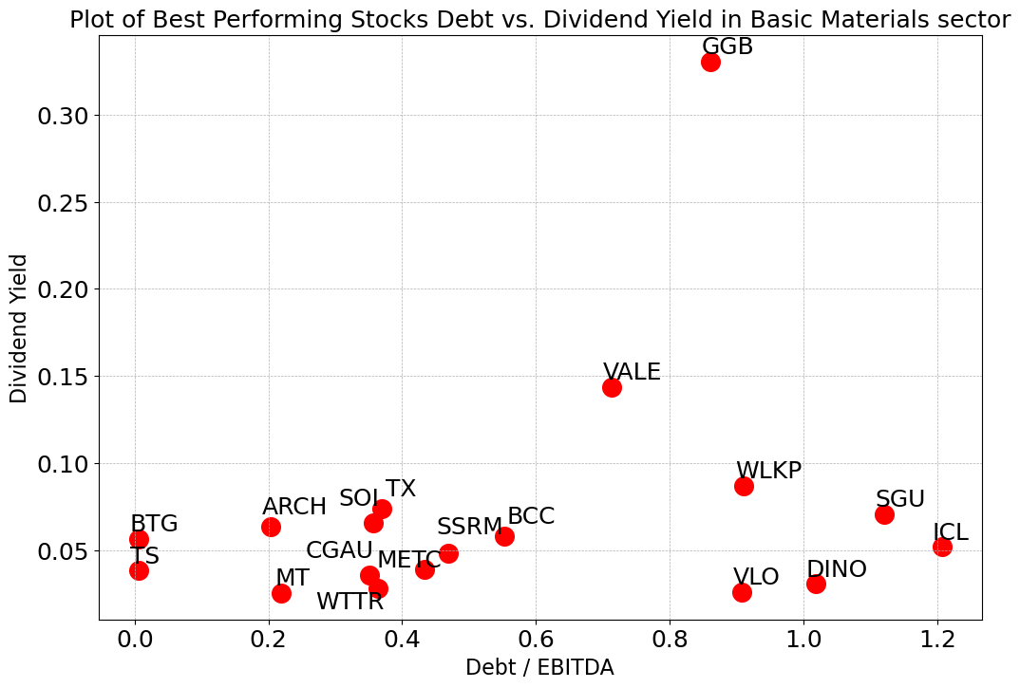
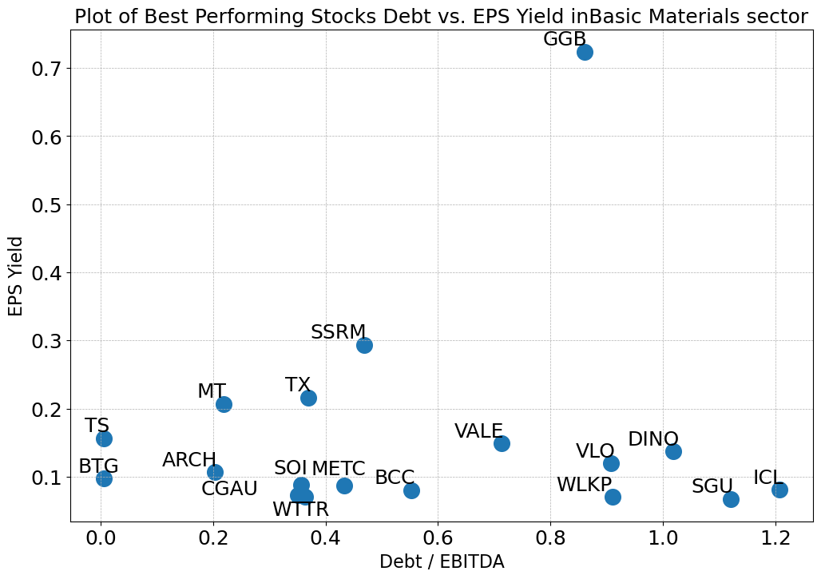
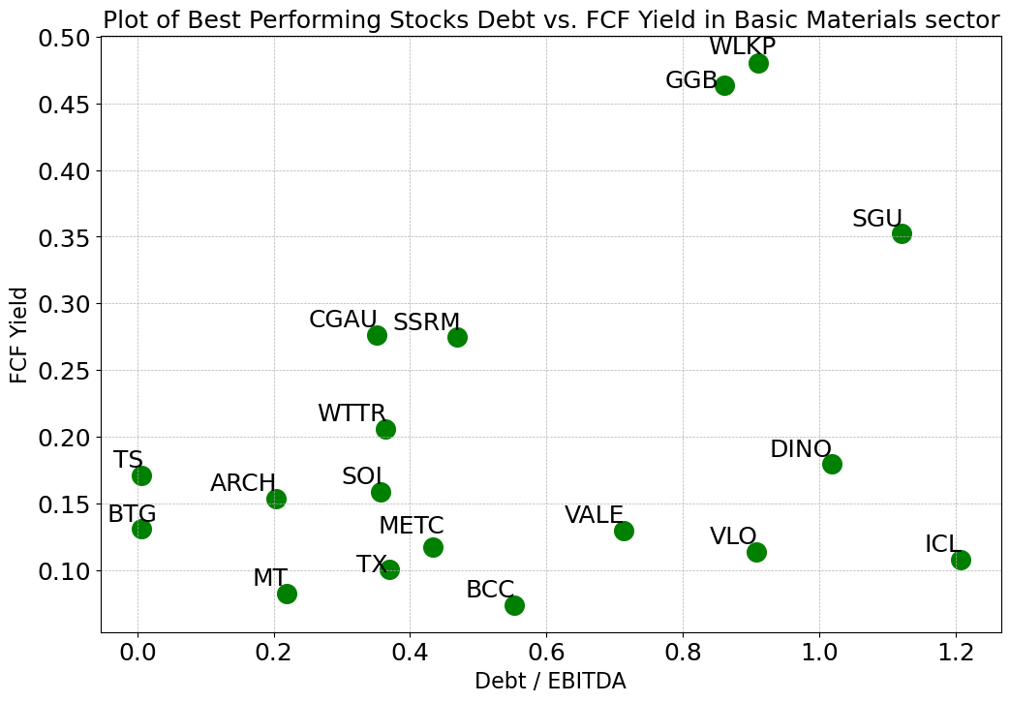
Basic Materials Sector
All the best-performing stocks have Debt/EBITDA between 0.0 and 1.22, compared to all 225 stocks with a range of -7.82~17.19 (negative exist because of negative EBITDA)
All but one of the best-performing stocks have a Dividend Yield between 0 and 0.25, compared to all 225 stocks with a range of 0.00~0.22
Most of the 18 stocks have EPS Yields between 0 and 0.25, compared to all stocks in -0.11~0.27
Most of the 18 stocks have FCF Yields between 0 and 0.3, compared to all stocks in -0.20~0.41

Slide 5
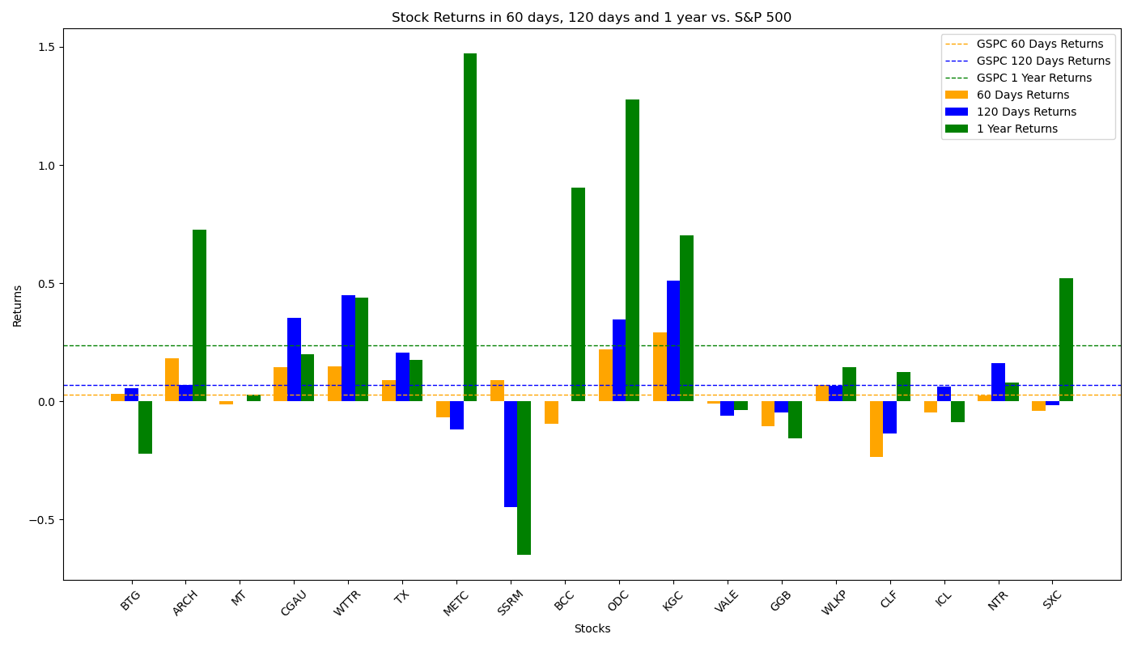
Performance of Filtered Stocks in Basic Materials Sector
Most Filtered Stocks have above-average returns rate in 60-day, 120-day and 1-year sector, higher than that of S&P 500 factors.
Total 18 Filtered Stocks | 60 Days | 120 Days | 1 Year
No. Stocks with Positive Returns | 10 | 12 | 14
No. Stocks with Returns Higher than S&P 500 | 10 | 8 | 7
Total Average Returns | 3.40% | 7.34% | 28.21%
Returns of S&P 500 | 2.65% | 6.89% | 23.62%

Slide 6
Communication Services Sector
Among all 302 stocks in financial services sector, 147 of which move forward to analysis process. Other stocks are dropped because: 7 stocks lack EPS data; 3 stocks lack price data in a long period; 40 stocks lack debt data; 18 stocks lack shares data; 10 stocks lack EBITDA data; 73 stocks paid zero dividend; 4 stocks lack FCF data.
After eliminating outliers in the stocks by IQR method with sensitivity = 1.5 (This may drop out some best-performing stocks), the stocks in Financial Services sector have the following distribution:
Factors for Best-performing Filter:
X = 50, Y = 60,
Final Size of Portfolio = 19
 | Max | Min | Mean | Median
Debt/EBITDA | 7.73 | -4.13 | 2.67 | 2.62
Dividend Yield | 0.36 | 0.00 | 0.06 | 0.03
EPS Yield | 0.22 | -0.23 | 0.03 | 0.04
FCF Yield | 0.49 | -0.30 | 0.08 | 0.07

Slide 7
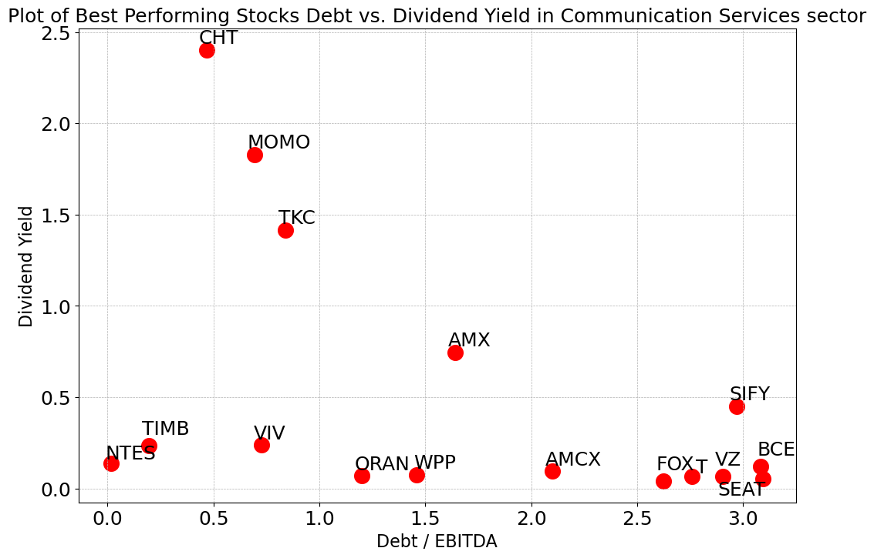
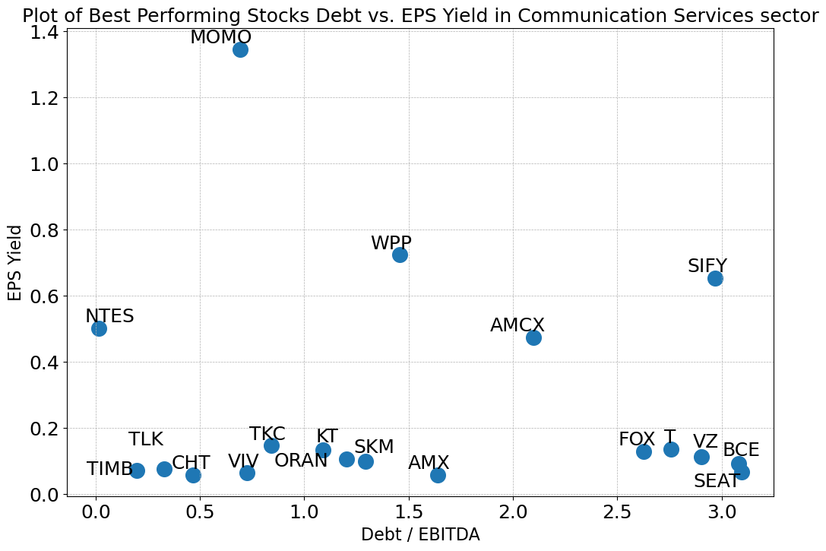
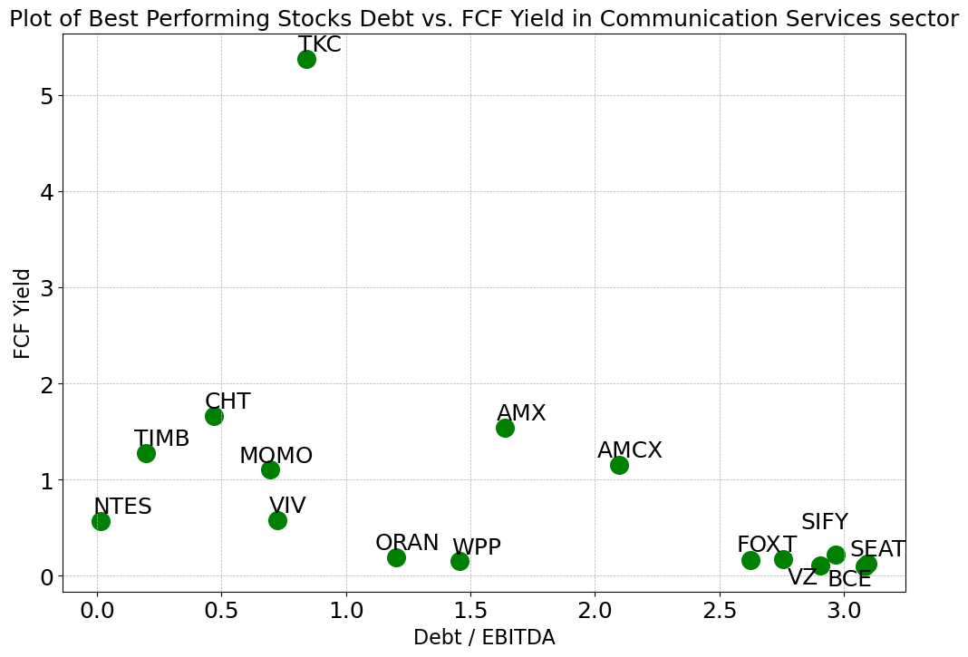
Communication Services Sector
Most of the best-performing stocks have Debt/EBITDA between 0.0 and 3.0, compared to all 147 stocks with a range of -4.13~7.73 (negative exist because of negative EBITDA)
All but one of the best-performing stocks have a Dividend Yield between 0 and 1.5, compared to all 147 stocks with a range of 0.00~0.36
Most of the 18 stocks have EPS Yields between 0.0 and 0.6, compared to all stocks in -0.23~0.22
Most of the 18 stocks have FCF Yields between 0.1 and 2.0, compared to all stocks in -0.30~0.49
*TLK, SKM and KT have been removed from the Dividend Yield plot and FCF Yield plot since their numbers are extremely high

Slide 8
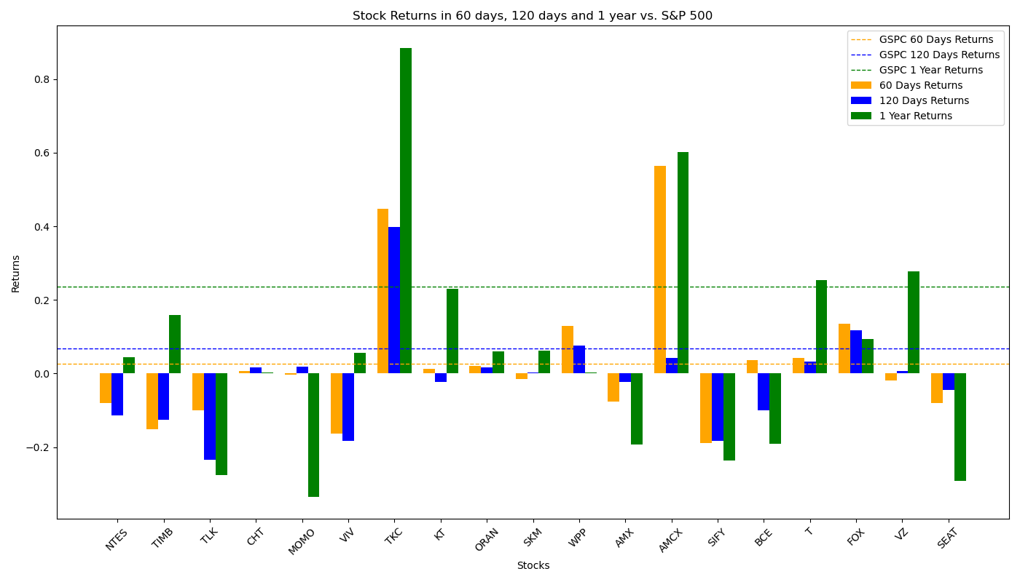
Performance of Filtered Stocks in Communication Services Sector
The Investment Portfolio performs badly in 120-day and 1-year period.
Total 18 Filtered Stocks | 60 Days | 120 Days | 1 Year
No. Stocks with Positive Returns | 9 | 9 | 11
No. Stocks with Returns Higher than S&P 500 | 5 | 4 | 4
Total Average Returns | 2.40% | -1.09% | 5.98%
Returns of S&P 500 | 2.65% | 6.89% | 23.62%

Slide 9
Conglomerates Sector
Among all 29 stocks in financial services sector, 18 of which move forward to analysis process. Other stocks are dropped because: 3 stocks lack EPS data; 3 stocks lack shares data; 5 stocks paid zero dividend;
After eliminating outliers in the stocks by IQR method with sensitivity = 1.5 (This may drop out some best-performing stocks), the stocks in Financial Services sector have the following distribution:
Factors for Best-performing Filter:
X = 15, Y = 4,
Final Size of Portfolio = 6
 | Max | Min | Mean | Median
Debt/EBITDA | 8.21 | -3.87 | 2.61 | 2.91
Dividend Yield | 0.08 | 0.00 | 0.03 | 0.02
EPS Yield | 0.16 | 0.03 | 0.08 | 0.09
FCF Yield | 0.13 | -0.10 | 0.04 | 0.04

Slide 10
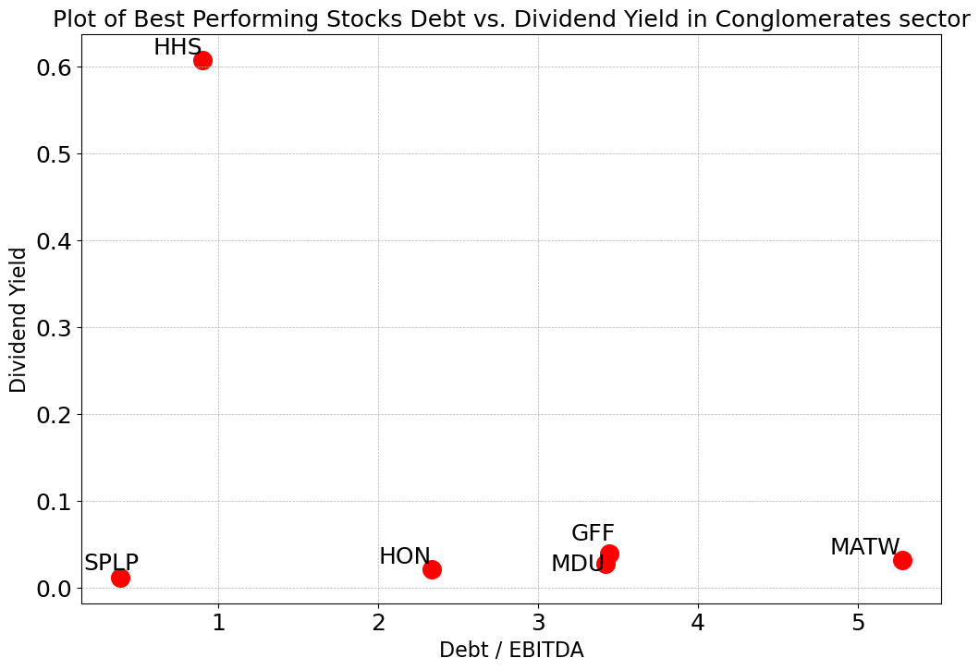
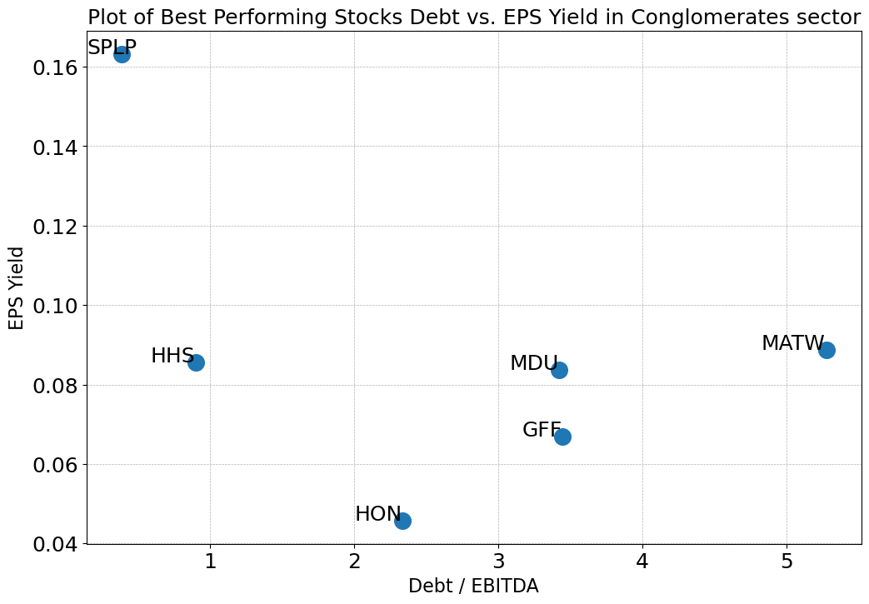
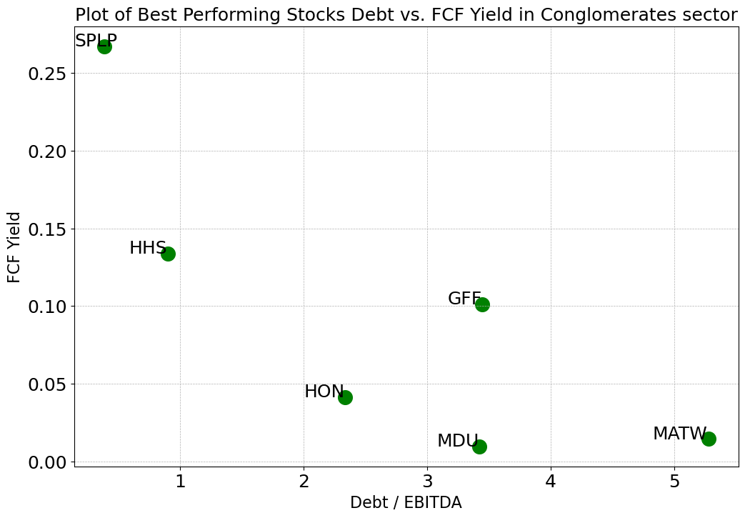
Conglomerates Sector
Most of the best-performing stocks have Debt/EBITDA between 0.0 and 5.5, compared to all 18 stocks with a range of -3.87~8.21 (negative exist because of negative EBITDA)
All but one of the best-performing stocks have a Dividend Yield between 0.0 and 0.1, compared to all 18 stocks with a range of 0.00~0.08
Most of the 18 stocks have EPS Yields between 0.04 and 0.1, compared to all stocks in 0.03~0.16
Most of the 18 stocks have FCF Yields between 0.0 and 0.15, compared to all stocks in -0.10~0.13

Slide 11
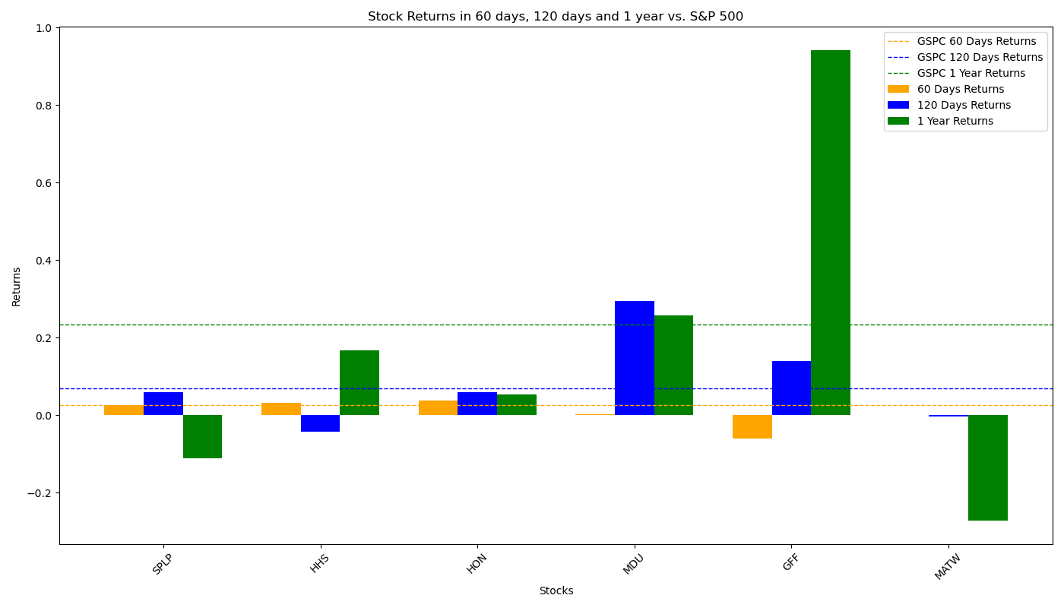
Performance of Filtered Stocks in Conglomerates Sector
The Investment Portfolio performs very well in all three period, with returns much higher than S&P 500 Factors.
Total 18 Filtered Stocks | 60 Days | 120 Days | 1 Year
No. Stocks with Positive Returns | 3 | 4 | 4
No. Stocks with Returns Higher than S&P 500 | 3 | 3 | 3
Total Average Returns | 37% | 11% | 38%
Returns of S&P 500 | 3% | 4% | 12%

Slide 12
Consumer Cyclical Sector
Among all 679 stocks in financial services sector, 356 of which move forward to analysis process. Other stocks are dropped because: 10 stocks lack EPS data; 9 stocks lack price data in a long period; 65 stocks lack debt data; 36 stocks lack shares data; 23 stocks lack EBITDA data; 175 stocks paid zero dividend; 5 stocks lack FCF data.
After eliminating outliers in the stocks by IQR method with sensitivity = 1.5 (This may drop out some best-performing stocks), the stocks in Financial Services sector have the following distribution:
Factors for Best-performing Filter:
X = 30, Y = 150,
Final Size of Portfolio = 21
 | Max | Min | Mean | Median
Debt/EBITDA | 8.37 | -3.98 | 2.23 | 1.92
Dividend Yield | 0.13 | 0.00 | 0.03 | 0.02
EPS Yield | 0.18 | -0.07 | 0.06 | 0.06
FCF Yield | 0.24 | -0.14 | 0.05 | 0.05

Slide 13
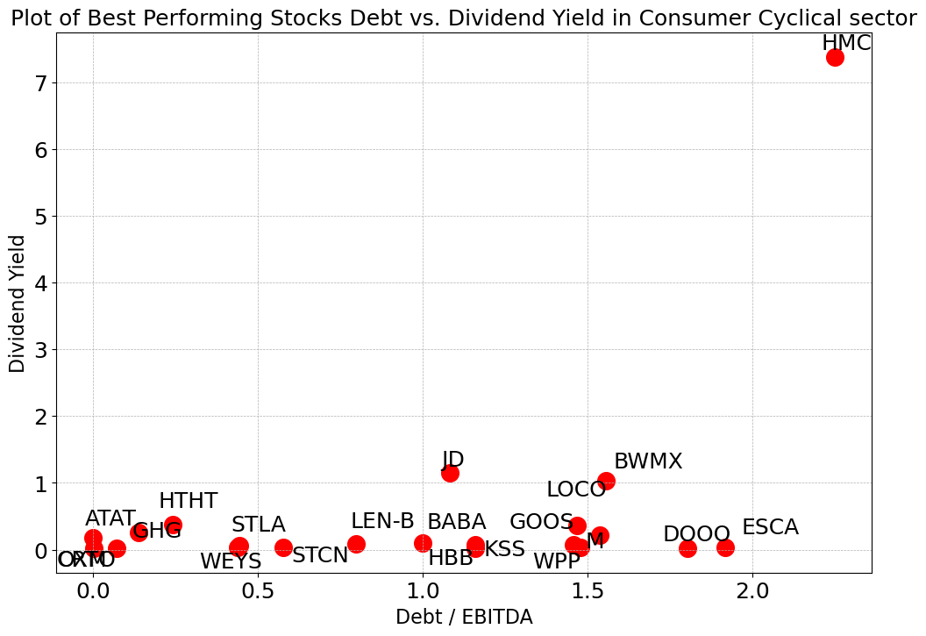
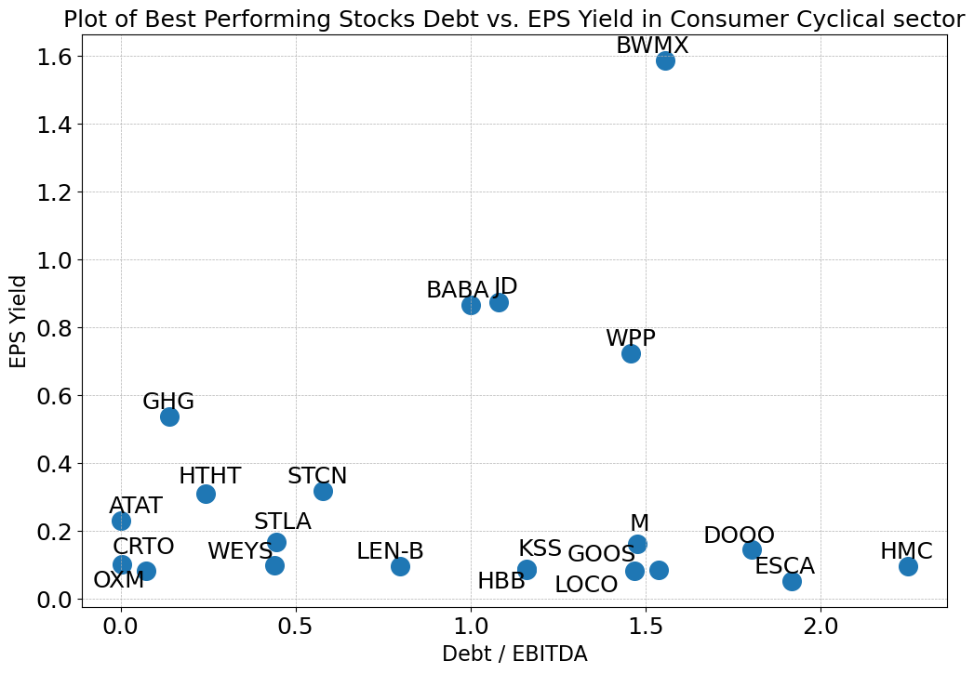
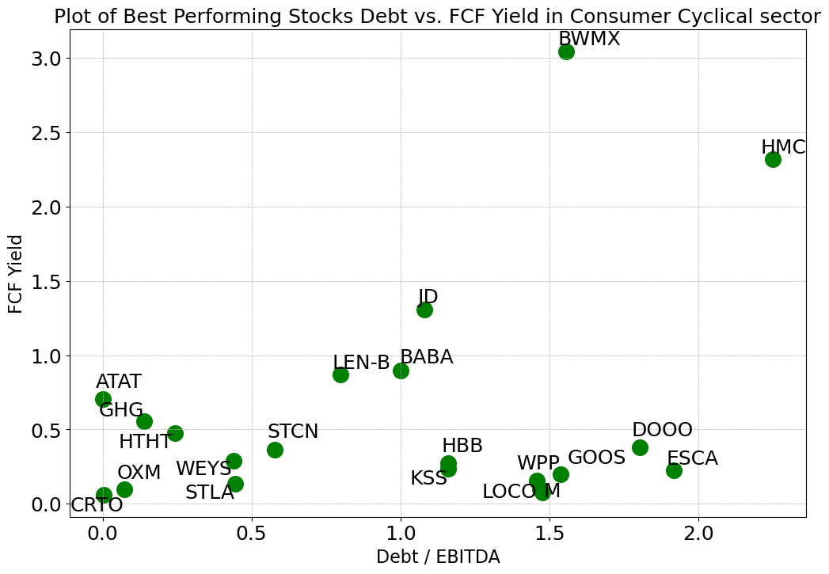
Consumer Cyclical Sector
Most of the best-performing stocks have Debt/EBITDA between 0.0 and 2.0, compared to all 356 stocks with a range of -3.98~8.37 (negative exist because of negative EBITDA)
All but one of the best-performing stocks have a Dividend Yield between 0.0 and 1.5, compared to all 356 stocks with a range of 0.00~0.13
Most of the 21 stocks have EPS Yields between 0.0 and 1.0, compared to all stocks in -0.07~0.18
Most of the 21 stocks have FCF Yields between 0.0 and 1.5, compared to all stocks in -0.14~0.24

Slide 14
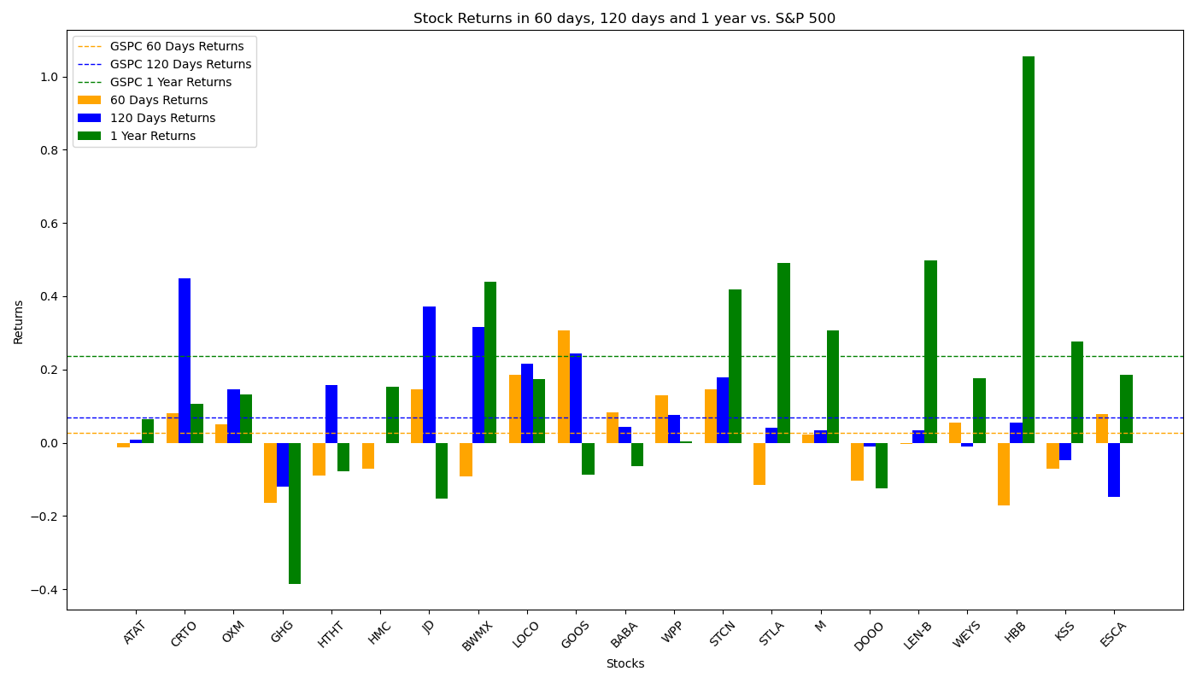
Performance of Filtered Stocks in Consumer Cyclical Sector
The Investment Portfolio performs worse than S&P 500 factors in 60-day and 1-year period but do has positive returns.
Total 18 Filtered Stocks | 60 Days | 120 Days | 1 Year
No. Stocks with Positive Returns | 11 | 15 | 14
No. Stocks with Returns Higher than S&P 500 | 10 | 9 | 7
Total Average Returns | 1.79% | 9.68% | 17.68%
Returns of S&P 500 | 2.65% | 6.89% | 23.62%

Slide 15
Consumer Defensive Sector
Among all 261 stocks in financial services sector, 148 of which move forward to analysis process. Other stocks are dropped because: 6 stocks lack EPS data; 3 stocks lack price data in a long period; 31 stocks lack debt data; 18 stocks lack shares data; 3 stocks lack EBITDA data; 52 stocks paid zero dividend.
After eliminating outliers in the stocks by IQR method with sensitivity = 1.5 (This may drop out some best-performing stocks), the stocks in Financial Services sector have the following distribution:
Factors for Best-performing Filter:
X = 15, Y = 50,
Final Size of Portfolio = 15
 | Max | Min | Mean | Median
Debt/EBITDA | 6.25 | -4.06 | 2.02 | 1.85
Dividend Yield | 0.15 | 0.00 | 0.03 | 0.02
EPS Yield | 0.14 | -0.04 | 0.06 | 0.05
FCF Yield | 0.2 | -0.10 | 0.06 | 0.05

Slide 16
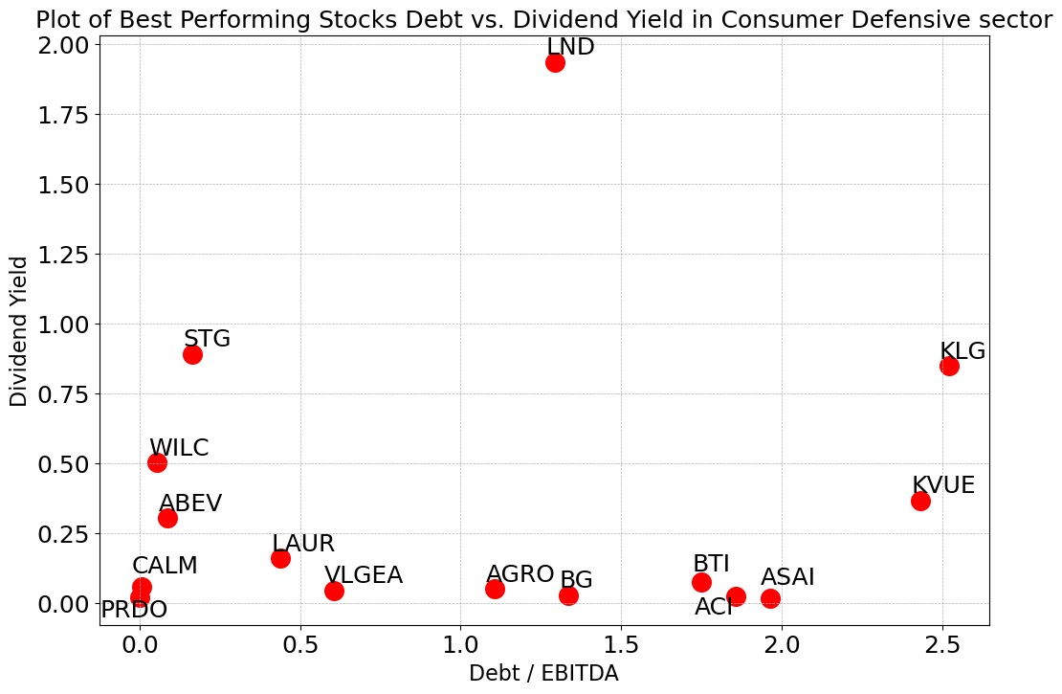
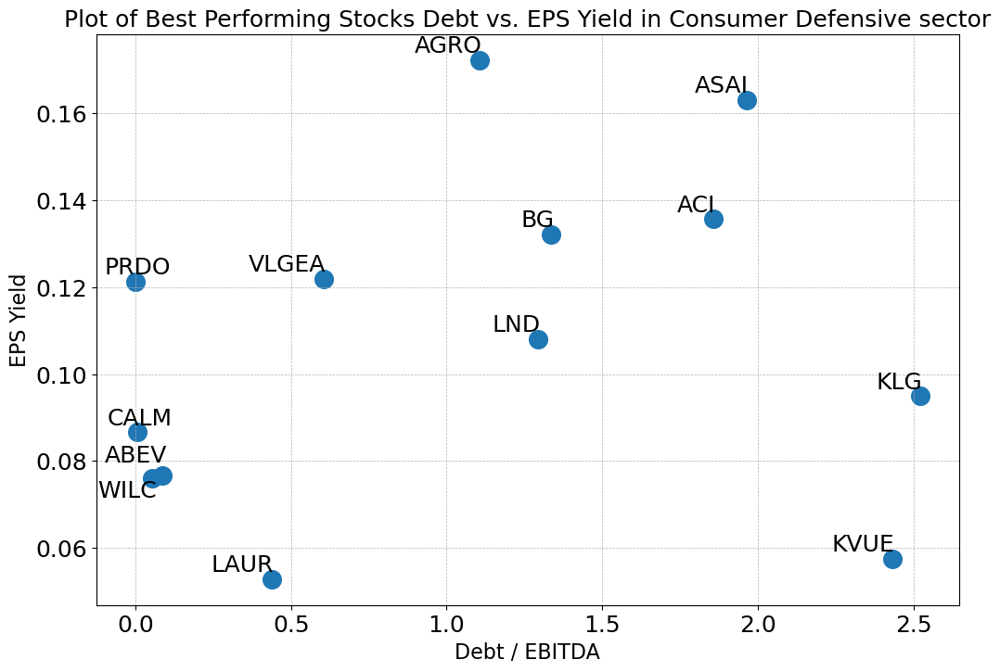
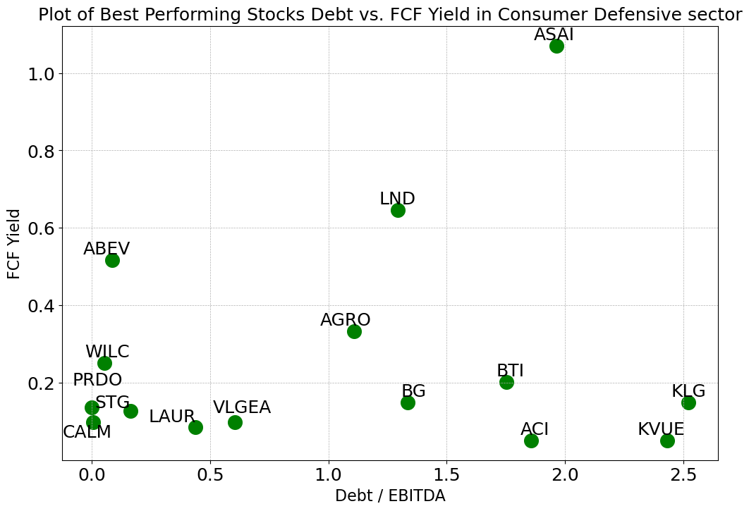
Consumer Defensive Sector
Most of the best-performing stocks have Debt/EBITDA between 0.0 and 2.6, compared to all 148 stocks with a range of -4.06~6.25 (negative exist because of negative EBITDA)
All but one of the best-performing stocks have a Dividend Yield between 0.0 and 1.0, compared to all 148 stocks with a range of 0.00~0.15
Most of the 15 stocks have EPS Yields between 0.0 and 0.18, compared to all stocks in -0.04~0.14
Most of the 15 stocks have FCF Yields between 0.1 and 0.7, compared to all stocks in -0.10~0.20

Slide 17
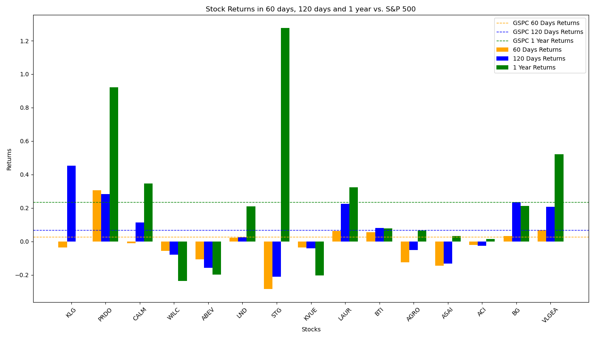
Performance of Filtered Stocks in Consumer Defensive Sector
The Investment Portfolio give negative returns in 60-day period, but in longer periods their performances are close to that of S&P 500’s.
Total 18 Filtered Stocks | 60 Days | 120 Days | 1 Year
No. Stocks with Positive Returns | 6 | 9 | 11
No. Stocks with Returns Higher than S&P 500 | 5 | 4 | 4
Total Average Returns | -1.77% | 6.96% | 21.73%
Returns of S&P 500 | 2.65% | 6.89% | 23.62%

Slide 18
Consumer Goods Sector
Among all 190 stocks in financial services sector, 114 of which move forward to analysis process. Other stocks are dropped because: 1 stock lack EPS data; 9 stocks lack debt data; 26 stocks lack shares data; 6 stocks lack EBITDA data; 33 stocks paid zero dividend; 1 stock lack FCF data.
After eliminating outliers in the stocks by IQR method with sensitivity = 1.5 (This may drop out some best-performing stocks), the stocks in Financial Services sector have the following distribution:
Factors for Best-performing Filter:
X = 50, Y = 50,
Final Size of Portfolio = 12
 | Max | Min | Mean | Median
Debt/EBITDA | 10.02 | -1.03 | 3.27 | 2.78
Dividend Yield | 0.09 | 0.00 | 0.03 | 0.03
EPS Yield | 0.15 | -0.04 | 0.06 | 0.05
FCF Yield | 0.19 | -0.05 | 0.07 | 0.06

Slide 19
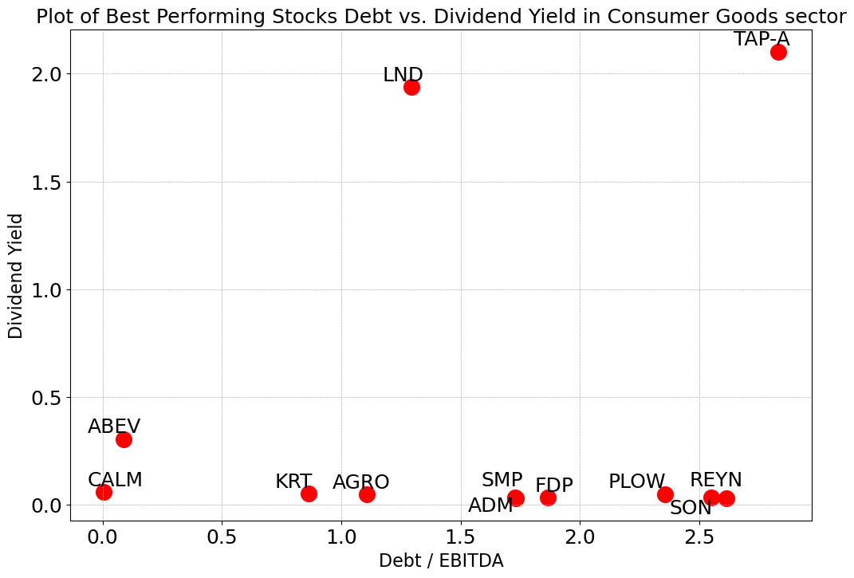
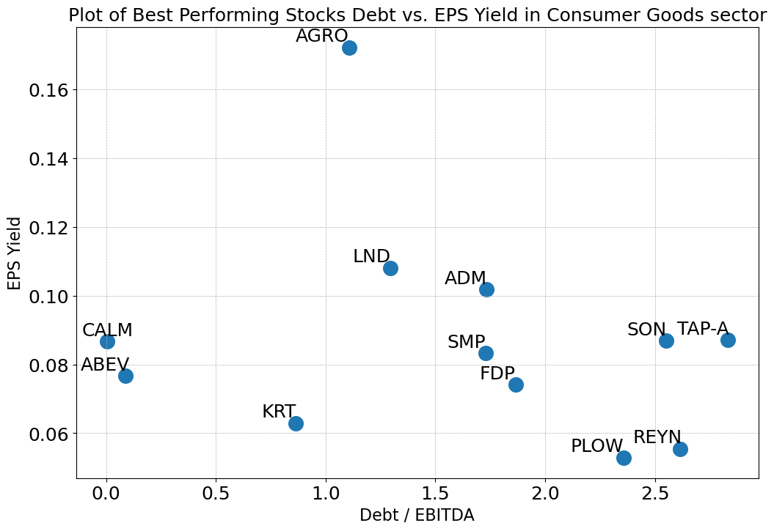
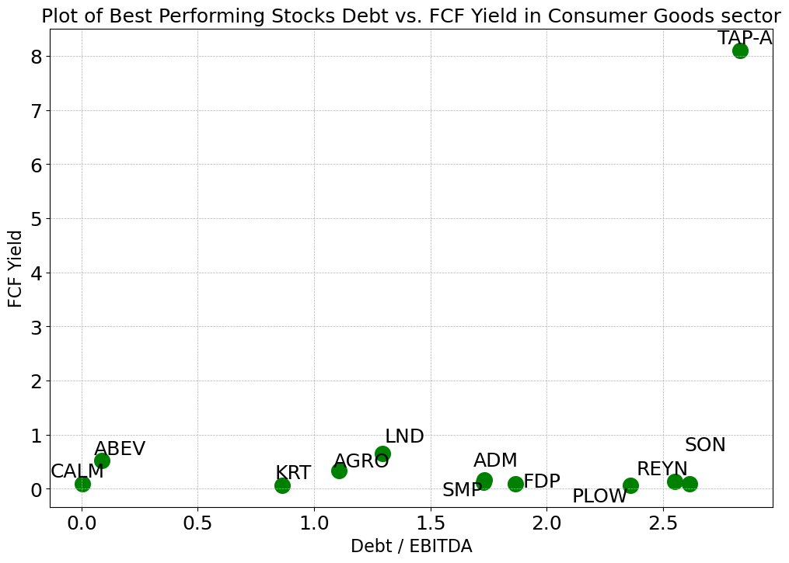
Consumer Goods Sector
Most of the best-performing stocks have Debt/EBITDA between 0.0 and 2.7, compared to all 114 stocks with a range of -1.03~10.02 (negative exist because of negative EBITDA)
All but one of the best-performing stocks have a Dividend Yield between 0.1 and 0.5, compared to all 114 stocks with a range of 0.00~0.09
Most of the 12 stocks have EPS Yields between 0.1 and 0.12, compared to all stocks in -0.04~0.15
Most of the 12 stocks have FCF Yields between 0.1 and 1.0, compared to all stocks in -0.05~0.19

Slide 20
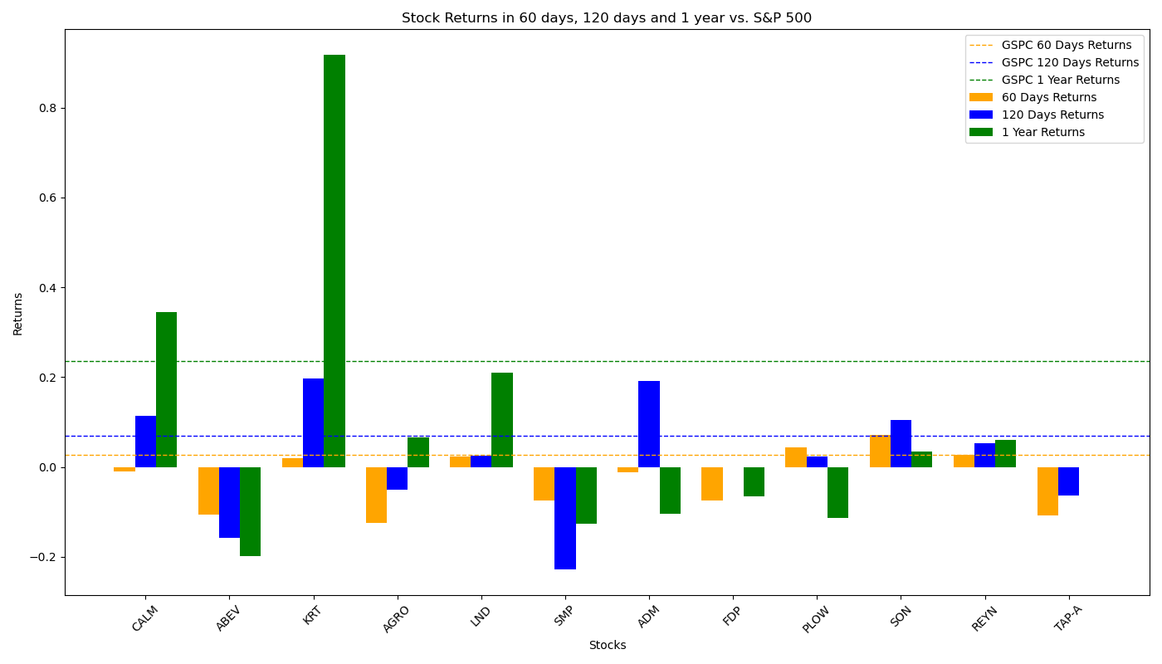
Performance of Filtered Stocks in Consumer Goods Sector
The Investment Portfolio performs below average in all three periods, especially in 60 days where they failed to provide positive returns.
Total 18 Filtered Stocks | 60 Days | 120 Days | 1 Year
No. Stocks with Positive Returns | 5 | 7 | 6
No. Stocks with Returns Higher than S&P 500 | 3 | 4 | 2
Total Average Returns | -2.71% | 1.69% | 8.53%
Returns of S&P 500 | 2.65% | 6.89% | 23.62%

Slide 21
Energy Sector
Among all 275 stocks in financial services sector, 200 of which move forward to analysis process. Other stocks are dropped because: 6 stocks lack EPS data; 26 stocks lack debt data; 12 stocks lack shares data; 3 stocks lack EBITDA data; 28 stocks paid zero dividend.
After eliminating outliers in the stocks by IQR method with sensitivity = 1.5 (This may drop out some best-performing stocks), the stocks in Financial Services sector have the following distribution:
Factors for Best-performing Filter:
X = 50, Y = 100,
Final Size of Portfolio = 21
 | Max | Min | Mean | Median
Debt/EBITDA | 6.79 | -1.17 | 1.91 | 1.44
Dividend Yield | 0.17 | 0.00 | 0.04 | 0.03
EPS Yield | 0.25 | -0.09 | 0.09 | 0.08
FCF Yield | 0.29 | -0.16 | 0.07 | 0.07

Slide 22
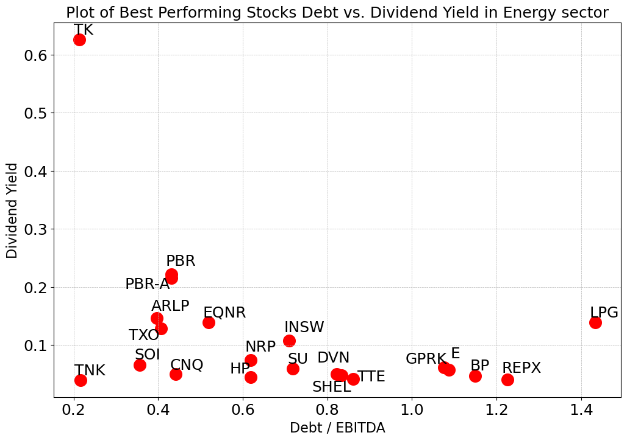
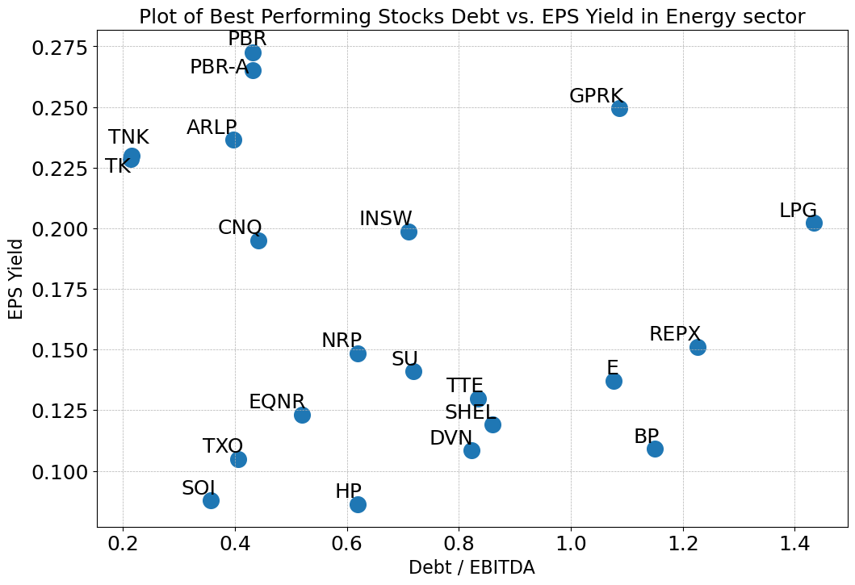
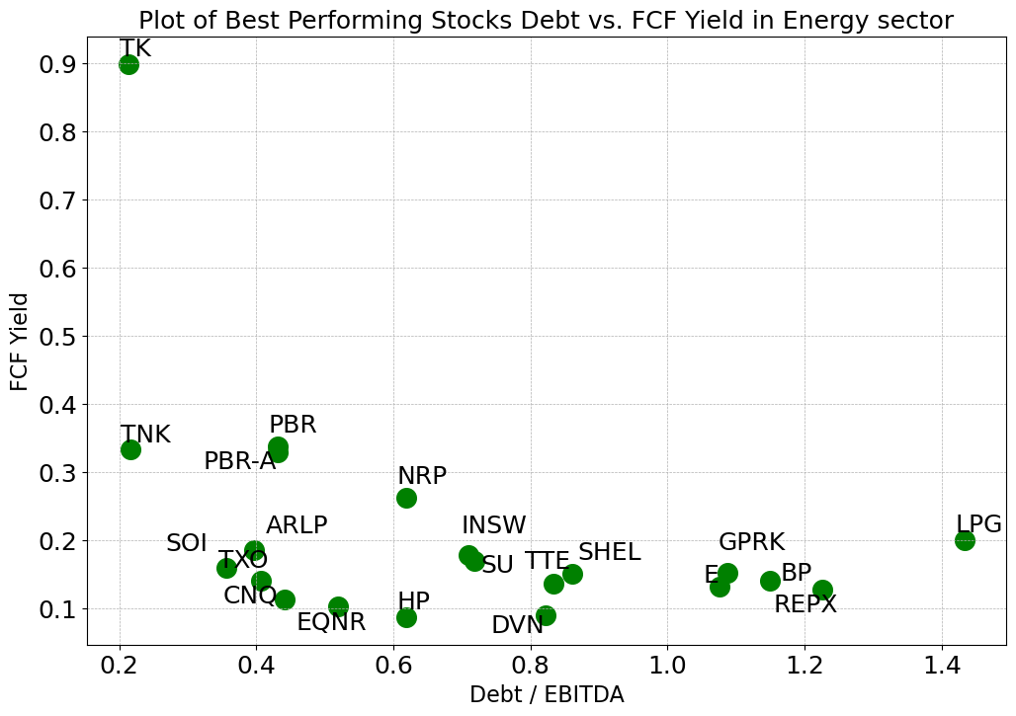
Energy Sector
Most of the best-performing stocks have Debt/EBITDA between 0.0 and 1.5, compared to all 357 stocks with a range of -1.17~6.79 (negative exist because of negative EBITDA)
All but one of the best-performing stocks have a Dividend Yield between 0.0 and 0.3, compared to all 357 stocks with a range of 0.00~0.17
Most of the 18 stocks have EPS Yields between 0.0 and 0.275, compared to all stocks in -0.09~0.25
Most of the 18 stocks have FCF Yields between 0.0 and 0.4, compared to all stocks in -0.16~0.29

Slide 23
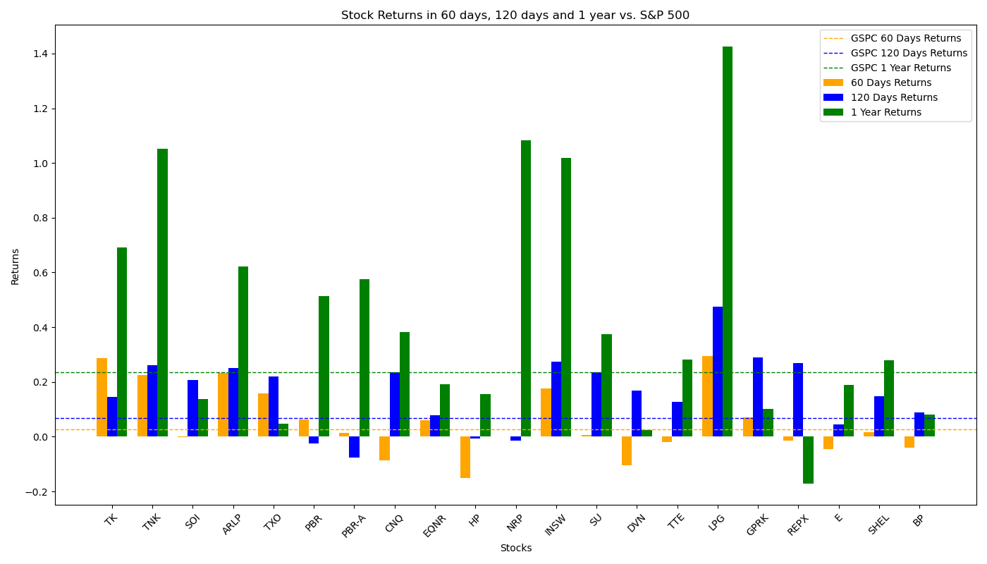
Performance of Filtered Stocks in Energy sector
Most Filtered Stocks have above-average returns rate in 60-day, 120-day and 1-year sector; they perform especially well in a longer term.
Total 18 Filtered Stocks | 60 Days | 120 Days | 1 Year
No. Stocks with Positive Returns | 14 | 18 | 20
No. Stocks with Returns Higher than S&P 500 | 8 | 17 | 11
Total Average Returns | 5.47% | 16.17% | 43.15%
Returns of S&P 500 | 2.65% | 6.89% | 23.62%

Slide 24
Financial Services Sector
Among all 1372 stocks in financial services sector, 357 of which move forward to analysis process. Other stocks are dropped because: 1) 270 stocks have no financial data in the database; 2) 26 stocks lack EPS data; 3) 32 stocks lack price data in a long period; 4) 500 stocks lack debt data; 5) 86 stocks lack shares data; 6) 11 stocks lack EBITDA data; 7) 85 stocks paid zero dividend; 8) 5 stocks lack FCF data.
After eliminating outliers in the stocks by IQR method with sensitivity = 1.5 (This may drop out some best-performing stocks), the stocks in Financial Services sector have the following distribution:
Factors for Best-performing Filter:
X = 15, Y = 100,
Final Size of Portfolio = 18
 | Max | Min | Mean | Median
Debt/EBITDA | 17.19 | -7.82 | 3.51 | 2.32
Dividend Yield | 0.22 | 0.00 | 0.05 | 0.04
EPS Yield | 0.27 | -0.11 | 0.08 | 0.08
FCF Yield | 0.41 | -0.20 | 0.09 | 0.08

Slide 25
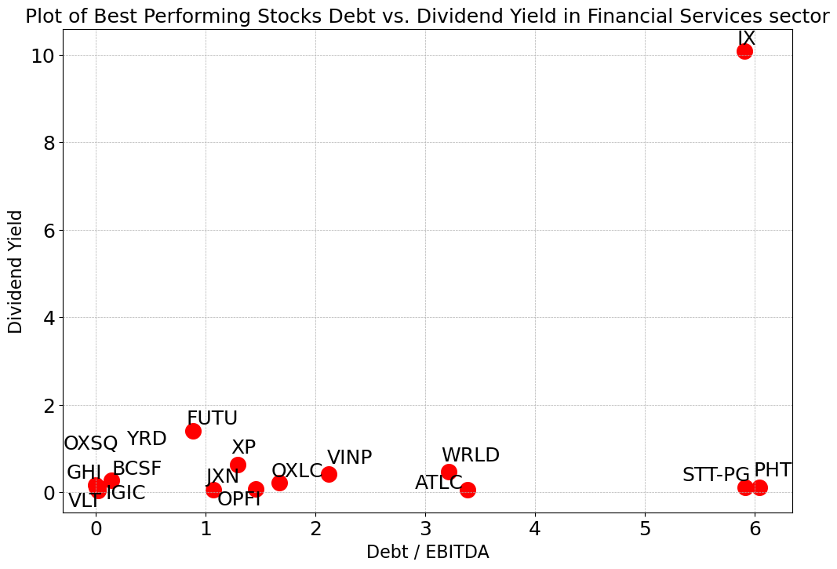
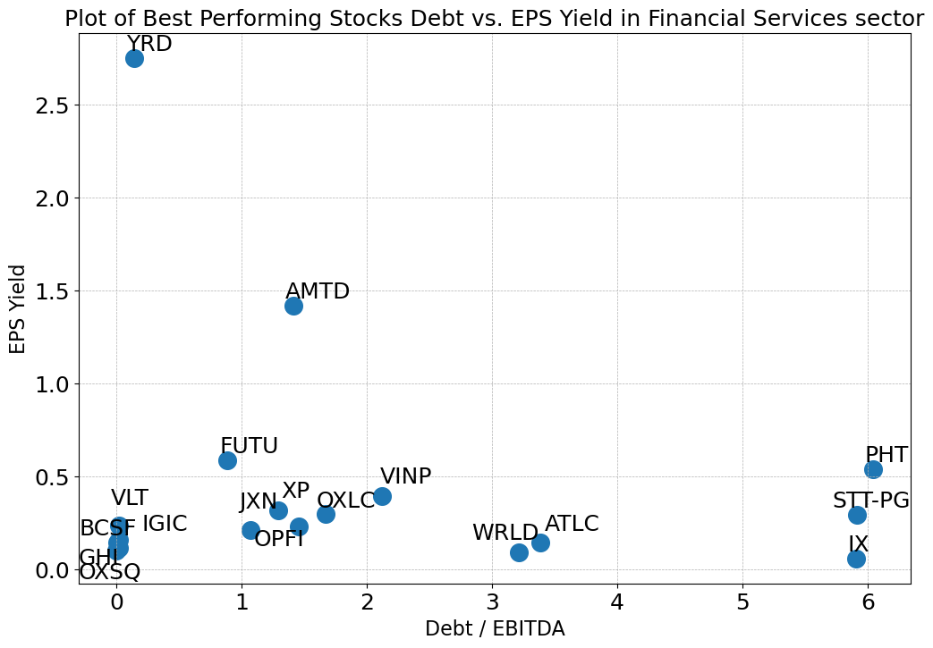
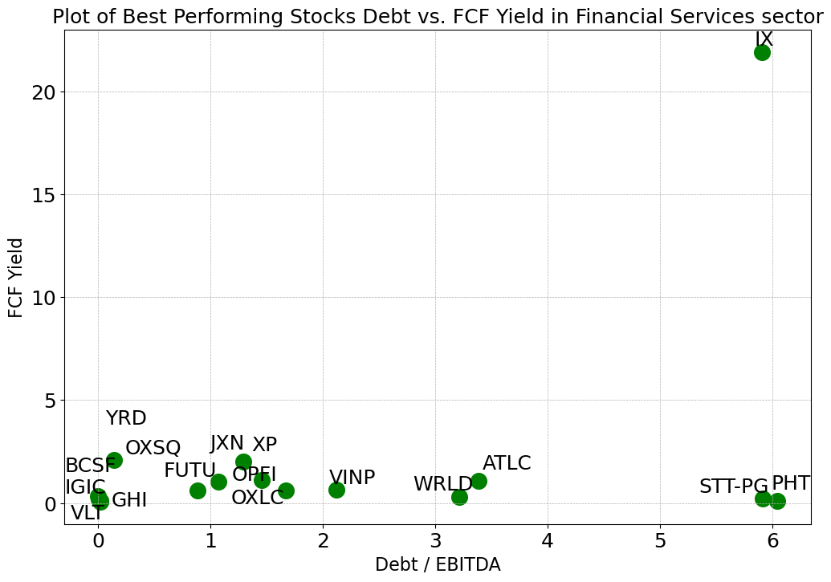
Financial Services Sector
Most of the best-performing stocks have Debt/EBITDA between 0.0 and 3.5, compared to all 357 stocks with a range of -7.82~17.19 (negative exist because of negative EBITDA)
All but one of the best-performing stocks have a Dividend Yield between 0.1 and 1.8, compared to all 357 stocks with a range of 0.00~0.22
Most of the 18 stocks have EPS Yields between 0.1 and 0.6, compared to all stocks in -0.11~0.27
Most of the 18 stocks have FCF Yields between 0.1 and 2.5, compared to all stocks in -0.20~0.41

Slide 26
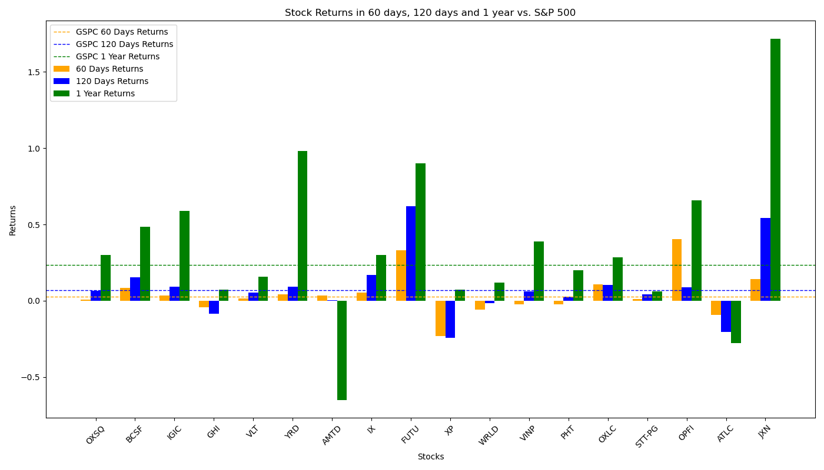
Performance of Filtered Stocks in Financial Service Sector
The Filtered Investment Portfolio performs badly in 120-day and 1-year period.
Total 18 Filtered Stocks | 60 Days | 120 Days | 1 Year
No. Stocks with Positive Returns | 9 | 9 | 11
No. Stocks with Returns Higher than S&P 500 | 5 | 4 | 4
Total Average Returns | 2.40% | -1.09% | 5.98%
Returns of S&P 500 | 2.65% | 6.89% | 23.62%

Slide 27
Healthcare Sector
Among all 1308 stocks in financial services sector, 360 of which move forward to analysis process. Other stocks are dropped because: 12 stocks lack EPS data; 12 stocks lack price data in a long period; 299 stocks lack debt data; 55 stocks lack shares data; 30 stocks lack EBITDA data; 536 stocks paid zero dividend; 4 stocks lack FCF data.
After eliminating outliers in the stocks by IQR method with sensitivity = 1.5 (This may drop out some best-performing stocks), the stocks in Financial Services sector have the following distribution:
Factors for Best-performing Filter:
X = 30, Y = 75,
Final Size of Portfolio = 18
 | Max | Min | Mean | Median
Debt/EBITDA | 5.93 | -3.76 | 0.70 | 0.00
Dividend Yield | 0.21 | 0.00 | 0.03 | 0.01
EPS Yield | 0.34 | -0.88 | -0.08 | 0.01
FCF Yield | 0.39 | -0.65 | -0.05 | 0.01

Slide 28
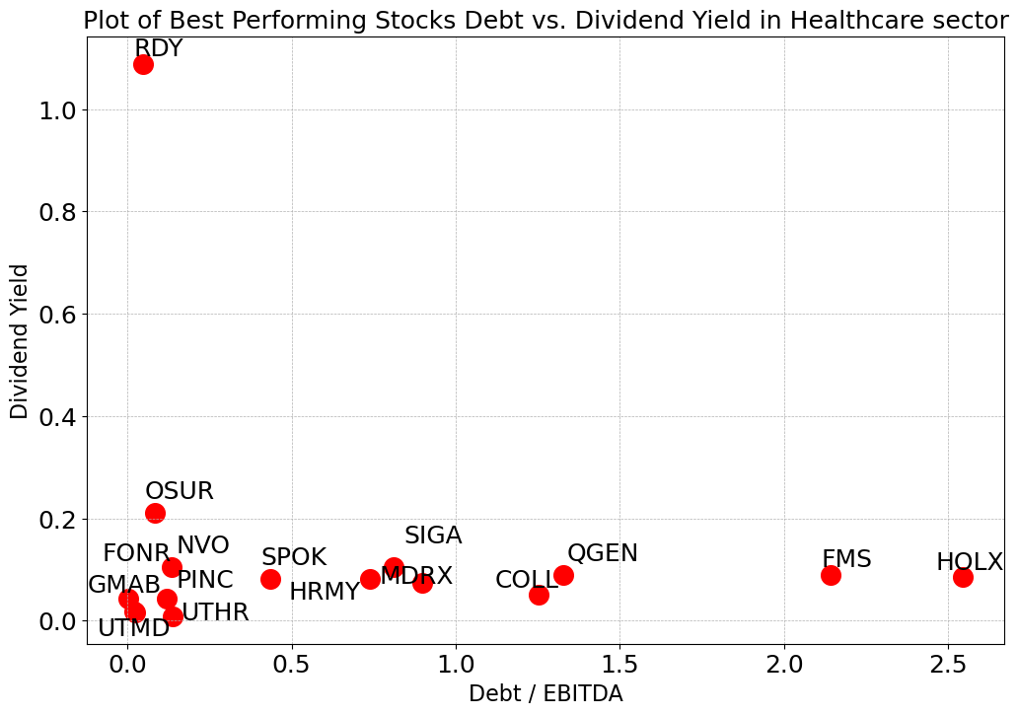
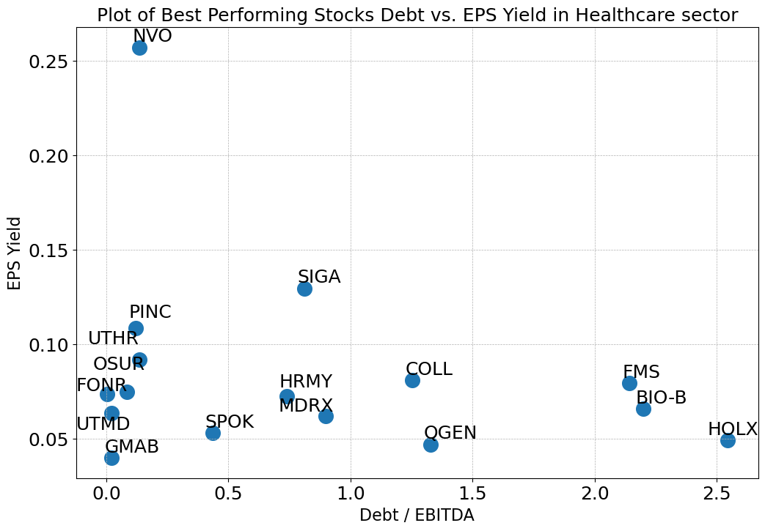
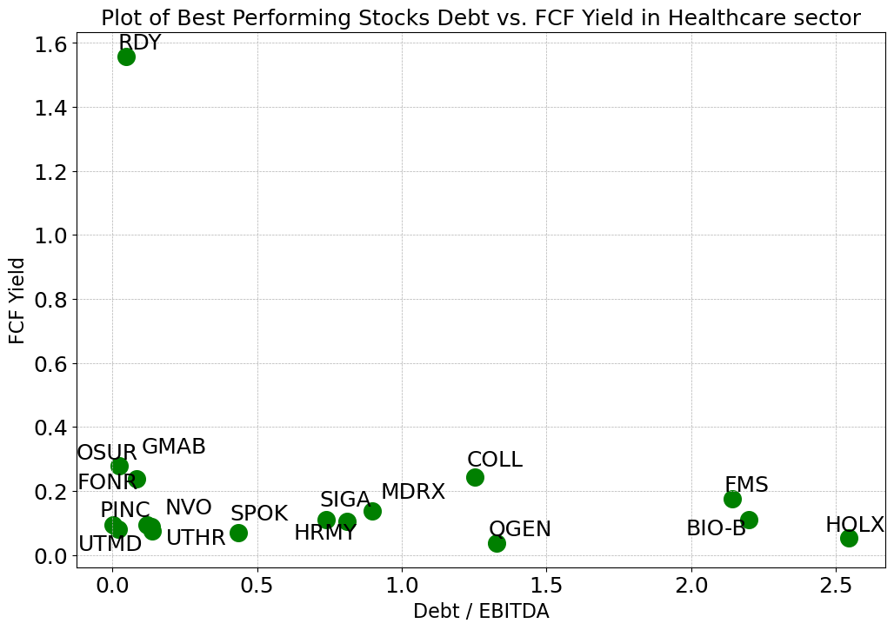
Healthcare Sector
Most of the best-performing stocks have Debt/EBITDA between 0.0 and 2.7, compared to all 360 stocks with a range of -3.76~5.93 (negative exist because of negative EBITDA)
All but one of the best-performing stocks have a Dividend Yield between 0.0 and 0.3, compared to all 360 stocks with a range of 0.00~0.21
Most of the 18 stocks have EPS Yields between 0.03 and 0.15, compared to all stocks in -0.88~0.34
Most of the 18 stocks have FCF Yields between 0.0 and 0.4, compared to all stocks in -0.65~0.39

Slide 29
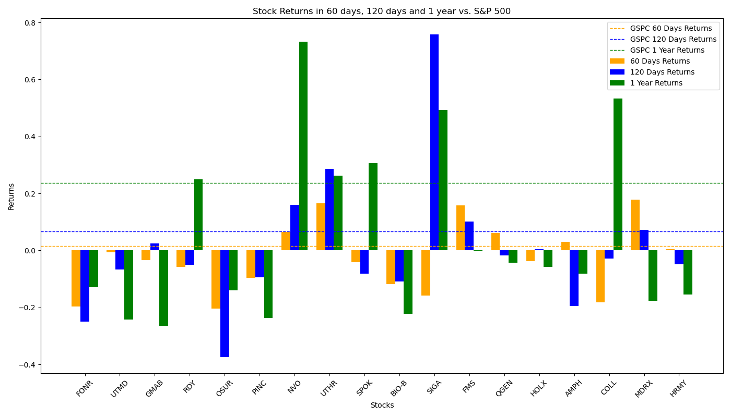
Performance of Filtered Stocks in Healthcare Sector
The Filtered Investment Portfolio doesn’t have a good performance in all periods.
Total 18 Filtered Stocks | 60 Days | 120 Days | 1 Year
No. Stocks with Positive Returns | 6 | 7 | 6
No. Stocks with Returns Higher than S&P 500 | 5 | 5 | 6
Total Average Returns | -2.94% | 1.65% | 5.34%
Returns of S&P 500 | 2.65% | 6.89% | 23.62%

Slide 30
Industrial Goods Sector
Among all 85 stocks in financial services sector, 53 of which move forward to analysis process. Other stocks are dropped because: 2 stocks lack price data in a long period; 3 stocks lack debt data; 6 stocks lack shares data; 3 stocks lack EBITDA data; 17 stocks paid zero dividend; 1 stock lack FCF data.
After eliminating outliers in the stocks by IQR method with sensitivity = 1.5 (This may drop out some best-performing stocks), the stocks in Financial Services sector have the following distribution:
Factors for Best-performing Filter:
X = 20, Y = 20,
Final Size of Portfolio = 9
 | Max | Min | Mean | Median
Debt/EBITDA | 6.11 | -1.11 | 1.94 | 1.73
Dividend Yield | 0.03 | 0.00 | 0.01 | 0.01
EPS Yield | 0.19 | -0.09 | 0.06 | 0.05
FCF Yield | 0.12 | -0.09 | 0.03 | 0.04

Slide 31
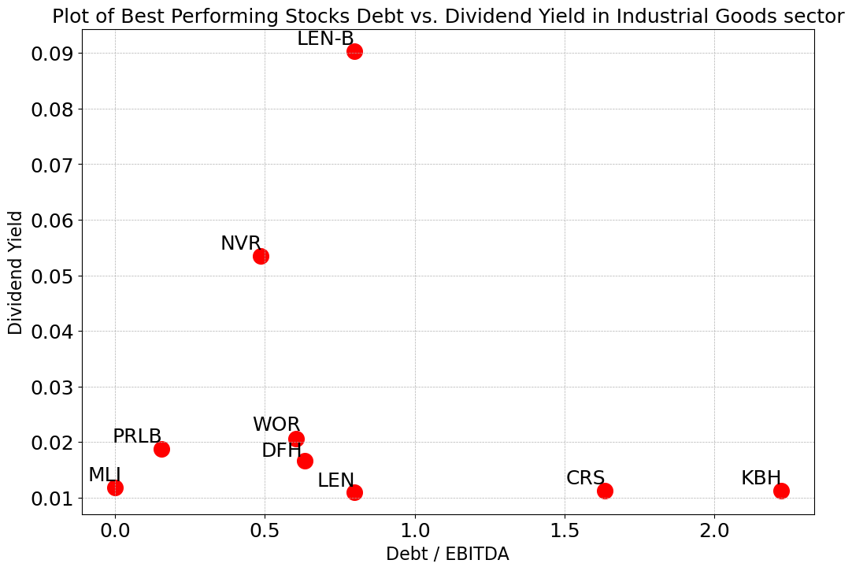
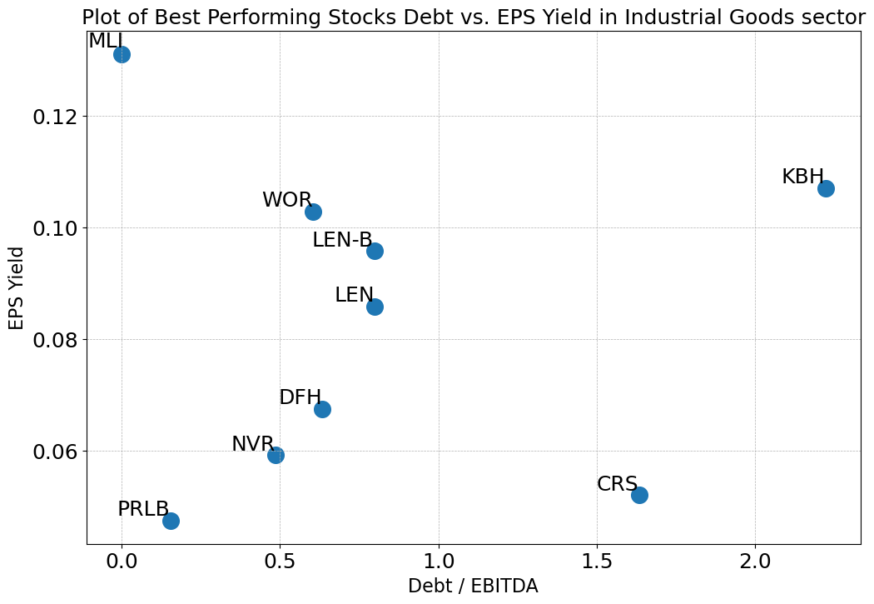
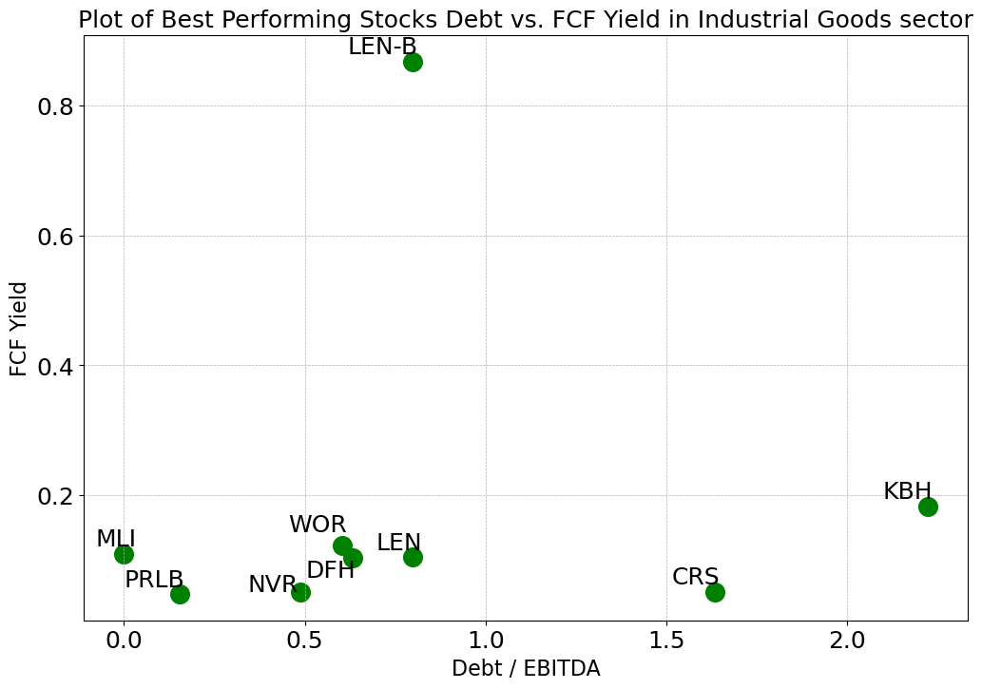
Industrial Goods Sector
Most of the best-performing stocks have Debt/EBITDA between 0.0 and 2.5, compared to all 53 stocks with a range of -1.11~6.11 (negative exist because of negative EBITDA)
All but two of the best-performing stocks have a Dividend Yield between 0.01 and 0.05, compared to all 53 stocks with a range of 0.00~0.03
Most of the 9 stocks have EPS Yields between 0.01 and 0.12, compared to all stocks in -0.09~0.19
Most of the 18 stocks have FCF Yields between 0.0 and 0.2, compared to all stocks in -0.09~0.12

Slide 32
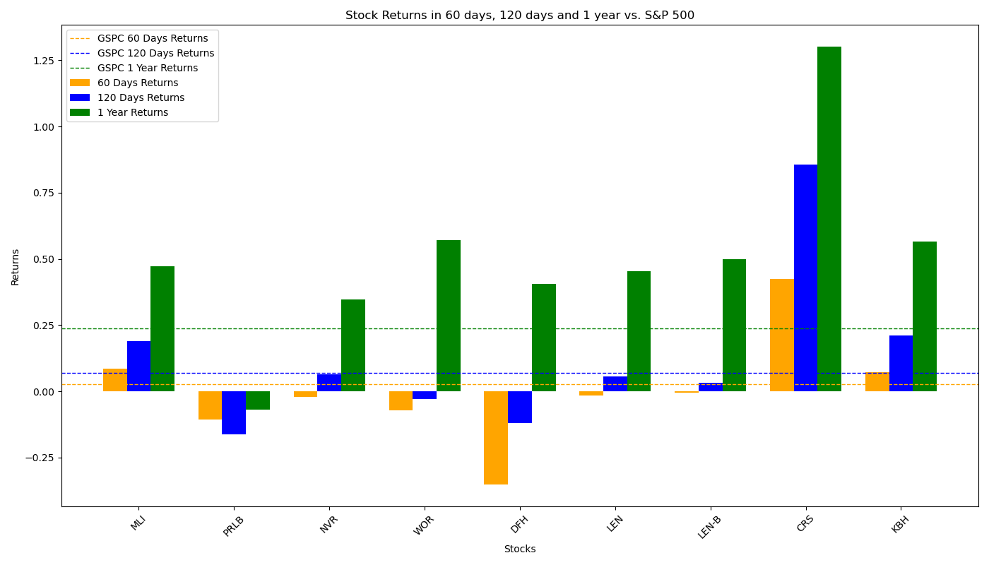
Performance of Filtered Stocks in Industrial Goods Sector
The portfolio performs under average in 60-day period, while its performance in long-term, however, is significantly good.
Total 18 Filtered Stocks | 60 Days | 120 Days | 1 Year
No. Stocks with Positive Returns | 3 | 6 | 8
No. Stocks with Returns Higher than S&P 500 | 3 | 3 | 8
Total Average Returns | 0.11% | 12.23% | 50.53%
Returns of S&P 500 | 2.65% | 6.89% | 23.62%

Slide 33
Industrials Sector
Among all 720 stocks in financial services sector, 441 of which move forward to analysis process. Other stocks are dropped because: 15 stocks lack EPS data; 10 stocks lack price data in a long period; 56 stocks lack debt data; 42 stocks lack shares data; 20 stocks lack EBITDA data; 133 stocks paid zero dividend; 3 stocks lack FCF data.
After eliminating outliers in the stocks by IQR method with sensitivity = 1.5 (This may drop out some best-performing stocks), the stocks in Financial Services sector have the following distribution:
Factors for Best-performing Filter:
X = 18, Y = 150,
Final Size of Portfolio = 20
 | Max | Min | Mean | Median
Debt/EBITDA | 7.12 | -3.06 | 1.94 | 1.75
Dividend Yield | 0.09 | 0.00 | 0.02 | 0.01
EPS Yield | 0.13 | -0.04 | 0.05 | 0.05
FCF Yield | 0.17 | -0.10 | 0.04 | 0.04

Slide 34
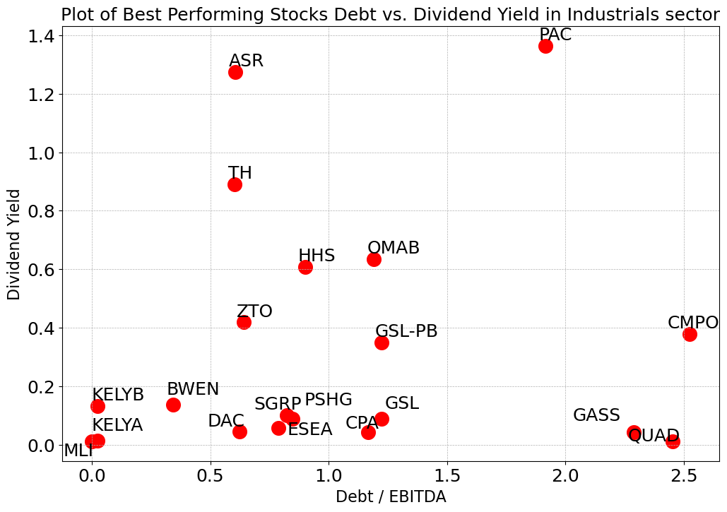
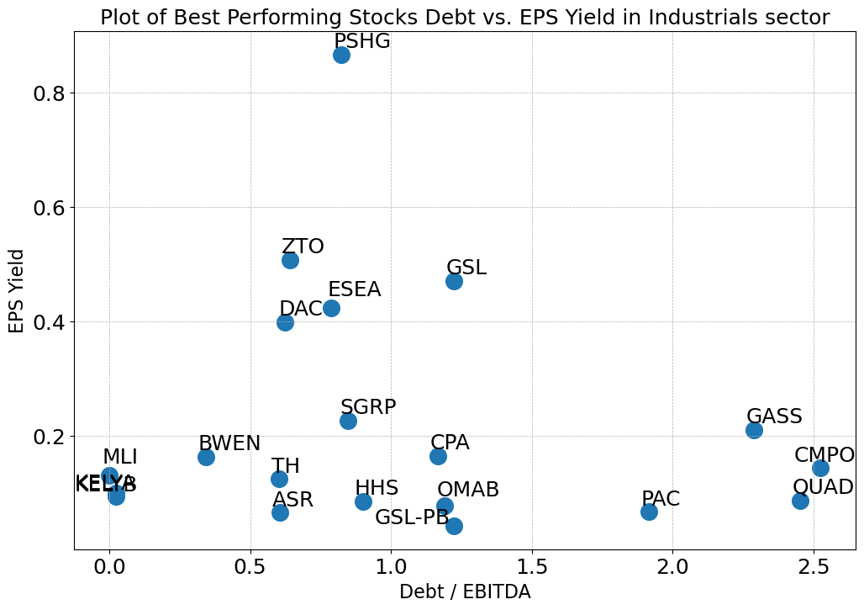
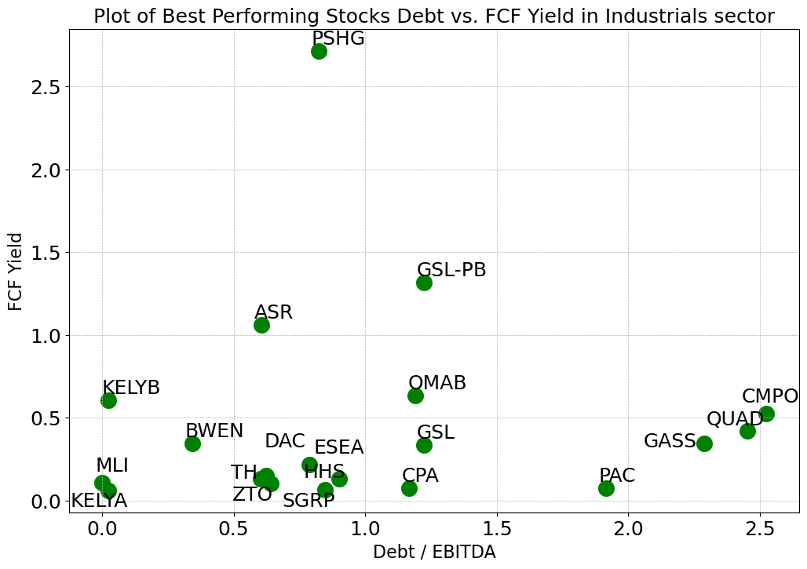
Industrials Sector
Most of the best-performing stocks have Debt/EBITDA between 0.0 and 2.6, compared to all 157 stocks with a range of -3.06~7.12 (negative exist because of negative EBITDA)
All but one of the best-performing stocks have a Dividend Yield between 0.1 and 1.0, while YRD’s dividend is close to 3.0, compared to all 157 stocks with a range of 0.00~0.09
Most of the 18 stocks have EPS Yields between 0.1 and 0.6, compared to all stocks in -0.04~0.13
Most of the 18 stocks have FCF Yields between 0.1 and 1.5, compared to all stocks in -0.10~0.17

Slide 35
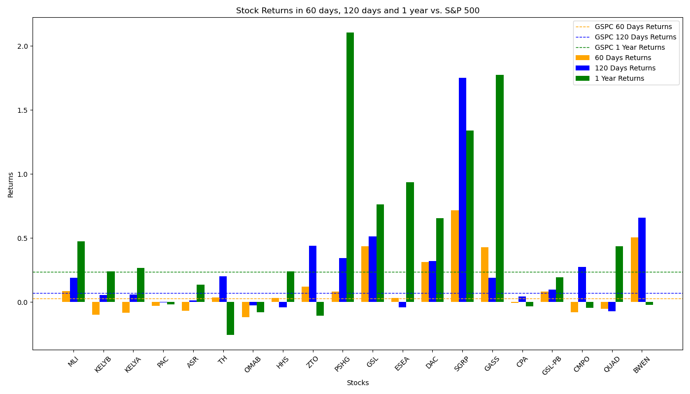
Performance of Filtered Stocks in Industrials Sector
Most Filtered Stocks perform very well in all three periods.
Total 18 Filtered Stocks | 60 Days | 120 Days | 1 Year
No. Stocks with Positive Returns | 12 | 16 | 13
No. Stocks with Returns Higher than S&P 500 | 12 | 11 | 11
Total Average Returns | 11.59% | 24.74% | 44.88%
Returns of S&P 500 | 2.65% | 6.89% | 23.62%

Slide 36
Services Sector
Among all 377 stocks in financial services sector, 220 of which move forward to analysis process. Other stocks are dropped because: 11 stocks lack EPS data; 3 stocks lack price data in a long period; 36 stocks lack debt data; 27 stocks lack shares data; 8 stocks lack EBITDA data; 71 stocks paid zero dividend; 1 stock lack FCF data.
After eliminating outliers in the stocks by IQR method with sensitivity = 1.5 (This may drop out some best-performing stocks), the stocks in Financial Services sector have the following distribution:
Factors for Best-performing Filter:
X = 20, Y = 100,
Final Size of Portfolio = 14
 | Max | Min | Mean | Median
Debt/EBITDA | 8.63 | -3.98 | 2.30 | 1.92
Dividend Yield | 0.11 | 0.00 | 0.02 | 0.02
EPS Yield | 0.16 | -0.04 | 0.06 | 0.05
FCF Yield | 0.22 | -0.13 | 0.04 | 0.05

Slide 37
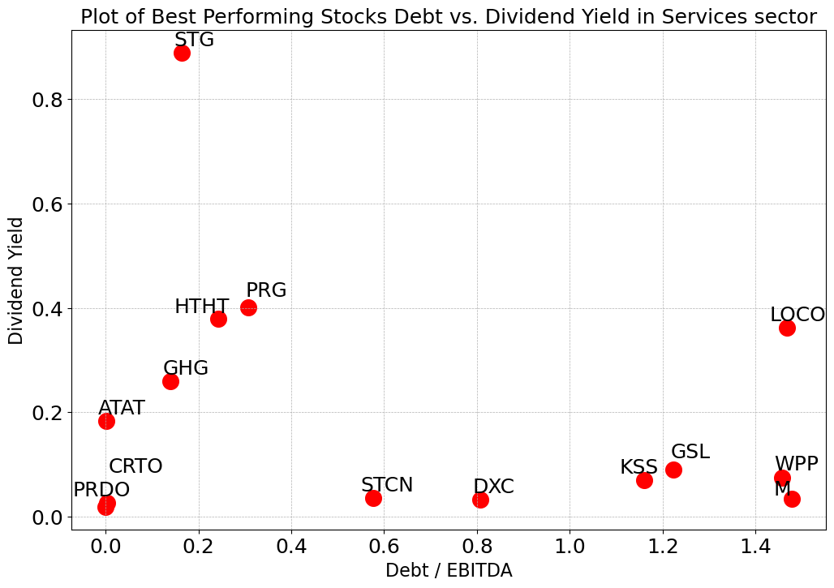
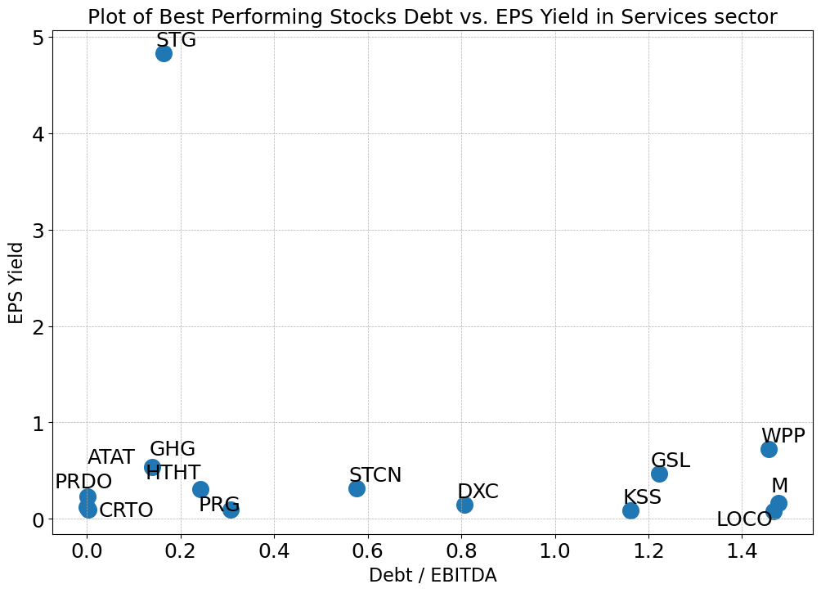
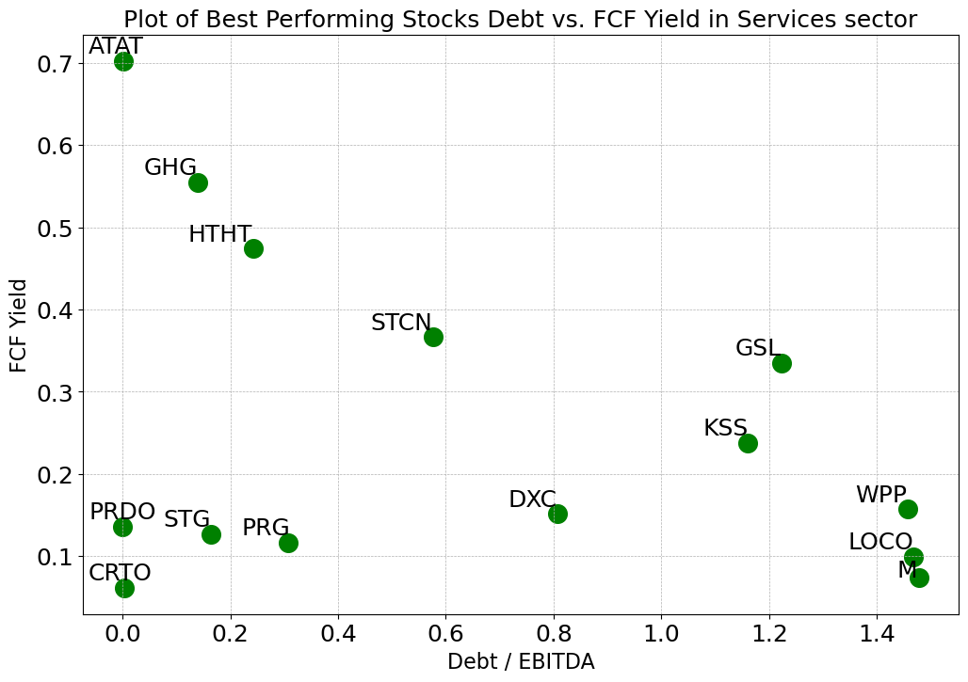
Services Sector
Most of the best-performing stocks have Debt/EBITDA between 0.0 and 1.5, compared to all 220 stocks with a range of -3.98~8.63 (negative exist because of negative EBITDA)
All but one of the best-performing stocks have a Dividend Yield between 0.1 and 0.4, compared to all 220 stocks with a range of 0.00~0.11
Most of the 14 stocks have EPS Yields between 0.1 and 1, compared to all stocks in -0.04~0.16
Most of the 14 stocks have FCF Yields between 0.1 and 0.4, compared to all stocks in -0.13~0.22

Slide 38
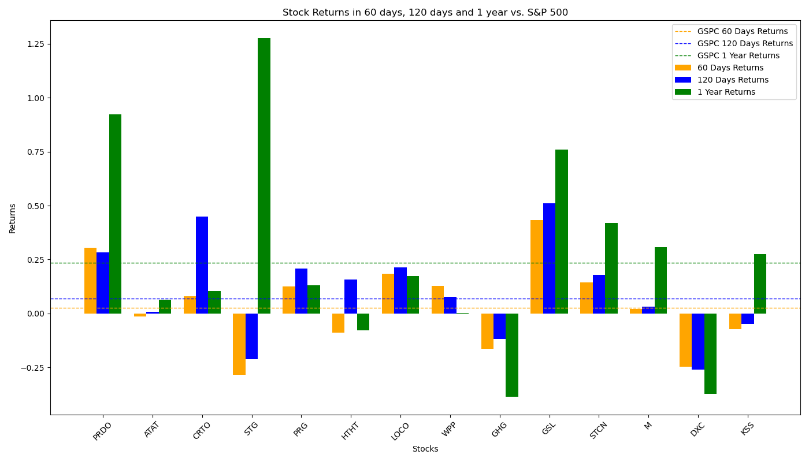
Performance of Filtered Stocks in Services Sector
The Filtered Investment Portfolio performs very good in all three time periods, especially in short terms when the returns it gives is twice of that of S&P 500.
Total 18 Filtered Stocks | 60 Days | 120 Days | 1 Year
No. Stocks with Positive Returns | 9 | 11 | 12
No. Stocks with Returns Higher than S&P 500 | 8 | 9 | 7
Total Average Returns | 5.21% | 12.30% | 30.27%
Returns of S&P 500 | 2.65% | 6.89% | 23.62%

Slide 39
Technology Sector
Among all 1057 stocks in financial services sector, 465 of which move forward to analysis process. Other stocks are dropped because: 16 stocks lack EPS data; 13 stocks lack price data in a long period; 166 stocks lack debt data; 52 stocks lack shares data; 36 stocks lack EBITDA data; 306 stocks paid zero dividend; 3 stocks lack FCF data.
After eliminating outliers in the stocks by IQR method with sensitivity = 1.5 (This may drop out some best-performing stocks), the stocks in Financial Services sector have the following distribution:
Factors for Best-performing Filter:
X = 20, Y = 150,
Final Size of Portfolio = 19
 | Max | Min | Mean | Median
Debt/EBITDA | 8.02 | -4.82 | 1.51 | 0.84
Dividend Yield | 0.14 | 0.00 | 0.02 | 0.01
EPS Yield | 0.17 | -0.13 | 0.04 | 0.04
FCF Yield | 0.18 | -0.11 | 0.04 | 0.04

Slide 40
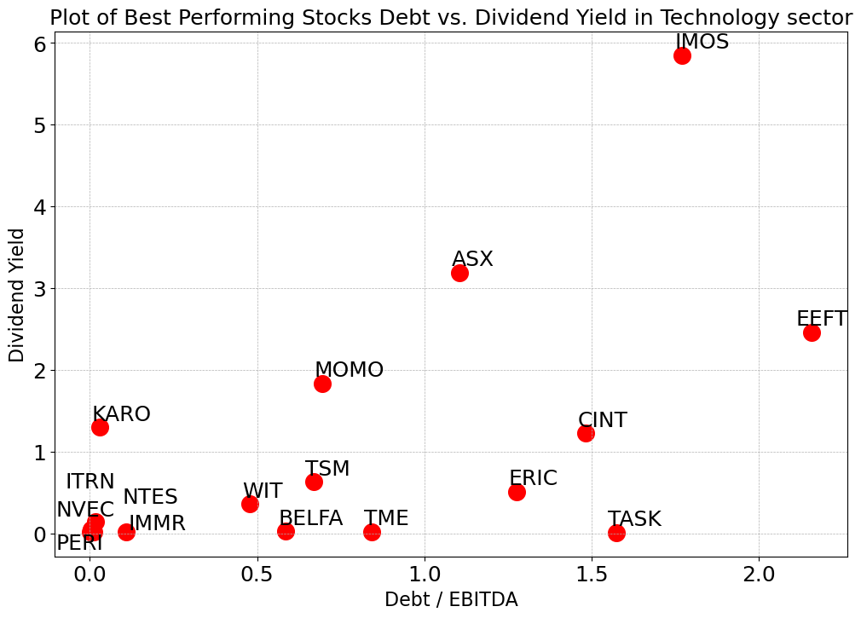
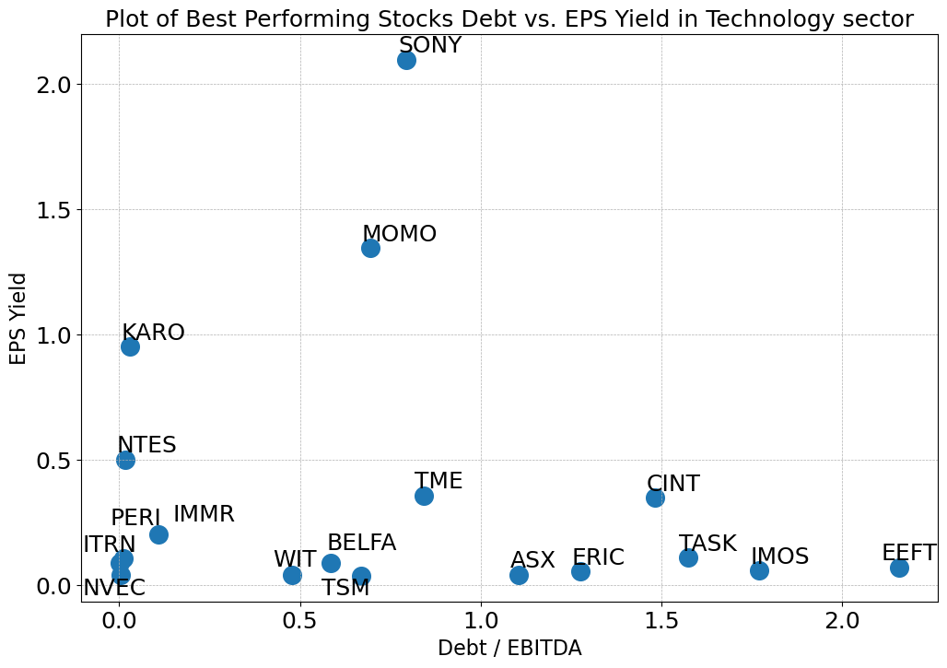

Technology Sector
Most of the best-performing stocks have Debt/EBITDA between 0.0 and 2.5, compared to all 465 stocks with a range of -4.82~8.02 (negative exist because of negative EBITDA)
All but one of the best-performing stocks have a Dividend Yield between 0.0 and 3.2, compared to all 465 stocks with a range of 0.00~0.14
Most of the 19 stocks have EPS Yields between 0.1 and 1.0, compared to all stocks in -0.13~0.17
Most of the 19 stocks have FCF Yields between 0.0and 4.0, compared to all stocks in -0.11~0.18

Slide 41

Performance of Filtered Stocks in Technology Sector
The Filtered Investment Portfolio performs worse than S&P 500 factors in 1-year period, but better in shorter terms.
Total 18 Filtered Stocks | 60 Days | 120 Days | 1 Year
No. Stocks with Positive Returns | 11 | 15 | 14
No. Stocks with Returns Higher than S&P 500 | 10 | 9 | 7
Total Average Returns | 4.42% | 10.96% | 17.13%
Returns of S&P 500 | 2.65% | 6.89% | 23.62%

Slide 42
Utilities Sector
Among all 97 stocks in financial services sector, 84 of which move forward to analysis process. Other stocks are dropped because: 1 stock lack EPS data; 1 stock lack price data in a long period; 2 stocks lack debt data; 7 stocks lack shares data; 6) 1 stock lack EBITDA data; 1 stock paid zero dividend.
After eliminating outliers in the stocks by IQR method with sensitivity = 1.5 (This may drop out some best-performing stocks), the stocks in Financial Services sector have the following distribution:
Factors for Best-performing Filter:
X = 50, Y = 50,
Final Size of Portfolio = 9
 | Max | Min | Mean | Median
Debt/EBITDA | 7.13 | 0.62 | 4.33 | 4.77
Dividend Yield | 0.09 | 0.00 | 0.04 | 0.04
EPS Yield | 0.11 | -0.01 | 0.06 | 0.06
FCF Yield | 0.11 | -0.18 | -0.02 | -0.03

Slide 43



Utilities Sector
Most of the best-performing stocks have Debt/EBITDA between 0.0 and 3.5, compared to all 84 stocks with a range of 0.62~7.13 (negative exist because of negative EBITDA)
All but one of the best-performing stocks have a Dividend Yield between 0.0 and 0.25, compared to all 84 stocks with a range of 0.00~0.09
Most of the 9 stocks have EPS Yields between 0.0 and 0.35, compared to all stocks in -0.01~0.11
Most of the 9 stocks have FCF Yields between 0.0 and 1.0, compared to all stocks in -0.18~0.11
*ENIC and CEPU have been removed from the Dividend Yield plot, EPS and FCF Yield plot since their numbers are extremely high

Slide 44

Performance of Filtered Stocks in Utilities Sector
The Filtered Investment Portfolio performs worse than S&P 500 factors in 60-day and 1-year period, especially in 60-day when the returns fail to get positive.
Total 18 Filtered Stocks | 60 Days | 120 Days | 1 Year
No. Stocks with Positive Returns | 6 | 7 | 6
No. Stocks with Returns Higher than S&P 500 | 3 | 4 | 3
Total Average Returns | -1.33% | 10.26% | 14.52%
Returns of S&P 500 | 2.65% | 6.89% | 23.62%

Slide 45
Summary of Portfolios’ Returns
Stock Name |  | 60 Days | 120 Days | 1 Year
Basic Materials | % With positive return | 56% | 67% | 78%
 | % Outperforming the market | 56% | 44% | 39%
 | Total Average Return | 3.40% | 7.34% | 28.21%
Consumer Cyclical | % With positive return | 52% | 71% | 67%
 | % Outperforming the market | 48% | 43% | 33%
 | Total Average Return | 1.79% | 9.68% | 17.68%
Consumer Defensive | % With positive return | 38% | 56% | 69%
 | % Outperforming the market | 31% | 50% | 31%
 | Total Average Return | -1.77% | 6.96% | 21.73%
Consumer Goods | % With positive return | 42% | 58% | 50%
 | % Outperforming the market | 25% | 33% | 17%
 | Total Average Return | -2.71% | 1.69% | 8.53%
Communication Service | % With positive return | 45% | 45% | 55%
 | % Outperforming the market | 25% | 20% | 20%
 | Total Average Return | 2.40% | -1.09% | 5.98%
Conglomerates | % With positive return | 67% | 67% | 67%
 | % Outperforming the market | 50% | 33% | 33%
 | Total Average Return | 0.65% | 8.49% | 17.28%
Energy | % With positive return | 67% | 86% | 95%
 | % Outperforming the market | 38% | 81% | 52%
 | Total Average Return | 5.47% | 16.17% | 43.15%
S&P 500 Factors | Returns | 2.65% | 6.89% | 23.62%
Stock Name |  | 60 Days | 120 Days | 1 Year
Financial Services | % With positive return | 50% | 50% | 61%
 | % Outperforming the market | 28% | 22% | 22%
 | Total Average Return | 2.40% | -1.09% | 5.98%
Healthcare | % With positive return | 58% | 79% | 74%
 | % Outperforming the market | 53% | 47% | 37%
 | Total Average Return | 4.42% | 10.96% | 17.13%
Industrial Goods | % With positive return | 33% | 67% | 89%
 | % Outperforming the market | 33% | 33% | 89%
 | Total Average Return | 0.11% | 12.23% | 50.53%
Industrials | % With positive return | 60% | 80% | 65%
 | % Outperforming the market | 60% | 55% | 55%
 | Total Average Return | 11.59% | 24.74% | 44.88%
Services | % With positive return | 47% | 58% | 63%
 | % Outperforming the market | 42% | 47% | 37%
 | Total Average Return | 5.21% | 12.30% | 30.27%
Technology | % With positive return | 58% | 79% | 74%
 | % Outperforming the market | 53% | 47% | 37%
 | Total Average Return | 4.42% | 10.96% | 17.13%
Utilities | % With positive return | 67% | 78% | 67%
 | % Outperforming the market | 33% | 44% | 33%
 | Total Average Return | -1.33% | 10.26% | 14.52%
S&P 500 Factors | Returns | 2.65% | 6.89% | 23.62%
*None of the 301 stocks in Other Sector pass the filter before being taken into calculation.

